Slide 1

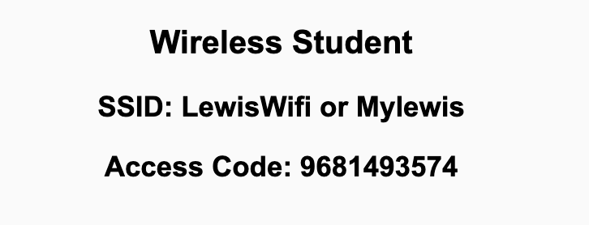
Preflight Check List
Sign into our Zoom meeting through our integrated Blackboard/Zoom link
Make sure that you can hear the conversation, see shared desktops, and view chat topics
Thank you if you choose to leave your camera on to help make our class more interactive
Be prepared to share your computer screen
Be prepared to utilize a headset with a microphone
In person participants also:
Make sure that your microphone and speakers are muted/off so that we don’t get an echo
Sit in a good spot near the classroom ceiling microphones if possible

Slide 2
Recordings
Discuss that recording are:
Opportunistic
Automatically available in Blackboard/Zoom
Sound Check… plus Video, and Desktop Sharing check
Start Recording

Slide 3
Agenda:
Prework
Sprint 8 Preview
Open Mic Demos
Review Security
Prework for Next Class
Quiz 7
Discussion & Questions welcome at any time but please be present with no phones or email during our time together

Slide 4
Prework
Complete through activity 9
Be prepared for Security discussion
Be prepared for Quiz 7

Slide 5
Sprint 8 Preview
Normal class schedule next week with:
Sprint 8 planning Monday
Sprint 7 Demos, Retrospective, and Chapter discussion on Wednesday
Quiz 8 and Lab on Friday
Final Exams start the following week with no regular classes
We will be presenting our Final Project during our scheduled Final Exam time

Slide 6
Open Mic Demos

Slide 7
Review Final Project
Presentation Times

Slide 8
Review Security
Assign presenter
Team reviews topics below
Team sits back, relaxes, and acknowledges the bravery and dedication of the presenter
Chapter 17 of Dale on Computer Security
17.1: Information Security and Confidentiality, Availability, and Integrity
17.2: Access, Authentication, Authorization, CAPTCHA
17.3: Malicious Code /Malware, Worms, Trojan Horses, Phishing, and DoS
17.4: Cryptography, Encryption/Decryption, ciphers, public-key cryptography, and digital signatures
17.5: Protecting Online Information

Slide 9
Prework For Next Class
Everything is Due Sunday!
Be prepared for Lab

Slide 10
Quiz 7
A sincere attempt of the quiz is due
before you leave class today.

Slide 11
End of Session

