Slide 1

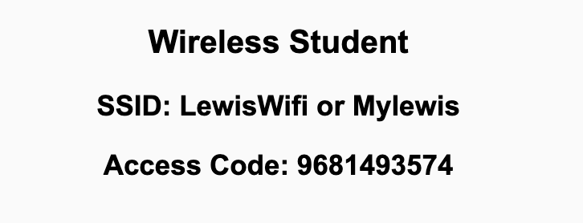
Preflight Check List
Sign into our Zoom meeting through our integrated Blackboard/Zoom link
Make sure that you can hear the conversation, see shared desktops, and view chat topics
Thank you if you choose to leave your camera on to help make our class more interactive
Be prepared to share your computer screen
Be prepared to utilize a headset with a microphone
In person participants also:
Make sure that your microphone and speakers are muted/off so that we don’t get an echo
Sit in a good spot near the classroom ceiling microphones if possible

Slide 2
Recordings
Discuss that recording are:
Opportunistic
Automatically available in Blackboard/Zoom
Sound Check… plus Video, and Desktop Sharing check
Start Recording

Slide 3
Agenda:
Prework
Sprint 8 Preview
Review Design Patterns
Prework for Next Class
Quiz 7
Discussion & Questions welcome at any time but please be present with no phones or email during our time together

Slide 4
Prework For Next Class
Complete through activity 8
Be prepared for Design Patterns discussion
Be prepared for Quiz 7

Slide 5
Sprint 8 Preview
Sprint 8 – Week 1 with normal classes:
Sprint 8 planning Monday
Sprint 7 Demos, Retrospective, and Chapter discussion on Wednesday
Quiz 8 and Lab on Friday
Sprint 8 - Week 2 with Final Exams and no regular classes
Review Sprint 8 Schedule including Due Dates and Final Exam

Slide 6
Review Design Patterns
Assign presenter
Team reviews topics below
Team sits back, relaxes, and acknowledges the bravery and dedication of the presenter
Chapter 11 of Fox on Design Patterns for Saas
Patterns and Antipatterns, SOLID Class Architecture, and the “Gang of Four (GoF)”
Just Enough UML
Single Responsibility Principle, Open/Closed Principle, and Liskov Substitution Principle
Dependency Injection Principle and Demeter Principle
The Plan-And-Document Perspective on Design Patterns, Fallacies and Pitfalls, and Frameworks

Slide 7
Prework For Next Class
Everything is Due Sunday!
Be prepared for Lab & Backlog Grooming on Friday

Slide 8
Quiz 7
A sincere attempt of the quiz is due
before you leave class today.

Slide 9
End of Session

