Slide 1

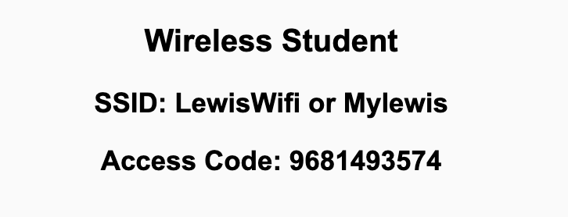
Preflight Check List
Sign into our Zoom meeting through our integrated Blackboard/Zoom link
Make sure that you can hear the conversation, see shared desktops, and view chat topics
Thank you if you choose to leave your camera on to help make our class more interactive
Be prepared to share your computer screen
Be prepared to utilize a headset with a microphone
In person participants also:
Make sure that your microphone and speakers are muted/off so that we don’t get an echo
Sit in a good spot near the classroom ceiling microphones if possible

Slide 2
Recordings
Discuss that recording are:
Opportunistic
Automatically available in Blackboard/Zoom
Sound Check… plus Video, and Desktop Sharing check
Start Recording

Slide 3
Agenda:
Prework & Announcements
Shortcomings of College Software Engineering Programs
Backlog Grooming in preparation for Sprint 8 Planning
Lab
Discussion & Questions welcome at any time but please be present with no phones or email during our time together

Slide 4
Prework For Next Class
Everything is Due Sunday!
Be prepared for Lab & Backlog Grooming on Friday

Slide 5
Shortcomings of College Software Engineering Programs
Little or No Sustainability in Projects
Few or No Application Users

Slide 6
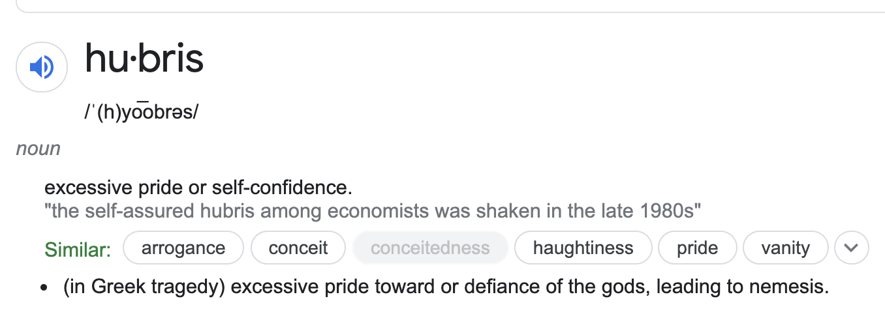
Shortcomings of College Software Engineering Programs
Little or No Sustainability in Projects... which leads to false expectations
Few or No Application Users… which leads to hubris

Slide 7
Backlog Grooming
for Monday’s Sprint 8 Planning

Slide 8
This is Your Scrum Process

Slide 9
INVEST to Write Good User Stories
Independent: Self contained, not dependent on other user stories
Negotiable: Leave space for discussion, discovery and invention
Valuable: Has immediate value to stakeholder.
Estimable: Constrained in size and scope, just enough information
Small: Ideally 1-2 days work with larger efforts being decomposed
Testable: Acceptance criteria makes clear when work is done

Slide 10
Sprint Planning Goal
By the end the class Monday every team member will have committed to multiple meaningful User Stories that are estimated at a total effort 12 or more Story Points per person
Steps:
Update “Done” definition prior to Monday’s session
Come into Sprint Planning with a fully Groomed Story Backlog of at least 12 story points per team member
Team members REQUEST stories, stories are assigned, and team members COMMIT to delivering stories by end of sprint
The TEAM is responsible for defining Done and having a fully Groomed Backlog.
The Product Owner maintains and updates the Backlogs.
Each team member is responsible for requesting and committing to stories. Stories must be deliverable within the sprint. Make it a priority to assign a story to a single team member.

Slide 11
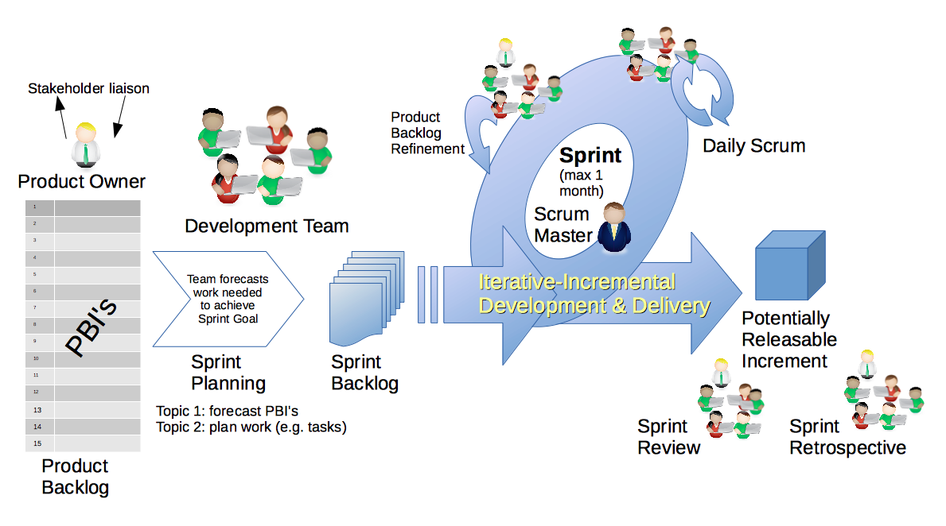
Scrum Process
By Dr ian mitchell - Own work, CC BY-SA 4.0, Link

Slide 12
Backlog Grooming and Sprint Planning
Steps:
Priorities & Roles Assignment (review)
Epic Backlog Grooming
Story Backlog Grooming
Sprint Planning (Monday)
Commitment to Sprint Backlog (Monday)
Celebrate! (Monday)

Slide 13
Step 1: Priorities & Roles
Recall Agile Priorities (associated scrum role):
Customer (Product Owner)
Technology (Architect)
Process (Scrum Master)
Recall the Agile Glossary [link]
Recall that one person can play multiple roles.
Recall that it is different/difficult for us because we are playing the role of the customer as well as the delivery team.

Slide 14
Step 2: Epic Backlog Grooming
Recall User Stories, Epics and Backlogs
Recall the Agile Glossary [link]… review User Story format

Slide 15
Step 2: Epic Backlog Grooming
Actions & Requirements:
Product Owner to lead the review and/or creation of Epics
There must be one list of Epics managed by the Product Owner
Each Epic must deliver customer functionality and value
Epics should be written in User Story format
Epics must be prioritized and forced ranked
Each product must have at least three Epics
New Epic: As a product user I need for the product to continue to evolve after the semester (sustainability)
Epic Backlog Grooming report questions (Scrum Master / Product Owner):
Who will be the Scrum Master & Product Owner for sprint 8
Review your list of force ranked Epics

Slide 16
Step 3: Story Backlog Grooming
By Dr ian mitchell - Own work, CC BY-SA 4.0, Link

Slide 17
Step 3: Story Backlog Grooming
Review Done, User Stories, and Story Backlog:
“Done” must be well defined and for us includes at a minimum:
Successfully deployed and integration tested in the production environment
Demoed to the Product Owner
Available to be demoed to the class
User Stories must:
Be written in User Story format from a customer / user perspective
Deliver user (customer) value
Be associated with Epic
Product Product Backlog is:
Managed by to Product Owner
The team’s master list of prioritized (force ranked) User Stories
The team’s master list of all important project work (spikes, continuous improvement, etc.)
Notes:
How will you handle dependancies?

Slide 18
Step 3: Story Backlog Grooming
Requirements:
Product Owner to lead the creation, force ranking, and estimating of User Stories.
Each User Story must have an estimated effort in Story Points
For our purposes assume 1 Story Point is approximately equal to 1 hour of effort
Each User Story must be deliverable in a single sprint
Stories to support New Epic:
As a product user I need for the product to continue to evolve after the semester (sustainability)

Slide 19
Step 3: Story Backlog Grooming
Requirements & Actions:
Update Product Backlog by:
Relocating “Done” User Stories “Done” list (skip)
Relocating “Pending” User Stories to the “Pending” list
Reviewing remaining User Stories
Creating new User Stories
Prioritize and force rank important stories (anything that might make it to the Sprint Backlog)
Provide Story Point estimates for important stories
Product Backlog report out questions (Product Owner):
What is the total number of user stories?
What is the total number of story points?
Story points per team member?
Notes:
How will you handle dependancies?

Slide 20
Prework
Everything is due Sunday!
Be prepared for in-person Sprint 8 Planning on Monday
... contact me if you will not be there Monday for Sprint 7 Planning (or if you will not be in-person).

Slide 21
Lab
What do we need to do to finish sprint 7 stories?

Slide 22
End of Session

