Slide 1

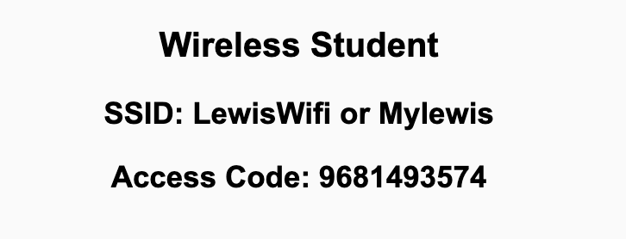
Preflight Check List
Sign into our Zoom meeting through our integrated Blackboard/Zoom link
Make sure that you can hear the conversation, see shared desktops, and view chat topics
Thank you if you choose to leave your camera on to help make our class more interactive
Be prepared to share your computer screen
Be prepared to utilize a headset with a microphone
In person participants also:
Make sure that your microphone and speakers are muted/off so that we don’t get an echo
Sit in a good spot near the classroom ceiling microphones if possible

Slide 2
Recordings
Discuss that recording are:
Opportunistic
Automatically available in Blackboard/Zoom
Sound Check… plus Video, and Desktop Sharing check
Start Recording

Slide 3
Agenda:
Prework
Final Project Presentation Schedule
Submit Final Project Presentation Assignment
Final Project Presentations
Thank you!
Quiz 8
Lab
Discussion & Questions welcome at any time but please be present with no phones or email during our time together

Slide 4
Prework For Next Class
Be ready for Quiz 8 on Friday

Slide 5
Final Project
Presentation Schedule

Slide 6
Submit Final Project
Presentation Assignment

Slide 7
Final Project Presentations

Slide 8
Thank You!

Slide 9
Prework For Next Class
Review Schedule
Everything is due Thursday!

Slide 10
Quiz 8
A sincere attempt of the quiz is due
before you leave class today.

Slide 11
Lab

Slide 12
End of Session

