Slide 1

Class Session Check List
Everyone:
Sign into our Zoom meeting through our integrated Blackboard/Zoom link
Make sure that you can hear the conversation, see shared desktops, and view group chat topics
You will need a headset with a microphone to be able to effectively listen and speak
You will need to be able to share your computer screen
Thank you if you choose to leave your camera on to help make our class more interactive
In person participants also:
Make sure that your microphone and speakers are muted/off so that we don’t get an echo
Sit in a good spot near the classroom ceiling microphones if possible

Slide 2
Attendance
Document in-person attendance for contact tracing.

Slide 3
Class Session Check List
Review that recordings are:
Opportunistic
Automatically available within Blackboard/Zoom
… Now make sure that the classroom microphone, speakers, and camera are being used in Zoom, move to the next slide, AND verify that recording is started.
… Also make sure that slides are visible to attendees

Slide 4
Agenda:
Prework and Announcements
Foreshadowing FaceDraw
Development Methodologies
UML and UML Class Diagrams
Class Design vs Relational Database Design
Scrum Team Review: Object-Oriented Principles
Prework for Next Class
Discussion & Questions welcome at any time but please be present with no phones or email during our time together

Slide 5
Prework & Announcements
Complete through activity 12
Be prepared for scrum team chapter review Object-Oriented Programming Principles

Slide 6
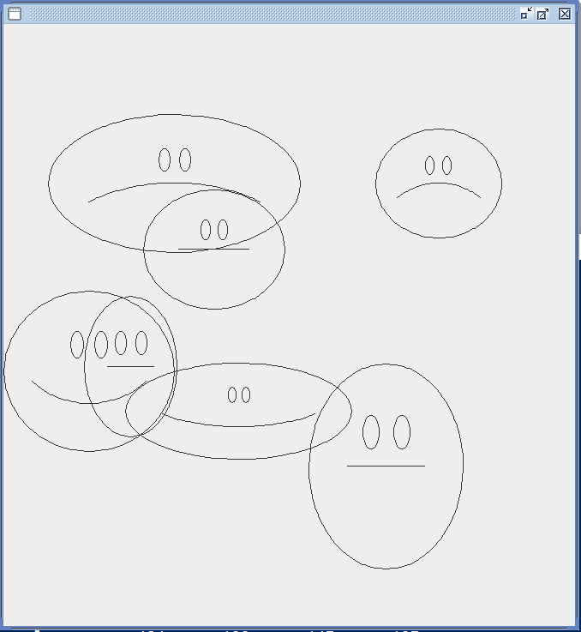
Foreshadowing FaceDraw
In the sprint 3 FaceDraw assignment, you will need to:
Create a graphical Java application
Draw 3 to 10 random faces on a window
Make each face a random width and height
Give each face a random emotion
Make it all visually appealing
And more
It will be challenging!

Slide 7
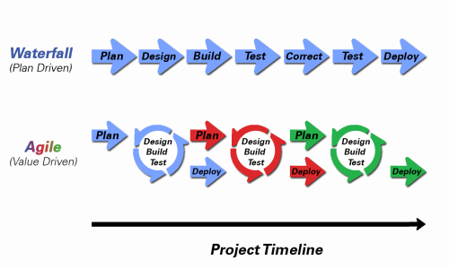
Development Methodologies
Notes:
Development Methodology and Software Development Lifecycle (SDLC) are often used interchangeably.
The Iterative development methodology is not depicted here as even the mainstays and inventors of the Iterative development methodology seem to be moving toward agile. Plus as Waterfall “holdouts” move, they seem to be moving directly toward Agile. Can you start to see my biases?
Object oriented-programming concepts/practices evolve and reprioritize depending on the development methodology.
For example, in Waterfall (as well as in Iterative) object-oriented design often play a critical role in the (big upfront) design activities. UML diagrams and project artifacts are often important to the overall project success. (opinion) Practical reality has been that these design artifacts often do not reflect the actual implementation and are rarely maintained or updated.
The Agile practitioners do not reject these design artifacts. However, the focus on shorter time horizons, evolving architecture, and working code changes the value proposition for object-oriented practices to more focus on the build, test, enhance activities.

Slide 8
UML and UML Class Diagrams

Slide 9

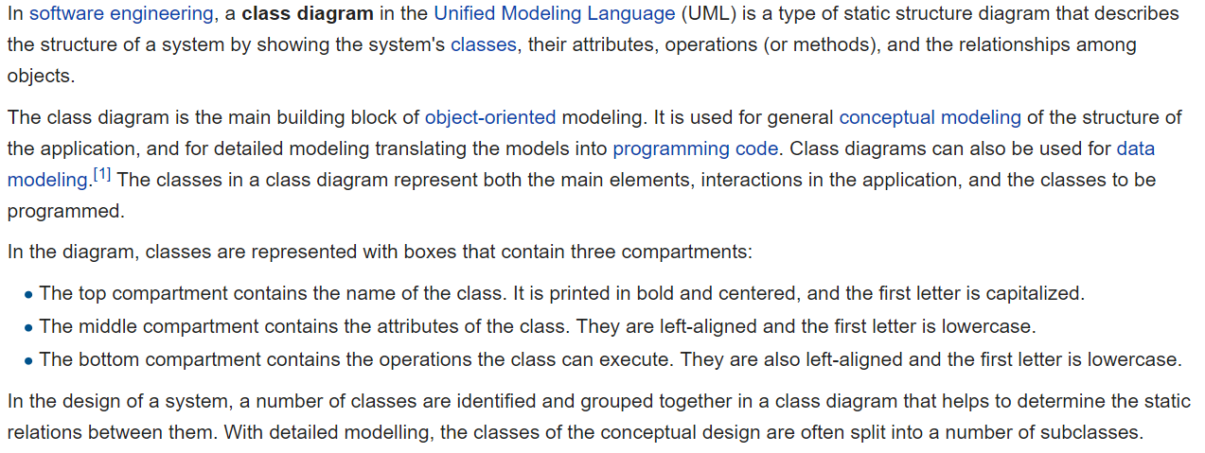
UML Class Diagram [link]

Slide 10
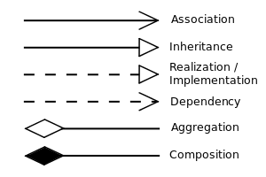


UML Class Diagram (continued) [link]

Slide 11
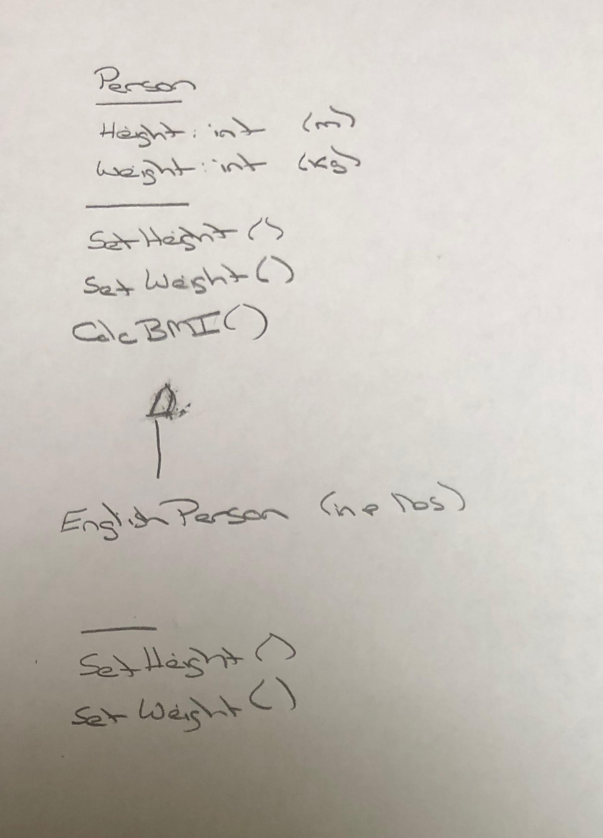
UML – BMI Calculator Plus

Slide 12
Is Object-Oriented Always Best?
Class Design vs
Relational Database Design

Slide 13
Concepts, Patterns, and Principles
Concepts – powerful features that are indispensable to modern software development
Practices – everyday activities that software developers perform in order to delivery quality products utilizing key Concepts
Patterns – tried-and-true templates for forging powerful relationships between classes
Principles – guidelines that help you determine what classes are needed and how they should work together

Slide 14
Scrum Team Chapter Review
Assign presenter
Team discusses topics while the presenter summarizes the topics below:
Who wrote “the book”
Rigidity, fragility, and immobility
Single-Responsibility Principle (team 1)
Open-Closed Principle (team 2)
Liskov's Substitution Principle (team 3)
Dependency-Inversion Principle (team 4)
Interface-Segregation Principle (team 5)
SOLID?
Which of these can be applied to non-object-oriented programs and/or non-agile environments?
Team sits back, relaxes, and acknowledges the bravery and dedication of the presenter
Object-Oriented Principles

Slide 15
Prework For Next Class
Complete through activity 13 and be working on activity 14
Be prepared for Quiz 2

Slide 16
End of Session

