Slide 1

Class Session Check List
Everyone:
Sign into our Zoom meeting through our integrated Blackboard/Zoom link
Make sure that you can hear the conversation, see shared desktops, and view group chat topics
You will need a headset with a microphone to be able to effectively listen and speak
You will need to be able to share your computer screen
Thank you if you choose to leave your camera on to help make our class more interactive
In person participants also:
Make sure that your microphone and speakers are muted/off so that we don’t get an echo
Sit in a good spot near the classroom ceiling microphones if possible

Slide 2
Class Session Check List
Review that recordings are:
Opportunistic
Automatically available within Blackboard/Zoom
… Now make sure that the classroom microphone, speakers, and camera are being used in Zoom, move to the next slide, AND verify that recording is started.
… Also make sure that slides are visible to attendees

Slide 3
Agenda:
Prework and Announcements
Scrum Team Chapter Review: Principles
Assignment Q&A
Seriously Your Thoughts on “Coding Standards Validator - Part 1”
Quiz Expectations
Quiz
Discussion & Questions welcome at any time but please be present with no phones or email during our time together

Slide 4
Prework & Announcements
Complete through activity 11 prior to next class
Be prepared for scrum team chapter review of OOP Principles
Be prepared for Quiz 2

Slide 5
Concepts, Patterns, and Principles
Concepts – powerful features that are indispensable to modern software development
Practices – everyday activities that software developers perform in order to delivery quality products utilizing key Concepts
Patterns – tried-and-true templates for forging powerful relationships between classes
Principles – aspirational guidelines that help you determine what classes are needed and how they should work together
Notes:
https://stackify.com/solid-design-principles/

Slide 6
Scrum Team Chapter Review
Assign presenter
Team discusses topics while the presenter summarizes the topics below:
Who wrote “the book”
Rigidity, fragility, and immobility (team 1)
Single-Responsibility Principle (team 1)
Open-Closed Principle (team 2)
Liskov's Substitution Principle (team 2)
Dependency-Inversion Principle (team 3)
Interface-Segregation Principle (team 3)
SOLID?
Which of these can be applied to non-object-oriented programs and/or non-agile environments?
Team sits back, relaxes, and acknowledges the bravery and dedication of the presenter
Object-Oriented Principles

Slide 7
Assignment Q&A

Slide 8
Seriously Your Thoughts on
“Coding Standards Validator - Part 1”

Slide 9
Prework For Next Class
Prior to our next class please:
Complete through activity 11 and be working on activity 12
How can we best working together on Thursday to complete sprint 2 assignments?
Everything is due Sunday!

Slide 10
Quiz Expectations
Quiz Expectations include:
You may use any naturally available documentation include books, notes, and web browser
You may not use quiz specific content like question banks
It is an individual assignment so asking others questions would be inappropriate
You are welcome to ask me questions

Slide 11
Quiz

Slide 12
End of Session

Slide 13
Backup Slides

Slide 14
Categorizing Software
Development Languages

Slide 15
Types of Programming Languages
According to how “close” they are to hardware running the program:
Machine languages
Assembly languages
High-level languages

Slide 16
High-Level Languages
Popular categorizations:
System languages
Designed for writing low-level tasks, like memory and process management
e.g. C, C++, Rust, Swift, Go, Java (compile to bytecode)
Scripting languages
Very high-level, powerful (i.e. can do a lot), may not require explicit compilation, generally runs on a special run-time environment
e.g. JavaScript, Python, Visual Basic, PHP, Ruby, VBScript, Perl

Slide 17
System vs Scripting Languages (Cont.)
System languages are compiled to assembly code, assembled to machine code
User runs the (binary) compiled code
Scripting languages are usually interpreted
Environment scripting language run on are typically written in system languages and distributed as compiled code

Slide 18
System vs Scripting Languages (Cont.)
C++ (compiled, system)
#include <iostream>
using namespace std;
int main(){
cout << “Hello World”;
return 0; }
Java (compiled to bytecode, runs on JVM)
public class HelloWorld {
public void printHelloWorld() {
System.out.println("Hello World");
}
}
Python: print(“Hello World”)
Execute directly in a python command line

Slide 19
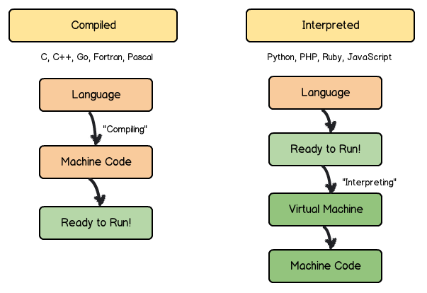
System vs Scripting Languages (Cont.)

Slide 20
A Related Concept: Managed Code
Languages that are “sandboxed” inside a runtime environment
Java in JVM/JRE
C# in CLR (Common Language Runtime), the VM component of Microsoft .NET Framework
Compiled to intermediate form
Not exactly “native” or compiled code
Not interpreted either
Environment handles memory management, type safety, exception handling, garbage collection, etc.

Slide 21
General-Purpose vs Domain-Specific Languages
Can also categorize languages as general-purpose vs domain specific
General Purpose – across application domains
C, C++, Java, PHP, Python
Domain-specific – specialized to particular application, e.g.
HTML for web pages
XML for markup
Perl for text processing (initially)
VHDL/Verilog for hardware description
SQL for relational database queries

Slide 22
Languages Based on Typing
Statically-typed – declare variable/object types prior to runtime (usually by compile time)
C, C++, Java
int var1;
short s = 102;
Dynamically-typed – type checking deferred to runtime
Python: num1 = 1.5
Ruby: a = 3
JavaScript: b = “A string”;

Slide 23
Languages Based on Typing [link]
You may also come across references to weakly vs strongly-typed languages
Weakly-typed languages allow implicit type conversion, e.g.
int a = 3; //a is an integer
a = 3.5; //a now a double
Strongly-typed, convert explicitly
Error occurs for above
Type casting: (double) a = 3.5;

Slide 24
Based on Programming Paradigm [link]
4 main programming paradigms
Imperative – gives a series of instructions
Procedural – series of steps, may include routines, subroutines or functions
C, FORTRAN, PASCAL, BASIC…
Object-oriented – computer programs comprises of objects that interact with one another
Java, C++, Python, JavaScript, PHP, Ruby, Perl, Swift, Scala, MATLAB…
Declarative – describe what the program must accomplish, not how
Database query languages (e.g. SQL), regular expressions, HASKELL, HTML, VHDL, logic programming, functional programming

