Slide 1

Class Session Check List
Everyone:
Sign into our Zoom meeting through our integrated Blackboard/Zoom link
Make sure that you can hear the conversation, see shared desktops, and view group chat topics
You will need a headset with a microphone to be able to effectively listen and speak
You will need to be able to share your computer screen
Thank you if you choose to leave your camera on to help make our class more interactive
In person participants also:
Make sure that your microphone and speakers are muted/off so that we don’t get an echo
Sit in a good spot near the classroom ceiling microphones if possible

Slide 2
Class Session Check List
Review that recordings are:
Opportunistic
Automatically available within Blackboard/Zoom
… Now make sure that the classroom microphone, speakers, and camera are being used in Zoom, move to the next slide, AND verify that recording is started.
… Also make sure that slides are visible to attendees

Slide 3
Agenda:
Friendly Conversation topic
Prework and Announcements
The Humble Text File
Scrum Team Review: Chapters 3 through 5 and plus A.6 and A.7
Assignment Q&A
Quiz Expectations
Quiz
Discussion & Questions welcome at any time but please be present with no phones or email during our time together

Slide 4
Friendly Conversation Topic
Should there be 1 or 2 spaces after a period?

Slide 5
The Humble Text File
Notes:
Anybody else wonder how the simple text file remains the standard for building some of the most complex creations in the world?

Slide 6
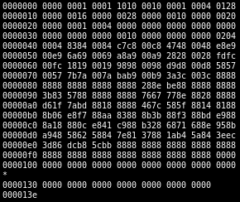
Files
All computer files are binary and can be represented in Hex
Some binary files can also be represented as text files
The term “binary file” is often incorrectly used to imply that a file is a “non-text” file.

Slide 7
In The Beginning There Were ASCII Text Files

Slide 8
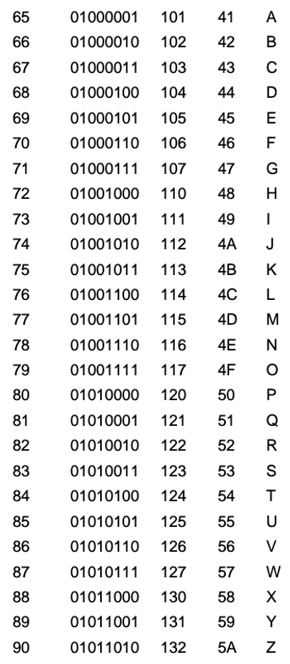
ASCII Files
Bytes are frequently used to hold individual characters in a text document. In the ASCII character set, each binary value between 0 and 127 is given a specific character. Most computers extend the ASCII character set to use the full range of 256 characters available in a byte. The upper 128 characters handle special things like accented characters from common foreign languages.

Slide 9
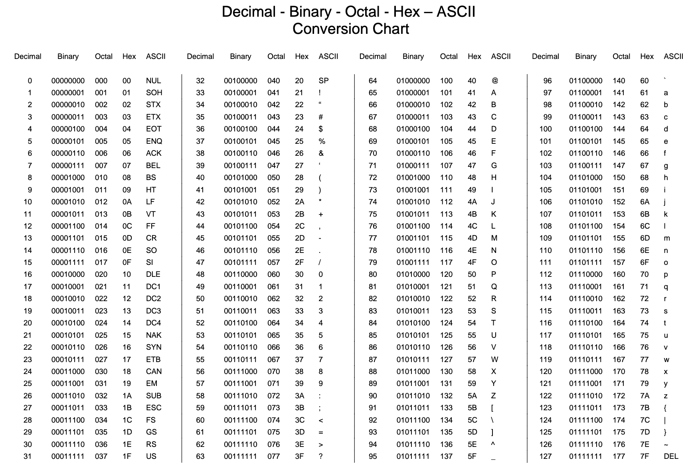

Slide 10
Unicode & UTF-16

Slide 11
Unicode, UTF-16, and UTF-8
Unlike ASCII, UTF-16 (Unicode) includes 65,536 possible combinations covering 154 modern and historical scripts, as well as multiple symbol sets [link]

Slide 12

Unicode, UTF-16, and UTF-8
Unicode
Unicode was a brave effort to create a single character set that included every reasonable writing system on the planet and some make-believe ones like Klingon, too. Some people are under the misconception that Unicode is simply a 16-bit code where each character takes 16 bits and therefore there are 65,536 possible characters. This is not, actually, correct. It is the single most common myth about Unicode, so if you thought that, don’t feel bad. [link]
“Oops!” -- Eric

Slide 13
Unicode, UTF-16, and UTF-8
Unicode: Code Points
UTF-16 Encoding: 2 bytes per character… plus some craziness

Slide 14
UTF-8

Slide 15
Unicode, UTF-16, and UTF-8
Unicode
For a while it seemed like that (UTF-16) might be good enough, but programmers were complaining. “Look at all those zeros!” they said, since they were Americans and they were looking at English text … Also they were liberal hippies in California who wanted to conserve (sneer). If they were Texans they wouldn’t have minded guzzling twice the number of bytes. But those Californian wimps couldn’t bear the idea of doubling the amount of storage it took for strings, and anyway, there were already all these doggone documents out there using various ANSI and DBCS character sets and who’s going to convert them all? Moi? For this reason alone most people decided to ignore Unicode for several years and in the meantime things got worse.
Thus was invented the brilliant concept of UTF-8. UTF-8 was another system for storing your string of Unicode code points, those magic U+ numbers, in memory using 8 bit bytes. In UTF-8, every code point from 0-127 is stored in a single byte. Only code points 128 and above are stored using 2, 3, in fact, up to 6 bytes.

Slide 16
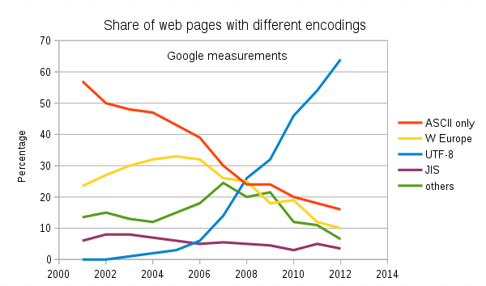
Text File Standards (Encoding)
ASCII
Unicode
UTF-8
Others

Slide 17
Text File End-Of-Line (EOL) and Encoding
Industry adoption of end-of-line encoding includes:
Windows: Both Carriage Return (CR, \r, 0x0d) and Line Feed (LF, \n, 0x0a) together.
Unix/Linux/OSX: Just Line Feed (LF, \n, 0x0a)
Mac (pre-OSX): Just Carriage Return (CR, \r, 0x0d)
Article on Windows Notepad supporting non-Windows EOF conventions [link]

Slide 18
HTML Character Entities

Slide 19

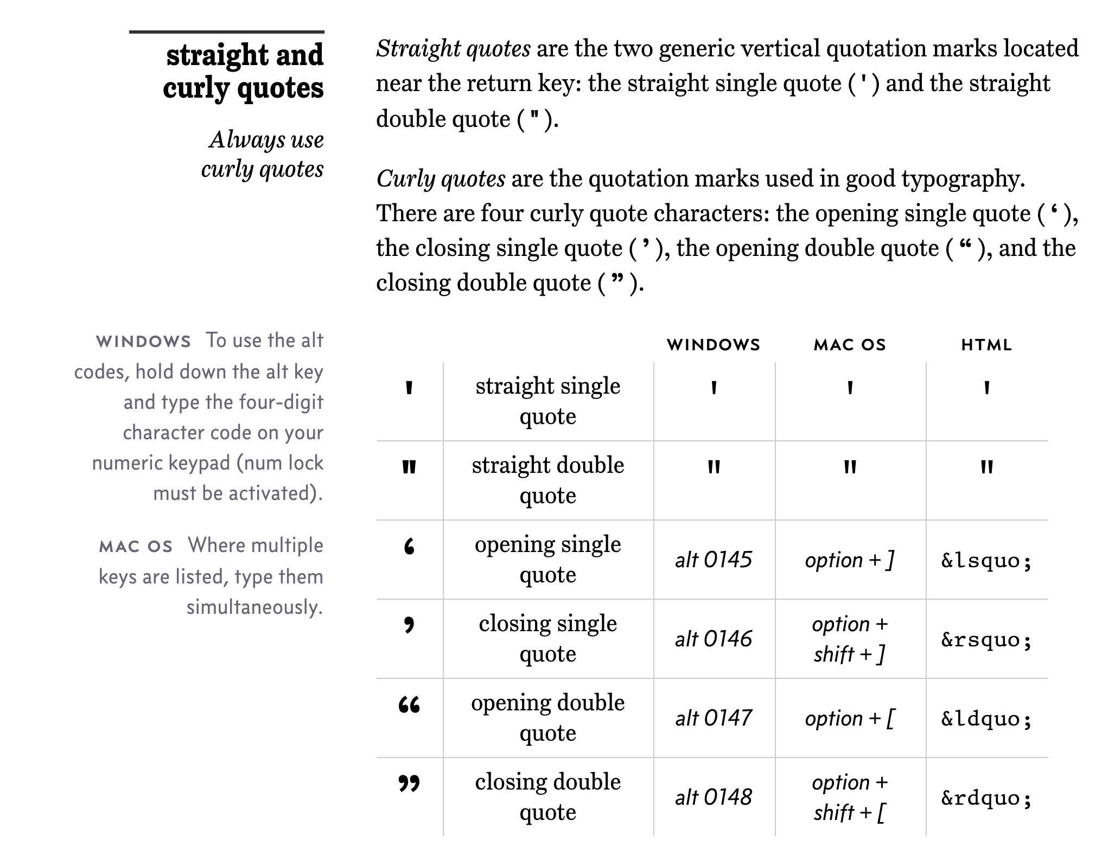
Straight vs Curly Quotes

Slide 20
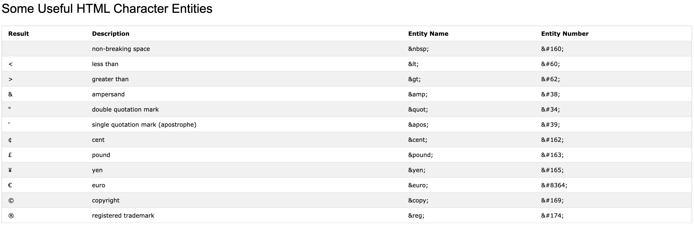
HTML Character Entities

Slide 21

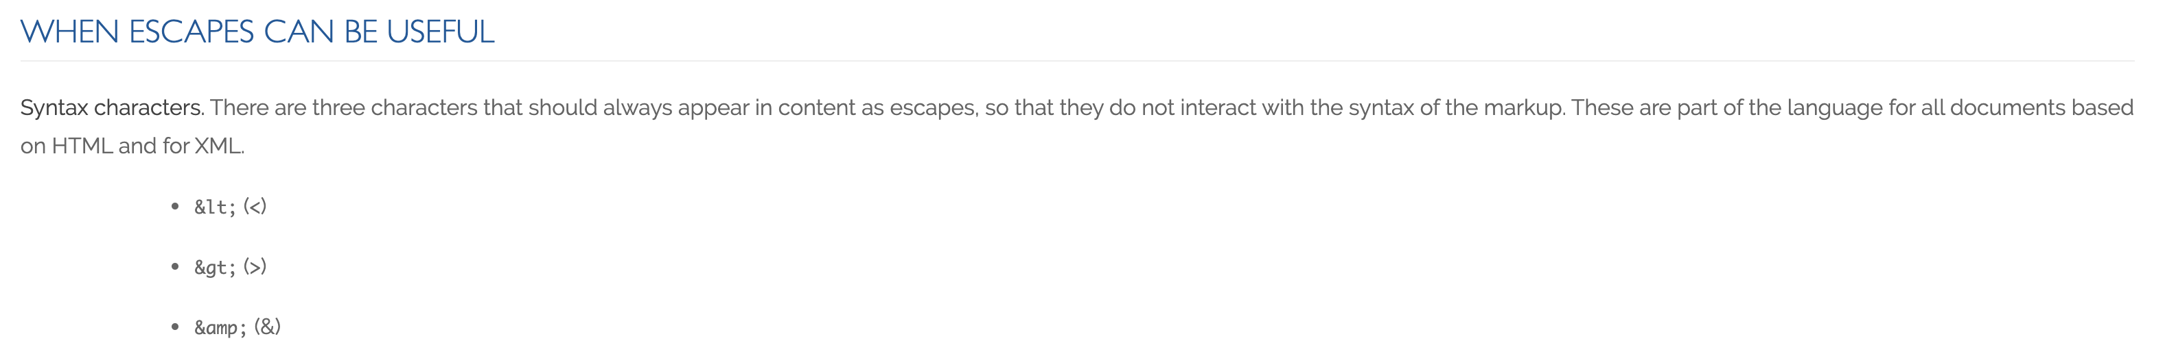
Always Escape

Slide 22
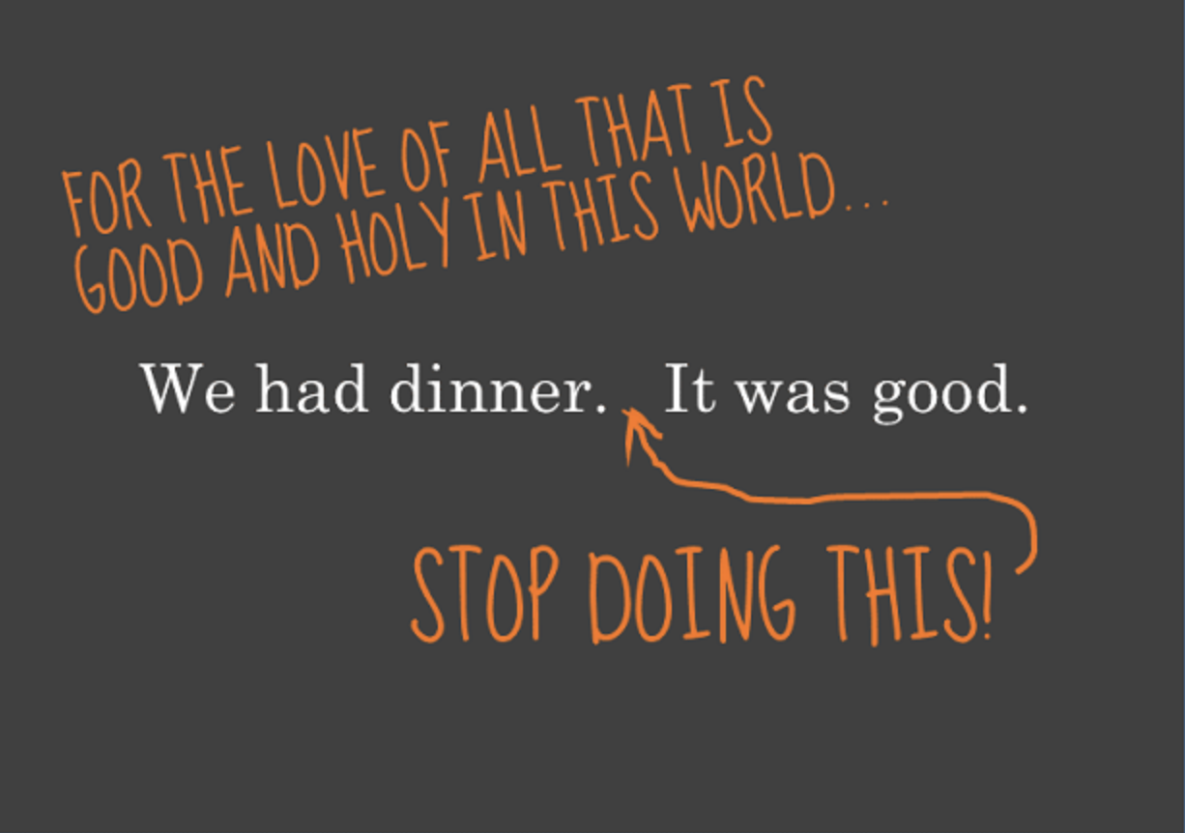
Oh yes, and…

Slide 23
Scrum Team Chapter Review
Assign presenter
Team discusses topics while the presenter summarizes the topics below:
Chapter 3
Chapter 4
Chapter 5
A.6
A.7
ORM (Object-Relational-Mapper)
Team sits back, relaxes, and acknowledges the bravery and dedication of the presenter
Fox Chapter Chapters 3 through 5 and plus A.6 and A.7

Slide 24
Assignment Q&A

Slide 25
Prework For Next Class
Complete through activity 16 and be actively working on activity 17
Be prepared for programming together with Azure… if you have not been actively working with Microsoft Azure yet this, you are behind
Be prepared for Nick and Eric programming Azure together
Everything is due Sunday!

Slide 26
Quiz Expectations
Quiz Expectations include:
You may use any naturally available documentation include books, notes, and web browser
You may not use quiz specific content like question banks
It is an individual assignment so asking others questions would be inappropriate
You are welcome to ask me questions

Slide 27
Quiz

Slide 28
End of Session

Slide 29
Backup & Future Slides

Slide 30
Scrum Team Chapter Discussion
Assign presenter
Team discussing chapter topics while the presenter summarizes the 5 topics below:
The importance of Branching is VCS systems (which VCS focused on branching)
Where should pared programming fit into the development process
The priority of specialization vs generalization in Agile vs Waterfall/Iterative
The relative importance of PMs in Agile vs Waterfall/Iterative
The two most important book on managing people and conflict (according to the author)
Team sits back, relaxes, and acknowledges the bravery and dedication of the presenter
Fox Chapter 10 on Project Management, Scrum, Pairs, and Version Control Systems

Slide 31
Scrum Team Discussion Boards in 14 Minutes
Scrum teams should complete discussion board (DB) in 14 minutes by:
Scrum master accepting volunteers (or assigning) note taker and presenter responsibilities in 1 minute
Team discussing Discussion Board topic for 10 minutes while the note taker documents:
Discussion board number & title
Team name
Fully participating team members
At least 5 bulleted discussion topics from discussion
Note taker shares notes with participating team members in 1 minute
Team member who actively participated paste an exact copy of the notes into their individual DB post and submit the post taking at most 1 minute
Presenter is preparing to give a very brief report out from the team during above discussion
Team sits back, relaxes, and acknowledges the fine work of the note taker and presenter for 1 minute
Note: Team members who actively participated and submit DB notes in their individual DB do not need to make additional DB posts responding to other classmates’ posts

Slide 32
JAMStack
The ‘JAM,’ part stands for JavaScript, APIs, and Markup.
These are the essential building blocks to any JAMstack site. This term was invented by Netlify co-founder Mathias Biilmann.
Single-page application [link]
Serverless computing [link]

Slide 33
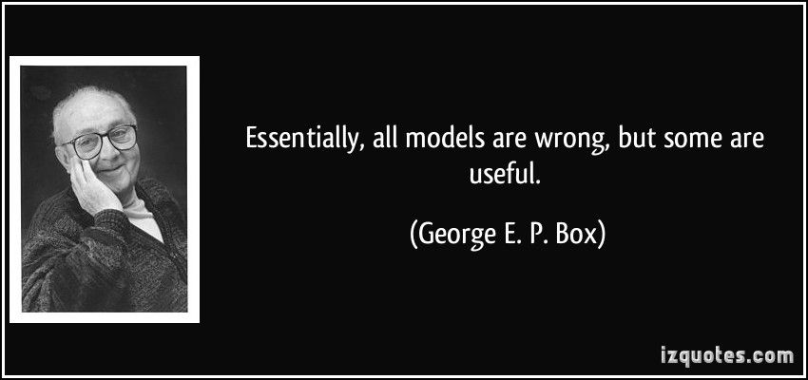
Models

