Slide 1

Class Session Check List
Everyone:
Sign into our Zoom meeting through our integrated Blackboard/Zoom link
Make sure that you can hear the conversation, see shared desktops, and view group chat topics
You will need a headset with a microphone to be able to effectively listen and speak
You will need to be able to share your computer screen
Thank you if you choose to leave your camera on to help make our class more interactive
In person participants also:
Make sure that your microphone and speakers are muted/off so that we don’t get an echo
Sit in a good spot near the classroom ceiling microphones if possible

Slide 2
Attendance
Document in-person attendance for contact tracing.

Slide 3
Class Session Check List
Review that recordings are:
Opportunistic
Automatically available within Blackboard/Zoom
… Now make sure that the classroom microphone, speakers, and camera are being used in Zoom, move to the next slide, AND verify that recording is started.
… Also make sure that slides are visible to attendees

Slide 4
Agenda:
Friendly Conversation Topic
Prework and Announcements
Representation: Text Files
Assignment Q&A
Programming Together
Prework for Next Class
Discussion & Questions welcome at any time but please be present with no phones or email during our time together

Slide 5
Should we focus 100% on Programming Together today?

Slide 6
Friendly Conversation Topic Should there be one or two spaces after a period?

Slide 7
Prework & Announcements
Be prepared for Programming Together
Everything is due Sunday!

Slide 8
Representation: Text Files

Slide 9
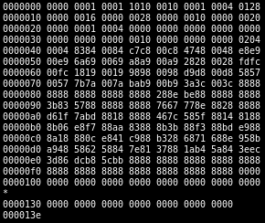
Recall Files
All computer files are binary and can be represented in Hex notation
The term “binary file” is often used to imply that a file is a “non-text” file.

Slide 10
ASCII Text Files

Slide 11
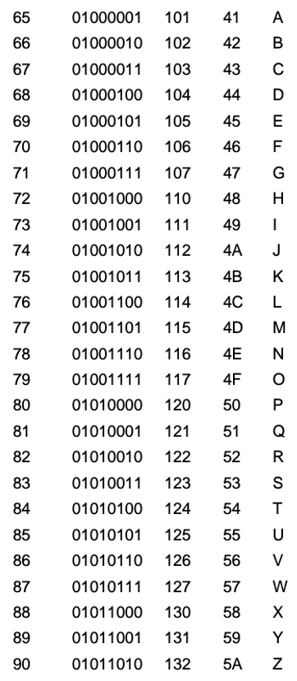
ASCII Files
Bytes are frequently used to hold individual characters in a text document. In the ASCII character set, each binary value between 0 and 127 is given a specific character. Most computers extend the ASCII character set to use the full range of 256 characters available in a byte. The upper 128 characters handle special things like accented characters from common foreign languages.

Slide 12
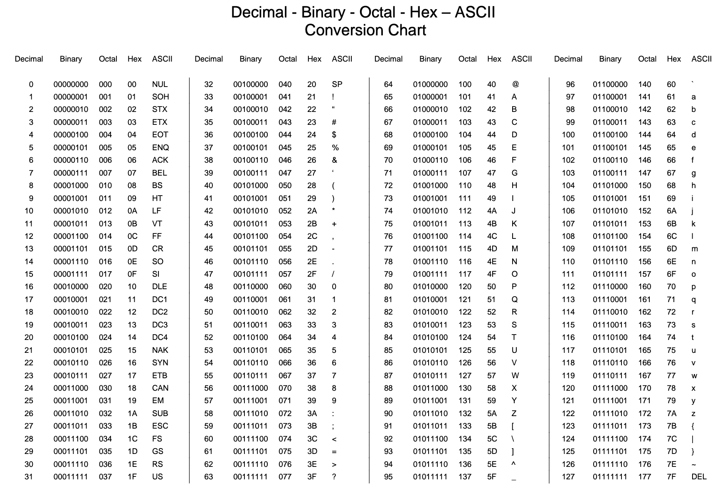

Slide 13
Unicode & UTF-16

Slide 14
Unicode & UTF-16
Unicode includes 65,536 possible combinations covering 154 modern and historical scripts, as well as multiple symbol sets [link]

Slide 15
UTF-8

Slide 16
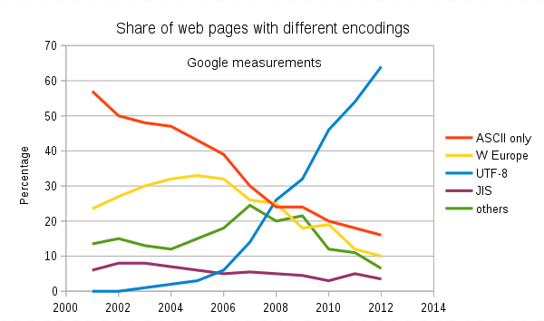
Text File Standards (Encoding)
ASCII
Unicode
UTF-8
Others

Slide 17
Text File End-Of-Line (EOL) and Encoding
Industry adoption of end-of-line encoding includes:
Windows: Both Carriage Return (CR, \r, 0x0d) and Line Feed (LF, \n, 0x0a) together.
Unix/Linux/OSX: Just Line Feed (LF, \n, 0x0a)
Mac (pre-OSX): Just Carriage Return (CR, \r, 0x0d)
Article on Windows Notepad supporting non-Windows EOF conventions [link]

Slide 18
HTML Character Entities

Slide 19

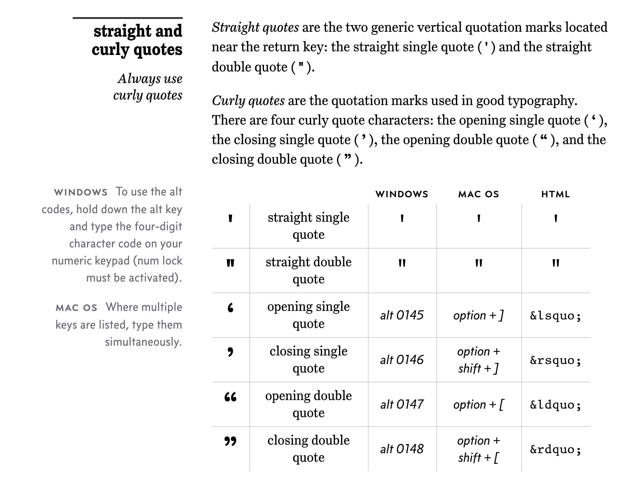
Straight vs Curly Quotes

Slide 20
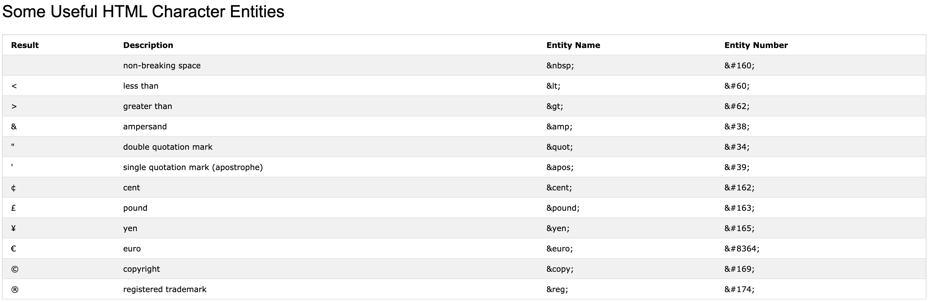
HTML Character Entities

Slide 21

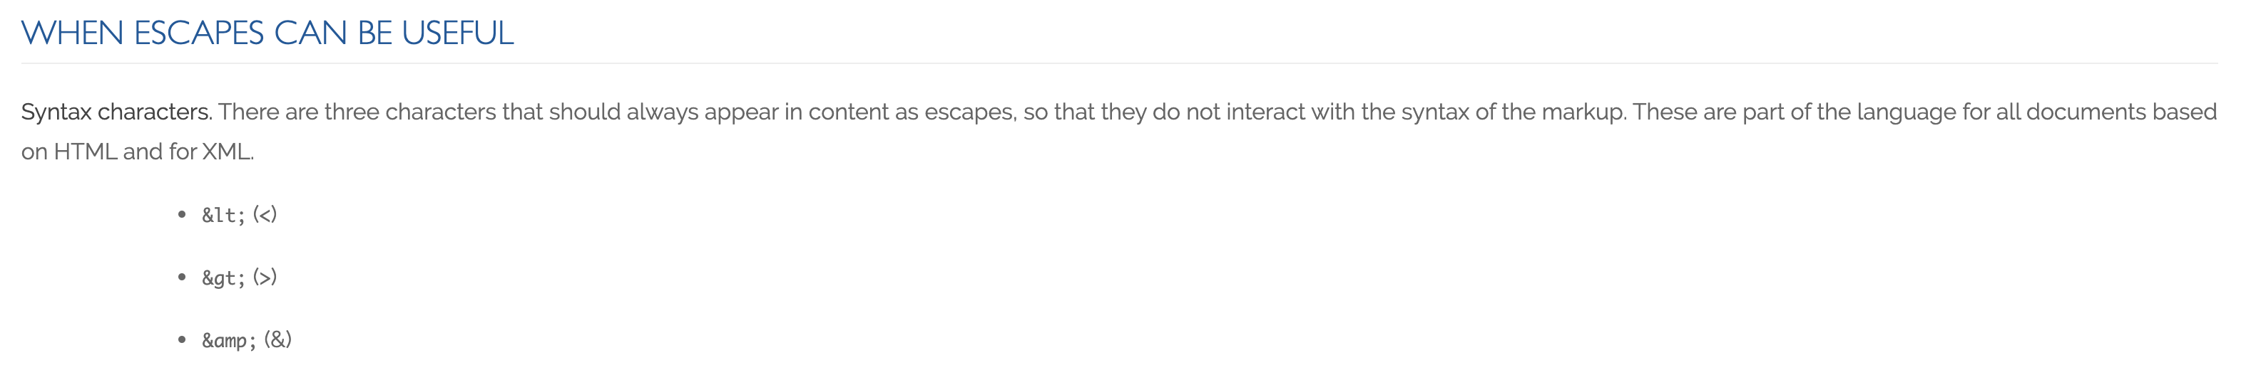
Always Escape

Slide 22
And Only One Space After a Period
Rule: Utilize one space after a period or similar punctuation [link]
Proportional based fonts like Helvetica and Times were designed to have the most visually appealing amount of space after the period.
Notes:
A possible exception would be non-proportional based fonts

Slide 23
Programming Together
Git?
“Hello World Plus with Pictures for the Web”

Slide 24
Prework For Next Class
Everything is due Sunday!
Be prepared for sprint 3 planning on Monday

Slide 25
End of Session

