Slide 1

Class Session Check List
Everyone:
Sign into our Zoom meeting through our integrated Blackboard/Zoom link
Make sure that you can hear the conversation, see shared desktops, and view group chat topics
You will need a headset with a microphone to be able to effectively listen and speak
You will need to be able to share your computer screen
Thank you if you choose to leave your camera on to help make our class more interactive
In person participants also:
Make sure that your microphone and speakers are muted/off so that we don’t get an echo
Sit in a good spot near the classroom ceiling microphones if possible

Slide 2
Class Session Check List
Review that recordings are:
Opportunistic
Automatically available within Blackboard/Zoom
… Now make sure that the classroom microphone, speakers, and camera are being used in Zoom, move to the next slide, AND verify that recording is started.
… Also make sure that slides are visible to attendees

Slide 3
Agenda:
Prework and Announcements
Sprint 2 Demos
Sprint 2 Retrospective
Sprint 3 Planning
Prework for Next Class
Discussion & Questions welcome at any time but please be present with no phones or email during our time together

Slide 4
Prework & Announcements
Everything is due Sunday!
Be prepared for Sprint 2 Demos, Sprint 2 Retrospective, and Sprint 3 Planning next class.

Slide 5
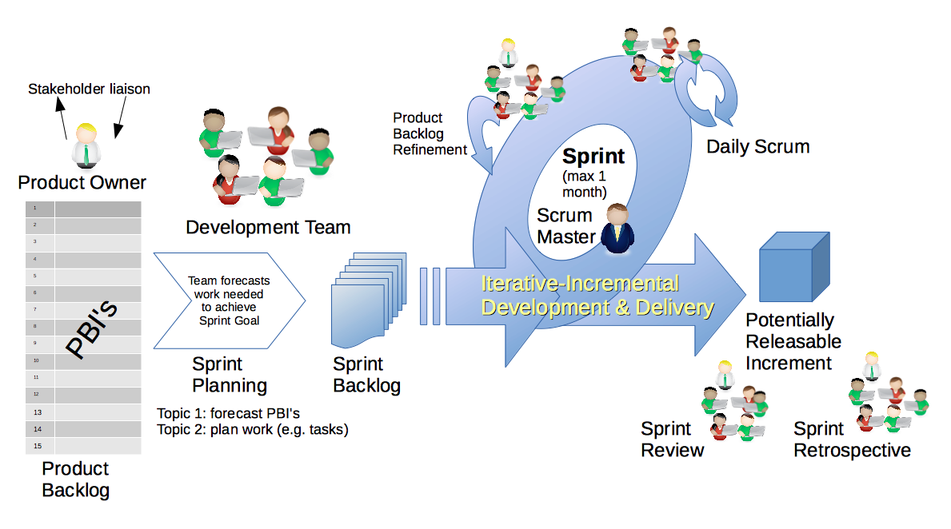
Scrum Process – Sprint Review & Demo
By Dr ian mitchell - Own work, CC BY-SA 4.0, Link

Slide 6
Demo Guidelines – Presenter
Everyone will give at least one demo of their work during the semester.
Your demo should be 2 to 5 minutes and can include any or all of the following:
Show your application running
Comment on your implementation
Show the source code
Explain how you organized the code
Talk about any challenges
You should not prepare slides or a presentation
**You will also need to complete the Demo assignment in Blackboard.

Slide 7
Demo Guidelines – Listener
Everyone will be listening to many demos during the semester.
Your listener responsibilities include:
Actively listening and watching what is being demoed
Come up with a meaningful yet easy to answer question
Ask your question if the presenter does not get sufficient questions from other listeners
Do not ask hard question or attempt to review the presenters code
Clap for the presenter at the end of the demo and thank them for presenting
Optionally follow up with the presenter later if you have what could be more difficult questions or if you have suggestions

Slide 8
Sprint Demos

Slide 9
Complete Sprint Demo Assignment

Slide 10
Scrum Process – Sprint Retrospective
By Dr ian mitchell - Own work, CC BY-SA 4.0, Link

Slide 11
Submission Percentage from Sprint 1

Slide 12
Submission Percentage for Sprint 2

Slide 13
Class Retrospective
Feedback from Assignments & Reflections:
Very good submission numbers
The numbers don’t even tell the whole story as the missing assignments were clustered around a specific situation
Wow! I really underestimated the effort in Lab 2. Thank you for making it successful!
Go modules are interesting but challenging
Maybe we should stick with Go packages (instead of modules) for the rest of the course
Stephanie and I continue to be challenged to effectively get through the grading before our Tuesday class

Slide 14
Scrum Team Retrospective
Provide your feedback on:
What is one thing your team can commit to improving on in sprint 3
Should we continue scrum team discussion boards?
Who will be the new scrum master for sprints 3 and 4
Class Forum options?
Should we remain with three scrum teams or consolidate into 2 teams?
Modules, packages, or both?

Slide 15
Sprint Planning

Slide 16
Sprint Planning
Sprint 3 Changes:
Very similar last sprint including Discussion, Quiz, Lab, and Reflection

Slide 17
Scrum Process – Sprint Planning
By Dr ian mitchell - Own work, CC BY-SA 4.0, Link

Slide 18
Product Backlog vs Sprint Backlog

Slide 19
Scrum Process – Product Backlog to Sprint Backlog
By Dr ian mitchell - Own work, CC BY-SA 4.0, Link

Slide 20
Scrum Process – Sprint Planning
By Dr ian mitchell - Own work, CC BY-SA 4.0, Link

Slide 21
Review Activities List and Assignments

Slide 22
Prework For Next Class
Complete through activity 7 prior to next class
Plus do an Internet search on Software Testing and review the results
Be prepared for a scrum team discussion of Testing

Slide 23
Lab
As a scrum team:
Review sprint 3 activities & assignments in detail
Discuss questions/concerns and topics that need more clarification
Scrum master share your team’s top 2 questions/concerns during report out

Slide 24
End of Session

