Slide 1

Class Session Check List
Everyone:
Sign into our Zoom meeting through our integrated Blackboard/Zoom link
Make sure that you can hear the conversation, see shared desktops, and view group chat topics
You will need a headset with a microphone to be able to effectively listen and speak
You will need to be able to share your computer screen
Thank you if you choose to leave your camera on to help make our class more interactive
In person participants also:
Make sure that your microphone and speakers are muted/off so that we don’t get an echo
Sit in a good spot near the classroom ceiling microphones if possible

Slide 2
Class Session Check List
Review that recordings are:
Opportunistic
Automatically available within Blackboard/Zoom
… Now make sure that the classroom microphone, speakers, and camera are being used in Zoom, move to the next slide, AND verify that recording is started.
… Also make sure that slides are visible to attendees

Slide 3
Agenda:
Prework and Announcements
Graphical User Interfaces before Object-Oriented Programming
Scrum Team Review of Graphical User Interfaces in Java
Programming Together
Software Licensing
Prework for Next Class
Discussion & Questions welcome at any time but please be present with no phones or email during our time together

Slide 4
Prework
Complete through activity 9 prior to next class
Be prepared for scrum team review of Graphical User Interfaces (GUI) in Java

Slide 5
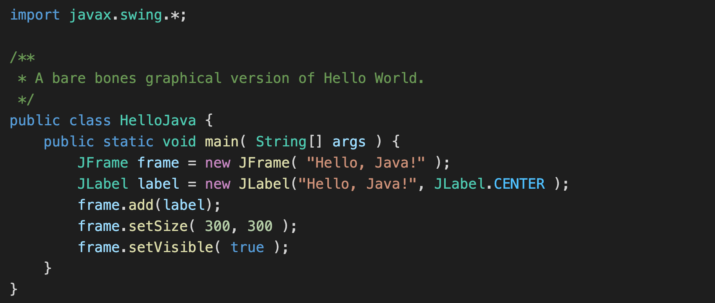
Graphical User Interfaces before Object-Oriented Programming
Notes:
Be okay with not being able to complete every requirements
It’s okay to do some of the lab questions differently, just explain what you did and why

Slide 6
Scrum Team Review of Graphical User Interfaces in Java
Assign presenter
Team reviews key topics using “team number by percent of content” method
Team sits back, relaxes, and acknowledges the bravery and dedication of the presenter

Slide 7
Programming Together
Notes:
Be okay with not being able to complete every requirements
It’s okay to do some of the lab questions differently, just explain what you did and why

Slide 8
Software Licensing
Primary software license types include:
Public Domain
Permissive including MIT and BSD
Copy Left including GPL and LGPL
Proprietary including all rights reserved
5 types of software licenses you need to understand [link]
What are you afraid of [link]

Slide 9
Prework
Complete through activity 10 and diligently working on 11
Be prepared for quiz 3

Slide 10
End of Session

