Slide 1

Class Session Check List
Everyone:
Sign into our Zoom meeting through our integrated Blackboard/Zoom link
Make sure that you can hear the conversation, see shared desktops, and view group chat topics
You will need a headset with a microphone to be able to effectively listen and speak
You will need to be able to share your computer screen
Thank you if you choose to leave your camera on to help make our class more interactive
In person participants also:
Make sure that your microphone and speakers are muted/off so that we don’t get an echo
Sit in a good spot near the classroom ceiling microphones if possible

Slide 2
Class Session Check List
Review that recordings are:
Opportunistic
Automatically available within Blackboard/Zoom
… Now make sure that the classroom microphone, speakers, and camera are being used in Zoom, move to the next slide, AND verify that recording is started.
… Also make sure that slides are visible to attendees

Slide 3
Agenda:
Prework and Announcements
Scrum Team Review of Sever Environments and Quiz JSON Formats
Discussion Board 4
Prework for Next Class
Diversity and Global Teams
Discussion & Questions welcome at any time but please be present with no phones or email during our time together

Slide 4
Prework For Next Class
Complete through activity 5 prior to next class
Focus on 5 as the highest priority
Be prepared for a scrum team decision on server platforms and JSON formats

Slide 5
Scrum Team Review: Sever Environments and JSON Formats
Assign presenter
Team reviews key JSON format in sample code
Finalize Server Environment
Team sits back, relaxes, and acknowledges the bravery and dedication of the presenter

Slide 6
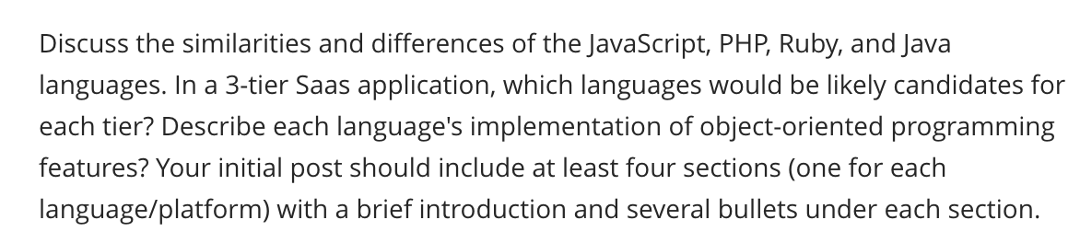
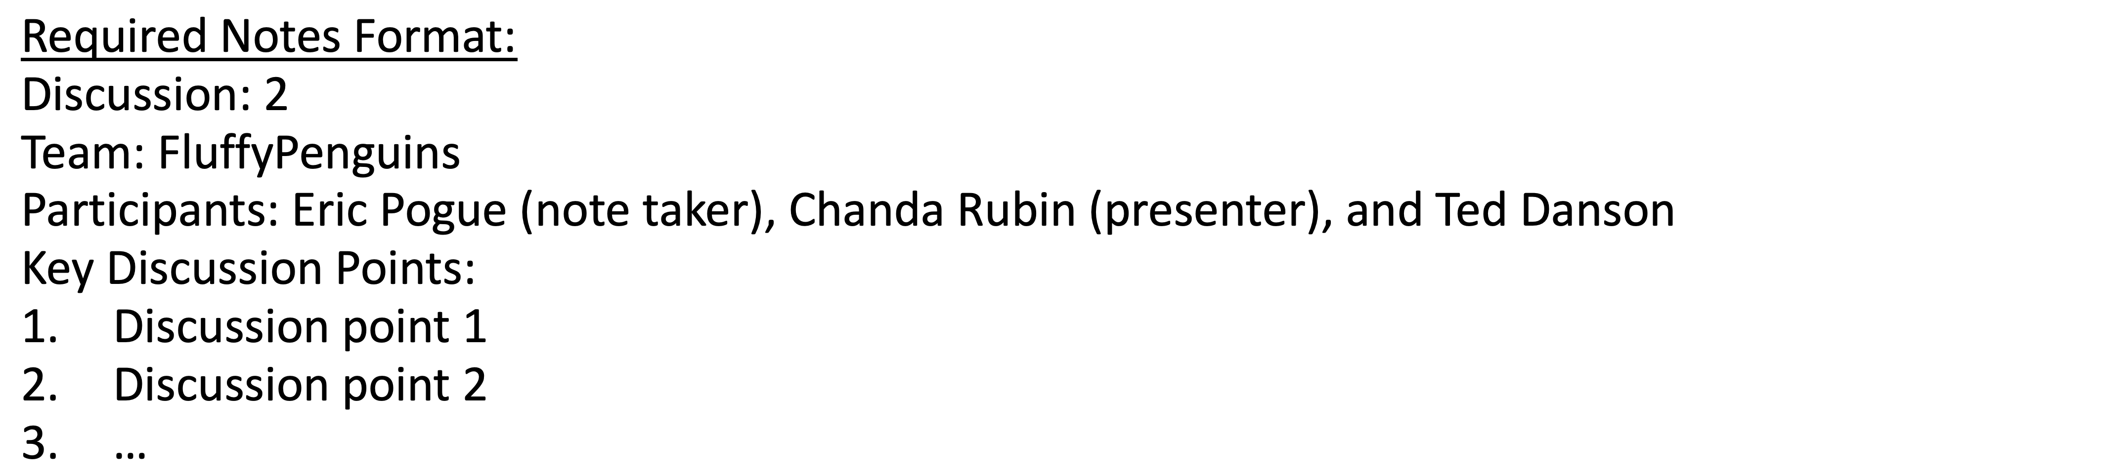
Scrum Team Discussion Board 4
Assign note taker and presenter roles to team members
Review and discuss the discussion topic for this sprint for approximately 10 minutes
Note taker takes notes and presenter prepares a report out summary
Note taker share notes with all participating team members
Each team member pastes and submits exact copy of the notes into their discussion board
Sit back, relax, and tell the note taker and presenter what I wonderful job the did
Notes:
Seating chart and attendance tracker (virtual and in person)

Slide 7
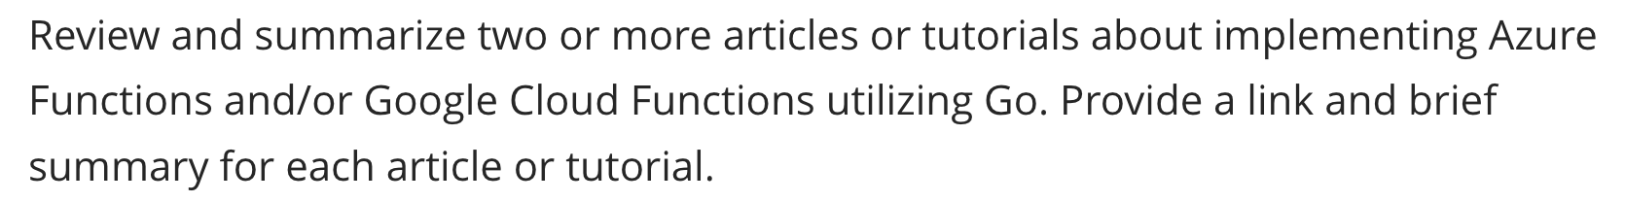
Scrum Team Discussion Board 4
Assign note taker and presenter roles to team members
Review and discuss the discussion topic for this sprint for approximately 10 minutes
Note taker takes notes and presenter prepares a report out summary
Note taker share notes with all participating team members
Each team member pastes and submits exact copy of the notes into their discussion board
Sit back, relax, and tell the note taker and presenter what I wonderful job the did
Notes:
Seating chart and attendance tracker (virtual and in person)

Slide 8
Diversity and Global Software Development
Developing software with distributed teams for global customers:
Economics
Culture
Process
Teams
Technology

Slide 9

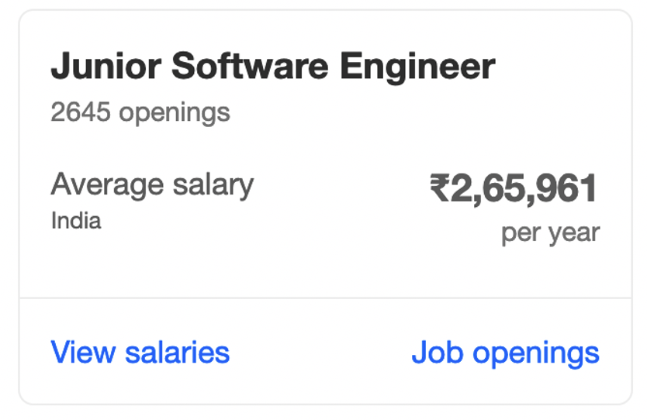
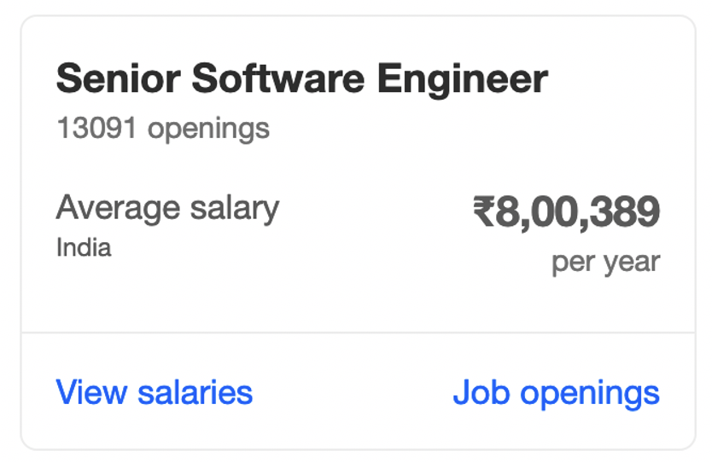
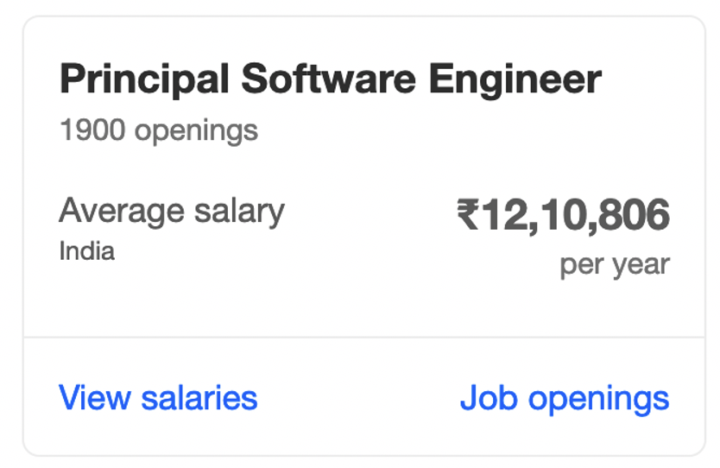
Economics

Slide 10

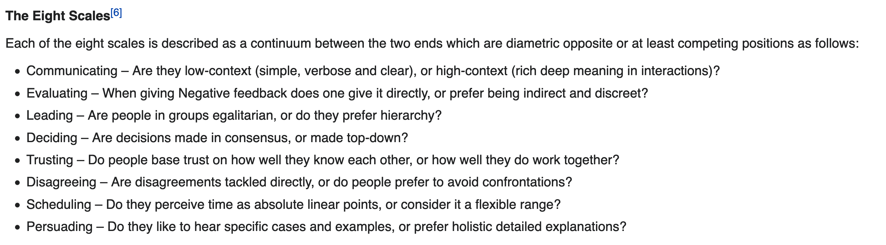
Cultural

Slide 11

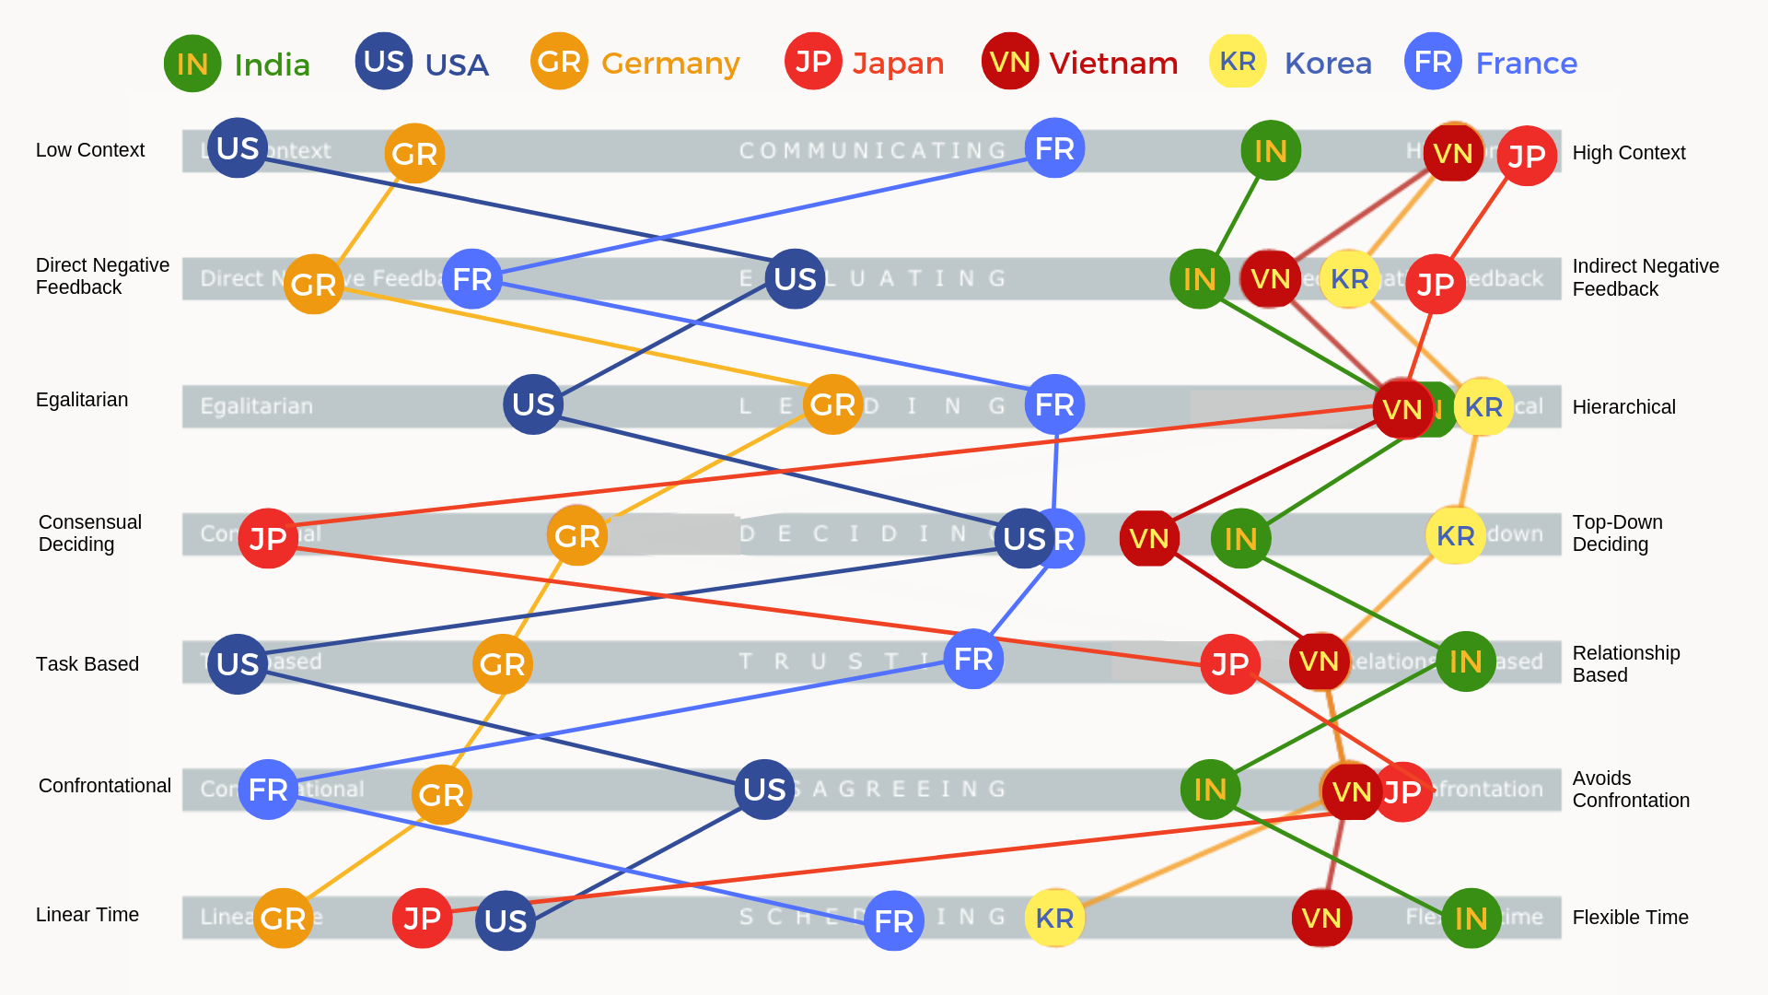
Cultural Map: Context & Feedback

Slide 12
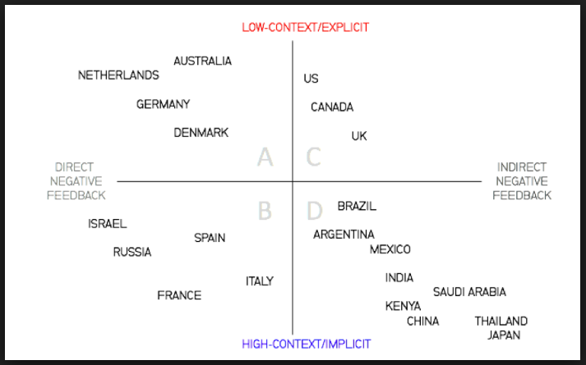
Distributed Software Development & Working With India
Notes:
Norway vs US
Germany and India

Slide 13
Cultural Map: Egalitarianism

Slide 14

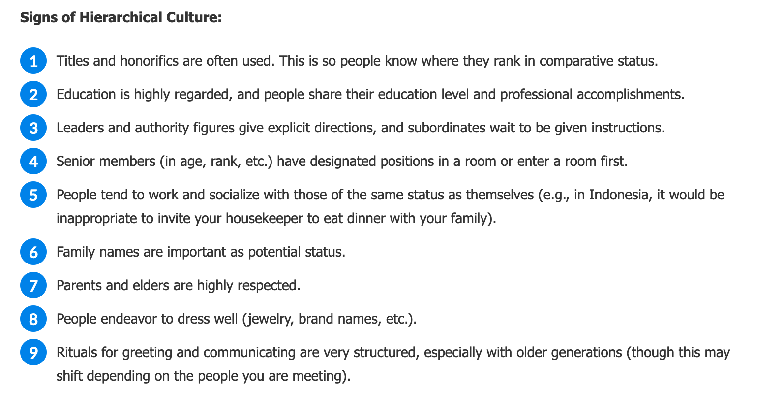
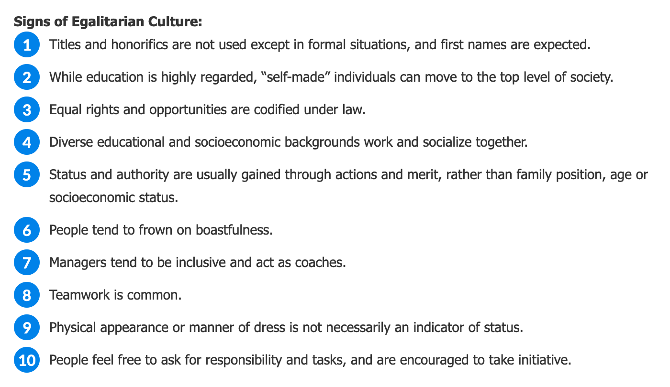
Cultural Understanding: Egalitarian vs Hierarchical
Notes:
Hierarchical

Slide 15
Cultural Map: Task Based

Slide 16
Process
Process Discussion Topics:
Project Outsourcing Model
CMMI Certifications
Default to Plan & Document
Technology

Slide 17
Teams
Teams Discussion Topics:
Economics push us to hire junior level India developers
Agile processes move us to full team by location model with mix of skill levels

Slide 18
Technology
Technology Discussion Topics:
Specialist focus in India development teams
Global Customers… a topic for another day.

Slide 19
Summary: Software Development & Working With India
Economics
Culture
Process
Teams
Technology
Embrace the adventure!

Slide 20
End of Session

