Slide 1

Class Session Check List
Everyone:
Sign into our Zoom meeting through our integrated Blackboard/Zoom link
Make sure that you can hear the conversation, see shared desktops, and view group chat topics
You will need a headset with a microphone to be able to effectively listen and speak
You will need to be able to share your computer screen
Thank you if you choose to leave your camera on to help make our class more interactive
In person participants also:
Make sure that your microphone and speakers are muted/off so that we don’t get an echo
Sit in a good spot near the classroom ceiling microphones if possible

Slide 2
Agenda:
Prework and Announcements
Open Mic Demos
Scrum Team Review of Artificial Intelligence
Programming Together with Matchmaker
Prework for Next Class
Discussion & Questions welcome at any time but please be present with no phones or email during our time together

Slide 3
Prework
Complete through activity 11
Be prepared for Programming Together with MatchmakerLite - Part 2
Be prepared for scrum team discussion of Artificial Intelligence

Slide 4
Open Mic Demos
Notes:
//filing in my own rectangle
g.setColor(new Color(0, 0, 139));
g.fillRect(0, 0, panelWidth, panelHeight);

Slide 5
Scrum Team Review of Artificial Intelligence
Assign presenter
Team reviews key topics using “team number by percent of content” method
Team sits back, relaxes, and acknowledges the bravery and dedication of the presenter

Slide 6
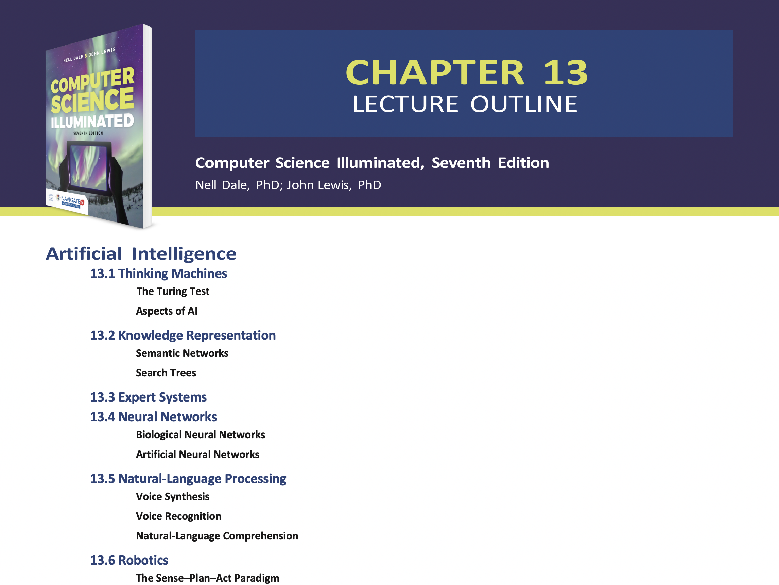

Slide 7
Programming Together with
Together with MatchmakerLite

Slide 8
Prework
Complete through first half of activity 13
Be prepared for Quiz 4
Be prepared for Programming Together with MatchmakerLite
Recall: No class Thursday or Friday
Everything is due Sunday!

Slide 9
End of Session

