Slide 1

Preflight Check List
Everyone:
Sign into our Zoom meeting through our integrated Blackboard/Zoom link
Make sure that you can hear the conversation, see shared desktops, and view group chat topics
You will need a headset with a microphone to be able to effectively listen and speak
You will need to be able to share your computer screen
Thank you if you choose to leave your camera on to help make our class more interactive
In person participants also:
Make sure that your microphone and speakers are muted/off so that we don’t get an echo
Sit in a good spot near the classroom ceiling microphones if possible

Slide 2
Agenda:
Prework and Announcements
Sprint 4 Demos
Sprint 4 Retrospective
Sprint 5 Planning
Prework for Next Class
Scrum Team Sprint 5 Planning
Discussion & Questions welcome at any time but please be present with no phones or email during our time together

Slide 3
Prework
Everything is due Sunday
No class Thursday… have a wonderful break
Be prepared for Sprint 4 Demos, Sprint 4 Retrospective, and Sprint 5 Planning

Slide 4
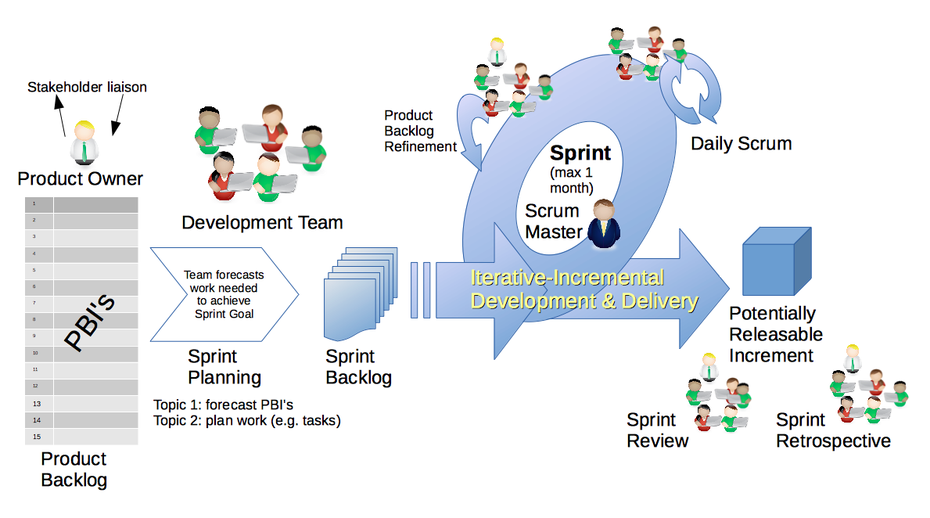
Scrum Process – Sprint Review & Demo
By Dr ian mitchell - Own work, CC BY-SA 4.0, Link

Slide 5
Demo Guidelines – Presenter
Everyone will give at least one demo of their work during the semester.
Your demo should be 2 to 5 minutes and can include any or all of the following:
Show your application running
Comment on your implementation
Show the source code
Explain how you organized the code
Talk about any challenges
You should not prepare slides or a presentation
**You will also need to complete the Demo assignment in Blackboard.

Slide 6
Demo Guidelines – Listener
Everyone will be listening to many demos during the semester.
Your listener responsibilities include:
Actively listening and watching what is being demoed
Come up with a meaningful yet easy to answer question
Ask your question if the presenter does not get sufficient questions from other listeners
Do not ask hard question or attempt to review the presenters code
Clap for the presenter at the end of the demo and thank them for presenting
Optionally follow up with the presenter later if you have what could be more difficult questions or if you have suggestions

Slide 7
Sprint Demos

Slide 8
Complete Sprint Demo Assignment

Slide 9
Scrum Process – Sprint Retrospective
By Dr ian mitchell - Own work, CC BY-SA 4.0, Link

Slide 10
Submission Percentage from Sprint 1

Slide 11
Submission Percentage from Sprint 2

Slide 12
Submission Percentage for Sprint 3

Slide 13
Submission Percentage for Sprint 4

Slide 14
Class Retrospective
Feedback from Assignments & Reflections:
Fantastic submission numbers! Well done.
Grades are posted for assignments that
Quiz answer should be available now… email me with questions or comments about the quiz
Lab Question #8 comments:
Given the list of tasks, predecessors, and durations below
Draw an activity network chart
Calculate the critical path
Determine the slack time
Draw a Gantt chart that shows the project schedule
Check your current grade… and be aware of drop date deadlines
It can be challenging to work in teams... and to grade team assignments equitably

Slide 15
Scrum Team Retrospective
Provide your feedback on:
This is your team now… what is one thing your team can commit to improving
Ideas for recognizing high achievement… and encouraging engagement?
What could we do to celebrate a perfect submission metric?
Review you first couple sprint 5 stories

Slide 16
Scrum Team Retrospective
Provide your feedback on:
What is one thing your team can commit to improving
Ideas for recognizing high achievement… and encouraging engagement?
Ideas:
Sincerely and immediately tell someone thank you
Sincerely and immediately tell someone they did a nice job
Find even the smallest positive behavior and recognize it

Slide 17
Sprint Planning

Slide 18
Sprint Planning
Sprint 5 Changes:
Similar to last sprint including Discussion, Quiz, Lab, and Reflection

Slide 19
Sprint Planning
Sprint 5 Changes:
Similar to last sprint including Discussion, Quiz, Lab, and Reflection
Thursday class will be virtual
All about working on a real project as a team

Slide 20
Scrum Process – Sprint Planning
By Dr ian mitchell - Own work, CC BY-SA 4.0, Link

Slide 21
Product Backlog vs Sprint Backlog

Slide 22
Scrum Process – Product Backlog to Sprint Backlog
By Dr ian mitchell - Own work, CC BY-SA 4.0, Link

Slide 23
Scrum Process – Sprint Planning
By Dr ian mitchell - Own work, CC BY-SA 4.0, Link

Slide 24
Review Activities List and Assignments

Slide 25
Prework For Next Class
Complete through activity 5 prior to next class
Be prepared for a scrum team chapter 9 on Software Maintenance

Slide 26
Scrum Team Sprint 5 Planning
As a scrum team:
Review sprint 5 activities & assignments in detail
Discuss questions/concerns and topics that need more clarification
Scrum master share your team’s top 2 questions/concerns during report out

Slide 27
End of Session

