Slide 1

Preflight Check List
Everyone:
Sign into our Zoom meeting through our integrated Blackboard/Zoom link
Make sure that you can hear the conversation, see shared desktops, and view group chat topics
You will need a headset with a microphone to be able to effectively listen and speak
You will need to be able to share your computer screen
Thank you if you choose to leave your camera on to help make our class more interactive
In person participants also:
Make sure that your microphone and speakers are muted/off so that we don’t get an echo
Sit in a good spot near the classroom ceiling microphones if possible

Slide 2
Agenda:
Prework and Announcements
Sprint 4 Demos
Sprint 4 Retrospective
Prework for Next Class
Brainstorming Final Projects
Discussion & Questions welcome at any time but please be present with no phones or email during our time together

Slide 3
Prework For Next Class
Complete through activity 4 prior to next class
Focus on ideas starting your final project proposal
Be prepared for demos & retrospective

Slide 4
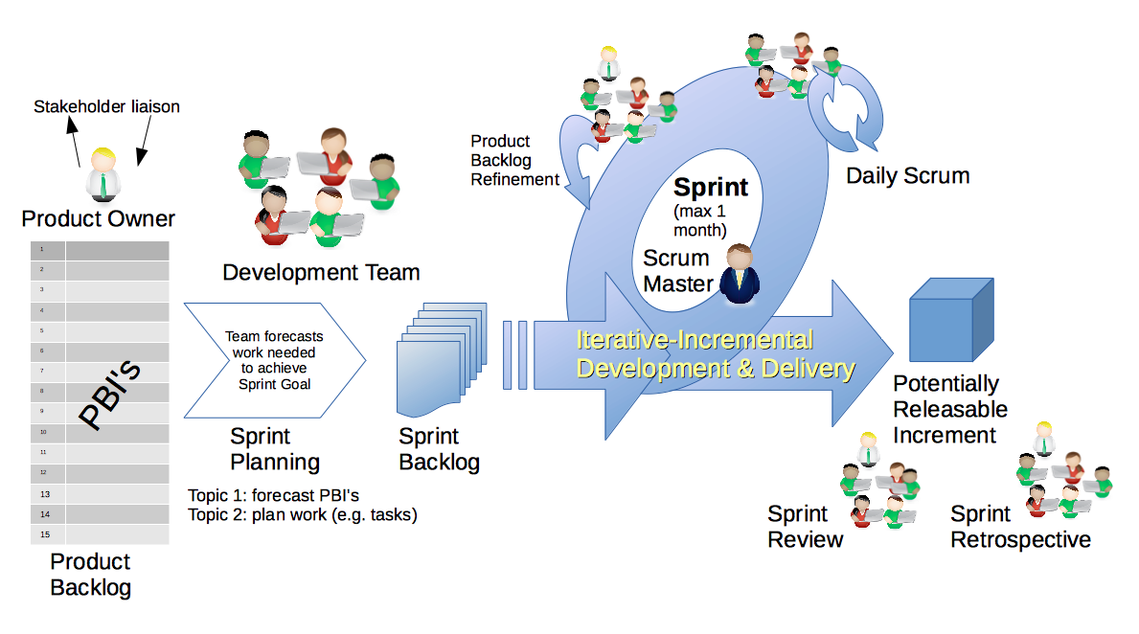
Scrum Process – Sprint Review & Demo
By Dr ian mitchell - Own work, CC BY-SA 4.0, Link

Slide 5
Demo Guidelines – Presenter
Everyone will give at least one demo of their work during the semester.
Your demo should be 2 to 5 minutes and can include any or all of the following:
Show your application running
Comment on your implementation
Show the source code
Explain how you organized the code
Talk about any challenges
You should not prepare slides or a presentation
**You will also need to complete the Demo assignment in Blackboard.

Slide 6
Demo Guidelines – Listener
Everyone will be listening to many demos during the semester.
Your listener responsibilities include:
Actively listening and watching what is being demoed
Be prepared to ask a meaningful yet easy to answer question
Clap for the presenter at the end of the demo and thank them for presenting

Slide 7
Sprint Demos

Slide 8
Complete Sprint Demo Assignment

Slide 9
Scrum Process – Sprint Retrospective
By Dr ian mitchell - Own work, CC BY-SA 4.0, Link

Slide 10
Submission Percentage for Sprint 4

Slide 11
Class Retrospective
Feedback from Assignments & Reflections:
Solid assignment submission numbers
Grades are posted and up to date through sprint 4
Quiz answer are available
Check your current grade and be aware of drop deadlines
Editorial: My goal is to make lab assignments challenging for everyone but to be an “easy grader” on the most challenging requirements

Slide 12
Prework
Next Class:
Complete through activity 7
Be prepared for scrum team Discussion on Brainstorming Final Project ideas
Be prepared for Programming Together with TurtleDraw Lite – Part 1/2
Upcoming:
Monday: Scrum team discussion on Networks
Wednesday: Quiz

Slide 13
Team Retrospective plus Brainstorming Final Project Ideas
Provide your feedback on:
What can we change in the class to make your life better and/or easier?
What is one thing your team can commit to improving on in sprint 5?
Brainstorm at least two Final Project ideas

Slide 14
End of Session

