Slide 1

Preflight Check List
Everyone:
Sign into our Zoom meeting through our integrated Blackboard/Zoom link
Make sure that you can hear the conversation, see shared desktops, and view group chat topics
You will need a headset with a microphone to be able to effectively listen and speak
You will need to be able to share your computer screen
Thank you if you choose to leave your camera on to help make our class more interactive
In person participants also:
Make sure that your microphone and speakers are muted/off so that we don’t get an echo
Sit in a good spot near the classroom ceiling microphones if possible

Slide 2
Agenda:
Prework and Announcements
Software Engineering Perspectives & Priorities
Sprint 5 Planning Q&A
Architectural Analysis Discussions
Final Project Proposals Scrum Team Discussions
Discussion Board 5: Final Project Proposal
Prework for Next Class
Discussion & Questions welcome at any time but please be present with no phones or email during our time together

Slide 3
Prework
Complete through activity 5 prior to next class
Be prepared to discuss analysis
Be prepared to work on Final Project Proposal

Slide 4
Perspectives & Priorities
Perspectives:
Process
Technology
Customer (User)

Slide 5
Perspectives & Priorities
Agile Priorities:
Customer
Technology
Process

Slide 6
Review Activities List and Assignments

Slide 7
Sprint 5 Planning Q&A

Slide 8
Architectural Analysis Discussions

Slide 9
Recall Architecture Analysis Papers
Serverless Computing Analysis
As a team, write a 2+ paper that compares Azure Functions, Google Cloud Functions, and AWS Lamda. Compare and contrast the environments across at least 4 key platform characteristics. One characteristic should be support for the Go language.
The initial section should list team participants and describe each serverless platform. In the second section of your paper, complete a table with each platform across the top and each characteristic listed in priority order (most important first) along the left side of the table. Complete the table for all serverless platforms. Finally, provide a conclusion section that summarizes your findings.
In the space below comment on your personal contribution to the paper before attaching a copy of the paper in MS Word format to this question.

Slide 10
Architectural Analysis Discussions

Slide 11
Saas Layers
Layers:
Presentation
Logic
Data

Slide 12
Architectural Analysis Discussions
Application Name (2 minutes)
Application Purpose and Key Features (10 minutes)
Technology Components (8 minutes)
Notes:
Seating chart and attendance tracker (virtual and in person)

Slide 13
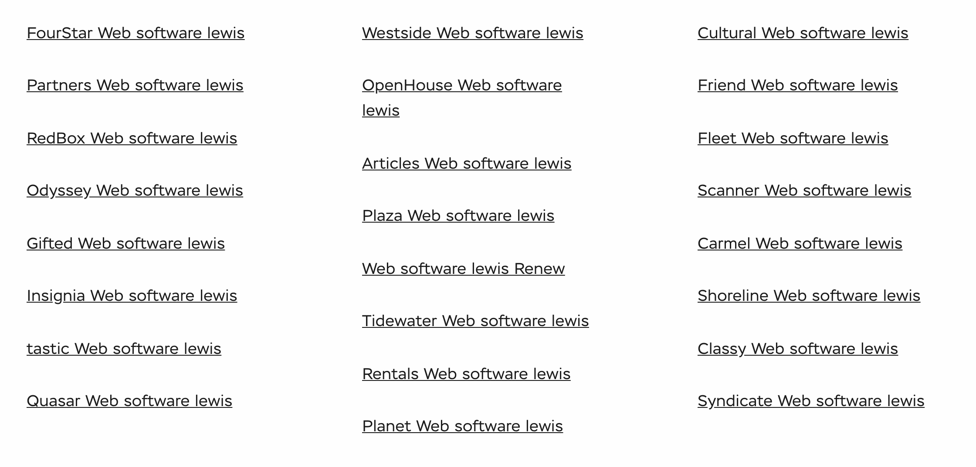
Lab
Final Project Teams and Application Names

Slide 14
Application Purpose and Key Features
Notes:
Seating chart attendance tracker contact tracer
Data driven syllabus creator
Test/Quiz application
Weather, Sports, Valdiator

Slide 15
Technology Components

Slide 16
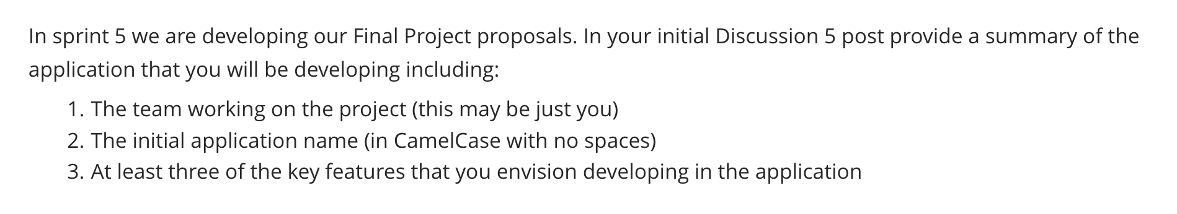
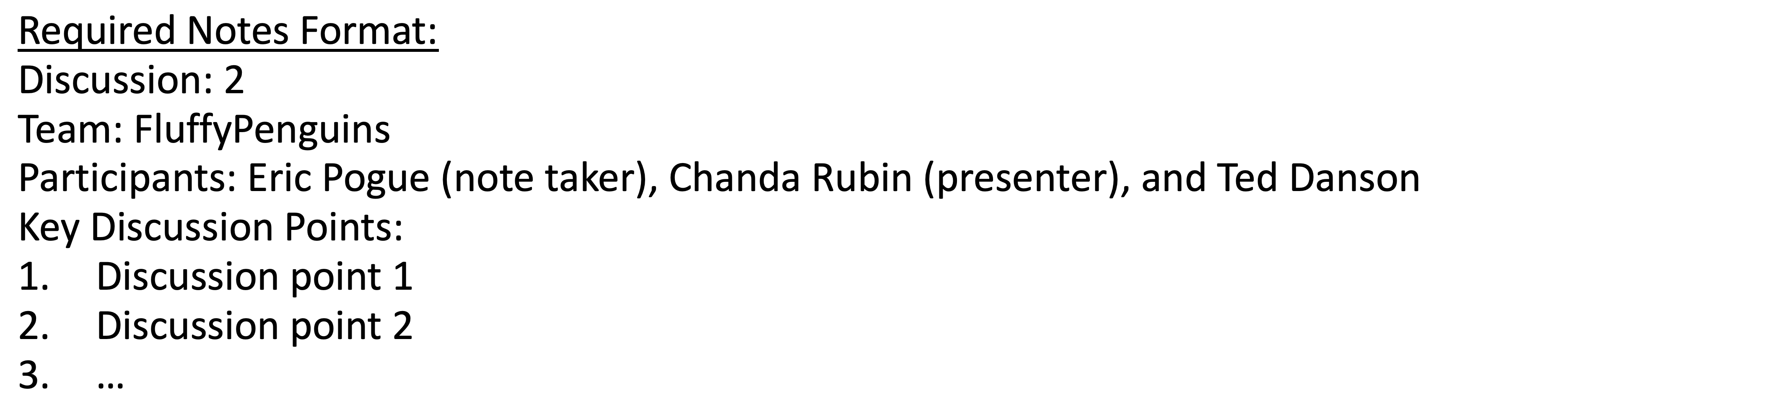
Scrum Team Discussion Board 5
Assign note taker and presenter roles to team members
Review and discuss the discussion topic for this sprint for approximately 10 minutes
Note taker takes notes and presenter prepares a report out summary
Note taker share notes with all participating team members
Each team member pastes and submits exact copy of the notes into their discussion board
Sit back, relax, and tell the note taker and presenter what I wonderful job the did

Slide 17
Report Out
Notes:
Seating chart attendance tracker contact tracer
Data driven syllabus creator
Test/Quiz application
Weather, Sports, Valdiator

Slide 18
Prework For Next Class
Complete through activity 10 prior to next class
Be prepared for a scrum team discussion on React, Docker, and Go
Be prepared for Quiz 5

Slide 19
End of Session

