Slide 1

Preflight Check List
Everyone:
Sign into our Zoom meeting through our integrated Blackboard/Zoom link
Make sure that you can hear the conversation, see shared desktops, and view group chat topics
You will need a headset with a microphone to be able to effectively listen and speak
You will need to be able to share your computer screen
Thank you if you choose to leave your camera on to help make our class more interactive
In person participants also:
Make sure that your microphone and speakers are muted/off so that we don’t get an echo
Sit in a good spot near the classroom ceiling microphones if possible

Slide 2
Preflight Check List
Everyone:
Sign into our Zoom meeting through our integrated Blackboard/Zoom link
Make sure that you can hear the conversation, see shared desktops, and view group chat topics
You will need a headset with a microphone to be able to effectively listen and speak
You will need to be able to share your computer screen
Thank you if you choose to leave your camera on to help make our class more interactive
In person participants also:
Make sure that your microphone and speakers are muted/off so that we don’t get an echo
Sit in a good spot near the classroom ceiling microphones if possible

Slide 3
Agenda:
Prework and Announcements
Programming Together
Discussion Board
Prework for Next Class
Discussion & Questions welcome at any time but please be present with no phones or email during our time together

Slide 4
Prework
Complete through activity 7
Be prepared for scrum team Discussion on Brainstorming Final Project ideas
Be prepared for Programming Together:
SwissArmyKnifeLite
Getters, Setters, and toString (Matt)
Azure Deployment (Ryan)

Slide 5
Programming Together

Slide 6
Final Project Discussions
Application Name (2 minutes)
Application Purpose and Key Features (10 minutes)
Notes:
Seating chart and attendance tracker (virtual and in person)

Slide 7
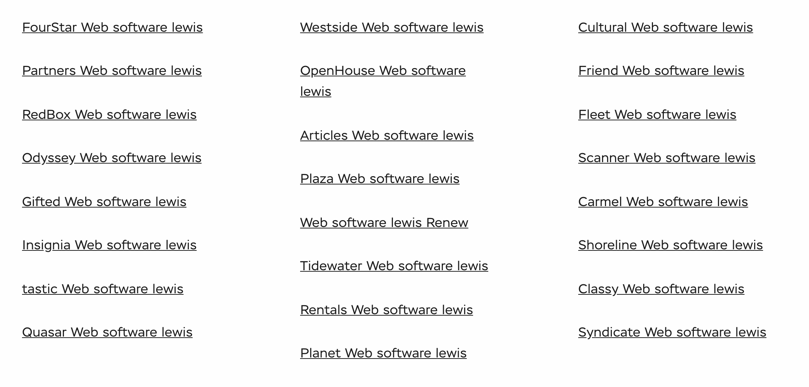
Lab
Final Project Teams and Application Names

Slide 8
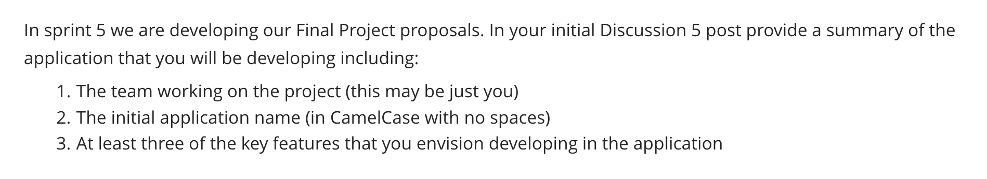
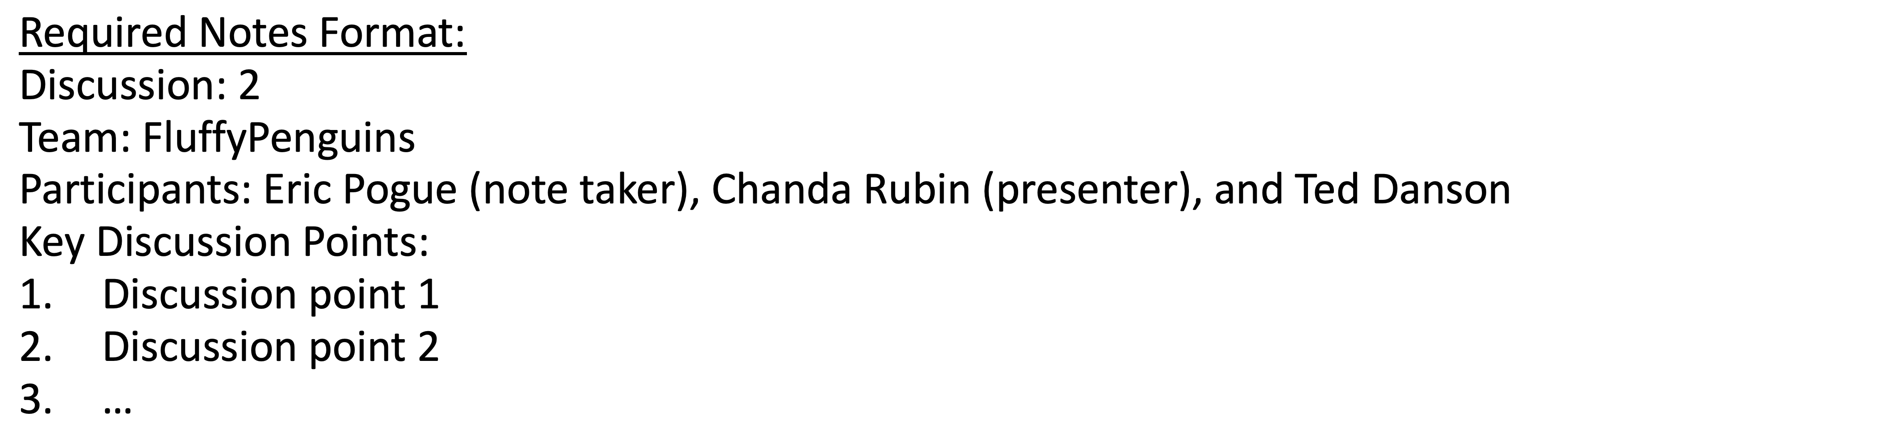
Scrum Team Discussion Board 5
Assign note taker and presenter roles to team members
Review and discuss the discussion topic for this sprint for approximately 10 minutes
Note taker takes notes and presenter prepares a report out summary
Note taker share notes with all participating team members
Each team member pastes and submits exact copy of the notes into their discussion board
Sit back, relax, and tell the note taker and presenter what I wonderful job the did

Slide 9
Report Out
Notes:
Seating chart attendance tracker contact tracer
Data driven syllabus creator
Test/Quiz application
Weather, Sports, Valdiator

Slide 10
Prework
Complete through activity 10+
Be prepared for scrum team discussion of Dale chapter 15 on Networks

Slide 11
End of Session

Slide 12
Agenda:
Prework and Announcements
Sprint 4 Demos
Sprint 4 Retrospective
Prework for Next Class
Team Retrospective plus Brainstorming Final Project Ideas
Discussion & Questions welcome at any time but please be present with no phones or email during our time together

Slide 13
Prework For Next Class
Complete through activity 4 prior to next class
Focus on ideas starting your final project proposal
Be prepared for demos & retrospective

Slide 14
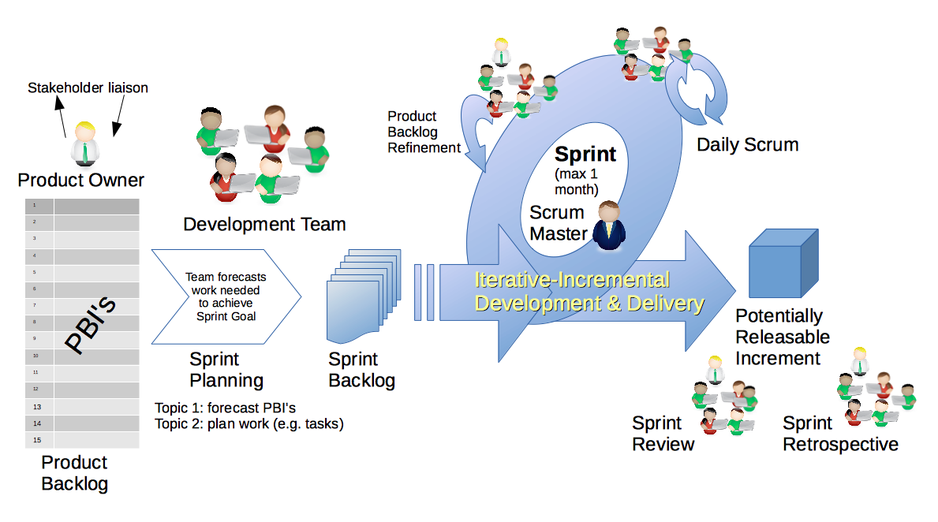
Scrum Process – Sprint Review & Demo
By Dr ian mitchell - Own work, CC BY-SA 4.0, Link

Slide 15
Demo Guidelines – Presenter
Everyone will give at least one demo of their work during the semester.
Your demo should be 2 to 5 minutes and can include any or all of the following:
Show your application running
Comment on your implementation
Show the source code
Explain how you organized the code
Talk about any challenges
You should not prepare slides or a presentation

Slide 16
Demo Guidelines – Listener
Everyone will be listening to many demos during the semester.
Your listener responsibilities include:
Actively listening and watching what is being demoed
Be prepared to ask a meaningful yet easy to answer question
Clap for the presenter at the end of the demo and thank them for presenting

Slide 17
Sprint Demos

Slide 18
Complete Sprint Demo Assignment

Slide 19
Scrum Process – Sprint Retrospective
By Dr ian mitchell - Own work, CC BY-SA 4.0, Link

Slide 20
Submission Percentage for Sprint 4

Slide 21
Class Retrospective
Feedback from Assignments & Reflections:
Solid assignment submission numbers
Grades are posted but comments are weak
Quiz answer should be available now and you may email me with questions
Check your current grade and be aware of drop date deadlines
Editorial: My goal is to make lab assignments challenging for everyone but to be an “easy grader” on the most challenging requirements

Slide 22
Prework
Complete through activity 7
Be prepared for scrum team Discussion on Brainstorming Final Project ideas
Be prepared for Programming Together:
SwissArmyKnifeLite, Getters, Setters, and toString (Matt)
Azure Deployment (Ryan)

Slide 23
Team Retrospective plus Brainstorming Final Project Ideas
Provide your feedback on:
What can we change in the class to make your life better and/or easier?
What is one thing your team can commit to improving on in sprint 5?
Brainstorm at least two Final Project ideas

Slide 24
End of Session

