Slide 1

Preflight Check List
Everyone:
Sign into our Zoom meeting through our integrated Blackboard/Zoom link
Make sure that you can hear the conversation, see shared desktops, and view group chat topics
You will need a headset with a microphone to be able to effectively listen and speak
You will need to be able to share your computer screen
Thank you if you choose to leave your camera on to help make our class more interactive
In person participants also:
Make sure that your microphone and speakers are muted/off so that we don’t get an echo
Sit in a good spot near the classroom ceiling microphones if possible
Start Recording

Slide 2
Agenda:
Prework and Announcements
Friendly Conversation Topic
Scrum Team Review CI/CD, Configuration Management, and Version Control Systems
Networks Protocols and Serverless Functions
Scrum Team Discussion 6
Prework for Next Class
Discussion & Questions welcome at any time but please be present with no phones or email during our time together

Slide 3
Prework For Next Class
Complete through activity 9 prior to next class
Be prepared for a scrum team discussion on:
Continuous Integration and Continuous Deployment (CI/CD)
Be prepared for scrum team Discussion 6

Slide 4
Friendly Conversation Topic
Who made the following statement?
This is my reality. I am not an emotionally empathetic kind of person and that probably doesn't come as a big surprise to anybody. Least of all me. The fact that I then misread people and don't realize (for years) how badly I've judged a situation and contributed to an unprofessional environment is not good. This week people in our community confronted me about my lifetime of not understanding emotions. My flippant attacks in emails have been both unprofessional and uncalled for. Especially at times when I made it personal. In my quest for a better patch, this made sense to me. I know now this was not OK and I am truly sorry. The above is basically a long-winded way to get to the somewhat painful personal admission that hey, I need to change some of my behavior, and I want to apologize to the people that my personal behavior hurt and possibly drove away from kernel development entirely. I am going to take time off and get some assistance on how to understand people’s emotions and respond appropriately.

Slide 5

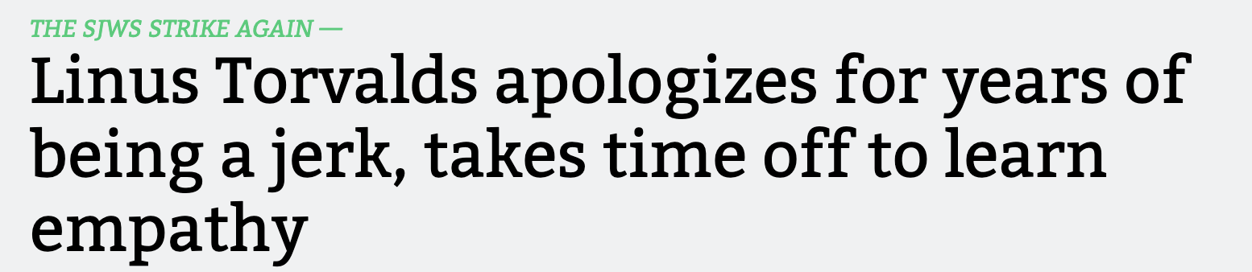
Friendly Conversation Topic

Slide 6

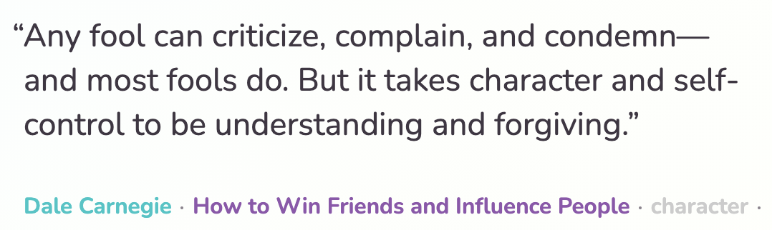
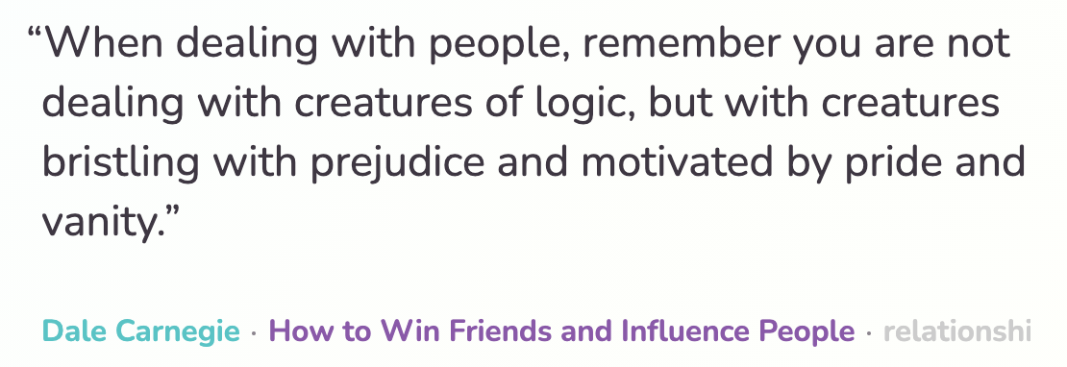

Slide 7
Scrum Team Review
Assign presenter
Team reviews key topics using “team number by percent of content” method
Team sits back, relaxes, and acknowledges the bravery and dedication of the presenter
Scrum Team Review CI/CD, Configuration Management, and Version Control Systems
CI/CD
The importance of Branching is VCS systems
Specialization vs generalization in Agile vs Waterfall/Iterative
Configuration Management
Project Managers including the relative importance of PMs in Agile vs Waterfall/Iterative
Agile, Scrum, XP (Extreme Programming), and Paired Programming

Slide 8
Waterfall vs Iterative vs Agile Requirements
 | Waterfall | Iterative | Agile
References | United States Department of Defense: DOD-STD-2167A (1985) | Rational Unified Process (RUP) Open Unified Process | Scrum Kanban Scaled Agile Framework (SAFe)
Priorities | Planning and predictability | Architecture, modeling, and efficiency through early detection & fixing of issues (verification) | Responsiveness to feedback, efficiency through engineering practices, early detection & fixing of issues, and validation
Principles | Execute phases sequentially: Requirements Analysis Design Coding Testing and Operations Define and commit to Scope, Cost, and Timeline “early” Implement strict Change Control | Manage requirements Develop and test iteratively Use components Model visually Verify quality Control changes | Capture lightweight near term requirements Allow requirements to evolve but maintain fixed timelines Develop, test, deploy, and release iteratively Empower teams Apply engineering practices and systems thinking Integrate early user feedback into remaining plan Maintain a collaborative approach between all stakeholders
Notes:
The views on testing and change management have changed dramatically as organizations have moved from Waterfall to Iterative to Agile development lifecycles.
Successful Agile (and Iterative) Development REQUIRES better application design, development techniques, and testing practices.
Testing and lack of defects are not the end goal. A higher quality more usable more cost-effective product is the goal.
Requirements:
Waterfall:
Full project requirements upfront
Inconsistent industry capture techniques
Tend to be verbose requirements with formal signoff
Change requests needed
Estimation bottom up detailed estimates sometimes function points
Iterative:
Mostly upfront

Slide 9
Git & GitHub Branching and Verification

Slide 10
Project Management & Architecture/Design
Project management is the practice of initiating, planning, executing, controlling, and closing the work of a team to achieve specific goals and meet specific success criteria at the specified time. The primary challenge of project management is to achieve all of the project goals within the given constraints.^{[1]} This information is usually described in project documentation, created at the beginning of the development process. The primary constraints are scope, time, quality and budget.^{[2]}
The objective of project management is to produce a complete project which complies with the client's objectives. In many cases the objective of project management is also to shape or reform the client's brief to feasibly address the client's objectives. Once the client's objectives are clearly established, they should influence all decisions made by other people involved in the project.
From Wikipedia, the free encyclopedia
Notes:
What is the term that Jeremy used for doing it in the place?

Slide 11
Plan & Document Project Management Monitoring & Control (continued)
A project is a temporary endeavor designed to produce a unique product, service or result with a defined beginning and end (usually time-constrained, and often constrained by funding or staffing) undertaken to meet unique goals and objectives, typically to bring about beneficial change or added value.^{[3][4]} The temporary nature of projects stands in contrast with business as usual (or operations),^{[5]} which are repetitive, permanent, or semi-permanent functional activities to produce products or services. In practice, the management of such distinct production approaches requires the development of distinct technical skills and management strategies.^{[6]}
From Wikipedia, the free encyclopedia
Notes:
Product Focus versus Project Focus

Slide 12
Agile, Scrum, XP (Extreme Programming), and Paired Programming

Slide 13
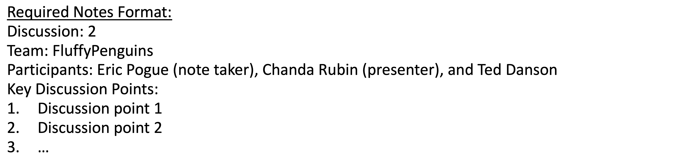
Scrum Team Discussion Board 6
Assign note taker and presenter roles to team members
Review and discuss the discussion topic for this sprint for approximately 10 minutes
Note taker takes notes and presenter prepares a report out summary
Note taker share notes with all participating team members
Each team member pastes and submits exact copy of the notes into their discussion board
Presenter reports out

Slide 14
Discussion 6 Report Out

Slide 15
Prework
Complete through activity 10
Be prepared for Quiz 6
Be prepared for Sprint 7 Planning

Slide 16
End of Session

Slide 17
Agenda:
Prework and Announcements
Sprint 5 Demos
Sprint 5 Retrospective
Sprint 6 Planning
Prework for Next Class
Programming Together with React, Azure, and Yarn
Discussion & Questions welcome at any time but please be present with no phones or email during our time together

Slide 18
Prework
Everything is due Sunday!
Be prepared for sprint 5 demos
Be prepared for sprint 6 planning

Slide 19
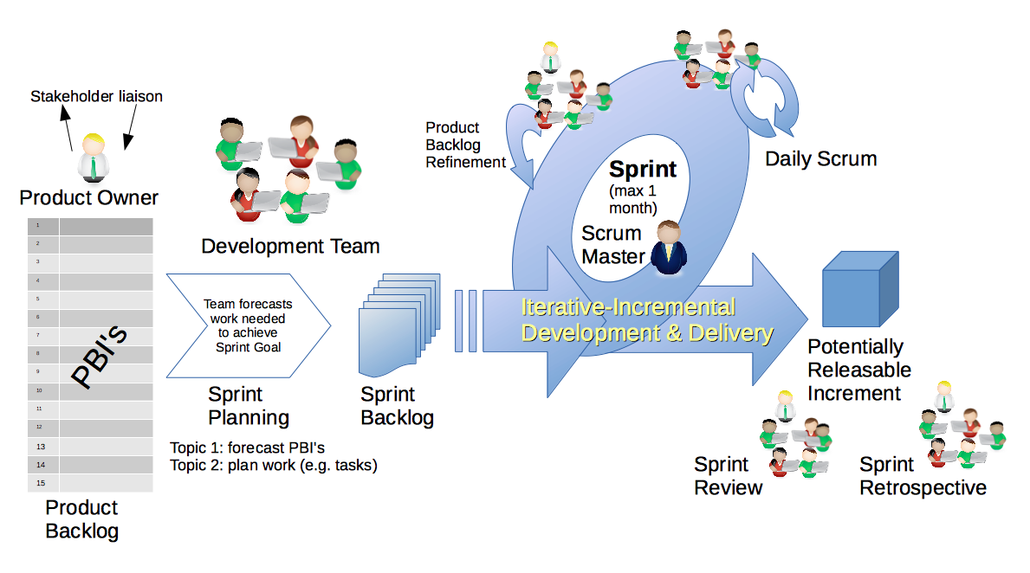
Scrum Process – Sprint Review & Demo
By Dr ian mitchell - Own work, CC BY-SA 4.0, Link

Slide 20
Demo Guidelines – Presenter
Everyone will give at least one demo of their work during the semester.
Your demo should be 2 to 5 minutes and can include any or all of the following:
Show your application running
Comment on your implementation
Show the source code
Explain how you organized the code
Talk about any challenges
You should not prepare slides or a presentation
**You will also need to complete the Demo assignment in Blackboard.

Slide 21
Demo Guidelines – Listener
Everyone will be listening to many demos during the semester.
Your listener responsibilities include:
Actively listening and watching what is being demoed
Come up with a meaningful yet easy to answer question
Ask your question if the presenter does not get sufficient questions from other listeners
Do not ask hard question or attempt to review the presenters code
Clap for the presenter at the end of the demo and thank them for presenting
Optionally follow up with the presenter later if you have what could be more difficult questions or if you have suggestions

Slide 22
Sprint Demos
Plus Product Demos (as needed)

Slide 23
Complete Sprint Demo Assignment

Slide 24
Scrum Process – Sprint Retrospective
By Dr ian mitchell - Own work, CC BY-SA 4.0, Link

Slide 25
Submission Percentage for Sprint 4

Slide 26
Submission Percentage for Sprint 5

Slide 27
Class Retrospective
Feedback from Assignments & Reflections:
Wonderful submission numbers!
Grades are posted for Discussion, Quiz, and Reflections
Quiz answer should be available now… email me with questions or comments about the quiz
Grades for Labs will be posted after demos

Slide 28
Scrum Team Retrospective
Provide your feedback on:
What is one thing your team can commit to improving
Do you have a new scrum master
Ideas for recognizing extra effort… and encouraging engagement?
What could we do to celebrate a perfect submission metric?
What stories from sprint 0 did not get completed, and do they need to be added to sprint 1?

Slide 29
Sprint Planning

Slide 30
Sprint Planning
Sprint 6:
Similar to last sprint including Discussion, Quiz, Lab, and Reflection
No class Thursday, Friday, or Monday will be a challenge
Initial Discussion post not due until the end of class Tuesday

Slide 31
Scrum Process – Sprint Planning
By Dr ian mitchell - Own work, CC BY-SA 4.0, Link

Slide 32
Review Activities List and Assignments

Slide 33
Prework For Next Class
Complete through activity 9 prior to next class
Be prepared for a scrum team discussion on:
Continuous Integration and Continuous Deployment (CI/CD)
Be prepared for scrum team Discussion 6

Slide 34
Programming Together with
React, Azure, and Yarn

Slide 35
End of Session

