Slide 1

Preflight Check List
Everyone:
Sign into our Zoom meeting through our integrated Blackboard/Zoom link
Make sure that you can hear the conversation, see shared desktops, and view group chat topics
You will need a headset with a microphone to be able to effectively listen and speak
You will need to be able to share your computer screen
Thank you if you choose to leave your camera on to help make our class more interactive
In person participants also:
Make sure that your microphone and speakers are muted/off so that we don’t get an echo
Sit in a good spot near the classroom ceiling microphones if possible
Start Recording

Slide 2
Agenda:
Prework and Announcements
Friendly Conversation Topic
Scrum Team Review Project Management, Scrum, Pairs, and Version Control Systems
Networks Protocols and Serverless Functions (as time allows)
Scrum Team Discussion 6
Prework for Next Class
Discussion & Questions welcome at any time but please be present with no phones or email during our time together

Slide 3
Prework and Announcements
Complete through activity 7 prior to next class
Be prepared for a scrum team discussion on:
Chapter 10 of Fox on Project Management, Scrum, Pairs, and Version Control Systems
Be prepared for scrum team Discussion 6

Slide 4
Friendly Conversation Topic
Who made the following statement?
This is my reality. I am not an emotionally empathetic kind of person and that probably doesn't come as a big surprise to anybody. Least of all me. The fact that I then misread people and don't realize (for years) how badly I've judged a situation and contributed to an unprofessional environment is not good. This week people in our community confronted me about my lifetime of not understanding emotions. My flippant attacks in emails have been both unprofessional and uncalled for. Especially at times when I made it personal. In my quest for a better patch, this made sense to me. I know now this was not OK and I am truly sorry. The above is basically a long-winded way to get to the somewhat painful personal admission that hey, I need to change some of my behavior, and I want to apologize to the people that my personal behavior hurt and possibly drove away from kernel development entirely. I am going to take time off and get some assistance on how to understand people’s emotions and respond appropriately.

Slide 5

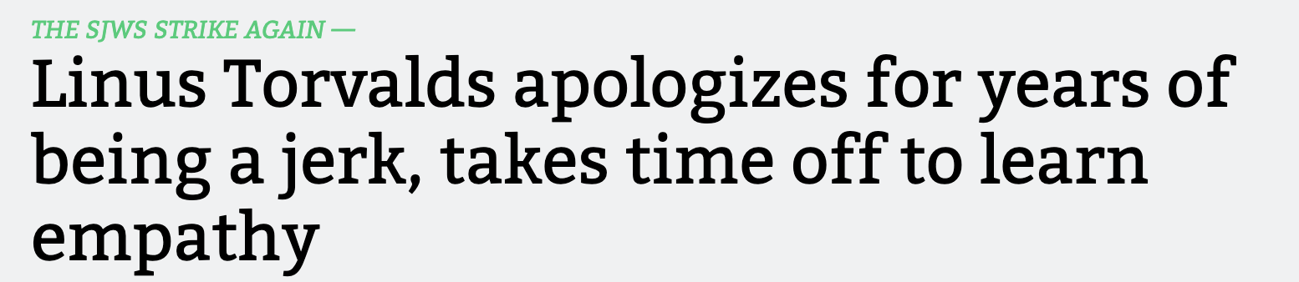
Friendly Conversation Topic

Slide 6

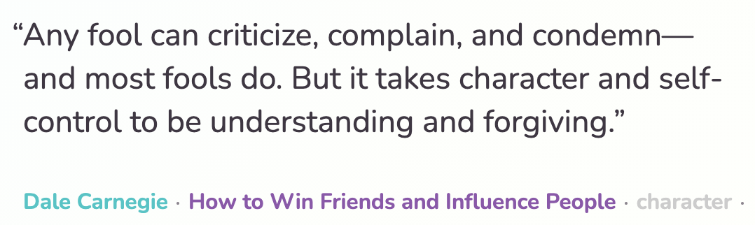


Slide 7
Scrum Team Review
Assign presenter
Team reviews key topics using “team number by percent of content” method
Team sits back, relaxes, and acknowledges the bravery and dedication of the presenter
Chapter 10 of Fox on Project Management, Scrum, Pairs, and Version Control Systems
Team Sizes, SDLCs, and key Scrum Roles
Key rituals including daily stand-up meetings… what are the three questions?
The priority of specialization vs generalization in Agile vs Waterfall/Iterative
Project Managers including the relative importance of PMs in Agile vs Waterfall/Iterative
Configuration Management
The importance of Branching is VCS systems (which VCS focused on branching)
Where should pared programming fit into the development process
The two most important book on managing people and conflict (according to the author)

Slide 8
Waterfall vs Iterative vs Agile Requirements
 | Waterfall | Iterative | Agile
References | United States Department of Defense: DOD-STD-2167A (1985) | Rational Unified Process (RUP) Open Unified Process | Scrum Kanban Scaled Agile Framework (SAFe)
Priorities | Planning and predictability | Architecture, modeling, and efficiency through early detection & fixing of issues (verification) | Responsiveness to feedback, efficiency through engineering practices, early detection & fixing of issues, and validation
Principles | Execute phases sequentially: Requirements Analysis Design Coding Testing and Operations Define and commit to Scope, Cost, and Timeline “early” Implement strict Change Control | Manage requirements Develop and test iteratively Use components Model visually Verify quality Control changes | Capture lightweight near term requirements Allow requirements to evolve but maintain fixed timelines Develop, test, deploy, and release iteratively Empower teams Apply engineering practices and systems thinking Integrate early user feedback into remaining plan Maintain a collaborative approach between all stakeholders
Notes:
The views on testing and change management have changed dramatically as organizations have moved from Waterfall to Iterative to Agile development lifecycles.
Successful Agile (and Iterative) Development REQUIRES better application design, development techniques, and testing practices.
Testing and lack of defects are not the end goal. A higher quality more usable more cost-effective product is the goal.
Requirements:
Waterfall:
Full project requirements upfront
Inconsistent industry capture techniques
Tend to be verbose requirements with formal signoff
Change requests needed
Estimation bottom up detailed estimates sometimes function points
Iterative:
Mostly upfront

Slide 9
Plan & Document Project Management Monitoring & Control
Project management is the practice of initiating, planning, executing, controlling, and closing the work of a team to achieve specific goals and meet specific success criteria at the specified time. The primary challenge of project management is to achieve all of the project goals within the given constraints.^{[1]} This information is usually described in project documentation, created at the beginning of the development process. The primary constraints are scope, time, quality and budget.^{[2]}
The objective of project management is to produce a complete project which complies with the client's objectives. In many cases the objective of project management is also to shape or reform the client's brief to feasibly address the client's objectives. Once the client's objectives are clearly established, they should influence all decisions made by other people involved in the project.
From Wikipedia, the free encyclopedia
Notes:
What is the term that Jeremy used for doing it in the place?

Slide 10
Plan & Document Project Management Monitoring & Control (continued)
A project is a temporary endeavor designed to produce a unique product, service or result with a defined beginning and end (usually time-constrained, and often constrained by funding or staffing) undertaken to meet unique goals and objectives, typically to bring about beneficial change or added value.^{[3][4]} The temporary nature of projects stands in contrast with business as usual (or operations),^{[5]} which are repetitive, permanent, or semi-permanent functional activities to produce products or services. In practice, the management of such distinct production approaches requires the development of distinct technical skills and management strategies.^{[6]}
From Wikipedia, the free encyclopedia
Notes:
Product Focus versus Project Focus

Slide 11
Git & GitHub Branching and Verification

Slide 13
Network Protocols & Serverless Functions (as time allows)

Slide 14
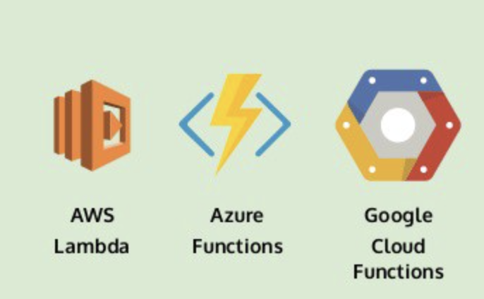
Preview Serverless Functions
Notes:
Review activity list item.

Slide 15
Network Architecture & Protocols

Slide 16

Foreshadowing Web Services
In a web service, the Web technology such as HTTP and HTTPS — originally designed for human-to-machine communication—is utilized for machine-to-machine RPC communication, more specifically for transferring machine-readable file formats such as XML and JSON.

Slide 17
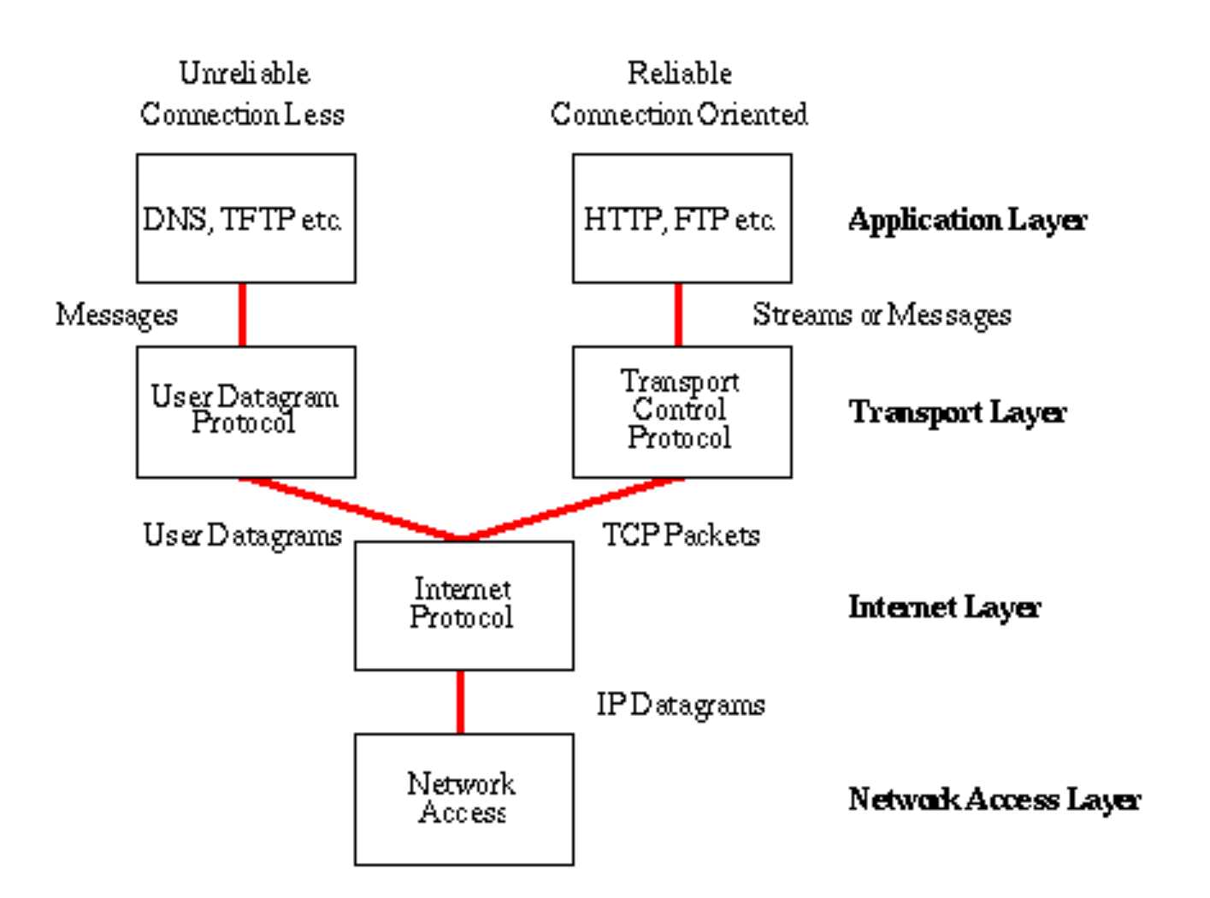
Network Architecture – The Internet
The Internet [link]
IP (Internet Protocol) [link]
TCP (Transmission Control Protocol) [link]
TCP/IP
UDP (User Datagram Protocol) [link]
UDP/IP
TCP/IP or UDP/IP Socket [link]
TCP and UDP Protocols & Port Numbers [link]

Slide 18
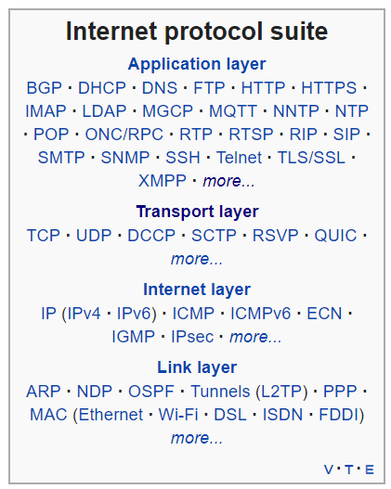
Network Architecture – The Web
The Web [link]
HTTP (Hypertext Transfer Protocol) [link]
DNS (Domain Name System) [link]
HTML (Hypertext Markup Language) [link]
CSS (Cascading Style Sheets) [link]
JavaScript [link]
Internet Protocol Suite [link]

Slide 19
Network Architecture – Distributed Computing
RPC (Remote procedure call) [link]
… SOA (service-oriented architecture) version 1
Java RMI (Java remote method invocation) [link]
DCOM (Distributed Component Object Model) [link]
CORBA (Common Object Request Broker Architecture) [link]
… [The Web takes over the world]
XML (Extensible Markup Language) [link]
XML-RPC (XML & HTTP) [link]
Internet Protocol Suite [link]

Slide 20
Network Architecture – Web Services
Web Services [link]
…SOA (service-oriented architecture) version 2
XML (Extensible Markup Language) [link]
XML-RPC (XML & HTTP) [link]
SOAP (Simple Object Access Protocol) [link]
JSON (JavaScript Object Notation) [link]
REST (Representational State Transfer) [link]
Internet Protocol Suite [link]

Slide 21
Network Architecture – Back to the Future
Web Services [link]
…SOA (service-oriented architecture) version 2 [link]
JSON (JavaScript Object Notation) [link]
REST (Representational State Transfer) [link]
gRPC [link] Or https://grpc.io/faq/
REST vs gRPC
REST vs. gRPC: Battle of the APIs [link]
Evaluating Performance of REST vs. gRPC [link]
Internet Protocol Suite [link]

Slide 22
Web Services, REST, SOAP, and CORs

Slide 23
Web Services
In a web service, the Web technology such as HTTP—originally designed for human-to-machine communication—is utilized for machine-to-machine communication, more specifically for transferring machine-readable file formats such as XML and JSON.
In practice, a web service commonly provides an object-oriented web-based interface to a database server, utilized for example by another web server, or by a mobile app, that provides a user interface to the end user.
Many organizations that provide data in formatted HTML pages will also provide that data on their server as XML or JSON, often through a web service to allow syndication

Slide 24
REST vs. SOAP

Slide 25
REST
Representational State Transfer (REST) is an architectural style that defines a set of constraints and properties based on HTTP. Other kinds of web services, such as SOAP web services, expose their own arbitrary sets of operations.
"Web resources" were first defined on the World Wide Web as documents or files identified by their URLs. However, today they have a much more generic and abstract definition that encompasses every thing or entity that can be identified, named, addressed, or handled, in any way whatsoever, on the web. In a RESTful web service, requests made to a resource's URI will elicit a response that may be in HTML, XML, JSON, or some other format. The response may confirm that some alteration has been made to the stored resource, and the response may provide hypertext links to other related resources or collections of resources. When HTTP is used, as is most common, the operations available are GET, POST, PUT, DELETE, and other predefined CRUD HTTP methods.
By using a stateless protocol and standard operations, REST systems aim for fast performance, reliability, and the ability to grow, by re-using components that can be managed and updated without affecting the system as a whole, even while it is running.

Slide 26


CORS
Cross-Origin Resource Sharing (CORS): CORS is a mechanism that uses additional HTTP headers to tell a browser to let a web application running at one origin (domain) have permission to access selected resources from a server at a different origin. A web application makes a cross-origin HTTP request when it requests a resource that has a different origin (domain, protocol, and port) than its own origin.
An example of a cross-origin request: The frontend JavaScript code for a web application served from http://domain-a.com uses XMLHttpRequest to make a request for http://api.domain-b.com/data.json.
For security reasons, browsers restrict cross-origin HTTP requests initiated from within scripts. For example, XMLHttpRequest and the Fetch API follow the same-origin policy. This means that a web application using those APIs can only request HTTP resources from the same origin the application was loaded from, unless the response from the other origin includes the right CORS headers.
Notes:
https://developer.mozilla.org/en-US/docs/Web/HTTP/CORS
https://www.youtube.com/watch?v=o8puzjzpjqo

Slide 27
Serverless Functions

Slide 28
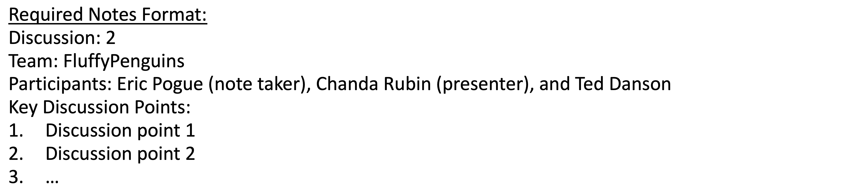
Scrum Team Discussion Board 6
Assign note taker and presenter roles to team members
Review and discuss the discussion topic for this sprint for approximately 10 minutes
Note taker takes notes and presenter prepares a report out summary
Note taker share notes with all participating team members
Each team member pastes and submits exact copy of the notes into their discussion board
Presenter reports out

Slide 29
Discussion 6 Report Out

Slide 30
Prework
Complete through activity 10
Be prepared for Quiz 6
Be prepared for Sprint 7 Planning

Slide 31
End of Session

