Slide 1

Preflight Check List
Everyone:
Sign into our Zoom meeting through our integrated Blackboard/Zoom link
Make sure that you can hear the conversation, see shared desktops, and view group chat topics
You will need a headset with a microphone to be able to effectively listen and speak
You will need to be able to share your computer screen
Thank you if you choose to leave your camera on to help make our class more interactive
In person participants also:
Make sure that your microphone and speakers are muted/off so that we don’t get an echo
Sit in a good spot near the classroom ceiling microphones if possible
Start Recording

Slide 2
Agenda:
Prework and Announcements
Scrum Team Review Performance and Multithreading
The Internet, The Web, Web Services, and REST
Scrum Team Discussion 6
Prework for Next Class
Programming Together with Azure Hosting of Final Project Proposals
Discussion & Questions welcome at any time but please be present with no phones or email during our time together

Slide 3
Prework and Announcements

Slide 4
Prework
Enjoy your Easter holiday!
Complete through activity list item 6
Prior to next class complete SwissArmyKnife version 2 requirements 1 through 4
Be prepared for scrum team discussion of Performance and Multithreading
Be prepared for scrum team Discussion 6… your initial Discussion 6 is due by the end of class
Upcoming:
Friday & Monday: No class
Wednesday: See above prework
Friday: Quiz 6 plus Programming Together with adding hosted JSON files to our index

Slide 5
Scrum Team Review
Assign presenter
Team reviews key topics using “team number by percent of content” method
Team sits back, relaxes, and acknowledges the bravery and dedication of the presenter
Performance and Multithreading... Why do you care?
Understand performance optimization, threads, and how to develop and optimize multi-treaded Java applications
Single threaded vs. Multithreaded Development
Multithreaded development challenges
Suggested Multithreading Exercise

Slide 6
What’s a RPC?

Slide 7
The Internet, The Web, Web Services, and REST

Slide 8
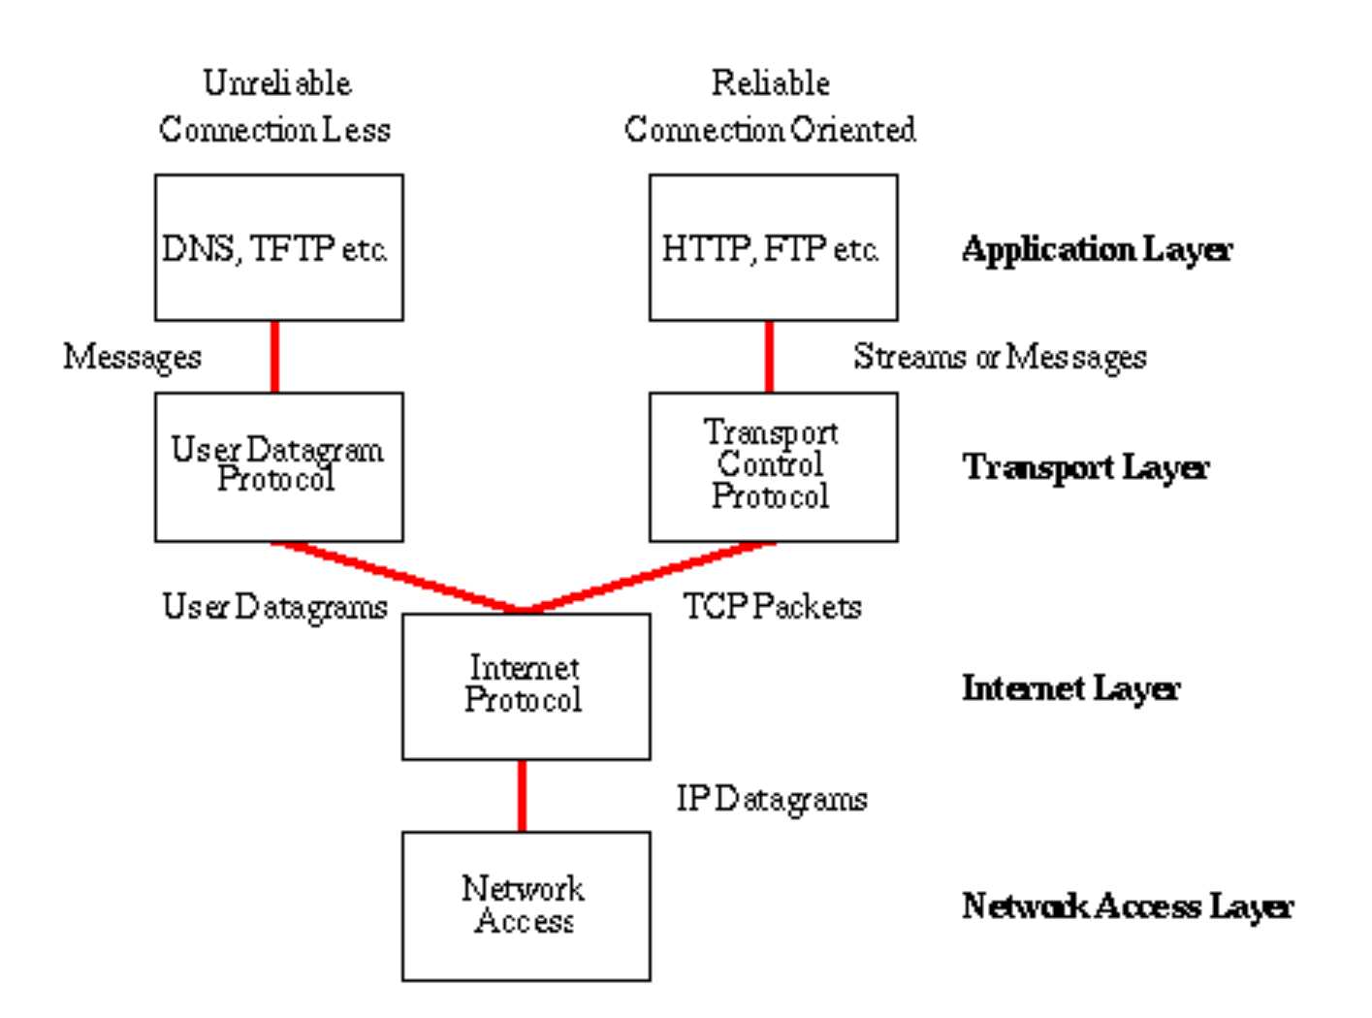
Network Architecture – The Internet
The Internet [link]
IP (Internet Protocol) [link]
TCP (Transmission Control Protocol) [link]
TCP/IP
UDP (User Datagram Protocol) [link]
UDP/IP
TCP/IP or UDP/IP Socket [link]
TCP and UDP Protocols & Port Numbers [link]

Slide 9
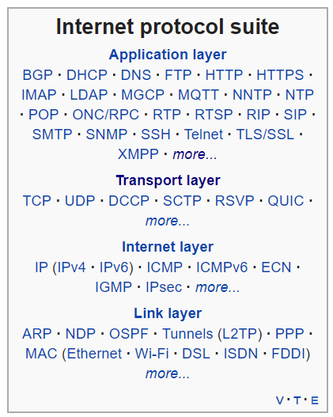
Network Architecture – The Web
The Web [link]
HTTP (Hypertext Transfer Protocol) [link]
DNS (Domain Name System) [link]
HTML (Hypertext Markup Language) [link]
CSS (Cascading Style Sheets) [link]
JavaScript [link]
Internet Protocol Suite [link]

Slide 10
Network Architecture – Distributed Computing
RPC (Remote procedure call) [link]
… SOA (service-oriented architecture) version 1
Java RMI (Java remote method invocation) [link]
DCOM (Distributed Component Object Model) [link]
CORBA (Common Object Request Broker Architecture) [link]
… [The Web takes over the world]
XML (Extensible Markup Language) [link]
XML-RPC (XML & HTTP) [link]
Internet Protocol Suite [link]

Slide 11
Network Architecture – Web Services
Web Services [link]
…SOA (service-oriented architecture) version 2
XML (Extensible Markup Language) [link]
XML-RPC (XML & HTTP) [link]
SOAP (Simple Object Access Protocol) [link]
JSON (JavaScript Object Notation) [link]
REST (Representational State Transfer) [link]
Internet Protocol Suite [link]

Slide 12
Network Architecture – Back to the Future
Web Services [link]
…SOA (service-oriented architecture) version 2 [link]
JSON (JavaScript Object Notation) [link]
REST (Representational State Transfer) [link]
gRPC [link] Or https://grpc.io/faq/
REST vs gRPC
REST vs. gRPC: Battle of the APIs [link]
Evaluating Performance of REST vs. gRPC [link]
Internet Protocol Suite [link]

Slide 13
Web Services, REST, SOAP, and CORs

Slide 14

Web Services
In a web service, the Web technology such as HTTP—originally designed for human-to-machine communication—is utilized for machine-to-machine communication, more specifically for transferring machine-readable file formats such as XML and JSON.
In practice, a web service commonly provides an object-oriented web-based interface to a database server, utilized for example by another web server, or by a mobile app, that provides a user interface to the end user.
Many organizations that provide data in formatted HTML pages will also provide that data on their server as XML or JSON, often through a web service to allow syndication

Slide 15
REST and Soap

Slide 16
REST
Representational State Transfer (REST) is an architectural style that defines a set of constraints and properties based on HTTP. Other kinds of web services, such as SOAP web services, expose their own arbitrary sets of operations.
"Web resources" were first defined on the World Wide Web as documents or files identified by their URLs. However, today they have a much more generic and abstract definition that encompasses every thing or entity that can be identified, named, addressed, or handled, in any way whatsoever, on the web. In a RESTful web service, requests made to a resource's URI will elicit a response that may be in HTML, XML, JSON, or some other format. The response may confirm that some alteration has been made to the stored resource, and the response may provide hypertext links to other related resources or collections of resources. When HTTP is used, as is most common, the operations available are GET, POST, PUT, DELETE, and other predefined CRUD HTTP methods.
By using a stateless protocol and standard operations, REST systems aim for fast performance, reliability, and the ability to grow, by re-using components that can be managed and updated without affecting the system as a whole, even while it is running.

Slide 17


CORS
Cross-Origin Resource Sharing (CORS): CORS is a mechanism that uses additional HTTP headers to tell a browser to let a web application running at one origin (domain) have permission to access selected resources from a server at a different origin. A web application makes a cross-origin HTTP request when it requests a resource that has a different origin (domain, protocol, and port) than its own origin.
An example of a cross-origin request: The frontend JavaScript code for a web application served from http://domain-a.com uses XMLHttpRequest to make a request for http://api.domain-b.com/data.json.
For security reasons, browsers restrict cross-origin HTTP requests initiated from within scripts. For example, XMLHttpRequest and the Fetch API follow the same-origin policy. This means that a web application using those APIs can only request HTTP resources from the same origin the application was loaded from, unless the response from the other origin includes the right CORS headers.
Notes:
https://developer.mozilla.org/en-US/docs/Web/HTTP/CORS
https://www.youtube.com/watch?v=o8puzjzpjqo

Slide 18
What’s a RPC?

Slide 19
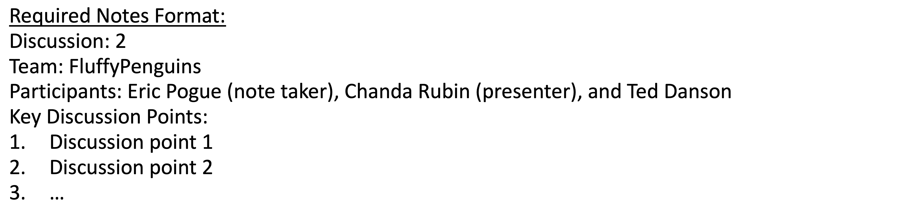
Scrum Team Discussion Board 6
Assign note taker and presenter roles to team members
Review and discuss the discussion topic
Note taker takes notes and presenter prepares a brief report out summary
Note taker share notes with all participating team members
Each team member pasts and submits exact copy of the notes in their discussion board
Presenter reports out

Slide 20
Prework for Next Class

Slide 21
Prework
Complete through activity list item 10
Be prepared for Quiz 6
Be prepared for scrum team review of Object-Oriented Programming Languages and Platforms
Be prepared for Programming Together
Upcoming:
Everything is due Sunday

Slide 22
Programming Together
Azure Hosting personal JSON files
Updating index with links

Slide 23
End of Session

