Slide 1

Preflight Check List
Everyone:
Sign into our Zoom meeting through our integrated Blackboard/Zoom link
Make sure that you can hear the conversation, see shared desktops, and view group chat topics
You will need a headset with a microphone to be able to effectively listen and speak
You will need to be able to share your computer screen
Thank you if you choose to leave your camera on to help make our class more interactive
In person participants also:
Make sure that your microphone and speakers are muted/off so that we don’t get an echo
Sit in a good spot near the classroom ceiling microphones if possible
Start Recording

Slide 2
Agenda:
Prework and Announcements
Foreshadowing Sprint 2 Planning Activities
Quiz 6
Scrum Team Sprint 2 Planning
Prework for Next Class
Discussion & Questions welcome at any time but please be present with no phones or email during our time together

Slide 3
Prework
Complete through activity 10
Be prepared for Quiz 6
Be prepared for Sprint 2 Planning

Slide 4
Foreshadowing: Assigning Roles for Sprints 1 through 3
Roles Requirements & Actions:
Everyone must play the Scrum Master role for at least one sprint during the class
There must be a Product Owner responsible for managing User Stories, Epics and Backlogs
What role (or individual) will be responsible for demoing each sprint starting next Tuesday
The architect role is not a formal part of Scrum and is therefore optional
Sprint 2 Roles report out questions (Scrum Master):
Who is the Scrum Master?
Who is the Product Owner?
Who will demo for you team Tuesday
Notes:
Who before what.

Slide 5
Foreshadowing: Product Backlog Grooming (User Stories)
Requirements & Actions:
Update Product Backlog by:
Relocating “Done” User Stories “Done” list
Relocating “Pending” User Stories to the “Pending” list
Reviewing remaining User Stories
Creating new User Stories
Prioritize and rank important stories (anything that might make it to the Sprint Backlog)
Provide Story Point estimates for important stories
Product Backlog report out questions (Product Owner):
How is “Done” defined for your team?
What is the total number of user stories?
What is the total number of story points?
How many stories and story points are force ranked?
Notes:
How will you handle dependancies?

Slide 6
Quiz 6

Slide 7
Scrum Team Sprint 2 Planning
…This is Your Scrum Process

Slide 8
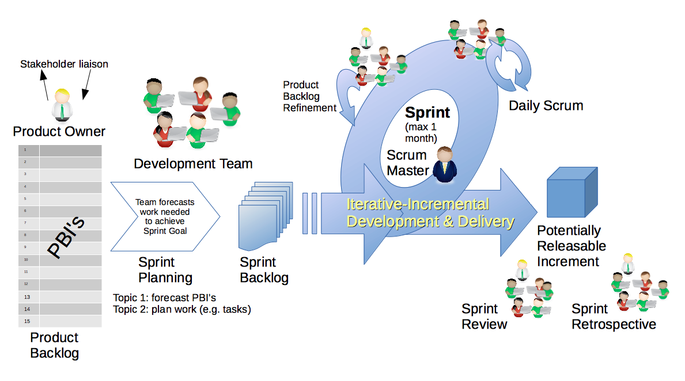
Scrum Process
By Dr ian mitchell - Own work, CC BY-SA 4.0, Link

Slide 9
Recall Perspectives & Priorities
Perspectives:
Process
Technology
Customer (User)

Slide 10
Recall Perspectives & Priorities
Process:
Waterfall
Iterative
Agile
CMMI and ISO
Technology:
Architecture & Design,
Languages, Tools, and Platforms
Customer (User):
Epics, Features, Stories

Slide 11
Recall Perspectives & Priorities
Agile Priorities:
Customer
Technology
Process

Slide 12
Agile Manifesto
& Principles [link]

Slide 13
Scrum Team Sprint 2 Planning
Steps:
Priorities & Roles Assignment
Epic Backlog Grooming
Product Backlog Grooming
Sprint Planning
Commitment to Sprint Backlog
Celebrate!

Slide 14
Step 1: Priorities & Roles
Recall Agile Priorities (associated scrum role):
Customer (Product Owner)
Technology (Architect)
Process (Scrum Master)
Recall the Agile Glossary [link]
Recall that one person can play multiple roles.
Recall that it is different/difficult for us because we are playing the role of the customer as well as the delivery team.

Slide 15
Recall Assigning Roles for Sprints 1 through 3
Roles Requirements & Actions:
Everyone must play the Scrum Master role for at least one sprint during the class
There must be a Product Owner responsible for managing User Stories, Epics and Backlogs
What role (or individual) will be responsible for demoing each sprint starting next Tuesday
The architect role is not a formal part of Scrum and is therefore optional
Sprint 2 Roles report out questions (Scrum Master):
Who is the Scrum Master?
Who is the Product Owner?
Who will demo for you team Tuesday
Notes:
Who before what.

Slide 16
Step 2: Portfolio Backlog Grooming (Epics)
Recall User Stories, Epics and Backlogs
Recall the Agile Glossary [link]… review User Story format

Slide 17
Scrum Process – Where is Epic Backlog Grooming?
By Dr ian mitchell - Own work, CC BY-SA 4.0, Link
Notes:
Epics are not part of Scrum.

Slide 18
Recall Scaled Agile

Slide 19
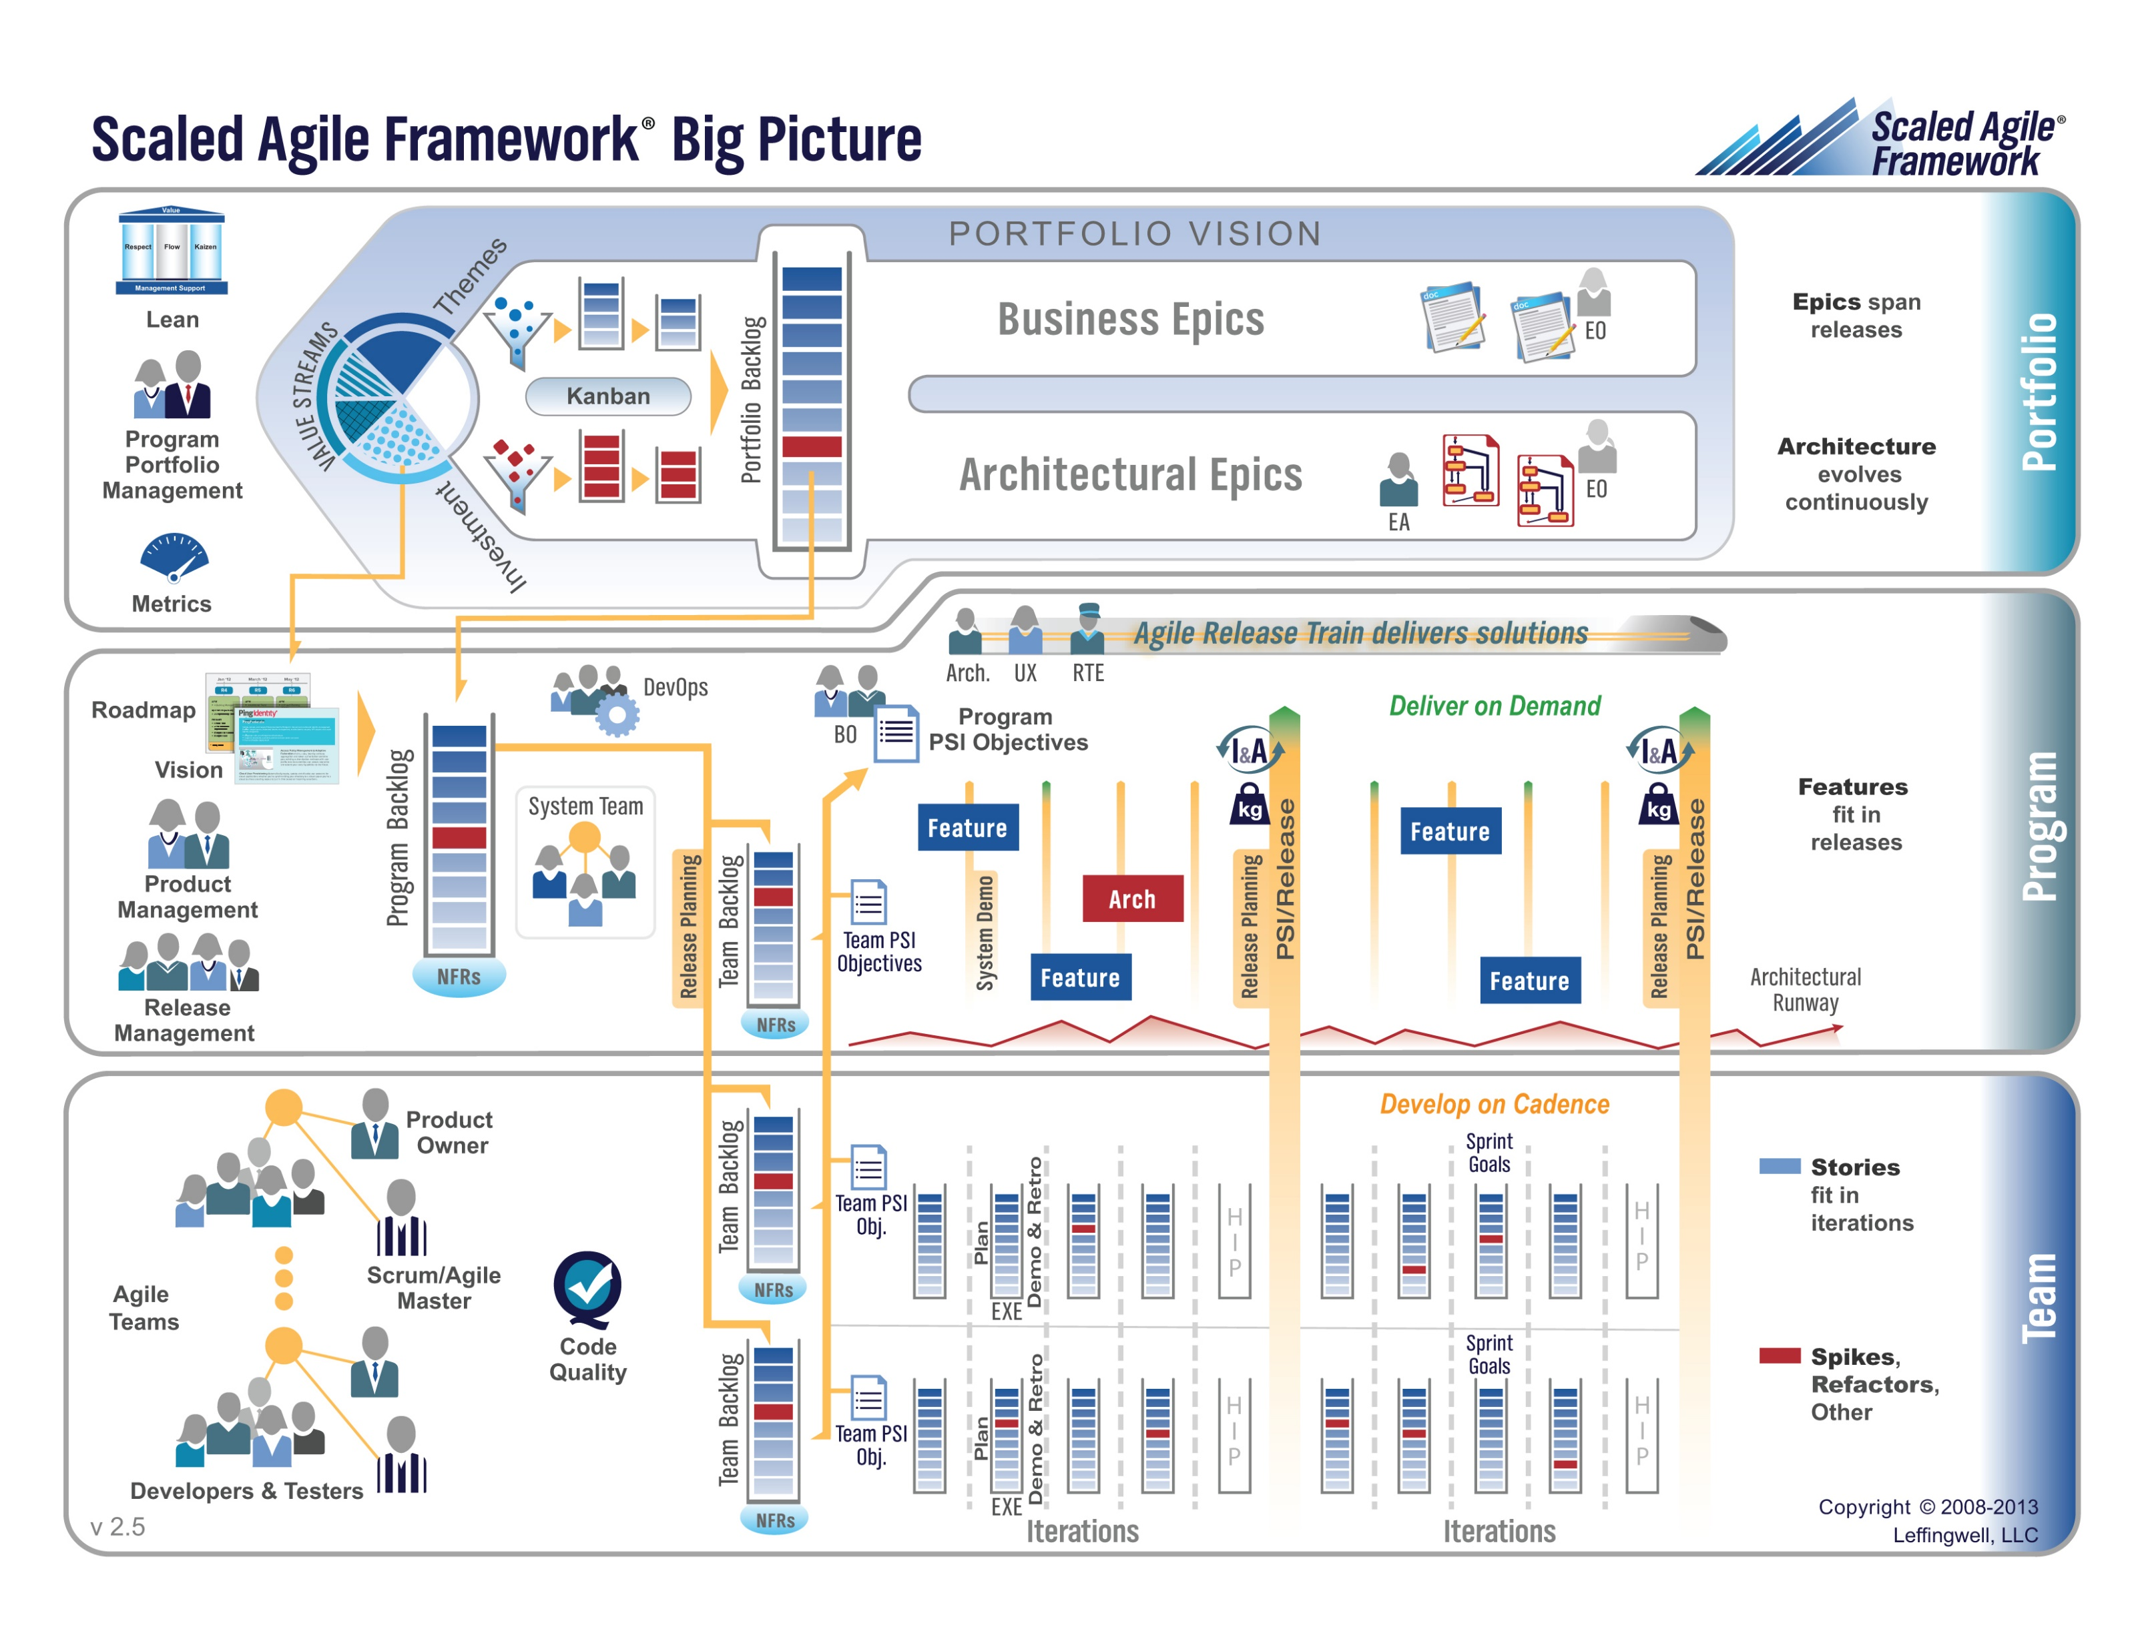

Slide 20
Step 2: Portfolio Backlog Grooming (Epics)
Actions & Requirements:
Product Owner to lead the review and/or creation of Epics
There must be one list of Epics managed by the Product Owner
Each Epic must deliver customer functionality and value
Epics should be written in User Story format
Epics must be prioritized and forced ranked
Each product must have at least three Epics
Epic Backlog Grooming report questions (Scrum Master):
What is the number of Epics?
How many are force ranked?

Slide 21
Step 3: Product Backlog Grooming (User Stories)
By Dr ian mitchell - Own work, CC BY-SA 4.0, Link

Slide 22
Step 3: Recall User Stories, the Product Backlog, and Done
Recall that User Stories must:
Be written in User Story format
Deliver user (customer) value
Be associated with Epic in Scaled Agile
Recall that the Product Product Backlog is:
Managed by to Product Owner
The team’s master list of prioritized (force ranked) User Stories
Opinion: The team’s master list of all important project work (spikes, continuous improvement, etc.)
Recall that “Done” must be well defined and for us includes at a minimum:
Successfully deployed and integration tested in the production environment
Demoed to the Product Owner
Available to be demoed to the class
Notes:
How will you handle dependancies?

Slide 23
Step 3: Recall User Story Estimation
Requirements:
Product Owner to lead the estimating of User Stories.
Each User Story must have an estimated effort in Story Points
For our purposes assume 1 Story Point is approximately equal to 1 hour of effort
Each User Story must be deliverable in a single sprint

Slide 24
Step 3: Product Backlog Grooming (User Stories)
Requirements & Actions:
Update Product Backlog by:
Relocating “Done” User Stories “Done” list
Relocating “Pending” User Stories to the “Pending” list
Reviewing remaining User Stories
Creating new User Stories
Prioritize and rank important stories (anything that might make it to the Sprint Backlog)
Provide Story Point estimates for important stories
Product Backlog report out questions (Product Owner):
How is “Done” defined for your team?
What is the total number of user stories?
What is the total number of story points?
How many stories and story points are force ranked?
Notes:
How will you handle dependancies?

Slide 25
Step 3: Future Considerations
Requirements & Actions:
Consider required Spikes and treat them as a User Story that does not deliver user value
Consider User Story and Spike dependencies
Consider “at risk” commitments in current Sprint
Notes:
How will you handle dependancies?

Slide 26
Step 4: Sprint Planning
By Dr ian mitchell - Own work, CC BY-SA 4.0, Link

Slide 27
Step 4: Recall Team Capacity Estimation and Cut Line
Activities:
Estimate Scrum Team Capacity current sprint by multiplying the number of team members times 8 hours each team member
Review your Product Backlog and draw your “cut line” to create your Sprint Backlog
Consider leaving some unutilized capacity to account for potential missed commitments (carry-over stories)

Slide 28
Step 4: Sprint Planning
Requirements & Activities:
Scrum Master and Product Owner lead effort to create Sprint Backlog
Move highest ranked Product Backlog stories to Sprint backlog until capacity is utilized
Comment: Your tools and formats you utilize for managing stories and backlogs are your own, but you need to be comfortable in showing how you choosing to do it.

Slide 29
Step 5: Sprint Backlog Commitment
By Dr ian mitchell - Own work, CC BY-SA 4.0, Link

Slide 30
Step 5: Sprint Backlog Commitment
The team commits to completing (fulfilling “Done” for each committed story) the stories in the Sprint backlog.
It is acceptable to miss commitments in Agile and Scrum.
However, it is required that we:
Be non-ambiguous in our commitments
Commit and deliver as a team
Be transparent in our actions
Commit to continuous improvement
Product Backlog report out questions (Scrum Master):
What is your team’s capacity and how was it calculate
How many stories and story points did you team commit to delivering in sprint 2
What are your assumptions about “carry-over” (high-risk) sprint 1 stories

Slide 31
Step 6: Celebrate
Recognize your teammates that stepped up. Tell them “Well done!”
Celebrate report out questions (Scrum Master & Product Owner):
How do you feel about your sprint 2 planning?

Slide 32
Prework
Everything is due Sunday!
Be prepared for Sprint 6 Reviews and Retrospectives including your Sprint 6 demo
Be prepared for our class Sprint 7 Planning

Slide 33
End of Session

