Slide 1

Preflight Check List
Everyone:
Sign into our Zoom meeting through our integrated Blackboard/Zoom link
Make sure that you can hear the conversation, see shared desktops, and view group chat topics
You will need a headset with a microphone to be able to effectively listen and speak
You will need to be able to share your computer screen
Thank you if you choose to leave your camera on to help make our class more interactive
In person participants also:
Make sure that your microphone and speakers are muted/off so that we don’t get an echo
Sit in a good spot near the classroom ceiling microphones if possible
Start Recording

Slide 2
Prework and Announcements

Slide 3
Prework
Everything is Due Sunday!
Be prepared for Sprint 7 Planning on Monday
Upcoming Wednesday:
Sharing more Hosted JSON links

Slide 4
Agenda:
Prework and Announcements
Sprint 7 Planning
Scrum Team Sprint 7 Planning
Prework for Next Class
Discussion & Questions welcome at any time but please be present with no phones or email during our time together

Slide 5
Sprint Planning

Slide 6
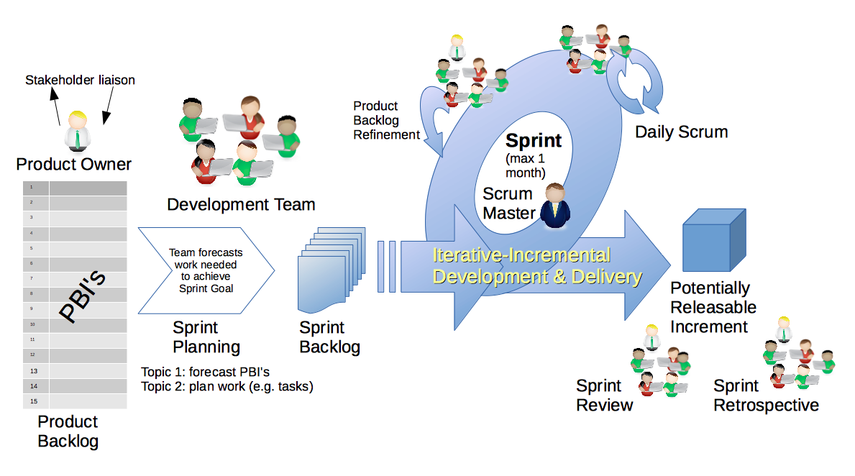
Scrum Process – Sprint Planning
By Dr ian mitchell - Own work, CC BY-SA 4.0, Link

Slide 7
Sprint Planning
Sprint 7 Changes:
Similar to last sprint including Discussion, Quiz, Lab, and Reflection
There are two programming assignments with the first one being “due” at the end of the the first week so that we can have extra time for our final project
This is the last sprint you can demo
No holidays which should make it easier than last sprint

Slide 8
Review Activities List and Assignments

Slide 9
Scrum Team Sprint 7 Planning
As a scrum team:
Identify scrum master for sprint 7
Review sprint 7 activities & assignments in detail
Discuss questions/concerns and topics that need more clarification
Scrum master share your team’s top 2 questions/concerns during report out

Slide 10
Review Demo Schedule

Slide 11
Prework For Next Class
Complete through activity 4 prior to next class
Be prepared for demos… hosted JSON files preferred
Be prepared for retrospectives
Be prepared to share hosted JSON files
Upcoming Friday:
Scrum team review “Application Architectures, Object-Oriented Programming, and Databases - Part 1”
Scrum team discussion 7

Slide 12
End of Session

