Slide 1

Preflight Check List
Everyone:
Sign into our Zoom meeting through our integrated Blackboard/Zoom link
Make sure that you can hear the conversation, see shared desktops, and view group chat topics
You will need a headset with a microphone to be able to effectively listen and speak
You will need to be able to share your computer screen
Thank you if you choose to leave your camera on to help make our class more interactive
In person participants also:
Make sure that your microphone and speakers are muted/off so that we don’t get an echo
Sit in a good spot near the classroom ceiling microphones if possible
Start Recording

Slide 2
Prework and Announcements

Slide 3
Prework
Everything is due Sunday!
Be prepared for Sprint 6 Reviews and Retrospectives including your Sprint 6 demo
Be prepared for our class Sprint 7 Planning

Slide 4
Agenda:
Sprint “1” Demos (scrum team)
Sprint “1” Retrospectives (scrum team)
Sprint “2” Planning Update (scrum team)
Sprint 6 Retrospective (class)
Sprint 7 Planning (class)
Prework for Next Class
Discussion & Questions welcome at any time but please be present with no phones or email during our time together

Slide 5
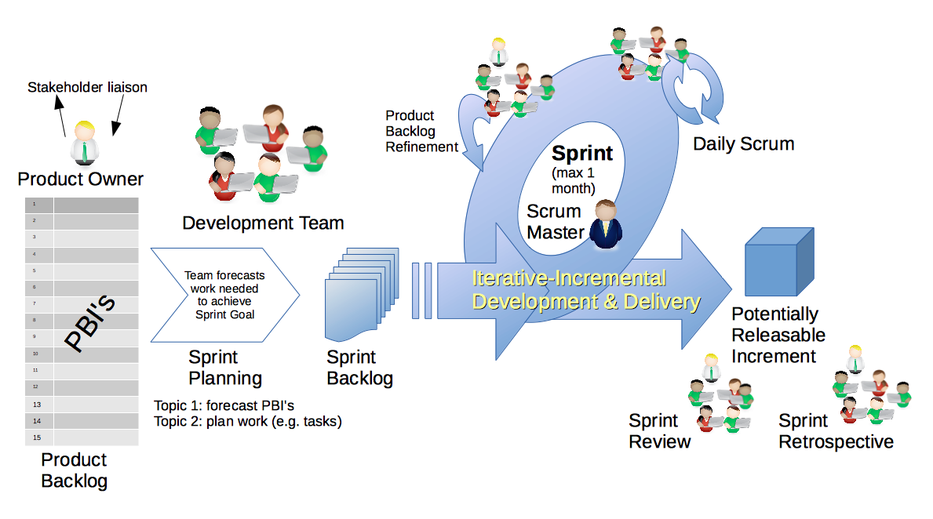
Scrum Process – Sprint Review & Demo
By Dr ian mitchell - Own work, CC BY-SA 4.0, Link

Slide 6
Demo Guidelines – Presenter
Everyone will give at least one demo of their work during the semester.
Your demo should be 2 to 5 minutes and can include any or all of the following:
Show your application running
Comment on your implementation
Show the source code
Explain how you organized the code
Talk about any challenges
You should not prepare slides or a presentation
**You will also need to complete the Demo assignment in Blackboard.

Slide 7
Demo Guidelines – Listener
Everyone will be listening to many demos during the semester.
Your listener responsibilities include:
Actively listening and watching what is being demoed
Come up with a meaningful yet easy to answer question
Ask your question if the presenter does not get sufficient questions from other listeners
Do not ask hard question or attempt to review the presenters code
Clap for the presenter at the end of the demo and thank them for presenting
Optionally follow up with the presenter later if you have what could be more difficult questions or if you have suggestions

Slide 8
Sprint Demos
Plus Product Demos (as needed)

Slide 9
Complete Sprint Demo Assignment

Slide 10
Scrum Process – Sprint Retrospective for Sprint 1
By Dr ian mitchell - Own work, CC BY-SA 4.0, Link

Slide 11
Sprint 1 Retrospective
The team calculates sprint 1 metrics and retrospective using start, stop, continue feedback method.
Calculate say/do ratio with no ambiguity.
Start, Stop, Continue:
Continue: What is something specific that is working? Something that we should make sure that we continue to do.
Start: What is something specific that would be nice to do that we are not doing now? Maybe something that you have seen work well for others.
Stop: What is not working or not adding value? Something to stop doing.
Report out questions (Scrum Master):
What was your say/do ratio and how was it calculated (story points committed and story points done)
What are two start, stop, continue items?

Slide 12
Scrum Process – Sprint Planning Update for Sprint 2?
By Dr ian mitchell - Own work, CC BY-SA 4.0, Link

Slide 13
Sprint 2 Planning Update
Review sprint 2 plan and make minor updates.
Report out questions (Scrum Master):
What were the changes?
What is your original and updated story and story point commitment for sprint 2

Slide 14
Submission Percentage for Sprint 3

Slide 15
Submission Percentage for Sprint 4

Slide 16
Submission Percentage for Sprint 5

Slide 17
Submission Percentage for Sprint 6

Slide 18
Class Retrospective
Feedback from Assignments & Reflections:
Excellent submission numbers
Grades are posted for Discussion, Quiz, and Reflections
Quiz answer should be available now… email me with questions or comments about the quiz
Grades for Labs will be posted by the end of the day tomorrow
Reminder that ALL epics and stories need to be 100% from a user perspective
I can see the team effectiveness improving
Reminder that if you do not participate in the scrum team discussion you need to respond back to at least two of your classmates’ discussion posts

Slide 19
Sprint Planning

Slide 20
Sprint Planning
Sprint 7 Changes:
Similar to last sprint including Discussion, Quiz, Lab, and Reflection
This is the last sprint you can demo
No holidays which should make it easier than last sprint

Slide 21
Scrum Process – Sprint Planning
By Dr ian mitchell - Own work, CC BY-SA 4.0, Link

Slide 22
Review Activities List and Assignments

Slide 23
Prework For Next Class
Complete through activity 6 prior to next class
Be prepared for scrum team discussion of Fox Chapter 11 on Design Patterns

Slide 24
End of Session

