Slide 1

Preflight Check List
Everyone:
Sign into our Zoom meeting through our integrated Blackboard/Zoom link
Make sure that you can hear the conversation, see shared desktops, and view group chat topics
You will need a headset with a microphone to be able to effectively listen and speak
You will need to be able to share your computer screen
Thank you if you choose to leave your camera on to help make our class more interactive
In person participants also:
Make sure that your microphone and speakers are muted/off so that we don’t get an echo
Sit in a good spot near the classroom ceiling microphones if possible
Start Recording

Slide 2
Prework And Announcements
Complete through activity 4 prior to next class
Be prepared for demos… hosted JSON files preferred
Be prepared for retrospectives
Be prepared to share hosted JSON files
Upcoming Friday:
Scrum team review “Application Architectures, Object-Oriented Programming, and Databases - Part 1”
Scrum team discussion 7

Slide 3
Agenda:
Sprint 6 Demos
Sprint 6 Retrospective
Sprint 6 Scrum Team Retrospective
Prework for Next Class
Programming Together with JSON files
Discussion & Questions welcome at any time but please be present with no phones or email during our time together

Slide 4
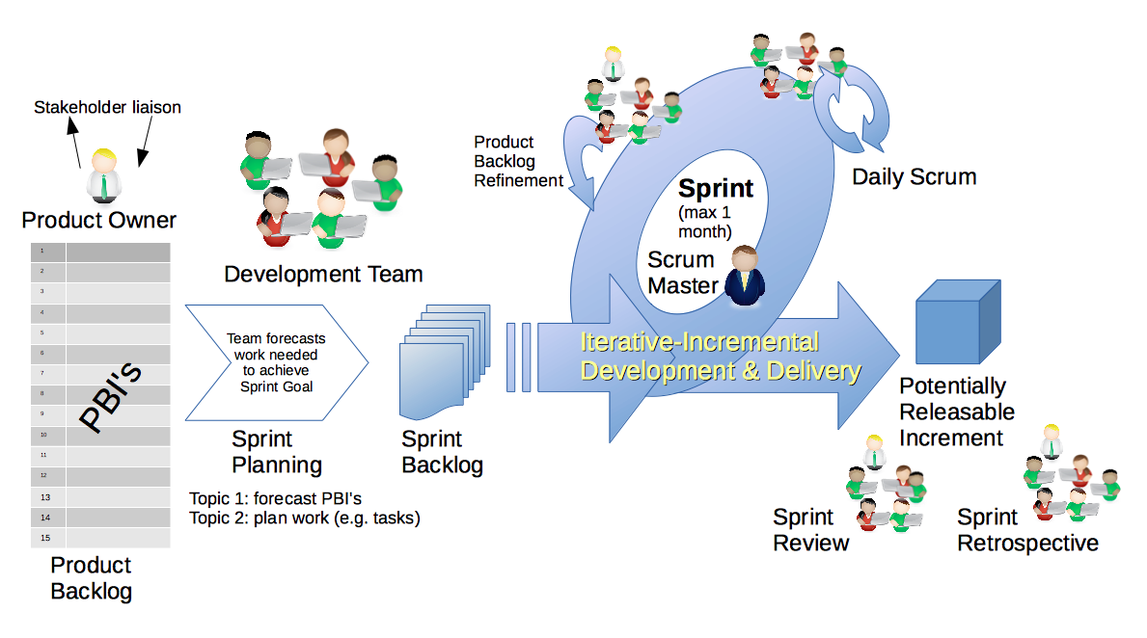
Scrum Process – Sprint Review & Demo
By Dr ian mitchell - Own work, CC BY-SA 4.0, Link

Slide 5
Demo Guidelines – Presenter
Everyone will give at least one demo of their work during the semester.
Your demo should be 2 to 5 minutes and can include any or all of the following:
Show your application running
Comment on your implementation
Show the source code
Explain how you organized the code
Talk about any challenges
You should not prepare slides or a presentation
**You will also need to complete the Demo assignment in Blackboard.

Slide 6
Demo Guidelines – Listener
Everyone will be listening to many demos during the semester.
Your listener responsibilities include:
Actively listening and watching what is being demoed
Be prepared to ask a meaningful yet easy to answer question
Clap for the presenter and/or send them a “well done” message at the end of the demo

Slide 7
Sprint Demos

Slide 8
Complete Sprint Demo Assignment

Slide 9
Scrum Process – Sprint Retrospective
By Dr ian mitchell - Own work, CC BY-SA 4.0, Link

Slide 10
Submission Percentage for Sprint 6

Slide 11
Class Retrospective
Feedback from Assignments & Reflections:
Very good assignment submission numbers
Grades are posted and up to date through sprint 6
Quiz answer are available
SwissArmyKnife V2 and threading are hard
… SwissArmyKnife V2 and threading with Easter Break thrown in the middle are really hard
… Well done implementing and submitting what you were able to complete

Slide 12
Scrum Team Sprint 6 Retrospective
Start, Stop, Continue:
Continue: What is something specific that is working? Something that we should make sure that we continue to do.
Start: What is something specific that would be nice to do that we are not doing now? Maybe something that you have seen work well for others.
Stop: What is not working or not adding value? Something to stop doing.
Report out questions (Scrum Master):
What are two start, stop, continue items?
What are two ways I could improve sprint 6 in the future

Slide 13
Prework For Next Class
Complete through activity 6
Be prepared for scrum team review of Dale chapter 17 Security
Be prepared for scrum team discussion 7
Be prepared for more sprint 6 demos – Sam

Slide 14
Prework And Announcements
Complete through activity 6 prior to next class
Be prepared for scrum team review “Application Architectures, Object-Oriented Programming, and Databases - Part 1”
Scrum team discussion 7

Slide 15
Programming Together
JSON Files
Thunderbird Starter Code

Slide 16
End of Session

