Slide 1

Preflight Check List
Everyone:
Sign into our Zoom meeting through our integrated Blackboard/Zoom link
Make sure that you can hear the conversation, see shared desktops, and view group chat topics
You will need a headset with a microphone to be able to effectively listen and speak
You will need to be able to share your computer screen
Thank you if you choose to leave your camera on to help make our class more interactive
In person participants also:
Make sure that your microphone and speakers are muted/off so that we don’t get an echo
Sit in a good spot near the classroom ceiling microphones if possible
Start Recording

Slide 2
Prework, Announcements, and The Four Minute Reflection
Please spend the first few minutes of class reviewing your assigned prework:
Complete through activity 6 prior to next class
Be prepared for scrum team discussion of “Application Architectures, Object-Oriented Programming, and Databases - Part 1”
Announcements

Slide 3
Agenda:
Friendly Conversation Topic: Frustrations, Lasallian Tradition, & Jeff Bezos
Sprint 7 Assignment Review plus Q&A
Scrum Team Chapter Review Application Architectures, Object-Oriented Programming, and Databases - Part 1
Scrum Team Discussion Board 7
Prework for Next Class
Discussion & Questions welcome at any time but please be present with no phones or email during our time together

Slide 4
Frustrations & Continuous Improvement?

Slide 5

Friendly Conversation Topic – Lasallian Principles
Notes:
We are practical University educators.

Slide 6
Friendly Conversation Topic
Recall:
I’m challenging you today to demonstrate:
Commitment to a Quality Education by proactively participating to make our time together effective
Community & Togetherness by getting to know your classmates and your instructor
Today:
Part of our tradition is to be okay with some quiet time in class to prepare ourselves to learn and to reflect
Notes:
Compassion and Empathy
Commitment and Integrity
Togetherness and Association

Slide 7
Lasallian Tradition, Jeff Bezos,
and the first few minutes of class?

Slide 8


Bezos created a new way to hold meetings: Meetings start with each attendee sitting and silently reading a “six-page, narratively-structured memo” for about the first 30 minutes of the meeting.
″[The memo is] supposed to create the context for what will then be a good discussion,” Bezos said.

Slide 9
Friendly Conversation Topic: Conclusion
“Start” – The Four Minute Reflection

Slide 10
Sprint 7 Assignment Update Review plus Q&A
Review Lab 7
Q&A Session

Slide 11
Team Discussion
Topic: Application Architectures, Object-Oriented Programming, and Databases - Part 1:
Scrum Master accepts volunteers for (or assigns) Presenter
Team discusses and presenter summarizes the topics including:
Three-tier Application Architecture
Object-Oriented Programming Concepts, Patterns, Principles
Horizontal vs Vertical Scaling
Files, JSON/XML, Binary, and Shared Files
SQL and NoSQL Databases
Database Pros & Cons
Shared Data
ORM?
Team sits back, relaxes, and acknowledges the bravery and dedication of the presenter
Team returns to class Zoom session where presenter presents summary
Report Out

Slide 12
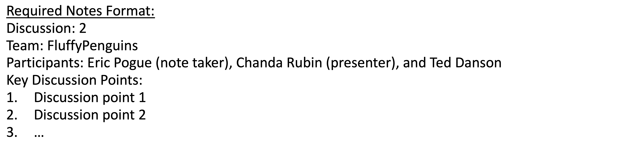
Scrum Team Discussion Board 7
Assign note taker and presenter roles to team members
Review and discuss the discussion topic for this sprint for approximately 10 minutes
Note taker takes notes and presenter prepares a report out summary
Note taker share notes with all participating team members
Each team member pastes and submits exact copy of the notes into their discussion board
Presenter reports out
Report Out

Slide 13
Prework
Complete through activity 11
Be prepared for team discussion of “Application Architectures, Object-Oriented Programming, and Databases - Part 1”
Be prepared for Quiz 7

Slide 14
Prework and Announcements

Slide 15
Prework
Everything is due Sunday!
Be prepared for Sprint 6 Reviews and Retrospectives including your team’s Sprint 6 demo
Be prepared for our class Sprint 7 Planning
Who will be demoing for each team?

Slide 16
Agenda:
Sprint 6 Demos (scrum team)
Sprint 6 Retrospective
Sprint 6 Retrospectives (scrum team)
Sprint 7 Planning
Prework for Next Class
Discussion & Questions welcome at any time but please be present with no phones or email during our time together

Slide 17
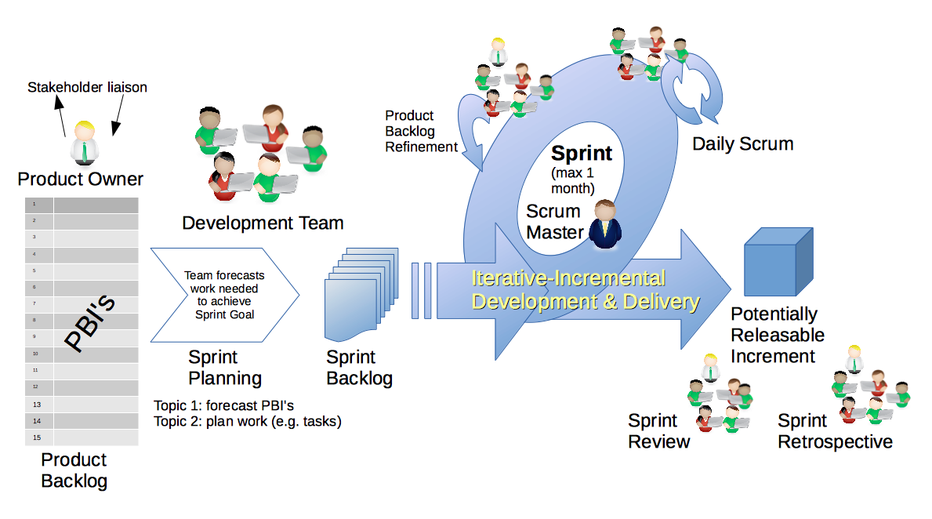
Scrum Process – Sprint Review & Demo
By Dr ian mitchell - Own work, CC BY-SA 4.0, Link

Slide 18
Demo Guidelines – Presenter
Everyone will give at least one demo of their work during the semester.
Your demo should be 2 to 5 minutes and can include any or all of the following:
Show your application running
Comment on your implementation
Show the source code
Explain how you organized the code
Talk about any challenges
You should not prepare slides or a presentation
**You will also need to complete the Demo assignment in Blackboard.

Slide 19
Demo Guidelines – Listener
Everyone will be listening to many demos during the semester.
Your listener responsibilities include:
Actively listening and watching what is being demoed
Come up with a meaningful yet easy to answer question
Ask your question if the presenter does not get sufficient questions from other listeners
Do not ask hard question or attempt to review the presenters code
Clap for the presenter at the end of the demo and thank them for presenting
Optionally follow up with the presenter later if you have what could be more difficult questions or if you have suggestions

Slide 20
Sprint Demos
Plus Product Demos (as needed)

Slide 21
Complete Sprint Demo Assignment

Slide 22
Voting

Slide 23
Scrum Process – Sprint Retrospective
By Dr ian mitchell - Own work, CC BY-SA 4.0, Link

Slide 24
Submission Percentage for Sprint 6

Slide 25
Class Retrospective
Feedback from Assignments & Reflections:
Excellent submission numbers
Grades are posted for Discussion, Quiz, and Reflections
Quiz answer should be available now… email me with questions or comments about the quiz
Grades for Labs will be posted by the end of the day tomorrow
Reminder that if you do not participate in the scrum team discussion you need to respond back to at least two of your classmates’ discussion posts

Slide 26
Scrum Team Retrospective
Start, Stop, Continue:
Continue: What is something specific that is working? Something that we should make sure that we continue to do.
Start: What is something specific that would be nice to do that we are not doing now? Maybe something that you have seen work well for others.
Stop: What is not working or not adding value? Something to stop doing.
Report out questions (Scrum Master):
What are two start, stop, continue items?

Slide 27
Scrum Team Retrospective
Provide your feedback on:
What is one thing your team can commit to improving
Do you have a new scrum master

Slide 28
Sprint Planning

Slide 29
Sprint Planning
Sprint 7 Changes:
Similar to last sprint including Discussion, Quiz, Lab, and Reflection
This is the last sprint you can demo
No holidays which should make it easier than last sprint

Slide 30
Scrum Process – Sprint Planning
By Dr ian mitchell - Own work, CC BY-SA 4.0, Link

Slide 31
Review Activities List and Assignments

Slide 32
Prework For Next Class
Complete through activity 6 prior to next class
Be prepared for scrum team discussion of “Application Architectures, Object-Oriented Programming, and Databases - Part 1”

Slide 33
End of Session

