Slide 1

Preflight Check List
Everyone:
Sign into our Zoom meeting through our integrated Blackboard/Zoom link
Make sure that you can hear the conversation, see shared desktops, and view group chat topics
You will need a headset with a microphone to be able to effectively listen and speak
You will need to be able to share your computer screen
Thank you if you choose to leave your camera on to help make our class more interactive
In person participants also:
Make sure that your microphone and speakers are muted/off so that we don’t get an echo
Sit in a good spot near the classroom ceiling microphones if possible

Slide 2
Four Minutes of Preparation and Reflection
Please spend the first few minutes of class reviewing your assigned prework:
Complete through activity 6
Be prepared for scrum team review of Dale chapter 17 Security
Be prepared for scrum team discussion 7
Be prepared for more sprint 6 demos – Sam
Start Recording

Slide 3
Agenda:
Friendly Conversation Topic: Lasallian Traditions, Jeff Bezos, Eric’s small frustration, and the first few minutes of class
Sprint 6 Demos (continued)
Scrum Team Discussion Board 7
Prework for Next Class
Programming Together
Discussion & Questions welcome at any time but please be present with no phones or email during our time together

Slide 4
Friendly Conversation Topic
What do Lasallian Traditions, Jeff Bezos, Eric’s small frustration, and the first few minutes of class have in common?

Slide 5

Friendly Conversation Topic – Lasallian Principles
Notes:
We are practical University educators.

Slide 6
Lasallian Tradition
Recall:
I’m challenging you today to demonstrate:
Commitment to a Quality Education by proactively participating to make our time together effective
Community & Togetherness by getting to know your classmates and your instructor
Today:
Part of our Lasallian Tradition is to be okay with some quiet time in class to prepare ourselves to learn and to prepare and reflect.
Notes:
Compassion and Empathy
Commitment and Integrity
Togetherness and Association

Slide 7

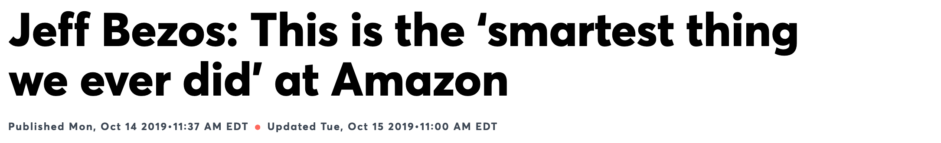
Bezos created a new way to hold meetings: Meetings start with each attendee sitting and silently reading [the memo and preparing for the discussion]
…
″[The memo is] supposed to create the context for what will then be a good discussion,” Bezos said.

Slide 8
Eric’s Small Frustration
(And Continuous Improvement)

Slide 9
Friendly Conversation Topic - Conclusion
For the next several classes, we are going to give ourselves the first four minutes of class to prepare and reflect.
Requests:
Embrace this for the next several classes
Be prepared to vote whether to continue, enhance, or stop this activity in our sprint 7 reflection
Please continue to focus on being on time or slightly early to class
Please come to class even you come late
Help continue to make our class time effective and enjoyable

Slide 10
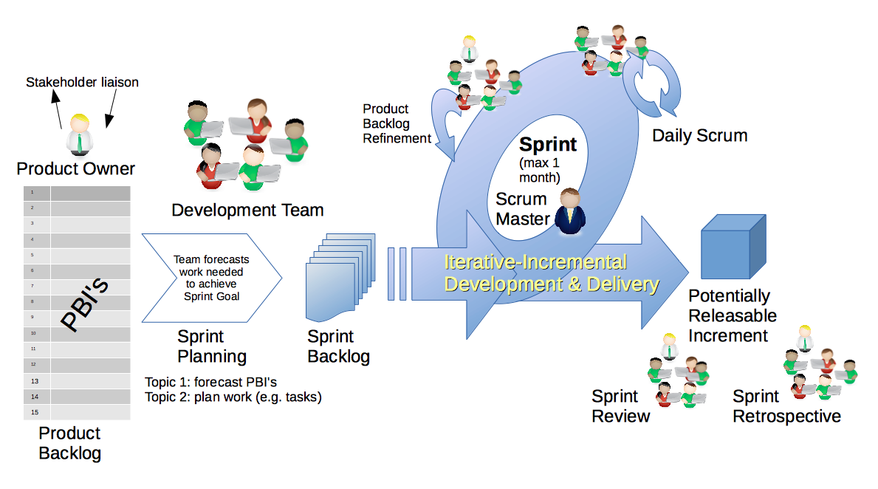
Scrum Process – Sprint Review & Demo
By Dr ian mitchell - Own work, CC BY-SA 4.0, Link

Slide 11
Demo Guidelines – Presenter
Everyone will give at least one demo of their work during the semester.
Your demo should be 2 to 5 minutes and can include any or all of the following:
Show your application running
Comment on your implementation
Show the source code
Explain how you organized the code
Talk about any challenges
You should not prepare slides or a presentation
**You will also need to complete the Demo assignment in Blackboard.

Slide 12
Demo Guidelines – Listener
Everyone will be listening to many demos during the semester.
Your listener responsibilities include:
Actively listening and watching what is being demoed
Be prepared to ask a meaningful yet easy to answer question
Clap for the presenter at the end of the demo and thank them for presenting

Slide 13
Sprint Demos

Slide 14
Complete Sprint Demo Assignment

Slide 15
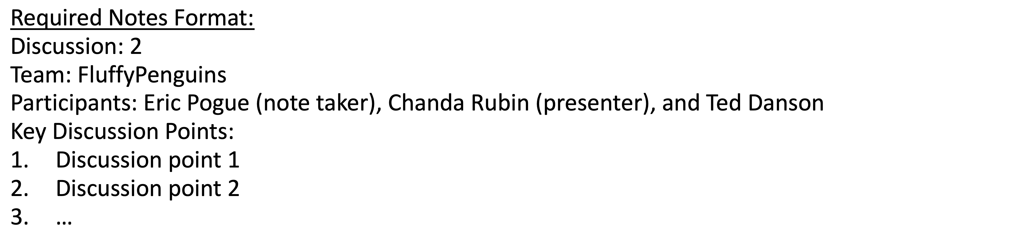
Scrum Team Discussion 7
Assign note taker and presenter roles to team members
Review and discuss the discussion topic for this sprint for approximately 10 minutes
Note taker takes notes and presenter prepares a report out summary
Note taker share notes with all participating team members
Each team member pastes and submits exact copy of the notes into their discussion board
Presenter reports out
Report Out

Slide 16
Prework For Next Class
Complete through activity 9
Be prepared for scrum team review of Dale chapter 17 Security

Slide 17
Programming Together

Slide 18
End of Session

