Slide 1

Preflight Check List
Everyone:
Sign into our Zoom meeting through our integrated Blackboard/Zoom link
Make sure that you can hear the conversation, see shared desktops, and view group chat topics
You will need a headset with a microphone to be able to effectively listen and speak
You will need to be able to share your computer screen
Thank you if you choose to leave your camera on to help make our class more interactive
In person participants also:
Make sure that your microphone and speakers are muted/off so that we don’t get an echo
Sit in a good spot near the classroom ceiling microphones if possible

Slide 2
Four Minutes of Preparation and Reflection
Please spend the first few minutes of class reviewing your assigned prework:
Complete through activity 8
Be diligently working on activity 9
Be prepared Quiz 7
Start Recording

Slide 3
Agenda:
Job, Internship, and Tutoring Opportunities
Programming Together
Prework for Next Class
Quiz 7
Discussion & Questions welcome at any time but please be present with no phones or email during our time together

Slide 4
Job, Internship,
and Tutoring Opportunities

Slide 5
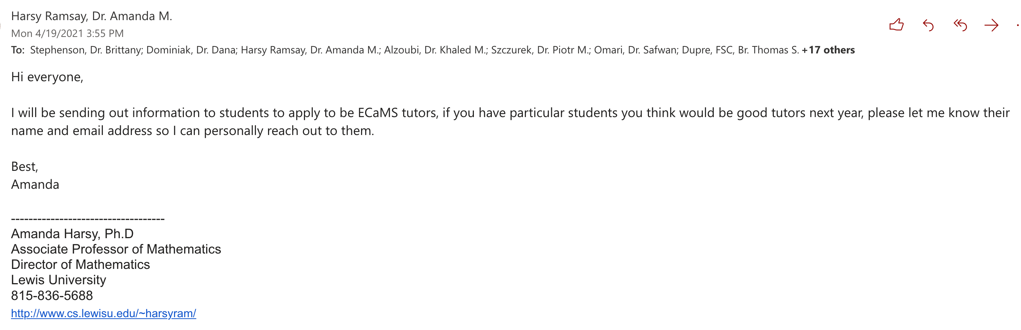
ECaMS Tutors Needed

Slide 6
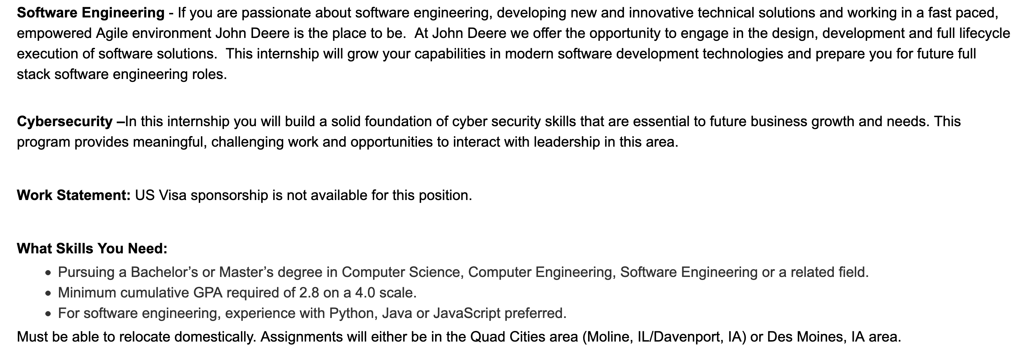
Job Opportunities

Slide 7
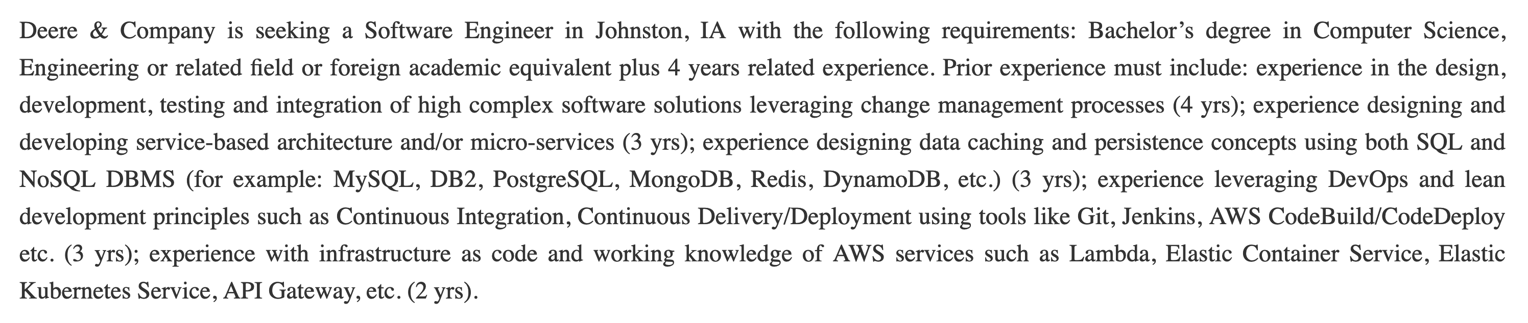
Job Opportunities

Slide 8
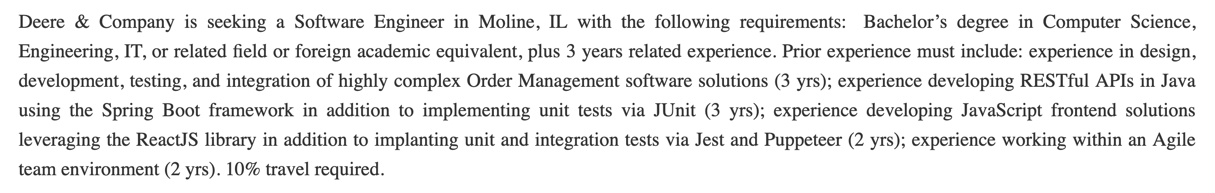
Job Opportunities

Slide 9
Programming Together
Final Projects

Slide 10
Prework
Be diligently working on activity 10 and 11
Be prepared for Programming Together

Slide 11
Quiz 7

Slide 12
End of Session

