Slide 1

Preflight Check List
Everyone:
Sign into our Zoom meeting through our integrated Blackboard/Zoom link
Make sure that you can hear the conversation, see shared desktops, and view group chat topics
You will need a headset with a microphone to be able to effectively listen and speak
You will need to be able to share your computer screen
Thank you if you choose to leave your camera on to help make our class more interactive
In person participants also:
Make sure that your microphone and speakers are muted/off so that we don’t get an echo
Sit in a good spot near the classroom ceiling microphones if possible

Slide 2
Four Minutes of Preparation and Reflection
Please spend the first few minutes of class reviewing your assigned prework:
Complete through activity 14
Be prepared for sharing your Azure Authentication experiences to date
Start Recording

Slide 3
Agenda:
Review Review Sprint 7 Demo Schedule for next Tuesday
Azure Authentication Experiences
Wrapping up Mosaic v2
Final Project Proposal Updates and Review
Prework For Next Class
Discussion & Questions welcome at any time but please be present with no phones or email during our time together

Slide 4
Review Sprint 7 Demo Schedule

Slide 5
Azure Authentication Experiences

Slide 6
How can we successfully bring
closure to Mosaic v2?

Slide 7
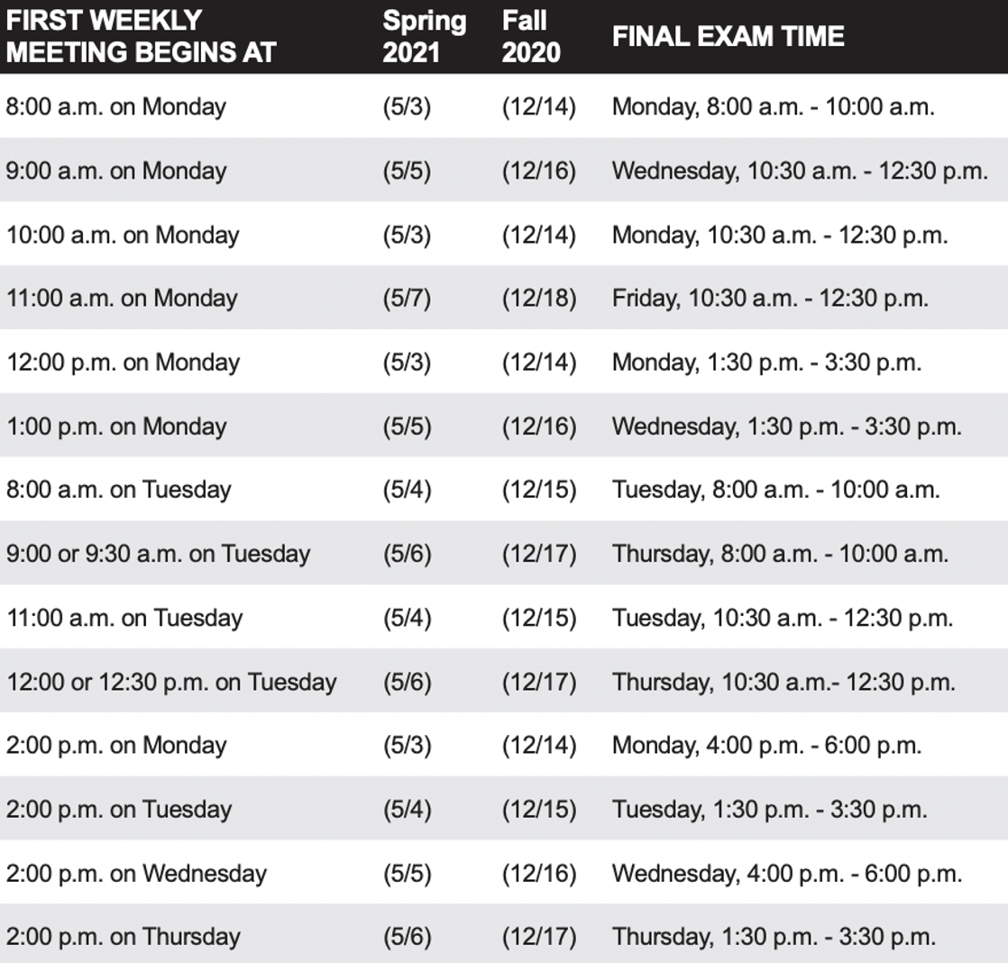
Final Project Presentations
Foreshadowing Sprint 8:
Finals week start Monday, May 3rd
No regular classes during finals week
Final project presentations are scheduled during our final exam time time
Everything is due at least 2 hours before your final project presentation timeslot
You may resubmit assignments up until the end of the day Thursday, May 6th

Slide 8
Final Project Proposal
Updates and Review

Slide 9
Prework For Next Class
Everything is due Sunday
Be prepared to demo your team’s Mosaic v2 implementation
Be prepared for sprint 7 reviews, retrospectives, and demos
Be prepared for sprint 8 planning

Slide 10
End of Session

