Slide 1

Preflight Check List
Everyone:
Sign into our Zoom meeting through our integrated Blackboard/Zoom link
Make sure that you can hear the conversation, see shared desktops, and view group chat topics
You will need a headset with a microphone to be able to effectively listen and speak
You will need to be able to share your computer screen
Thank you if you choose to leave your camera on to help make our class more interactive
In person participants also:
Make sure that your microphone and speakers are muted/off so that we don’t get an echo
Sit in a good spot near the classroom ceiling microphones if possible

Slide 2
Four Minutes of Preparation and Reflection
Please spend the first few minutes of class reviewing your assigned prework:
Complete through activity 11
Be diligently working on 12
Be prepared for sprint 3 planning
Start Recording

Slide 3
Agenda:
Review Sprint 2 Demos for next Tuesday
Review Sprint 8 Expectations
Sprint 3 Planning
Prework for Next Class
Discussion & Questions welcome at any time but please be present with no phones or email during our time together

Slide 4
Review Sprint 2 Demos

Slide 5
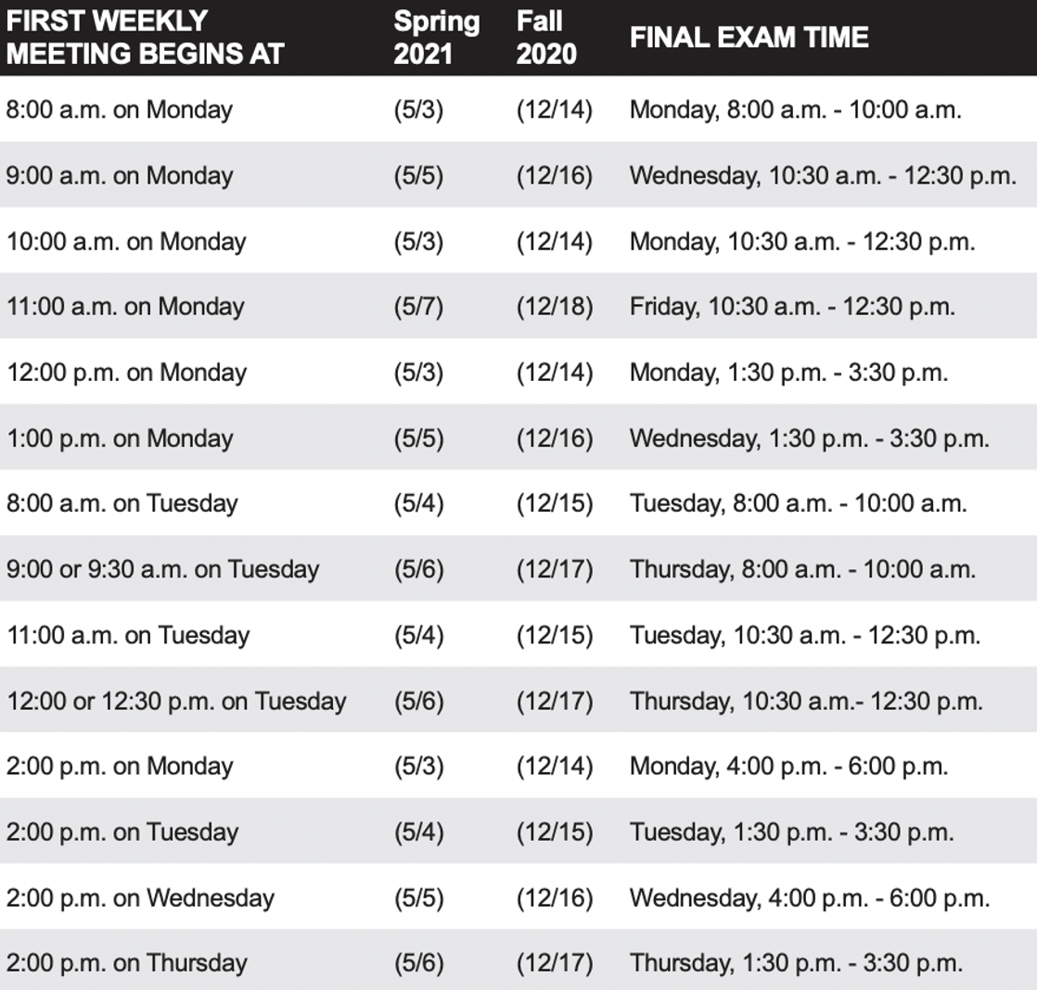
Review
Foreshadowing Sprint 8:
Finals week start Monday, May 3rd
No regular classes during finals week
Final project presentations are scheduled during our final exam time time
Everything is due at least 2 hours before your final project presentation timeslot
You may resubmit assignments up until the end of the day Thursday, May 6th

Slide 6
Sprint 3 Planning

Slide 7
Recall Assigning Roles for Sprints 1 through 3
Roles Requirements & Actions:
Everyone must play the Scrum Master role for at least one sprint during the class
There must be a Product Owner responsible for managing User Stories, Epics and Backlogs
What role (or individual) will be responsible for demoing each sprint starting next Tuesday
The architect role is not a formal part of Scrum and is therefore optional
Sprint 2 Roles report out questions (Scrum Master):
Who is the Scrum Master?
Who is the Product Owner?
Who will demo for you team Tuesday
Notes:
Who before what.

Slide 8
Sprint 3 Planning
…This is Your Scrum Team Process

Slide 9
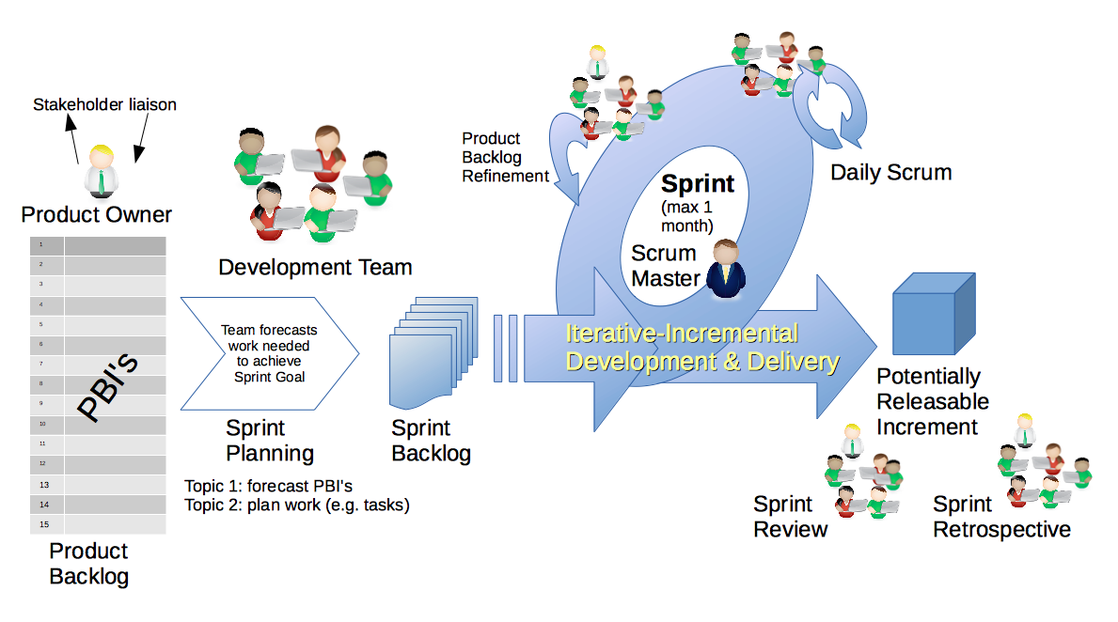
Scrum Process
By Dr ian mitchell - Own work, CC BY-SA 4.0, Link

Slide 10
Today’s Goal: Create A High Quality Sprint 3 Backlog
By Dr ian mitchell - Own work, CC BY-SA 4.0, Link

Slide 11
Foreshadowing Product Backlog Grooming (User Stories)
Requirements & Actions:
Update Product Backlog by:
Relocating “Done” User Stories “Done” list
Relocating “Pending” User Stories to the “Pending” list
Reviewing remaining User Stories
Creating new User Stories
Prioritize and rank important stories (anything that might make it to the Sprint Backlog)
Provide Story Point estimates for important stories
Product Backlog report out questions (Product Owner):
How is “Done” defined for your team?
What is the total number of user stories?
What is the total number of story points?
How many stories and story points are force ranked?
Notes:
How will you handle dependancies?

Slide 12
Scrum Team Sprint 3 Planning
Steps:
Clarify Roles, Priorities, and Done
Portfolio Backlog Grooming (Epics)
Product Backlog Grooming (Stories)
Sprint Planning
Commitment to Sprint Backlog
Celebrate!

Slide 13
Step 1: Clarify Roles, Priorities, and Done

Slide 14
Recall Assigning Roles for Sprints 1 through 3
Roles Requirements & Actions:
Everyone must play the Scrum Master role for at least one sprint during the class
There must be a Product Owner responsible for managing User Stories, Epics and Backlogs
What role (or individual) will be responsible for demoing each sprint starting next Tuesday
The architect role is not a formal part of Scrum and is therefore optional
Notes:
Who before what.

Slide 15
Recall Perspectives & Priorities
Perspectives:
Process
Technology
Customer (User)

Slide 16
Recall Perspectives & Priorities
Process:
Waterfall
Iterative
Agile
CMMI and ISO
Technology:
Architecture & Design,
Languages, Tools, and Platforms
Customer (User):
Epics, Features, Stories

Slide 17
Recall Perspectives & Priorities
Agile and Scrum Priorities:
Customer
Technology
Process

Slide 18
Step 1: Clarify Priorities, Roles, and Done
Recall:
Agile Manifesto & Principles [link]
The Agile Glossary [link]
That one person can play multiple roles
Stories are either “done” or “not done” and that, at a minimum, “done” includes being able to demo the story running in the production (Azure) environment
Report Out Questions (Scrum Master):
What is your team’s priority and from what perspective are Epics & Stories created?
Who is your sprint 3 Product Owner
What is your team definition of “done?” (Product Owner)

Slide 19
Step 2: Portfolio Backlog Grooming (Epics)

Slide 20
Step 2: Portfolio Backlog Grooming (Epics)
Recall User Stories, Epics and Backlogs
Recall the Agile Glossary [link]… review User Story format

Slide 21
Scrum Process – Where is Epic Backlog Grooming?
By Dr ian mitchell - Own work, CC BY-SA 4.0, Link
Notes:
Epics are not part of Scrum.

Slide 22
Recall Scaled Agile

Slide 23
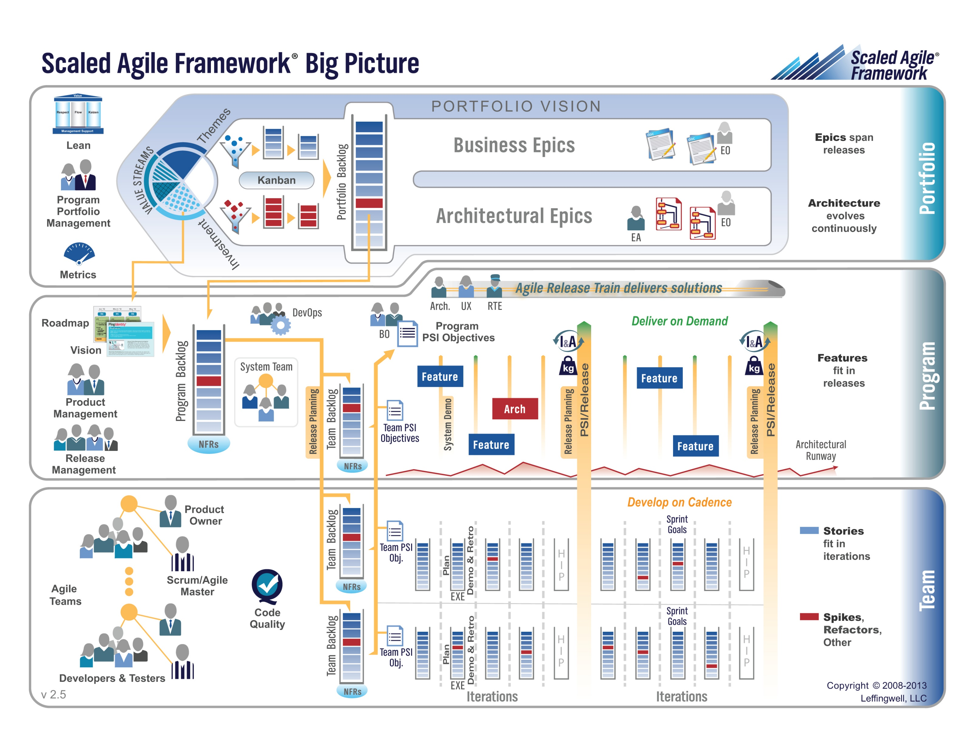

Slide 24
Step 2: Epic (Portfolio) Backlog Grooming
Actions & Requirements:
Product Owner to lead the review and/or creation of Epics
There must be one list of Epics managed by the Product Owner
Each Epic must deliver customer functionality and value
Epics should be written in User Story format
Epics must be prioritized and forced ranked
Each product must have at least three Epics
Epic Backlog Grooming report questions (Scrum Master):
How many Epics are in your Epic Backlog?
How many are force ranked?
What are your top three Epics in ranked order?

Slide 25
Step 3: Product Backlog Grooming (Stories)

Slide 26
Step 3: Product Backlog Grooming (User Stories)
By Dr ian mitchell - Own work, CC BY-SA 4.0, Link

Slide 27
Recall User Stories, the Product Backlog, and Done
Recall that User Stories must:
Be written in User Story format
Deliver user (customer) value
Be associated with Epic in Scaled Agile
Recall that the Product Product Backlog is:
Managed by to Product Owner
The team’s master list of prioritized (force ranked) User Stories
Opinion: The team’s master list of all important project work (spikes, continuous improvement, etc.)
Recall that “Done” must be well defined and for us includes at a minimum:
Successfully deployed and integration tested in the production environment
Demoed to the Product Owner
Available to be demoed to the class
Notes:
How will you handle dependancies?

Slide 28
Step 3: Product Backlog Grooming (Stories)
Recall User Story Estimation
Product Owner to lead the estimating of User Stories.
Each User Story must have an estimated effort in Story Points
For our purposes assume 1 Story Point is approximately equal to 1 hour of effort
Each User Story must be deliverable in a single sprint

Slide 29
Step 3: Product Backlog Grooming (Stories)
Update Product Backlog by:
Relocating “Done” User Stories “Done” list
Relocating “Pending” User Stories to the “Pending” list
Reviewing remaining User Stories
Creating new User Stories
Prioritize and rank important stories (anything that might make it to the Sprint Backlog)
Provide Story Point estimates for important stories
Product Backlog report out questions (Product Owner):
What is the total number of user stories?
What are you top three user stories?
What spikes do you have in your backlog?
Notes:
How will you handle dependancies?

Slide 30
Step 3: Product Backlog Grooming (Stories)
Future Considerations:
Consider required Spikes and treat them as a User Story that does not deliver user value
Consider User Story and Spike dependencies
Consider “at risk” commitments in current Sprint
Notes:
How will you handle dependancies?

Slide 31
Step 4: Sprint Planning

Slide 32
Step 4: Sprint Planning
By Dr ian mitchell - Own work, CC BY-SA 4.0, Link

Slide 33
Step 4: Recall Team Capacity Estimation and Cut Line
Activities:
Estimate Scrum Team Capacity current sprint by multiplying the number of team members times 10 hours each team member
Review your Product Backlog and draw your “cut line” to create your Sprint Backlog
Consider leaving some unutilized capacity to account for potential missed commitments (carry-over stories)

Slide 34
Step 4: Sprint Planning
Requirements & Activities:
Scrum Master and Product Owner lead effort to create Sprint Backlog
Move highest ranked Product Backlog stories to Sprint backlog until capacity is utilized
Comment: Your tools and formats you utilize for managing stories and backlogs are your own, but you need to be comfortable in showing how you choosing to do it.
Product Backlog report out questions (Scrum Master):
Do you have a prioritized backlog of stories?

Slide 35
Step 5: Commitment to Sprint Backlog

Slide 36
Step 5: Sprint Backlog Commitment
By Dr ian mitchell - Own work, CC BY-SA 4.0, Link

Slide 37
Step 5: Sprint Backlog Commitment
The team commits to completing (fulfilling “Done” for each committed story) the stories in the Sprint backlog.
It is acceptable to miss commitments in Agile and Scrum.
However, it is required that we:
Be non-ambiguous in our commitments
Commit and deliver as a team
Be transparent in our actions
Commit to continuous improvement
Product Backlog report out questions (Scrum Master):
What is your sprint 3 product backlog?

Slide 38
Step 6: Celebrate
Recognize your teammates that stepped up. Tell them “Well done!”
Celebrate report out questions (Scrum Master & Product Owner):
How do you feel about your sprint 3 planning?

Slide 39
Prework For Next Class
Everything is due Sunday
Be prepared for to demo your team’s sprint 2 product
Be prepared for sprint 7 reviews, retrospectives, and demos
Be prepared for sprint 8 planning

Slide 40
End of Session

