Slide 1

Preflight Check List
Everyone:
Sign into our Zoom meeting through our integrated Blackboard/Zoom link
Make sure that you can hear the conversation, see shared desktops, and view group chat topics
You will need a headset with a microphone to be able to effectively listen and speak
You will need to be able to share your computer screen
Thank you if you choose to leave your camera on to help make our class more interactive
In person participants also:
Make sure that your microphone and speakers are muted/off so that we don’t get an echo
Sit in a good spot near the classroom ceiling microphones if possible

Slide 2
Preparation
Let’s invest our first few minutes of class in preparing ourselves.
Prework:
Everything is due Sunday
Be prepared for sprint 8 planning
Be prepared to focus on your final project
Start Recording

Slide 3
Agenda:
Prework and Announcements
Sprint 8 Planning
Scrum Team Sprint 8 Planning
Prework for Next Class
Programming Together (as time allows)
Discussion & Questions welcome at any time but please be present with no phones or email during our time together

Slide 4
Sprint Planning

Slide 5
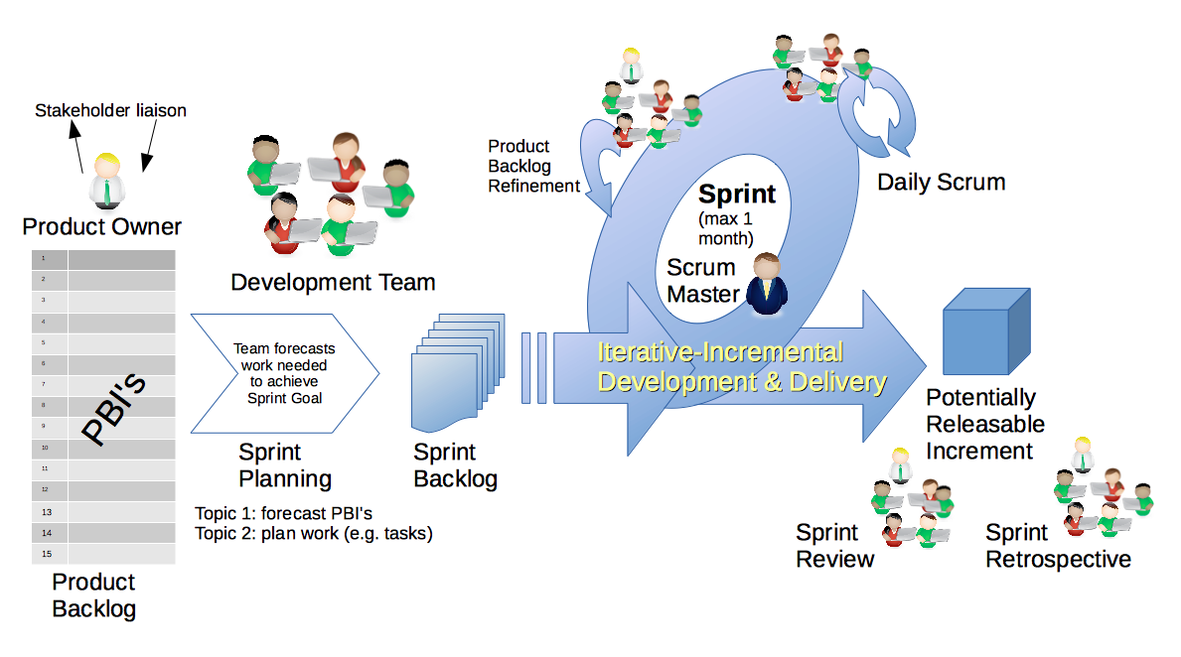
Scrum Process – Sprint Planning
By Dr ian mitchell - Own work, CC BY-SA 4.0, Link

Slide 6
Sprint 8 Planning
Sprint 8 week 1:
Normal class schedule
Sprint 8 planning today
Sprint 7 Demos, Retrospective, and Chapter discussion on Wednesday
Quiz 8 and Lab on Friday

Slide 7
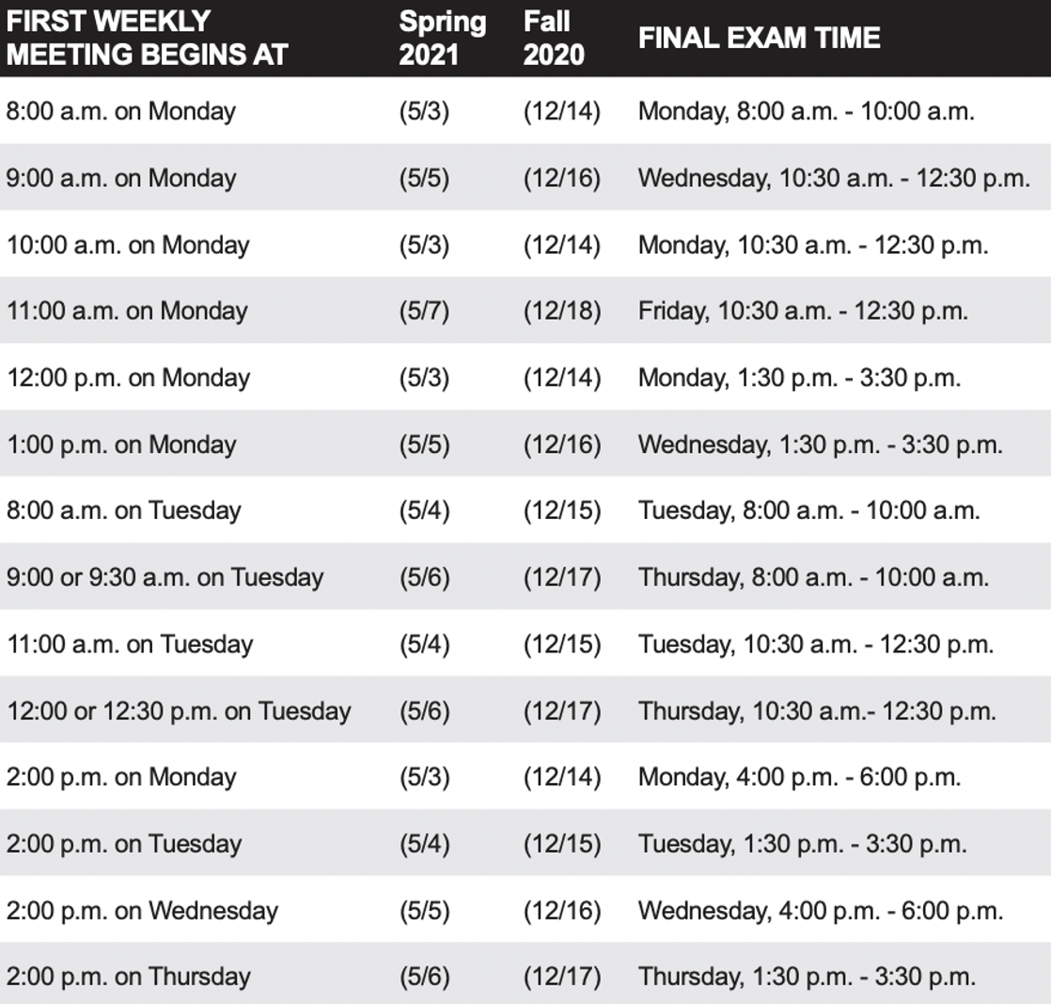
Sprint 8 Planning
Sprint 8 week 2:
Finals week starts Monday, May 3rd
No regular classes during finals week
Final project presentations will be during our final exam time time
All assignments are due 2 hours before our scheduled final exam time
You may resubmit assignments up until the end of the day Thursday, May 6th
You need to let me know during your final project presentation if you will be resubmitting Lab 8

Slide 8
Review Activities List and Assignments

Slide 9
Scrum Team Sprint Planning
As a scrum team:
Review sprint activities & assignments in detail
Discuss questions/concerns and topics that need more clarification
Has everyone confirmed their final project name and presentation time?
Scrum master share your team’s top 2 questions/concerns during report out

Slide 10
Review Demo Schedule
This is the last chance to demo

Slide 11
Prework For Next Class
Complete through activity 5 prior to next class
Be prepared for demos
Be prepared for scrum team review of “Application Architectures, Object-Oriented Programming, and Databases - Part 2”
Be prepared for retrospectives
Upcoming Friday:
Quiz 8

Slide 12
Programming Together
(as time allows)

Slide 13
End of Session

