Slide 1

Preflight Check List
Everyone:
Sign into our Zoom meeting through our integrated Blackboard/Zoom link
Make sure that you can hear the conversation, see shared desktops, and view group chat topics
You will need a headset with a microphone to be able to effectively listen and speak
You will need to be able to share your computer screen
Thank you if you choose to leave your camera on to help make our class more interactive
In person participants also:
Make sure that your microphone and speakers are muted/off so that we don’t get an echo
Sit in a good spot near the classroom ceiling microphones if possible

Slide 2
Preparation and Reflection
Please spend the first few minutes of class reviewing our assigned prework:
Complete through activity 7 prior to next class
Be prepared for scrum team discussion of “Application Architectures, Object-Oriented Programming, and Databases - Part 2”
Be prepared for Quiz 8
Start Recording

Slide 3
Agenda:
Sprint 2 Demos (continued)
Team Discussion of “Application Architectures, Object-Oriented Programming, and Databases”
Final Project Presentations
Prework for Next Class
Quiz 8
Discussion & Questions welcome at any time but please be present with no phones or email during our time together

Slide 4
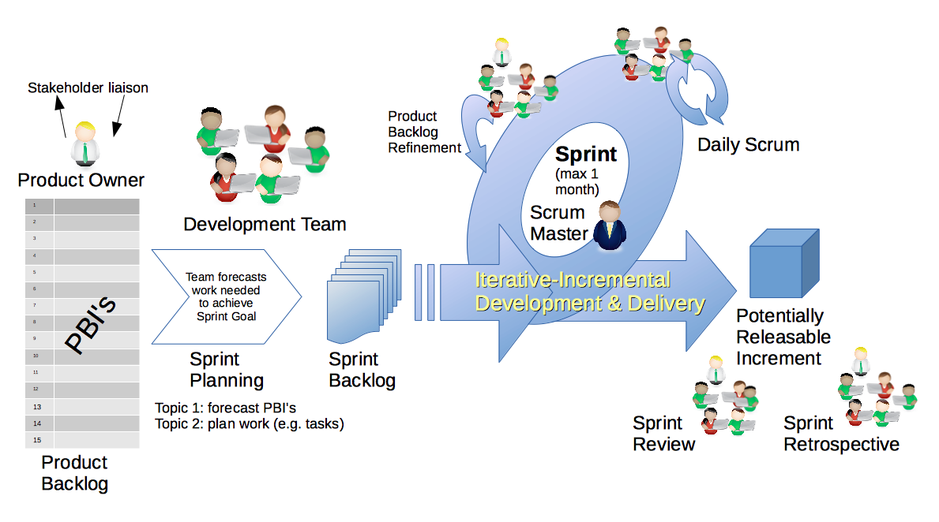
Scrum Process – Sprint Review & Demo
By Dr ian mitchell - Own work, CC BY-SA 4.0, Link

Slide 5
Demo Guidelines – Presenter
Everyone will give at least one demo of their work during the semester.
Your demo should be 2 to 5 minutes and can include any or all of the following:
Show your application running
Comment on your implementation
Show the source code
Explain how you organized the code
Talk about any challenges
You should not prepare slides or a presentation
**You will also need to complete the Demo assignment in Blackboard.

Slide 6
Demo Guidelines – Listener
Everyone will be listening to many demos during the semester.
Your listener responsibilities include:
Actively listening and watching what is being demoed
Come up with a meaningful yet easy to answer question
Ask your question if the presenter does not get sufficient questions from other listeners
Do not ask hard question or attempt to review the presenters code
Clap for the presenter at the end of the demo and thank them for presenting
Optionally follow up with the presenter later if you have what could be more difficult questions or if you have suggestions

Slide 7
Sprint & Product Demos

Slide 8
Complete Sprint Demo Assignment

Slide 9
Recall Team Discussion
Topic: Application Architectures, Object-Oriented Programming, and Databases - Part 1:
Scrum Master accepts volunteers for (or assigns) Presenter
Team discusses and presenter summarizes the topics including:
Three-tier Application Architecture
Object-Oriented Programming Concepts, Patterns, Principles
Horizontal vs Vertical Scaling
Files, JSON/XML, Binary, and Shared Files
SQL and NoSQL Databases
Database Pros & Cons
Shared Data
ORM?
Team sits back, relaxes, and acknowledges the bravery and dedication of the presenter
Team returns to class Zoom session where presenter presents summary
Report Out

Slide 10
Team Discussion
Topic: Application Architectures, Object-Oriented Programming, and Databases - Part 2:
Scrum Master accepts volunteers for (or assigns) Presenter
Team discusses and presenter summarizes the topics including:
Explore Two-Tier (client-server) Implementations and Limits… Shared data? Web technologies?
Object-Oriented Programming – The Dark Ages (OMG)… CORBA? Web services? REST?
Introduce Three-Tier (n-tier) Architectures…. Shared data practices? Web technologies?
Server Side Programming, NoSQL Database, and Azure Tables… JSON/REST?
Team sits back, relaxes, and acknowledges the bravery and dedication of the presenter
Team returns to class Zoom session where presenter presents summary
Report Out

Slide 11
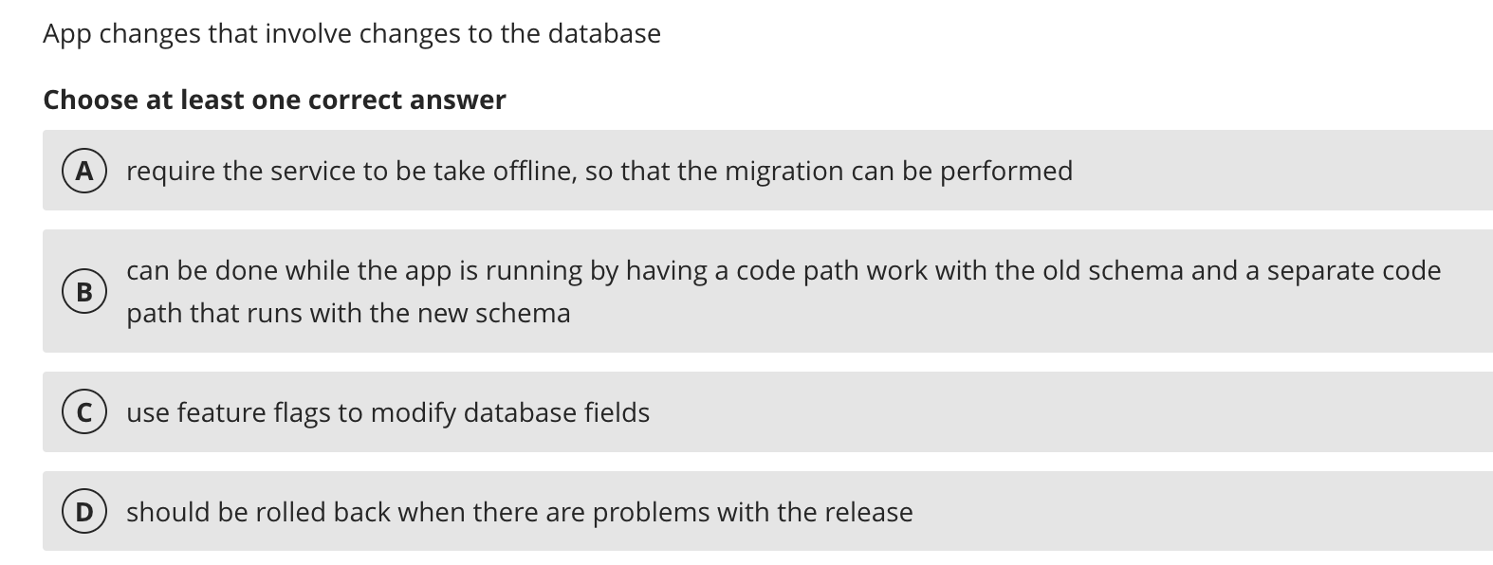
Bonus Topic – Database Schema

Slide 12
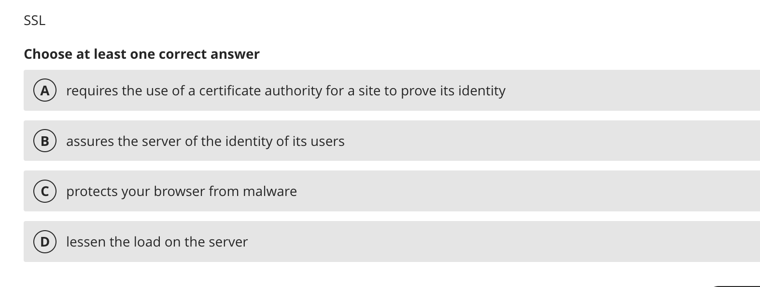
Bonus Topic – SSL & HTTPs

Slide 13
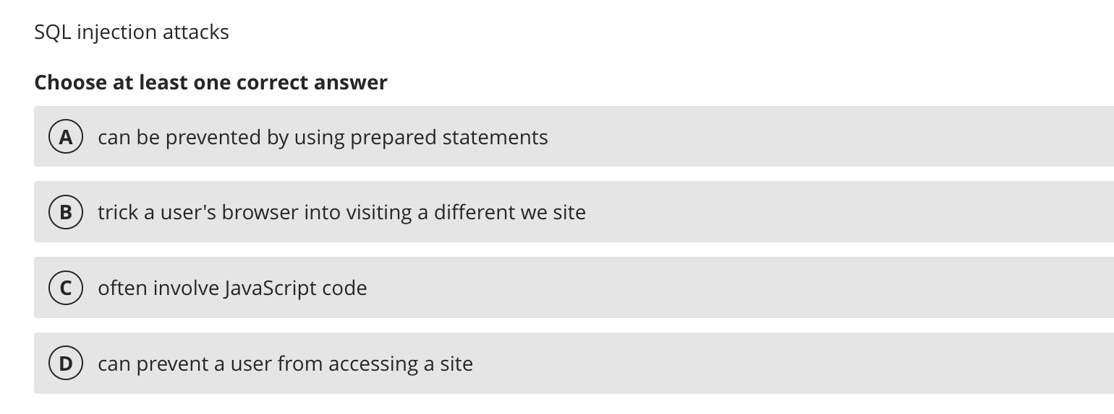
Bonus Topic – SQL Injection Attacks

Slide 14
Prework For Next Class
Be prepared Final Project presentations during our final exam time

Slide 15
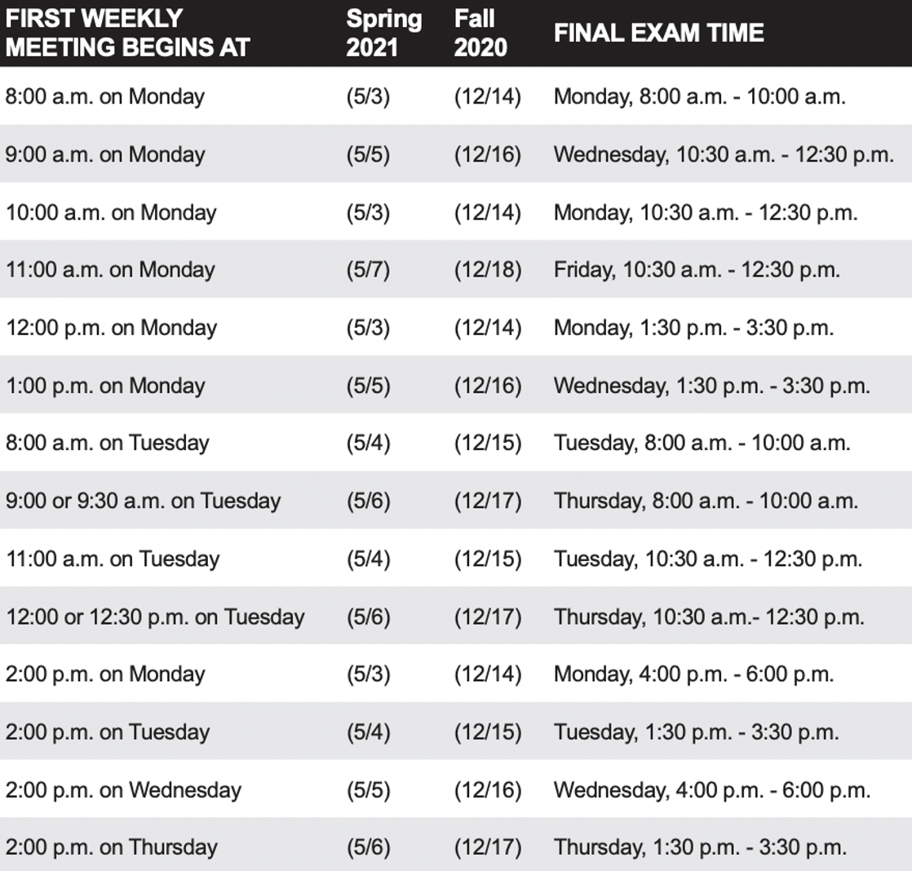
Sprint 8 Planning
Sprint 8 Week 2:
Finals week starts Monday, May 3rd
No regular classes during finals week
Final project presentations will be during our final exam time time
All assignments are due 2 hours before our scheduled final exam time
You may resubmit assignments up until the end of the day Thursday, May 6th
You need to let me know during your final project presentation if you will be resubmitting Lab 8

Slide 16
Review Final Project
Presentation Exceptions?

Slide 17
Thank You!

Slide 18
Quiz 8

Slide 19
End of Session

