Slide 1
Network Architecture & Protocols

Slide 2
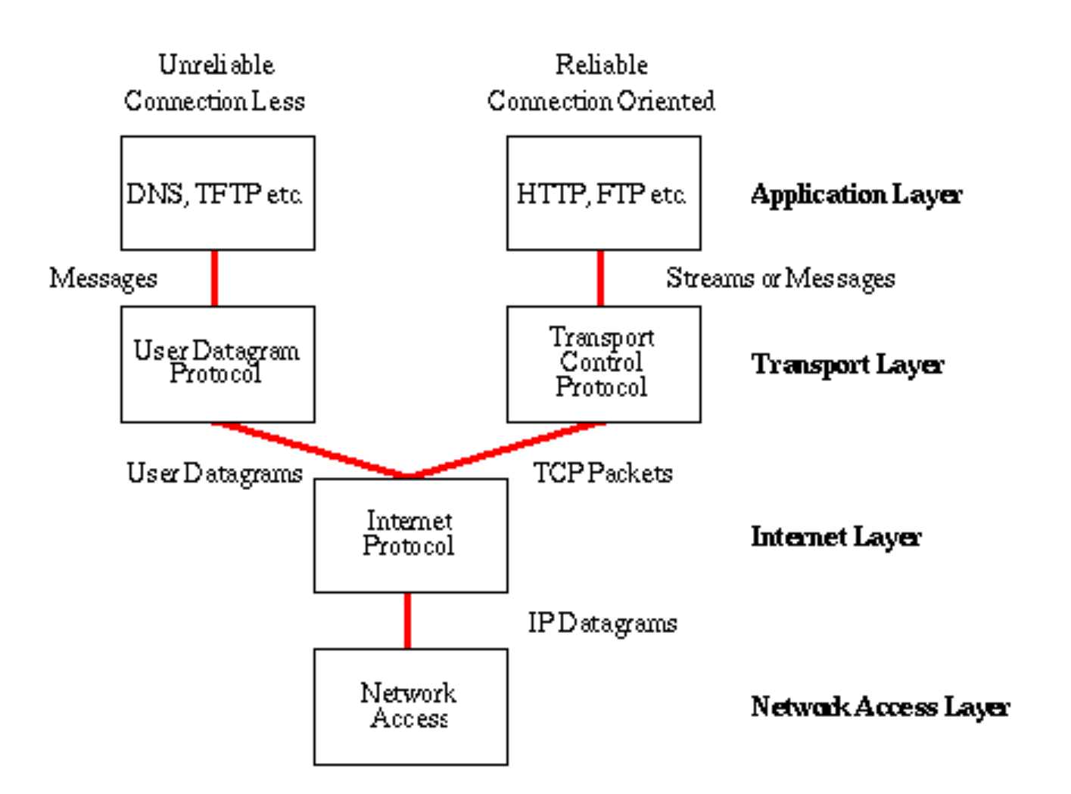
Network Architecture – The Internet
The Internet [link]
IP (Internet Protocol) [link]
TCP (Transmission Control Protocol) [link]
TCP/IP
UDP (User Datagram Protocol) [link]
UDP/IP
TCP/IP or UDP/IP Socket [link]
TCP and UDP Protocols & Port Numbers [link]

Slide 3
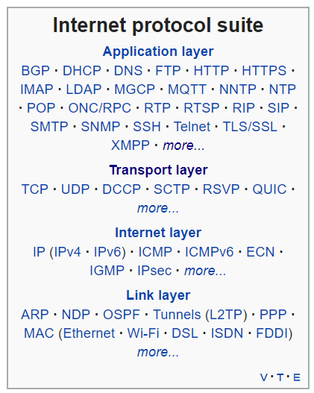
Network Architecture – The Web
The Web [link]
HTTP (Hypertext Transfer Protocol) [link]
DNS (Domain Name System) [link]
HTML (Hypertext Markup Language) [link]
CSS (Cascading Style Sheets) [link]
JavaScript [link]
Internet Protocol Suite [link]

Slide 4
Network Architecture – Distributed Computing
RPC (Remote procedure call) [link]
… SOA (service-oriented architecture) version 1
Java RMI (Java remote method invocation) [link]
DCOM (Distributed Component Object Model) [link]
CORBA (Common Object Request Broker Architecture) [link]
… [The Web takes over the world]
XML (Extensible Markup Language) [link]
XML-RPC (XML & HTTP) [link]
Internet Protocol Suite [link]

Slide 5
Network Architecture – Web Services
Web Services [link]
…SOA (service-oriented architecture) version 2
XML (Extensible Markup Language) [link]
XML-RPC (XML & HTTP) [link]
SOAP (Simple Object Access Protocol) [link]
JSON (JavaScript Object Notation) [link]
REST (Representational State Transfer) [link]
Internet Protocol Suite [link]

Slide 6
Network Architecture – Back to the Future
Web Services [link]
…SOA (service-oriented architecture) version 2 [link]
JSON (JavaScript Object Notation) [link]
REST (Representational State Transfer) [link]
gRPC [link] Or https://grpc.io/faq/
REST vs gRPC
REST vs. gRPC: Battle of the APIs [link]
Evaluating Performance of REST vs. gRPC [link]
Internet Protocol Suite [link]

Slide 7
Network Architecture – The Internet
The Internet [link]
IP (Internet Protocol) [link]
TCP (Transmission Control Protocol) [link]
TCP/IP
UDP (User Datagram Protocol) [link]
UDP/IP
TCP/IP or UDP/IP Socket [link]
TCP and UDP Protocols & Port Numbers [link]

Slide 8
Network Architecture – The Web
The Web [link]
HTTP (Hypertext Transfer Protocol) [link]
DNS (Domain Name System) [link]
HTML (Hypertext Markup Language) [link]
CSS (Cascading Style Sheets) [link]
JavaScript [link]

Slide 9
Network Architecture – Distributed Computing
RPC (Remote procedure call) [link]
… SOA (service-oriented architecture) version 1
Java RMI (Java remote method invocation) [link]
DCOM (Distributed Component Object Model) [link]
CORBA (Common Object Request Broker Architecture) [link]
…
XML (Extensible Markup Language) [link]
XML-RPC (XML & HTTP) [link]

Slide 10
Network Architecture – Web Services
Web Services [link]
…SOA (service-oriented architecture) version 2 [link]
XML (Extensible Markup Language) [link]
XML-RPC (XML & HTTP) [link]
SOAP (Simple Object Access Protocol) [link]
JSON (JavaScript Object Notation) [link]
REST (Representational State Transfer) [link]
https://en.wikipedia.org/wiki/GRPC

Slide 11
Network Architecture – Back to the Future
JSON (JavaScript Object Notation) [link]
REST (Representational State Transfer) [link]
gRPC [link]
REST vs gRPC
REST vs. gRPC: Battle of the APIs [link]
Evaluating Performance of REST vs. gRPC [link]

Slide 12
Web Services, REST, SOAP, and CORs

Slide 13

Web Services
In a web service, the Web technology such as HTTP—originally designed for human-to-machine communication—is utilized for machine-to-machine communication, more specifically for transferring machine-readable file formats such as XML and JSON.
In practice, a web service commonly provides an object-oriented web-based interface to a database server, utilized for example by another web server, or by a mobile app, that provides a user interface to the end user.
Many organizations that provide data in formatted HTML pages will also provide that data on their server as XML or JSON, often through a web service to allow syndication

Slide 14
REST vs. SOAP

Slide 15
REST
Representational State Transfer (REST) is an architectural style that defines a set of constraints and properties based on HTTP. Other kinds of web services, such as SOAP web services, expose their own arbitrary sets of operations.
"Web resources" were first defined on the World Wide Web as documents or files identified by their URLs. However, today they have a much more generic and abstract definition that encompasses every thing or entity that can be identified, named, addressed, or handled, in any way whatsoever, on the web. In a RESTful web service, requests made to a resource's URI will elicit a response that may be in HTML, XML, JSON, or some other format. The response may confirm that some alteration has been made to the stored resource, and the response may provide hypertext links to other related resources or collections of resources. When HTTP is used, as is most common, the operations available are GET, POST, PUT, DELETE, and other predefined CRUD HTTP methods.
By using a stateless protocol and standard operations, REST systems aim for fast performance, reliability, and the ability to grow, by re-using components that can be managed and updated without affecting the system as a whole, even while it is running.

Slide 16


CORS
Cross-Origin Resource Sharing (CORS): CORS is a mechanism that uses additional HTTP headers to tell a browser to let a web application running at one origin (domain) have permission to access selected resources from a server at a different origin. A web application makes a cross-origin HTTP request when it requests a resource that has a different origin (domain, protocol, and port) than its own origin.
An example of a cross-origin request: The frontend JavaScript code for a web application served from http://domain-a.com uses XMLHttpRequest to make a request for http://api.domain-b.com/data.json.
For security reasons, browsers restrict cross-origin HTTP requests initiated from within scripts. For example, XMLHttpRequest and the Fetch API follow the same-origin policy. This means that a web application using those APIs can only request HTTP resources from the same origin the application was loaded from, unless the response from the other origin includes the right CORS headers.
Notes:
https://developer.mozilla.org/en-US/docs/Web/HTTP/CORS
https://www.youtube.com/watch?v=o8puzjzpjqo

