Slide 1

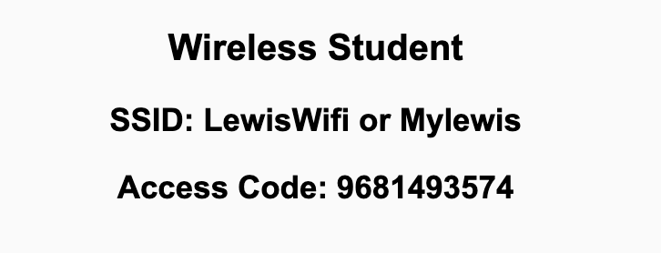
Preflight Check List
Sign into our Zoom meeting through our integrated Blackboard/Zoom link
Make sure that you can hear the conversation, see shared desktops, and view chat topics
Thank you if you choose to leave your camera on to help make our class more interactive
Be prepared to share your computer screen
Be prepared to utilize a headset with a microphone
In person participants also:
Make sure that your microphone and speakers are muted/off so that we don’t get an echo
Sit in a good spot near the classroom ceiling microphones if possible

Slide 2
Recordings
Discuss that recording are:
Opportunistic
Automatically available in Blackboard/Zoom
Start Recording

Slide 3
Agenda:
Prework and Announcements
Sprint Progress Polling
Sprint 1 Planning (continued)
Prework for Next Class
Breakout: Scrum Team Review, Discord Setup, and Planning Review
Discussion & Questions welcome at any time but please be present with no phones or email during our time together

Slide 4
Prework & Announcements
Before class today we were anticipating that we would be able to:
Complete through activity 6 prior to next class
Be ready to test your scrum team discussion capabilities with your team Discord server
Get your headset with microphone for teaming and programming together activities

Slide 5
Polling – Sprint Progress

Slide 6
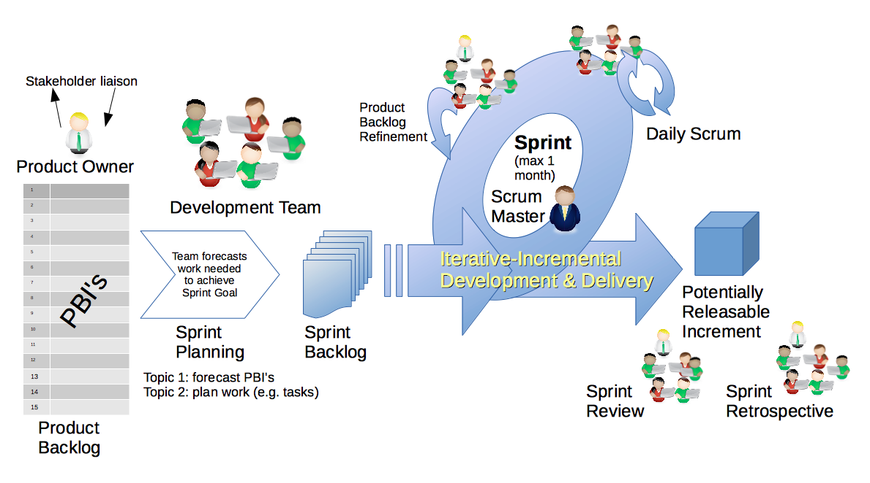
Scrum Process – Sprint Planning
By Dr ian mitchell - Own work, CC BY-SA 4.0, Link

Slide 7
Review Activities List,
Assignments, and Syllabus

Slide 8
Prework For Next Class
Prior to our next class please:
Complete through activity 10 prior to next class
Suggestion: Don’t forget to take screenshots when completing Tools of the Trade
Be prepared for your Scrum Team review and report out of “Computer Science Illuminated” chapter 11 File Systems and Directories
Recall: Fridays are fully remote sessions.

Slide 9
Breakout: Scrum Team Review, Planning, and Discord Setup
Review Scrum Team Members
Sprint 1 Planning Review
Set up your scrum team Discord server by:
Making sure everyone has a Discord account
Setting up a Discord server (with your team name if possible) and granting access
Test audio, video, and desktop sharing in Discord
Report Out:
What is your team name?
Do you have your Discord server set up?
What are the top two questions or concerns relating to our sprint 1 activities list, sprint 1 assignments, and/or our class syllabus?

Slide 10
End of Session

Slide 11
Preview: Scrum Team Chapter Discussion on Chapter 11
Chapter 11 Discussion on Files and File Systems:
Assign presenter
Team discusses chapter topics while the presenter summarizes the topics below:
Files and File Types… Are all text files also binary?
File Systems, Directories, and Directory Trees… Where would be a good place to store your class files? Why?
Review Lab question on where should and shouldn’t store you class files… How would you answer the question?
Hidden Files and Directories… Are hidden files a good way to keep information safe from hackers?
Can you (should you)… be able to find directories and files from the terminal?
Team sits back, relaxes, and acknowledges the bravery and dedication of the presenter

