Slide 1

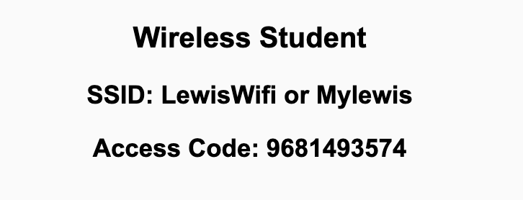
Preflight Check List
Sign into our Zoom meeting through our integrated Blackboard/Zoom link
Make sure that you can hear the conversation, see shared desktops, and view chat topics
Thank you if you choose to leave your camera on to help make our class more interactive
Be prepared to share your computer screen
Be prepared to utilize a headset with a microphone
In person participants also:
Make sure that your microphone and speakers are muted/off so that we don’t get an echo
Sit in a good spot near the classroom ceiling microphones if possible

Slide 2
Recordings
Discuss that recording are:
Opportunistic
Automatically available in Blackboard/Zoom
Start Recording

Slide 3
Agenda:
Prework and Announcements
Sprint Progress Polling
Scrum Team Discussion of “Computer Science Illuminated” chapter 1
Prework for Next Class
Quiz 1
Discussion & Questions welcome at any time but please be present with no phones or email during our time together

Slide 4
Prework
No class Monday due to the Labor Day holiday.
Prior to our Wednesday class please:
Complete through activity 13 prior to next class
Be mostly complete with activity 14
Be prepared for your Scrum Team review and report out on Dale chapter 1
Be prepared for Quiz 1
Reminder: Your initial Discussion 1 post was due Sunday.

Slide 5
Polling – Sprint Progress

Slide 6
Breakout Discussion on chapter 1 The Big Picture
Assign presenter
Team discusses chapter topics while the presenter summarizes the items below:
What is abstraction? Is it always good? Can you give a good and a bad example of abstraction?
What are the top two historical events in computing? Why?
What is algorithmic thinking and representation?
Describe programming and design? How much to they overlap?
Team sits back, relaxes, and acknowledges the bravery and dedication of the presenter

Slide 7
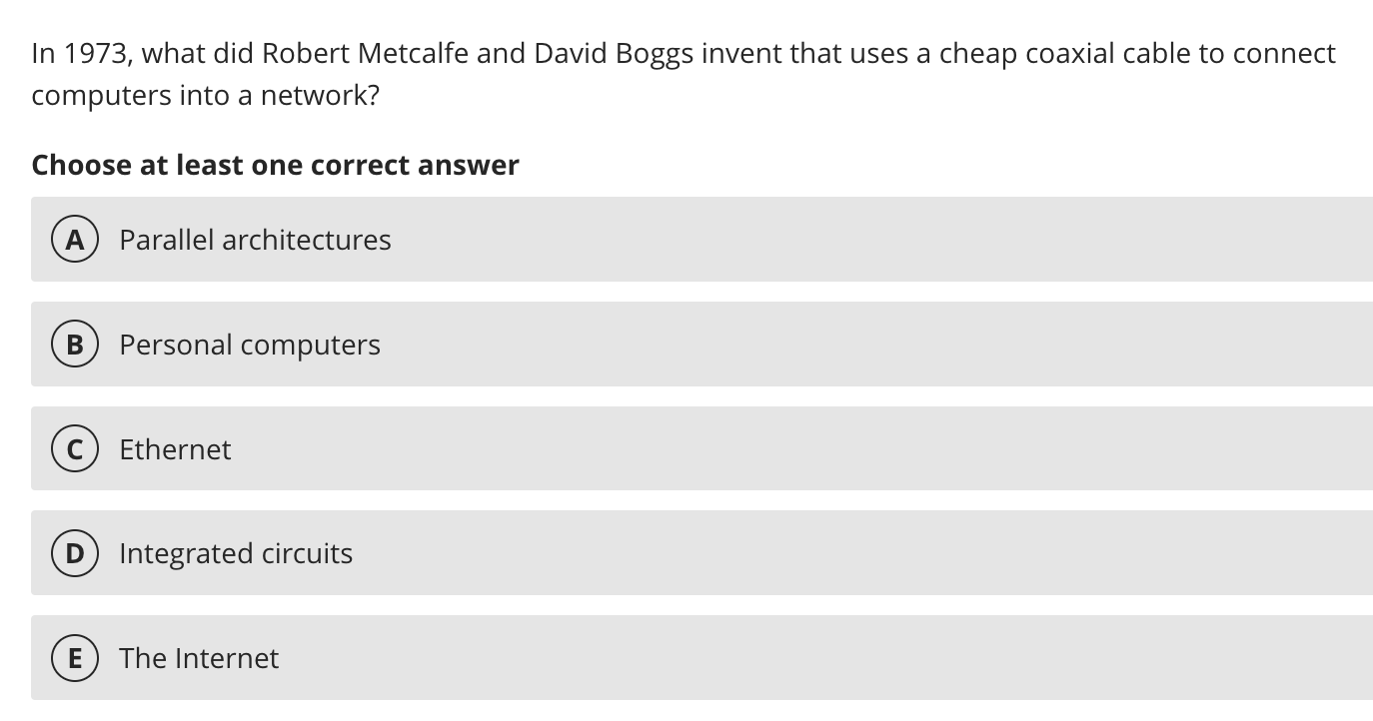

Slide 8
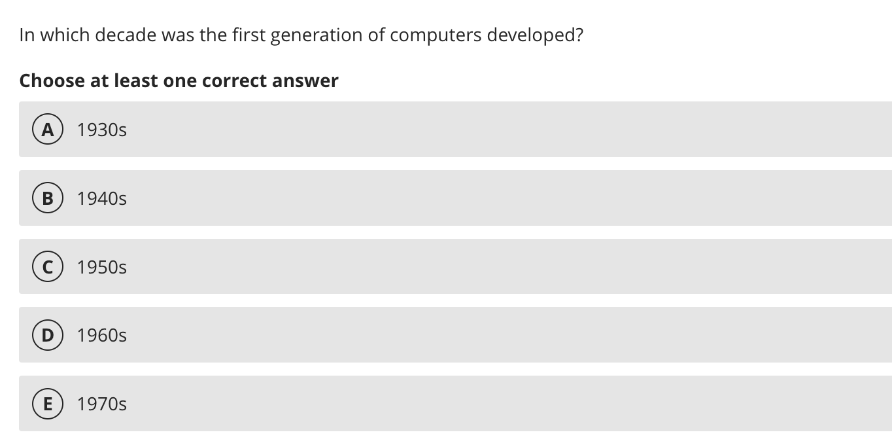

Slide 9
Prework For Next Class
Friday class is all virtual.
Prior to our class please:
Complete through activity 14 prior to next class
Be mostly complete with activity 15
Be prepared for working together on Lab 1 in class

Slide 10
Quiz 1
A sincere attempt at quiz 1 is due
before you leave class today.

Slide 11
End of Session

Slide 12
Foreshadowing Sprint Demos

Slide 13
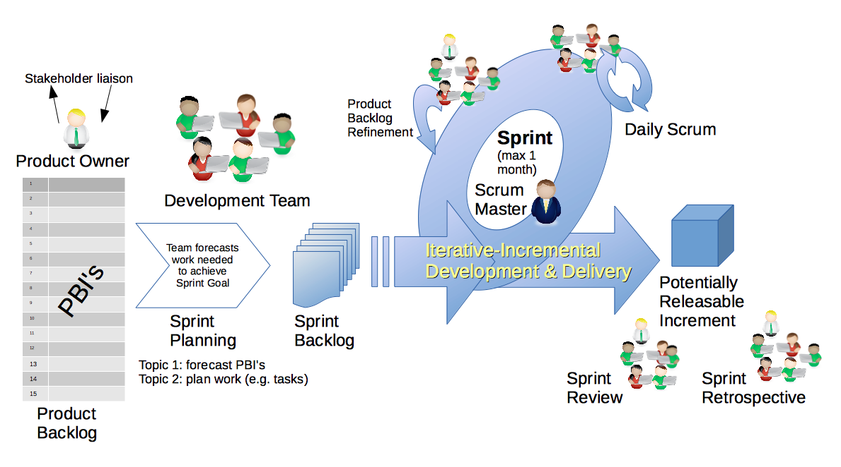
Scrum Process – Sprint Review & Demo
By Dr ian mitchell - Own work, CC BY-SA 4.0, Link

Slide 14

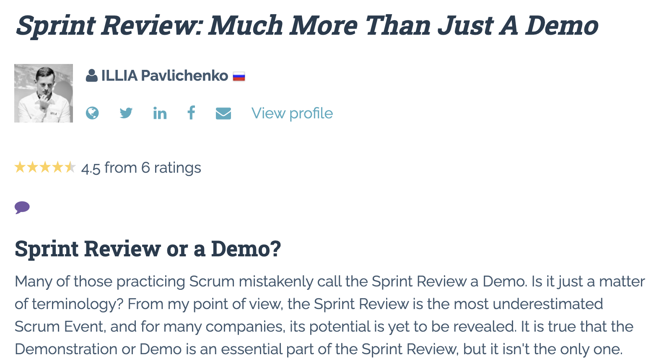

Slide 15
Demo Guidelines – Presenter
Everyone will give at least one demo of their work during the semester.
Your demo should be 2 to 5 minutes and can include any or all of the following:
Show your application running
Comment on your implementation
Show the source code
Explain how you organized the code
Talk about any challenges
You should not prepare slides or a presentation
**You will also need to complete the Demo assignment in Blackboard.

Slide 16
Demo Guidelines – Listener
Everyone will be listening to many demos during the semester.
Your listener responsibilities include:
Actively listening and watching what is being demoed
Come up with a meaningful yet easy to answer question
Ask your question if the presenter does not get sufficient questions from other listeners
Do not ask hard question or attempt to review the presenters code
Clap for the presenter at the end of the demo and thank them for presenting
Optionally follow up with the presenter later if you have what could be more difficult questions or if you have suggestions

Slide 17
Review Demo Schedule

