Slide 1

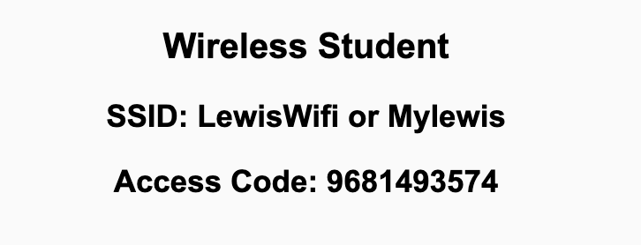
Preflight Check List
Sign into our Zoom meeting through our integrated Blackboard/Zoom link
Make sure that you can hear the conversation, see shared desktops, and view chat topics
Thank you if you choose to leave your camera on to help make our class more interactive
Be prepared to share your computer screen
Be prepared to utilize a headset with a microphone
In person participants also:
Make sure that your microphone and speakers are muted/off so that we don’t get an echo
Sit in a good spot near the classroom ceiling microphones if possible

Slide 2
Recordings
Discuss that recording are:
Opportunistic
Automatically available in Blackboard/Zoom
Start Recording

Slide 3
Agenda:
Prework and Announcements
Sprint Progress Polling
Scrum Team Discussion of “Computer Science Illuminated” chapter 1
Prework for Next Class
Quiz 1
Discussion & Questions welcome at any time but please be present with no phones or email during our time together

Slide 4
Prework For Next Class
No class Monday due to the Labor Day holiday.
Prior to our Wednesday class please:
Complete through activity 13 prior to next class
Be mostly complete with activity 14
Be prepared for your Scrum Team review and report out on Sebesta chapter 1
Be prepared for Quiz 1

Slide 5
Polling – Sprint Progress

Slide 6
Scrum Team Sebesta Chapter 1
Scrum Master accepts volunteers for (or assigns) Presenter
Team discusses and presenter summarizes the topics from Chapter 2 including:
The Internet vs The Web plus Web Browser and Web Servers
Uniform Resource Identifiers (URIs) and Uniform Resource Locators (URLs) plus Domain Names
Hypertext Transfer Protocol (HTTP) and Hypertext Transfer Protocol Secure (HTTPS) plus Multipurpose Internet Mail Extensions (MIMEs)
Client / Browser: HTML, JavaScript, Flash, Browser plug-ins
Communication: AJAX, REST, and XML (JSON)
Server: PHP, Java (Servlets), .NET (ASP), and Ruby on Rails
Security including Privacy, Integrity, Authentication, Authorization, and Nonrepudiation
Team sits back, relaxes, and acknowledges the bravery and dedication of the presenter
Team returns to class Zoom session where presenter presents summary

Slide 7
Prework For Next Class
Friday class is all virtual.
Prior to our class please:
Complete through activity 15 prior to next class
Be mostly complete with activity 16
Be prepared for working together on Lab 1 in class

Slide 8
Quiz 1
A sincere attempt at quiz 1 is due
before you leave class today.

Slide 9
End of Session

Slide 10
Scrum Team Chapter Review
Assign presenter
Team discusses topics while the presenter summarizes the 5 topics below:
JavaScript
AJAX
XML/JSON
Single-Page Web Applications
Angular, React, other single-page web application environments
Where does Jamstack fit?
Team sits back, relaxes, and acknowledges the bravery and dedication of the presenter
Fox Chapter 6 Saas Client Framework

Slide 11
Scrum Team Chapter Discussion
Assign presenter
Team discussing chapter topics while the presenter summarizes the 5 topics below:
The importance of Branching is VCS systems (which VCS focused on branching)
Where should pared programming fit into the development process
The priority of specialization vs generalization in Agile vs Waterfall/Iterative
The relative importance of PMs in Agile vs Waterfall/Iterative
The two most important book on managing people and conflict (according to the author)
Team sits back, relaxes, and acknowledges the bravery and dedication of the presenter
Fox Chapter 10 on Project Management, Scrum, Pairs, and Version Control Systems

