Slide 1

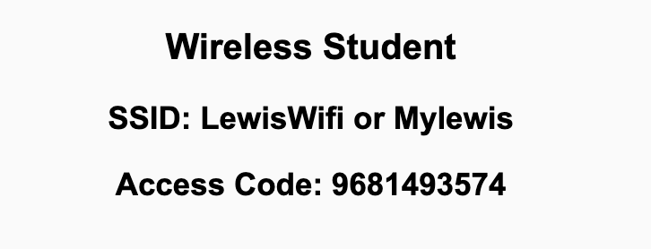
Preflight Check List
Sign into our Zoom meeting through our integrated Blackboard/Zoom link
Make sure that you can hear the conversation, see shared desktops, and view chat topics
Thank you if you choose to leave your camera on to help make our class more interactive
Be prepared to share your computer screen
Be prepared to utilize a headset with a microphone
In person participants also:
Make sure that your microphone and speakers are muted/off so that we don’t get an echo
Sit in a good spot near the classroom ceiling microphones if possible

Slide 2
Recordings
Discuss that recording are:
Opportunistic
Automatically available in Blackboard/Zoom
Start Recording

Slide 3
Agenda:
Prework and Announcements
Sprint Progress Polling
Agile Manifesto (continued)
Foreshadowing Sprint Demos
Prework for Next Class
Lab and Programming Together
Discussion & Questions welcome at any time but please be present with no phones or email during our time together

Slide 4
Prework
Friday class is all virtual.
Prior to our class please:
Complete through activity 15 prior to next class
Be mostly complete with activity 16
Be prepared for working together on Lab 1 in class

Slide 5
Polling – Sprint Progress

Slide 6
The Agile Manifesto
“We are uncovering better ways of developing software by doing it and helping others do it. Through this work we have come to value:
Individuals and interactions over processes and tools
Working software over comprehensive documentation
Customer collaboration over contract negotiation
Responding to change over following a plan
That is, while there is value in the items on the right, we value the items on the left more.”
Notes:
This was at best “hippy-ish” and egalitarian in its day. At worst sacrilegious.

Slide 7
The Agile Manifesto – The Flip Side
At fist glance The Agile Manifesto is very development team centric. However, successful agile are expected to make important commitments as well:
The rules (rituals) that we do have… we WILL follow
When we make commitments, we will live up to those commitments as a team (“No winners on a losing team, and no losers on a winning team”)
We will create, demo, and release working software/products
We will actively and voluntarily play important roles on our team
We will utilize practical processes, tools, documentation, and planning
We will be responsive and continuously improve (Retrospectives)
We will be transparent with how WE work and share our information

Slide 8
Foreshadowing Sprint Demos

Slide 9
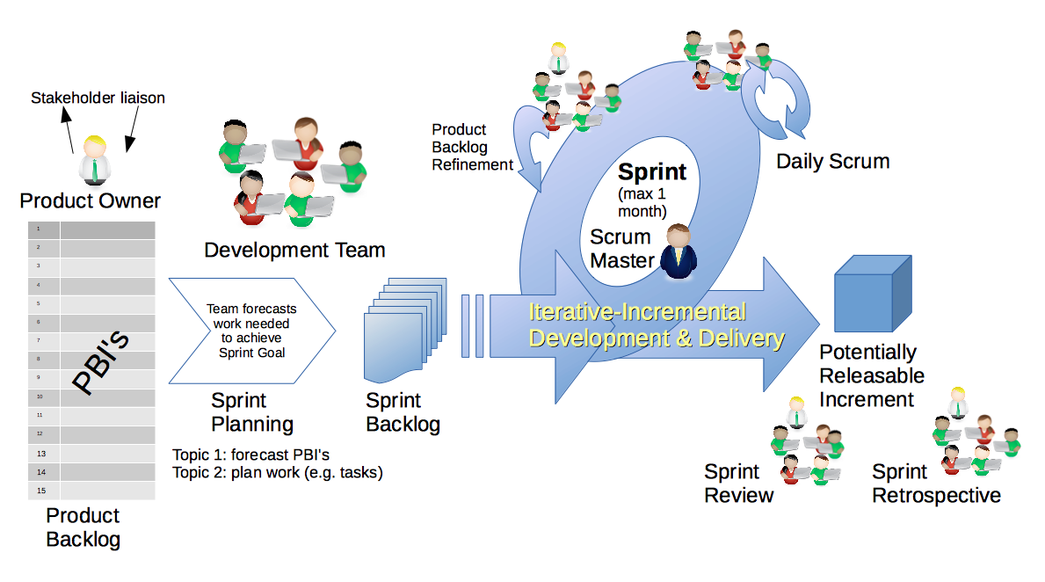
Scrum Process – Sprint Review & Demo
By Dr ian mitchell - Own work, CC BY-SA 4.0, Link

Slide 10

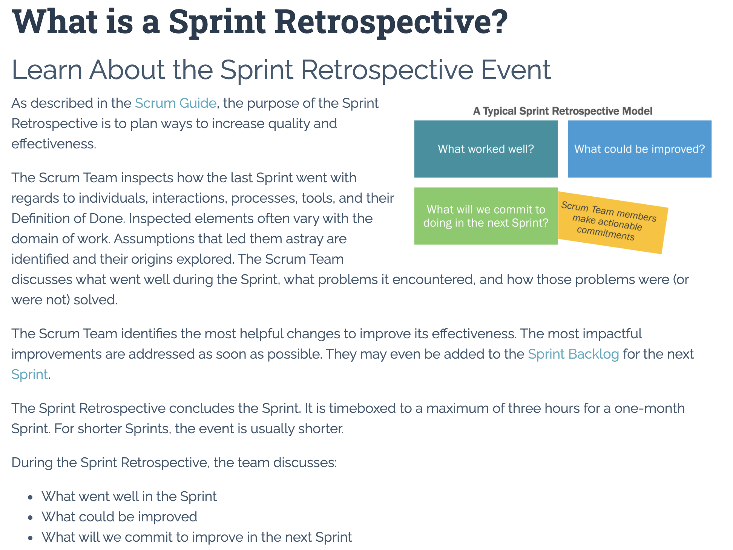

Slide 11
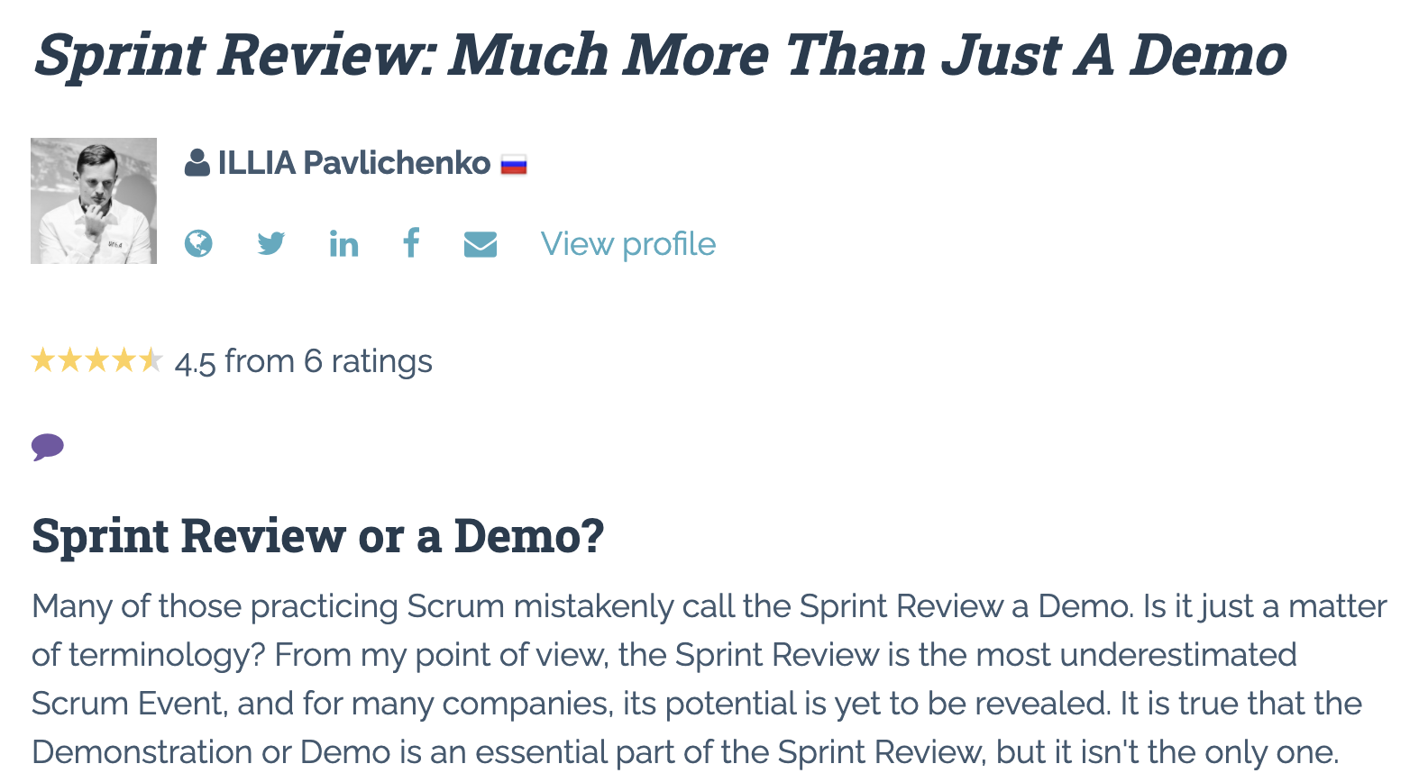

Slide 12
Demo Guidelines – Presenter
Everyone will give at least one demo of their work during the semester.
Your demo should be 2 to 5 minutes and can include any or all of the following:
Show your application running
Comment on your implementation
Show the source code
Explain how you organized the code
Talk about any challenges
You should not prepare slides or a presentation
**You will also need to complete the Demo assignment in Blackboard.

Slide 13
Demo Guidelines – Listener
Everyone will be listening to many demos during the semester.
Your listener responsibilities include:
Actively listening and watching what is being demoed
Come up with a meaningful yet easy to answer question
Ask your question if the presenter does not get sufficient questions from other listeners
Do not ask hard question or attempt to review the presenters code
Clap for the presenter at the end of the demo and thank them for presenting
Optionally follow up with the presenter later if you have what could be more difficult questions or if you have suggestions

Slide 14
Review Demo Schedule

Slide 15
Prework For Next Class
Everything is due Sunday!
Be prepared for Sprint 2 Planning Monday
Be prepared for Sprint 1 Demos, Sprint 1 Retrospective on Wednesday

Slide 16
Lab and Programming Together
Review Programming Together tutorials **
How can I help you with getting sprint 1 assignments complete?

Slide 17
Architecture and Tool Choices
There are many very good Language / Framework / Server options available including:
Ruby / Rails / Rack
JavaScript / Express / Node.js
Java / Spring / Tomcat
.NET / ASP.NET / IIS (Internet Information Services)
We will be focusing on JavaScript, Express, and Node.js.
We may attempt to include static web sites with serverless functions as an alternative.
MongoDB (Atlas) will be the preferred persistence / database solution.

Slide 18
Cloud Hosting Choices
There are also many very good cloud hosting services available including:
Amazon AWS
Microsoft Azure
Google App Engine
cloud9
GoDaddy
We will be focusing on the Microsoft Azure.

Slide 19
End of Session

Slide 20
Scrum Team Chapter Review
Assign presenter
Team discusses topics while the presenter summarizes the 5 topics below:
JavaScript
AJAX
XML/JSON
Single-Page Web Applications
Angular, React, other single-page web application environments
Where does Jamstack fit?
Team sits back, relaxes, and acknowledges the bravery and dedication of the presenter
Fox Chapter 6 Saas Client Framework

Slide 21
Scrum Team Chapter Discussion
Assign presenter
Team discussing chapter topics while the presenter summarizes the 5 topics below:
The importance of Branching is VCS systems (which VCS focused on branching)
Where should pared programming fit into the development process
The priority of specialization vs generalization in Agile vs Waterfall/Iterative
The relative importance of PMs in Agile vs Waterfall/Iterative
The two most important book on managing people and conflict (according to the author)
Team sits back, relaxes, and acknowledges the bravery and dedication of the presenter
Fox Chapter 10 on Project Management, Scrum, Pairs, and Version Control Systems

