Slide 1

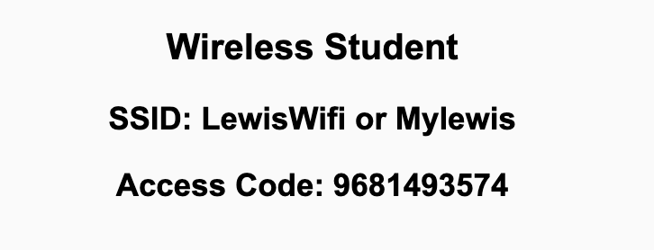
Preflight Check List
Sign into our Zoom meeting through our integrated Blackboard/Zoom link
Make sure that you can hear the conversation, see shared desktops, and view chat topics
Thank you if you choose to leave your camera on to help make our class more interactive
Be prepared to share your computer screen
Be prepared to utilize a headset with a microphone
In person participants also:
Make sure that your microphone and speakers are muted/off so that we don’t get an echo
Sit in a good spot near the classroom ceiling microphones if possible

Slide 2
Recordings
Discuss that recording are:
Opportunistic
Automatically available in Blackboard/Zoom
Start Recording

Slide 3
Agenda:
Prework and Announcements
Career Development and Resume Writing with Kelley Plass
Sprint 2 Planning
Prework for Next Class
Scrum Team Planning Review
Discussion & Questions welcome at any time but please be present with no phones or email during our time together

Slide 4
Prework
Everything is due Sunday!
Be prepared for Sprint 2 Planning Monday
Be prepared for Sprint 1 Demos, Sprint 1 Retrospective on Wednesday

Slide 5
Career Development and Resume Writing with Kelley Plass
Welcome Kelley
Kelley Plass – MLIS; MET – ID
Head of Research & Instruction
Librarian for – CoESS, CoB, SGPCE, Communication, English, Foreign Language, History, Philosophy, & Theology
Lewis University Library 815-836-5131 | plasske@lewisu.edu

Slide 6
Sprint Planning

Slide 7
Sprint Planning
Sprint 2 Changes:
Very similar to sprint 1 with sprint 2 including Discussion 2, Quiz 2, Lab 2, and Reflection 2
We will attempt our first Scrum Team Breakout Discussion on Friday
Should be a little easier since we don’t have a holiday during the sprint

Slide 8
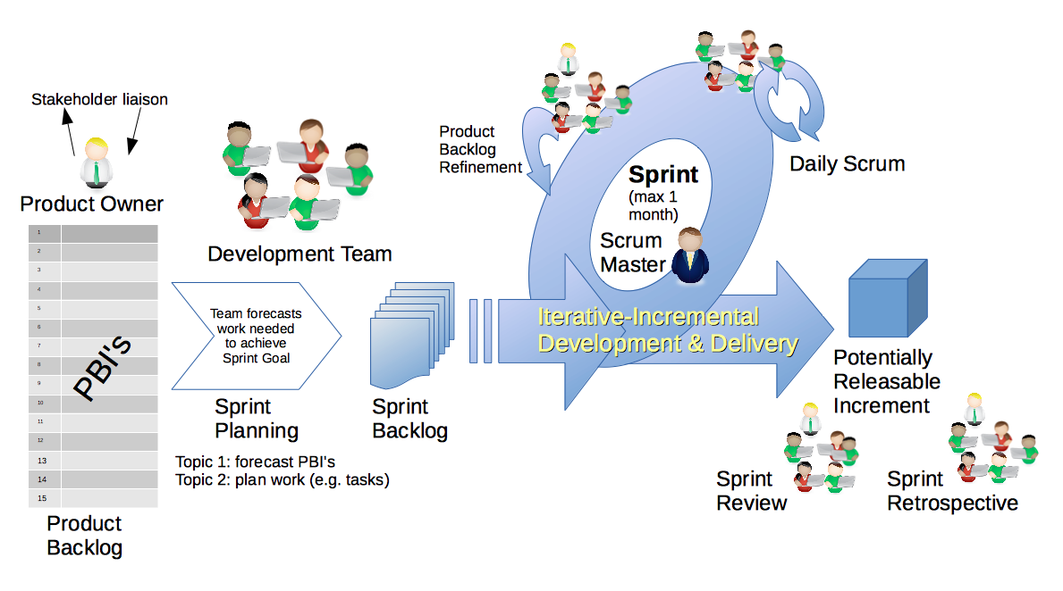
Scrum Process – Sprint Planning
By Dr ian mitchell - Own work, CC BY-SA 4.0, Link

Slide 9
Review Activities List and Assignments

Slide 10
Prework For Next Class
Complete through activity 7 prior to next class
Those scheduled to demo on Wednesday please be a couple of minutes early to class

Slide 11
Scrum Team Planning Review
As a scrum team:
Review sprint 2 activities & assignments in detail
Discuss and document questions/concerns
Scrum master share your team’s top 2 questions/concerns during report out

Slide 12
End of Session

Slide 13
Scrum Team Chapter Review
Assign presenter
Team discusses topics while the presenter summarizes the 5 topics below:
JavaScript
AJAX
XML/JSON
Single-Page Web Applications
Angular, React, other single-page web application environments
Where does Jamstack fit?
Team sits back, relaxes, and acknowledges the bravery and dedication of the presenter
Fox Chapter 6 Saas Client Framework

Slide 14
Scrum Team Chapter Discussion
Assign presenter
Team discussing chapter topics while the presenter summarizes the 5 topics below:
The importance of Branching is VCS systems (which VCS focused on branching)
Where should pared programming fit into the development process
The priority of specialization vs generalization in Agile vs Waterfall/Iterative
The relative importance of PMs in Agile vs Waterfall/Iterative
The two most important book on managing people and conflict (according to the author)
Team sits back, relaxes, and acknowledges the bravery and dedication of the presenter
Fox Chapter 10 on Project Management, Scrum, Pairs, and Version Control Systems

