Slide 1

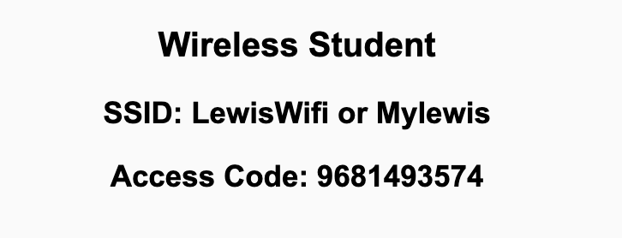
Preflight Check List
Sign into our Zoom meeting through our integrated Blackboard/Zoom link
Make sure that you can hear the conversation, see shared desktops, and view chat topics
Thank you if you choose to leave your camera on to help make our class more interactive
Be prepared to share your computer screen
Be prepared to utilize a headset with a microphone
In person participants also:
Make sure that your microphone and speakers are muted/off so that we don’t get an echo
Sit in a good spot near the classroom ceiling microphones if possible

Slide 2
Recordings
Discuss that recording are:
Opportunistic
Automatically available in Blackboard/Zoom
Sound Check… plus Video, and Desktop Sharing check
Start Recording

Slide 3
Agenda:
Prework
The Humble Text File
Prework for Next Class
Lab, Lab, Lab… and more Lab
Discussion & Questions welcome at any time but please be present with no phones or email during our time together

Slide 4
Prework For Next Class
Everything is due Sunday!
Be prepared for Lab on Friday

Slide 5
Question: Should there be 1 or 2
spaces after a period?

Slide 6
The Humble Text File
Notes:
Anybody else wonder how the simple text file remains the standard for building some of the most complex creations in the world?

Slide 7
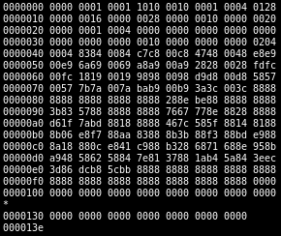
Files
All computer files are binary and can be represented in Hex
Some binary files can also be represented as text files
The term “binary file” is often incorrectly used to imply that a file is a “non-text” file.

Slide 8
In The Beginning There Were ASCII Text Files

Slide 9
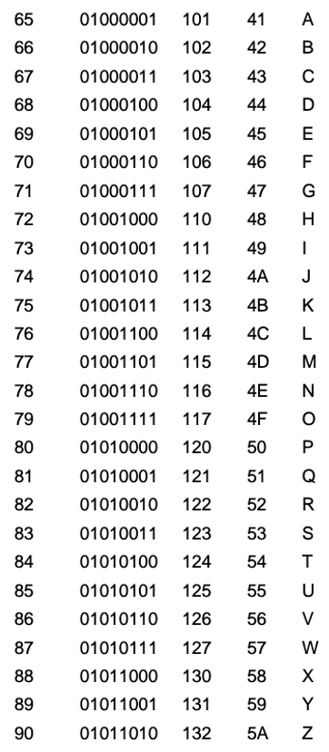
ASCII Files
Bytes are frequently used to hold individual characters in a text document. In the ASCII character set, each binary value between 0 and 127 is given a specific character. Most computers extend the ASCII character set to use the full range of 256 characters available in a byte. The upper 128 characters handle special things like accented characters from common foreign languages.

Slide 10
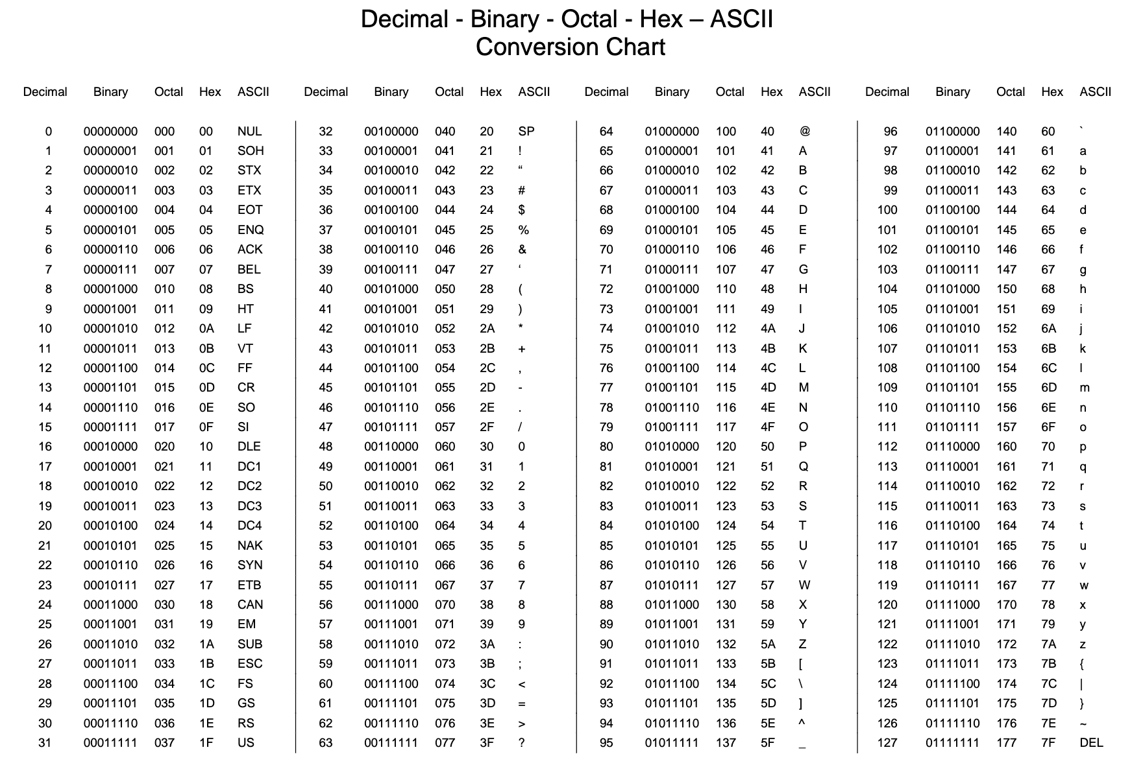

Slide 11
Unicode & UTF-16

Slide 12
Unicode, UTF-16, and UTF-8
Unlike ASCII, UTF-16 (Unicode) includes 65,536 possible combinations covering 154 modern and historical scripts, as well as multiple symbol sets [link]

Slide 13

Unicode, UTF-16, and UTF-8
Unicode
Unicode was a brave effort to create a single character set that included every reasonable writing system on the planet and some make-believe ones like Klingon, too. Some people are under the misconception that Unicode is simply a 16-bit code where each character takes 16 bits and therefore there are 65,536 possible characters.
This is not, actually, correct. It is the single most common myth about Unicode, so if you thought that, don’t feel bad. [link]
“Oops!” -- Eric

Slide 14
Unicode, UTF-16, and UTF-8
Unicode: Code Points
UTF-16 Encoding: 2 bytes per character… plus some craziness

Slide 15
UTF-8

Slide 16
Unicode, UTF-16, and UTF-8
Unicode
For a while it seemed like that (UTF-16) might be good enough, but programmers were complaining. “Look at all those zeros!” they said, since they were Americans and they were looking at English text … Also they were liberal hippies in California who wanted to conserve (sneer). If they were Texans they wouldn’t have minded guzzling twice the number of bytes. But those Californian wimps couldn’t bear the idea of doubling the amount of storage it took for strings, and anyway, there were already all these doggone documents out there using various ANSI and DBCS character sets and who’s going to convert them all? Moi? For this reason alone most people decided to ignore Unicode for several years and in the meantime things got worse.
Thus was invented the brilliant concept of UTF-8. UTF-8 was another system for storing your string of Unicode code points, those magic U+ numbers, in memory using 8 bit bytes. In UTF-8, every code point from 0-127 is stored in a single byte. Only code points 128 and above are stored using 2, 3, in fact, up to 6 bytes.

Slide 17
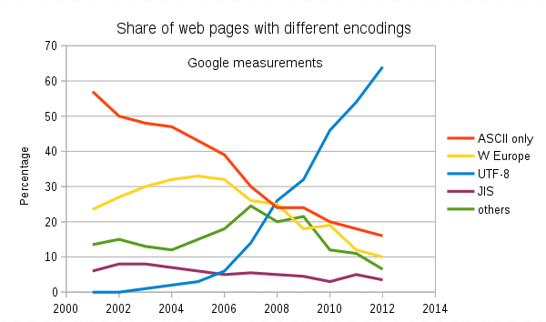
Text File Standards (Encoding)
ASCII
Unicode
UTF-8
Others

Slide 18
Text File End-Of-Line (EOL) and Encoding
Industry adoption of end-of-line encoding includes:
Windows: Both Carriage Return (CR, \r, 0x0d) and Line Feed (LF, \n, 0x0a) together.
Unix/Linux/OSX: Just Line Feed (LF, \n, 0x0a)
Mac (pre-OSX): Just Carriage Return (CR, \r, 0x0d)
Article on Windows Notepad supporting non-Windows EOF conventions [link]

Slide 19
HTML Character Entities

Slide 20
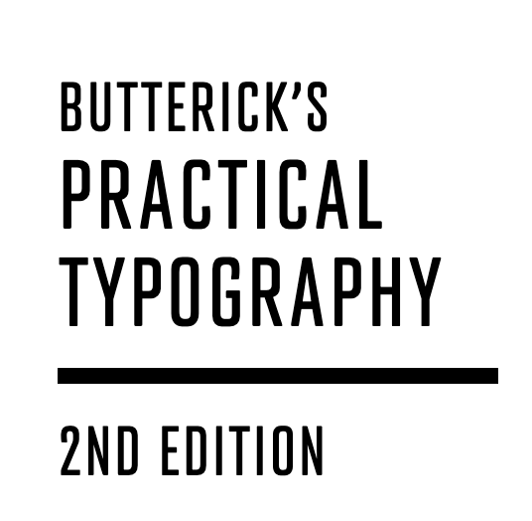
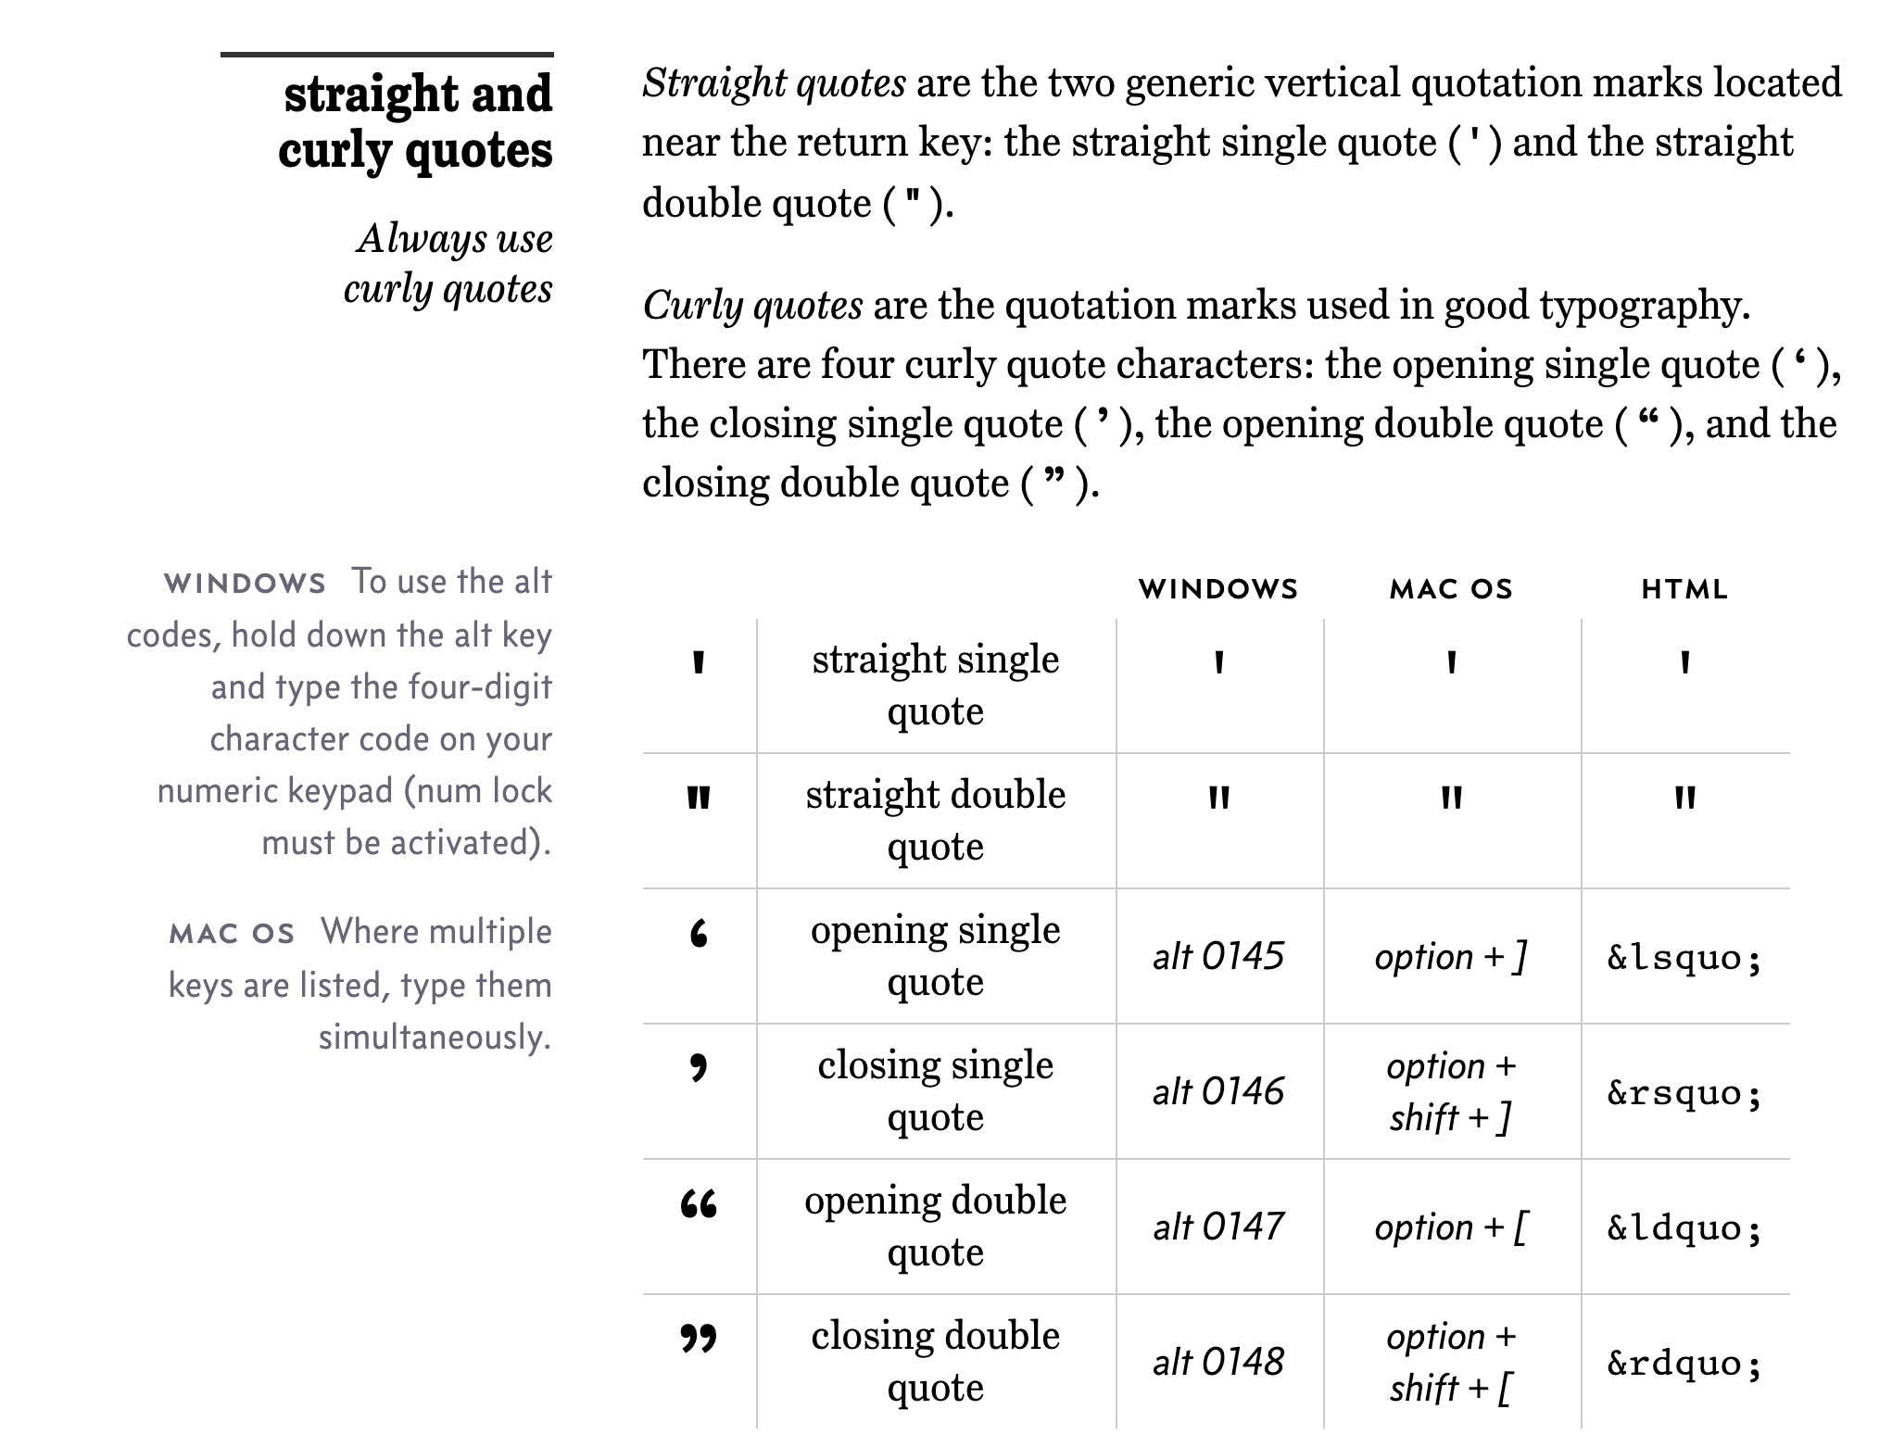
Straight vs Curly Quotes

Slide 21
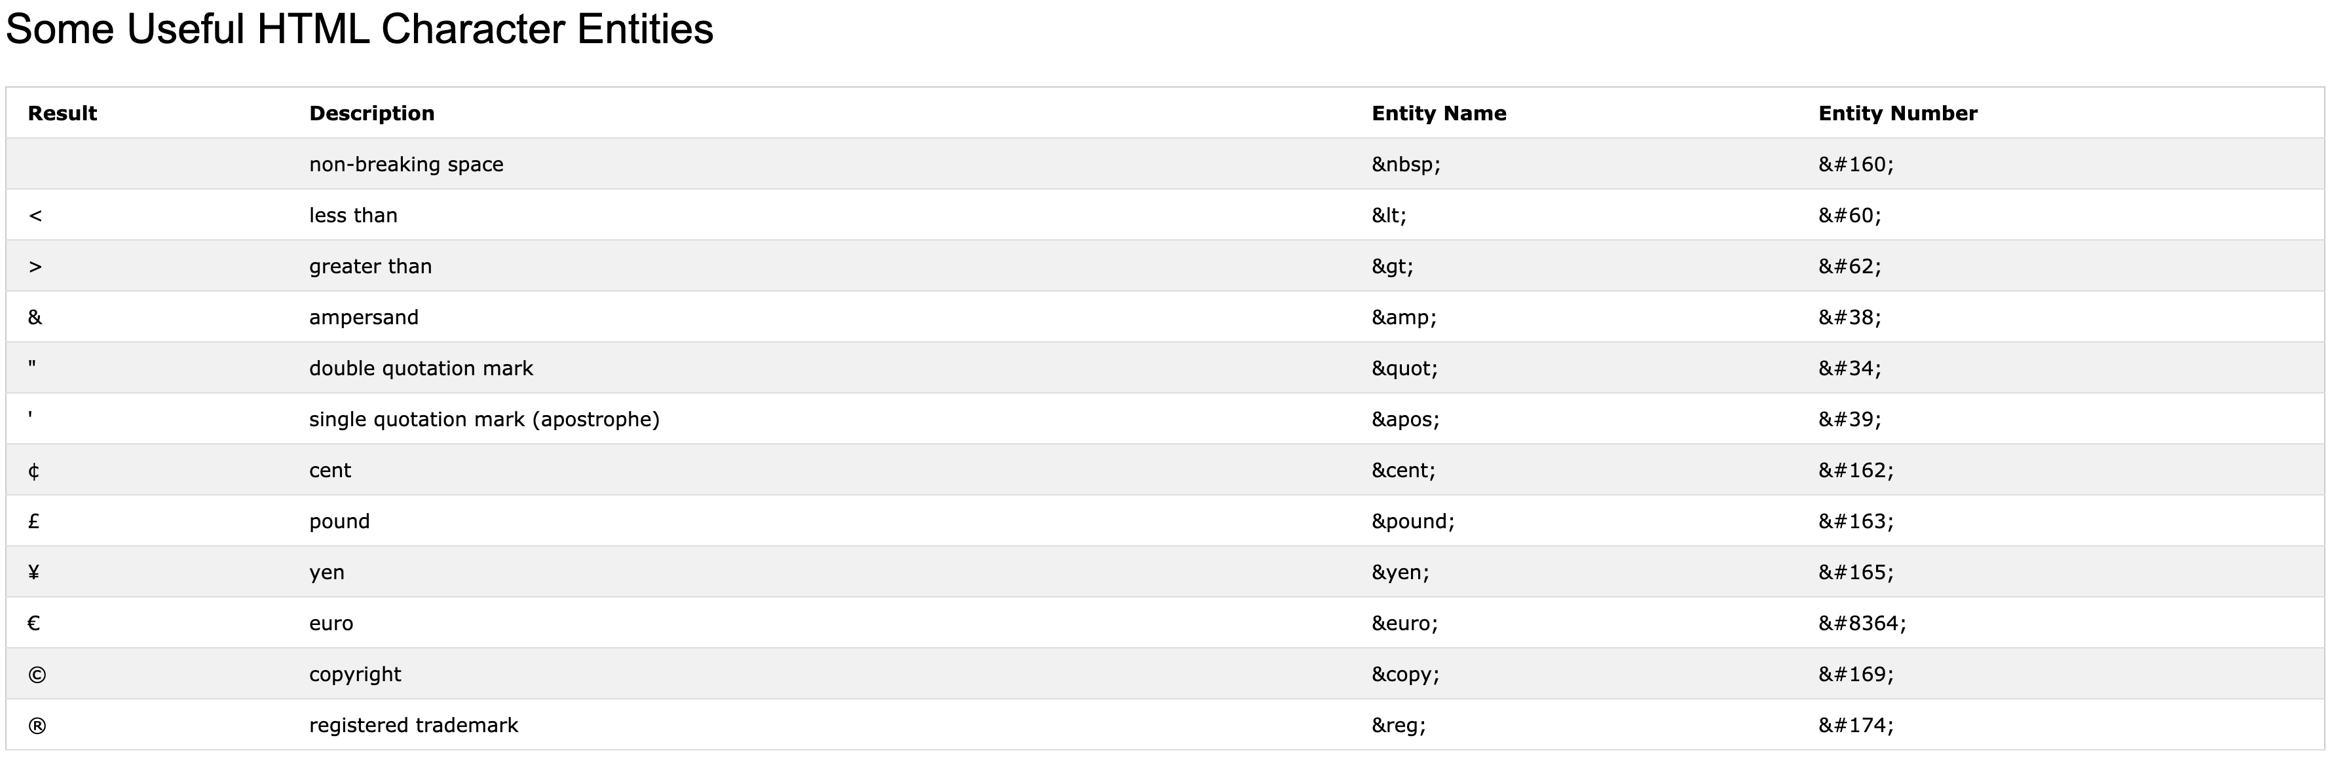
HTML Character Entities

Slide 22

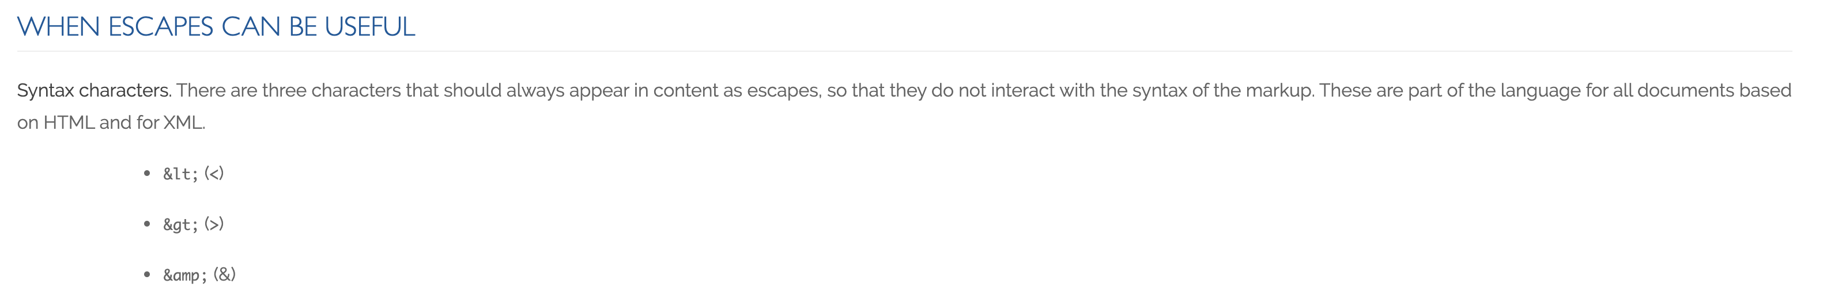
Always Escape

Slide 23
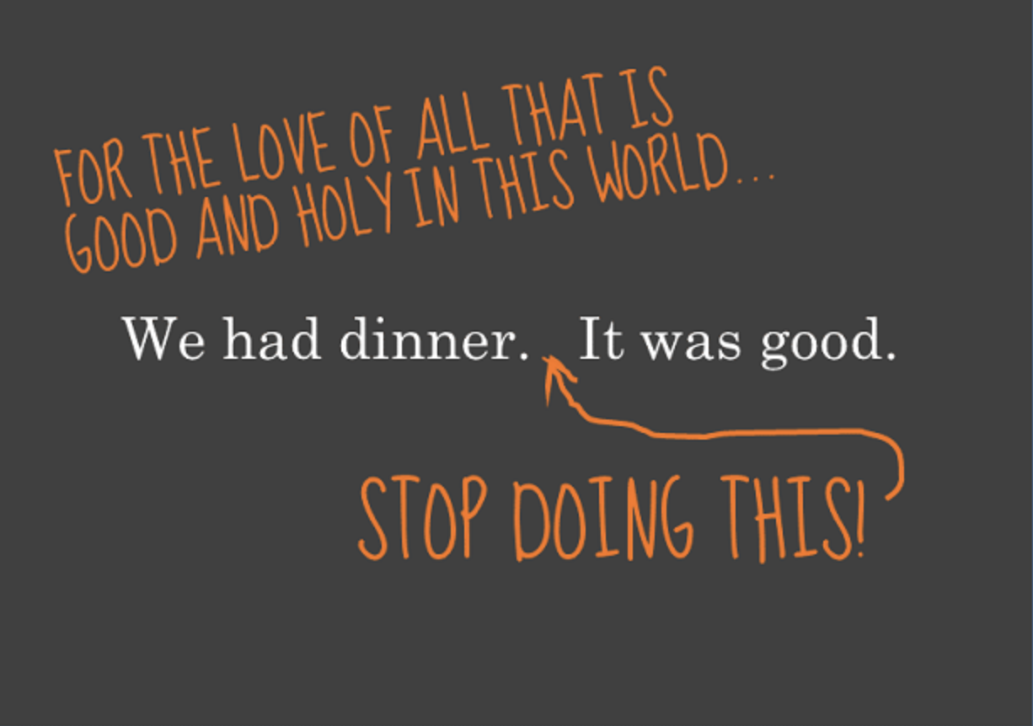
Oh yes, and…

Slide 24
Prework For Next Class
Everything is due Sunday!
Sprint 3 planning will be Monday
Sprint 2 demos and retrospectives will be Wednesday

Slide 25
Lab, Lab, Lab… and more Lab

Slide 26
Lab: Azure Web Applications with CI/CD
What is CI/CD?
How would we create and Azure based web application while focusing on CI/CD?
Prerequisites include Git, GitHub, Azure, Web Browser, Finder, Terminal, and VS Code
Review our example code to find a suitable basic web application
Create a GitHub repository
Add basic web application to the GitHub repository
Create an Azure website and link it to the GitHub repository
Update local Git repository with “git pull --no-edit” to update GitHub action
Update website, push changes, and review site
Regularly update and test Azure website during development
Notes:
git config –global pull.rebase false

Slide 27
End of Session

