Slide 1

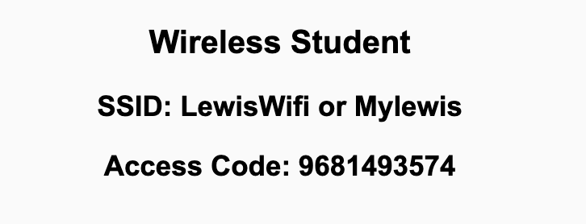
Preflight Check List
Sign into our Zoom meeting through our integrated Blackboard/Zoom link
Make sure that you can hear the conversation, see shared desktops, and view chat topics
Thank you if you choose to leave your camera on to help make our class more interactive
Be prepared to share your computer screen
Be prepared to utilize a headset with a microphone
In person participants also:
Make sure that your microphone and speakers are muted/off so that we don’t get an echo
Sit in a good spot near the classroom ceiling microphones if possible

Slide 2
Recordings
Discuss that recording are:
Opportunistic
Automatically available in Blackboard/Zoom
Sound Check… plus Video, and Desktop Sharing check
Start Recording

Slide 3
Agenda:
Prework and Announcements
Sprint 3 Planning
Prework for Next Class
Scrum Team Planning Review
Discussion & Questions welcome at any time but please be present with no phones or email during our time together

Slide 4
Prework
Everything is due Sunday!
Sprint 3 planning will be Monday
Sprint 2 demos and retrospectives will be Wednesday

Slide 5
Sprint Planning

Slide 6
Sprint Planning
Sprint 3 Changes:
Similar to the first two sprints in that sprint 3 will include including Discussion 3, Quiz 3, Lab 3, and Reflection 3
Validating your HTML code will be required to receive full credit on assignments
We will not have class Friday next week due to Fall Break

Slide 7
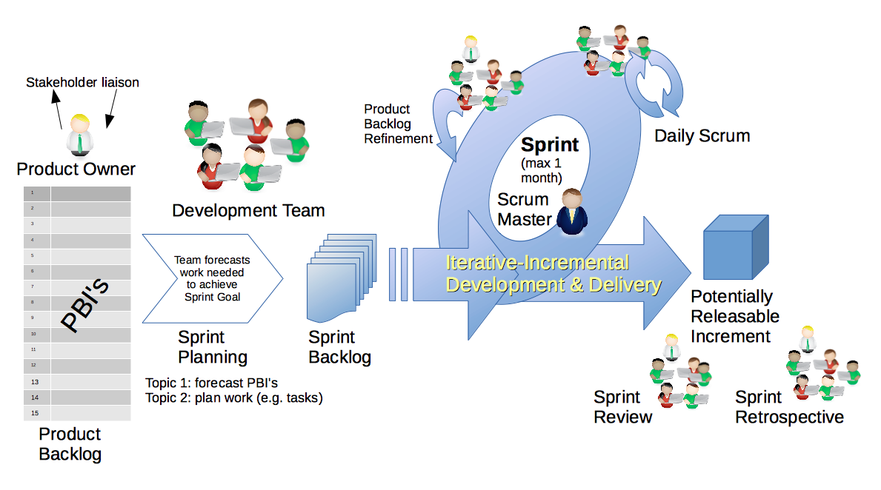
Scrum Process – Sprint Planning
By Dr ian mitchell - Own work, CC BY-SA 4.0, Link

Slide 8
Review Activities List and Assignments

Slide 9
Prework For Next Class
Complete through activity 5 and part way through activity 6 prior to next class
Those scheduled to demo on Wednesday please be a couple of minutes early to class

Slide 10
Scrum Team Planning Review
As a scrum team:
Review sprint activities & assignments in detail
Discuss and document questions/concerns
Scrum master share your team’s top 2 questions/concerns during report out

Slide 11
End of Session

