Slide 1

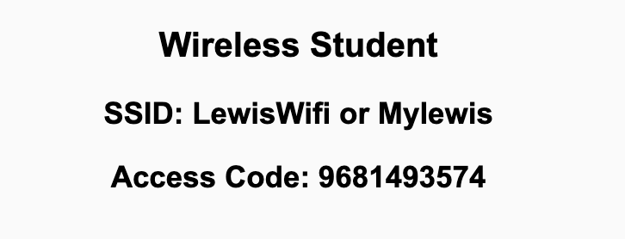
Preflight Check List
Sign into our Zoom meeting through our integrated Blackboard/Zoom link
Make sure that you can hear the conversation, see shared desktops, and view chat topics
Thank you if you choose to leave your camera on to help make our class more interactive
Be prepared to share your computer screen
Be prepared to utilize a headset with a microphone
In person participants also:
Make sure that your microphone and speakers are muted/off so that we don’t get an echo
Sit in a good spot near the classroom ceiling microphones if possible

Slide 2
Recordings
Discuss that recording are:
Opportunistic
Automatically available in Blackboard/Zoom
Sound Check… plus Video, and Desktop Sharing check
Start Recording

Slide 3
Agenda:
Prework
Sprint 2 Review & Demos
Sprint 2 Retrospective
Scrum Team Sprint 2 Retrospective (abbreviated)
Prework for Next Class
Review Gates and Circuits
Discussion & Questions welcome at any time but please be present with no phones or email during our time together

Slide 4
Prework For Next Class
Complete through activity 5 and part way through activity 6 prior to next class
Those scheduled to demo on Wednesday please be a couple of minutes early to class

Slide 5
Sprint Review & Demos

Slide 6
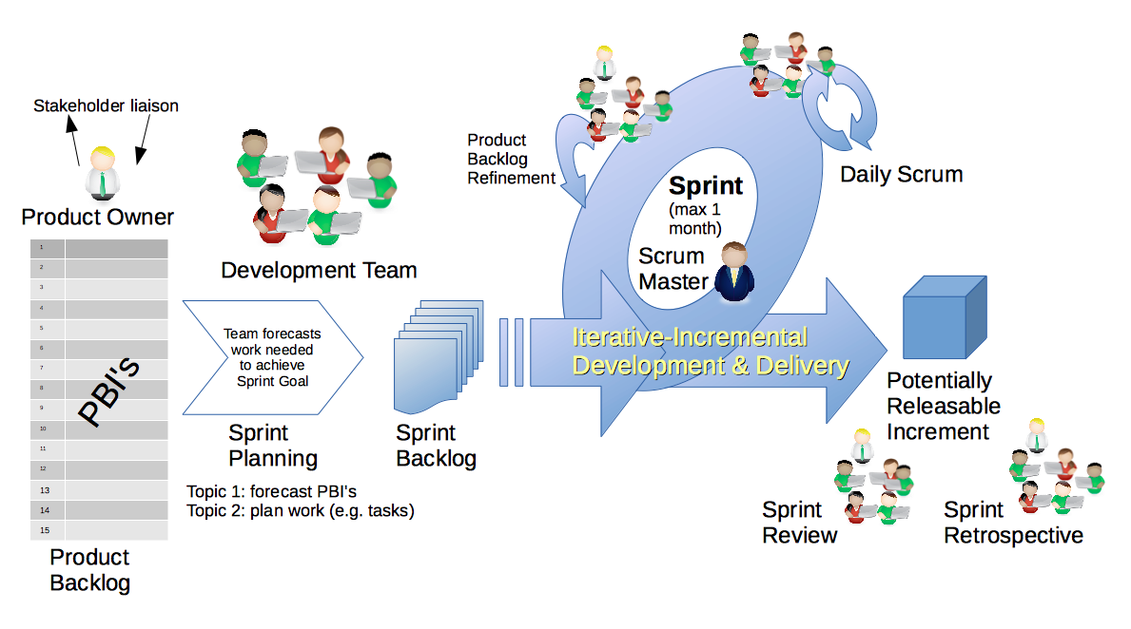
Scrum Process – Sprint Review & Demo
By Dr ian mitchell - Own work, CC BY-SA 4.0, Link

Slide 7
Demos

Slide 8
Demo Guidelines – Presenter
Everyone will give at least one demo of their work during the semester.
Your demo should be 2 to 5 minutes and can include any or all of the following:
Show your application running
Comment on your implementation
Show the source code
Explain how you organized the code
Talk about any challenges
You should not prepare slides or a presentation
**You will also need to complete the Demo assignment in Blackboard.

Slide 9
Demo Guidelines – Listener
Everyone will be listening to many demos during the semester.
Your listener responsibilities include:
Actively listening and watching what is being demoed
Come up with a meaningful yet easy to answer question
Ask your question if the presenter does not get sufficient questions from other listeners
Do not ask hard question or attempt to review the presenters code
Clap for the presenter at the end of the demo and thank them for presenting
Optionally follow up with the presenter later if you have what could be more difficult questions or if you have suggestions

Slide 10
Sprint Demos

Slide 11
Complete Sprint Demo Assignment

Slide 12
Scrum Process – Sprint Retrospective
By Dr ian mitchell - Own work, CC BY-SA 4.0, Link

Slide 13
Submission Percentage – Sprint 1

Slide 14
Submission Percentage – Sprint 2

Slide 15
Class Retrospective
Feedback from Assignments & Reflections:
I’m speechless. 100%. Unbelievable job turning in assignments on time!
All assignments are graded and posted
Sorry if some of my Reflection responses were brief
If you do the team Discussion, you need to submit an exact copy of the notes in your Discussion
Remember to copy/paste the requirement into the lab response
README.md files and LICENSE files where common questions
Sounds like Websites were more fun that Python for a majority
Many comments about sprint 2 getting easier… which is not actually true :-)
Very well done! What should we do to celebrate 100% submission percentage? (Please discuss this during your sprint team retrospective)
What can I/we do to improve in sprint 2?

Slide 16
Submission Percentage – Sprint 1

Slide 17
Submission Percentage – Sprint 2

Slide 18
Class Retrospective
Feedback from Assignments & Reflections:
Rock solid job turning in assignments on time!
All assignments are graded and posted
Sorry if some of my Reflection responses were brief
If you do the team Discussion, you need to submit an exact copy of the notes in your Discussion
Remember to copy/paste the requirement into the lab response
README.md files and LICENSE files where common questions
Sounds like Websites were more fun that Python for a majority
Many comments about sprint 2 getting easier… which is not actually true :-)
What can I/we do to improve in sprint 2?

Slide 19
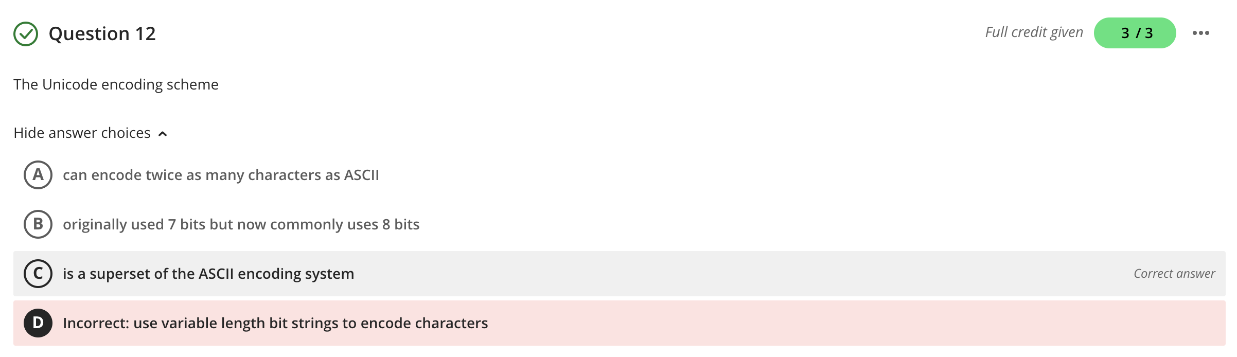
Quiz Question Correction

Slide 20
Scrum Team Retrospective (abbreviated)
What’s working and what’s not working (team/class)?
What is one continuous improvement activity (team/class)?
Report-out

Slide 21
Prework For Next Class
Complete through activity 7
Be prepared for publishing an Azure website Lab session**
Be prepared for Scrum Team Discussion 3

Slide 22
Review Gates and Circuits
Assign presenter
Team discusses topics while the presenter summarizes the most important topics including the representation of:
Gates and Boolean Values
Circuits and Logic Diagrams
NOT, AND, and OR
XOR, NAND, and NOR
Transistors, Integrated Circuits, CPUs, and GPUs
Team sits back, relaxes, and acknowledges the bravery and dedication of the presenter

Slide 23
End of Session

