Slide 1

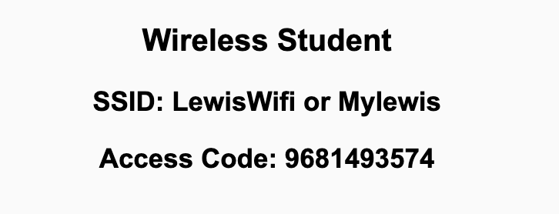
Preflight Check List
Sign into our Zoom meeting through our integrated Blackboard/Zoom link
Make sure that you can hear the conversation, see shared desktops, and view chat topics
Thank you if you choose to leave your camera on to help make our class more interactive
Be prepared to share your computer screen
Be prepared to utilize a headset with a microphone
In person participants also:
Make sure that your microphone and speakers are muted/off so that we don’t get an echo
Sit in a good spot near the classroom ceiling microphones if possible

Slide 2
Recordings
Discuss that recording are:
Opportunistic
Automatically available in Blackboard/Zoom
Sound Check… plus Video, and Desktop Sharing check
Start Recording

Slide 3
Agenda:
Prework
Sprint 2 Review & Demos
Sprint 2 Retrospective
Scrum Team Sprint 2 Retrospective (abbreviated)
Prework for Next Class
Models, Processes, and Requirements
Discussion & Questions welcome at any time but please be present with no phones or email during our time together

Slide 4
Prework For Next Class
Complete through activity 5 and part way through activity 6 prior to next class
Those scheduled to demo on Wednesday please be a couple of minutes early to class

Slide 5
Sprint Review & Demos

Slide 6
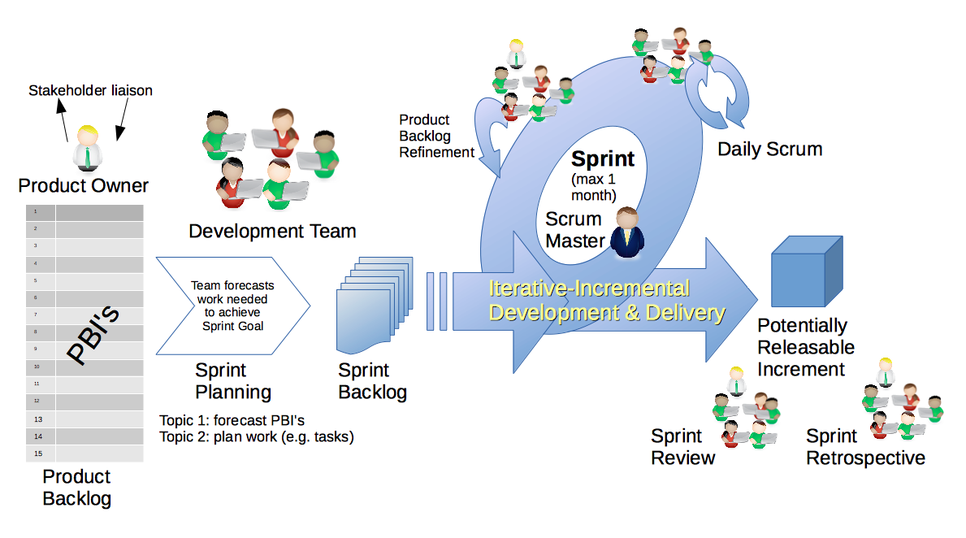
Scrum Process – Sprint Review & Demo
By Dr ian mitchell - Own work, CC BY-SA 4.0, Link

Slide 7

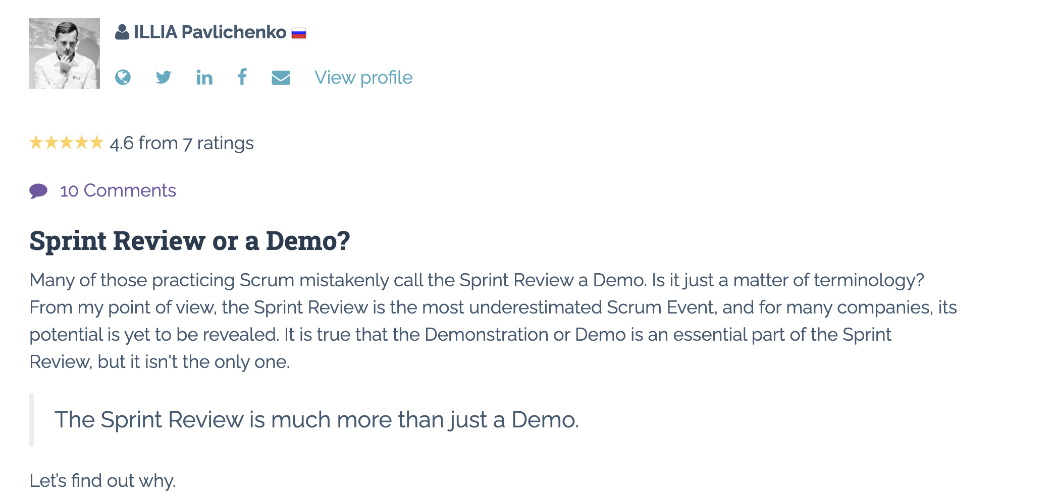
Sprint Review: Much More Than Just A Demo

Slide 8
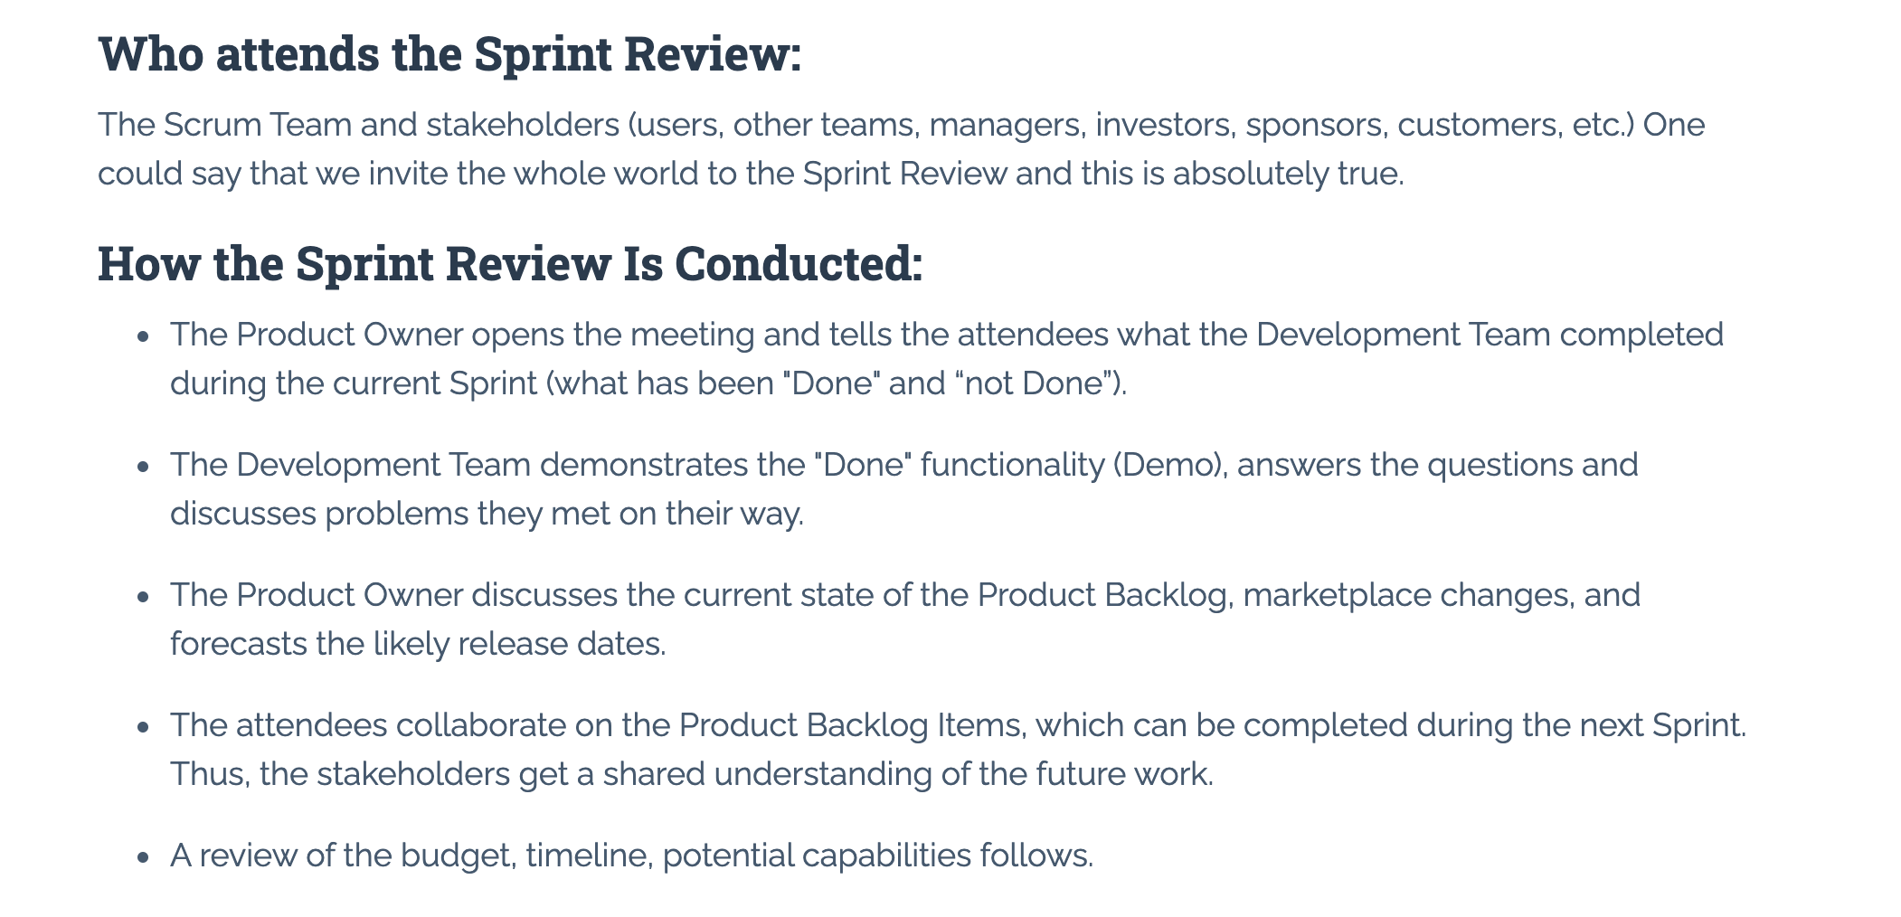
Sprint Review: Much More Than Just A Demo

Slide 9
Demos

Slide 10
Demo Guidelines – Presenter
Everyone will give at least one demo of their work during the semester.
Your demo should be 2 to 5 minutes and can include any or all of the following:
Show your application running
Comment on your implementation
Show the source code
Explain how you organized the code
Talk about any challenges
You should not prepare slides or a presentation
**You will also need to complete the Demo assignment in Blackboard.

Slide 11
Demo Guidelines – Listener
Everyone will be listening to many demos during the semester.
Your listener responsibilities include:
Actively listening and watching what is being demoed
Come up with a meaningful yet easy to answer question
Ask your question if the presenter does not get sufficient questions from other listeners
Do not ask hard question or attempt to review the presenters code
Clap for the presenter at the end of the demo and thank them for presenting
Optionally follow up with the presenter later if you have what could be more difficult questions or if you have suggestions

Slide 12
Sprint Demos

Slide 13
Complete Sprint Demo Assignment

Slide 14
Scrum Process – Sprint Retrospective
By Dr ian mitchell - Own work, CC BY-SA 4.0, Link

Slide 15
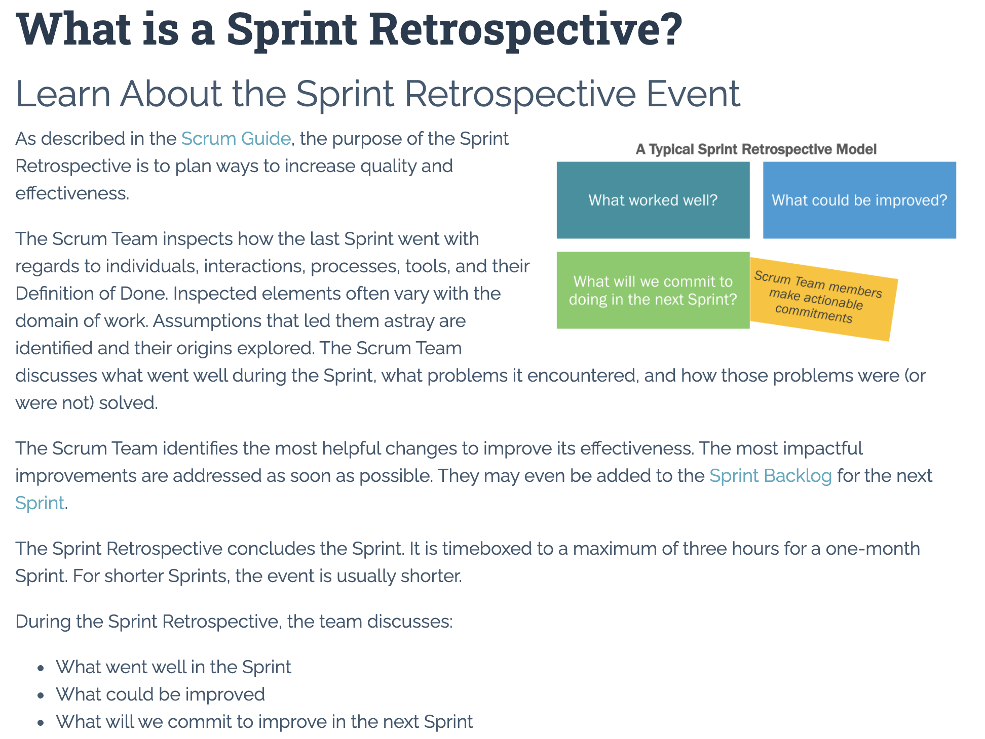

Slide 16
Submission Percentage – Sprint 1

Slide 17
Submission Percentage – Sprint 2

Slide 18
Class Retrospective
Feedback from Assignments & Reflections:
If doesn’t feel very good to have three labs not submitted
Very nice job on your web applications
Continue to have nice comments about teammates helping

Slide 19
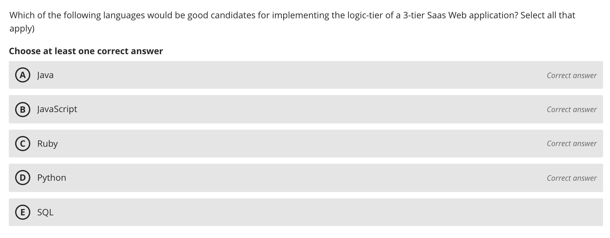
Class Retrospective – Quiz 2

Slide 20
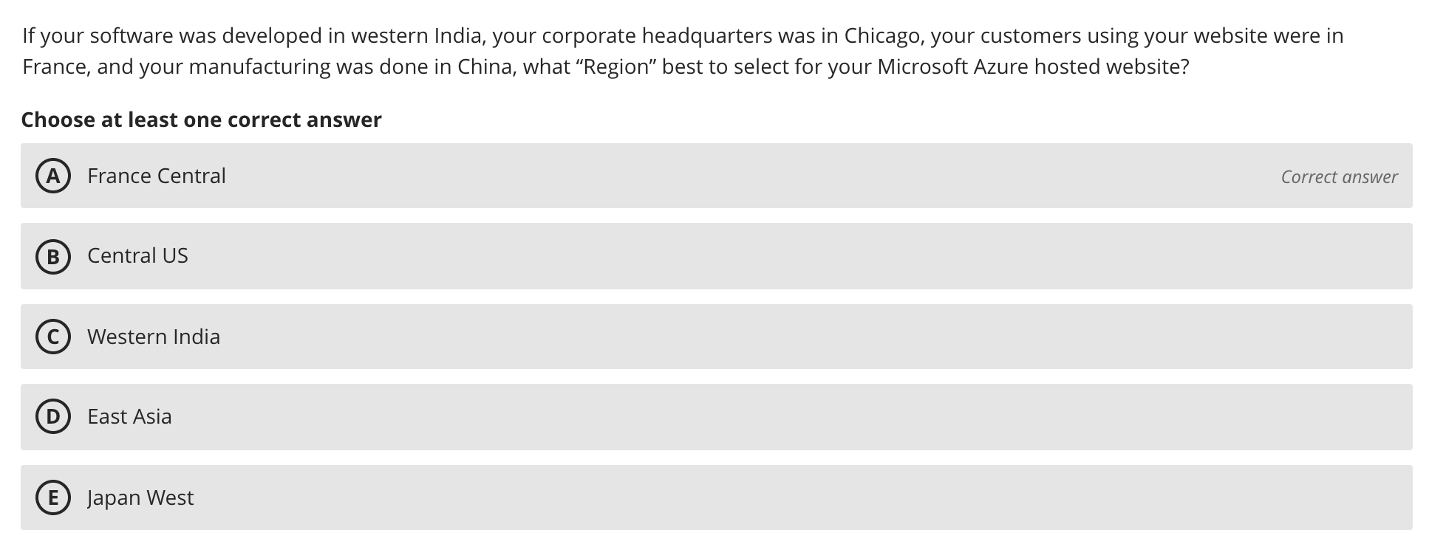
Class Retrospective – Quiz 2

Slide 21
Scrum Team Retrospective
What’s working and what’s not working (team/class)?
What is one continuous improvement activity (team/class)?
Report-out

Slide 22
Prework
Complete through activity 6 prior to next class
Be prepared for a scrum team Discussion 3
Be prepared for lab with “Getting to Know Each Others Teams”
Next Week
Monday: Review “Engineering Software as a Service” Requirements (chapter 7)
Wednesday: Quiz 3 and Lab
Friday: No class
Sunday: Everything is Due!

Slide 23
Models, Processes, and Requirements
Notes:
Critical Path… Light Weight long-term planning

Slide 24
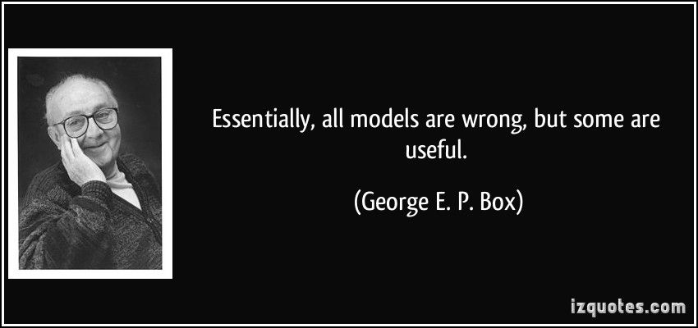
Models

Slide 25
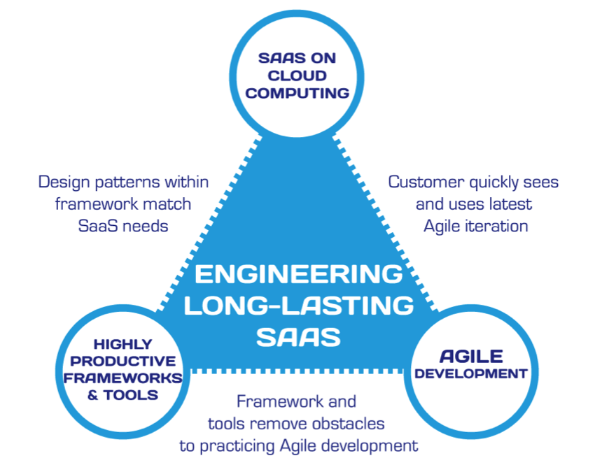
Hosting Technology: Cloud & Software as a Service (SaaS)…
People: Organizations, Domain Knowledge, Customers, Business Process…
The
Virtuous Triangle
Process: Agile, Requirements, Project Management, Prioritization, Portfolio Management, Metrics…
Productivity Technology: Configuration Management, Source Code Management, Automated Testing…

Slide 26
The Righteous Triangle of Software Development
People & Organizations
Technology & Tools
Process & Roles

Slide 27
Processes and Requirements
Notes:
Critical Path… Light Weight long-term planning

Slide 28
Waterfall vs Iterative vs Agile Requirements
 | Waterfall | Iterative | Agile
References | United States Department of Defense: DOD-STD-2167A (1985) | Rational Unified Process (RUP) Open Unified Process | Scrum Kanban Scaled Agile Framework (SAFe)
Priorities | Planning and predictability | Architecture, modeling, and efficiency through early detection & fixing of issues (verification) | Responsiveness to feedback, efficiency through engineering practices, early detection & fixing of issues, and validation
Principles | Execute phases sequentially: Requirements Analysis Design Coding Testing and Operations Define and commit to Scope, Cost, and Timeline “early” Implement strict Change Control | Manage requirements Develop and test iteratively Use components Model visually Verify quality Control changes | Capture lightweight near term requirements Allow requirements to evolve but maintain fixed timelines Develop, test, deploy, and release iteratively Empower teams Apply engineering practices and systems thinking Integrate early user feedback into remaining plan Maintain a collaborative approach between all stakeholders
Notes:
The views on testing and change management have changed dramatically as organizations have moved from Waterfall to Iterative to Agile development lifecycles.
Successful Agile (and Iterative) Development REQUIRES better application design, development techniques, and testing practices.
Testing and lack of defects are not the end goal. A higher quality more usable more cost-effective product is the goal.
Requirements:
Waterfall:
Full project requirements upfront
Inconsistent industry capture techniques
Tend to be verbose requirements with formal signoff
Change requests needed
Estimation bottom up detailed estimates sometimes function points
Iterative:
Mostly upfront

Slide 29
Requirements – Waterfall
When working in a Waterfall SDLC Requirements are generally:
Captured up front (before any design or development)
Documented in a variety of formats
Verbose
Estimated in detail using bottom-up estimating techniques (sometime Function Points)
Risk Analysis & Mitigation
Signed off on
Managed with change requests
Notes:
Grace period until Monday morning a 6am CT

Slide 30
Requirements – Iterative (RUP)
When working in an Iterative (RUP) SDLC Requirements are generally:
Captured primarily up front but updated during design
Documented in Use Cases
Moderately verbose
Estimated using Use Case points
Signed off on with an understanding that minor changes are likely
Managed with change requests
Notes:
Grace period until Monday morning a 6am CT

Slide 31
Recall Scaled Agile Framework is an Agile Model
Notes:
Critical Path… Light Weight long-term planning

Slide 32
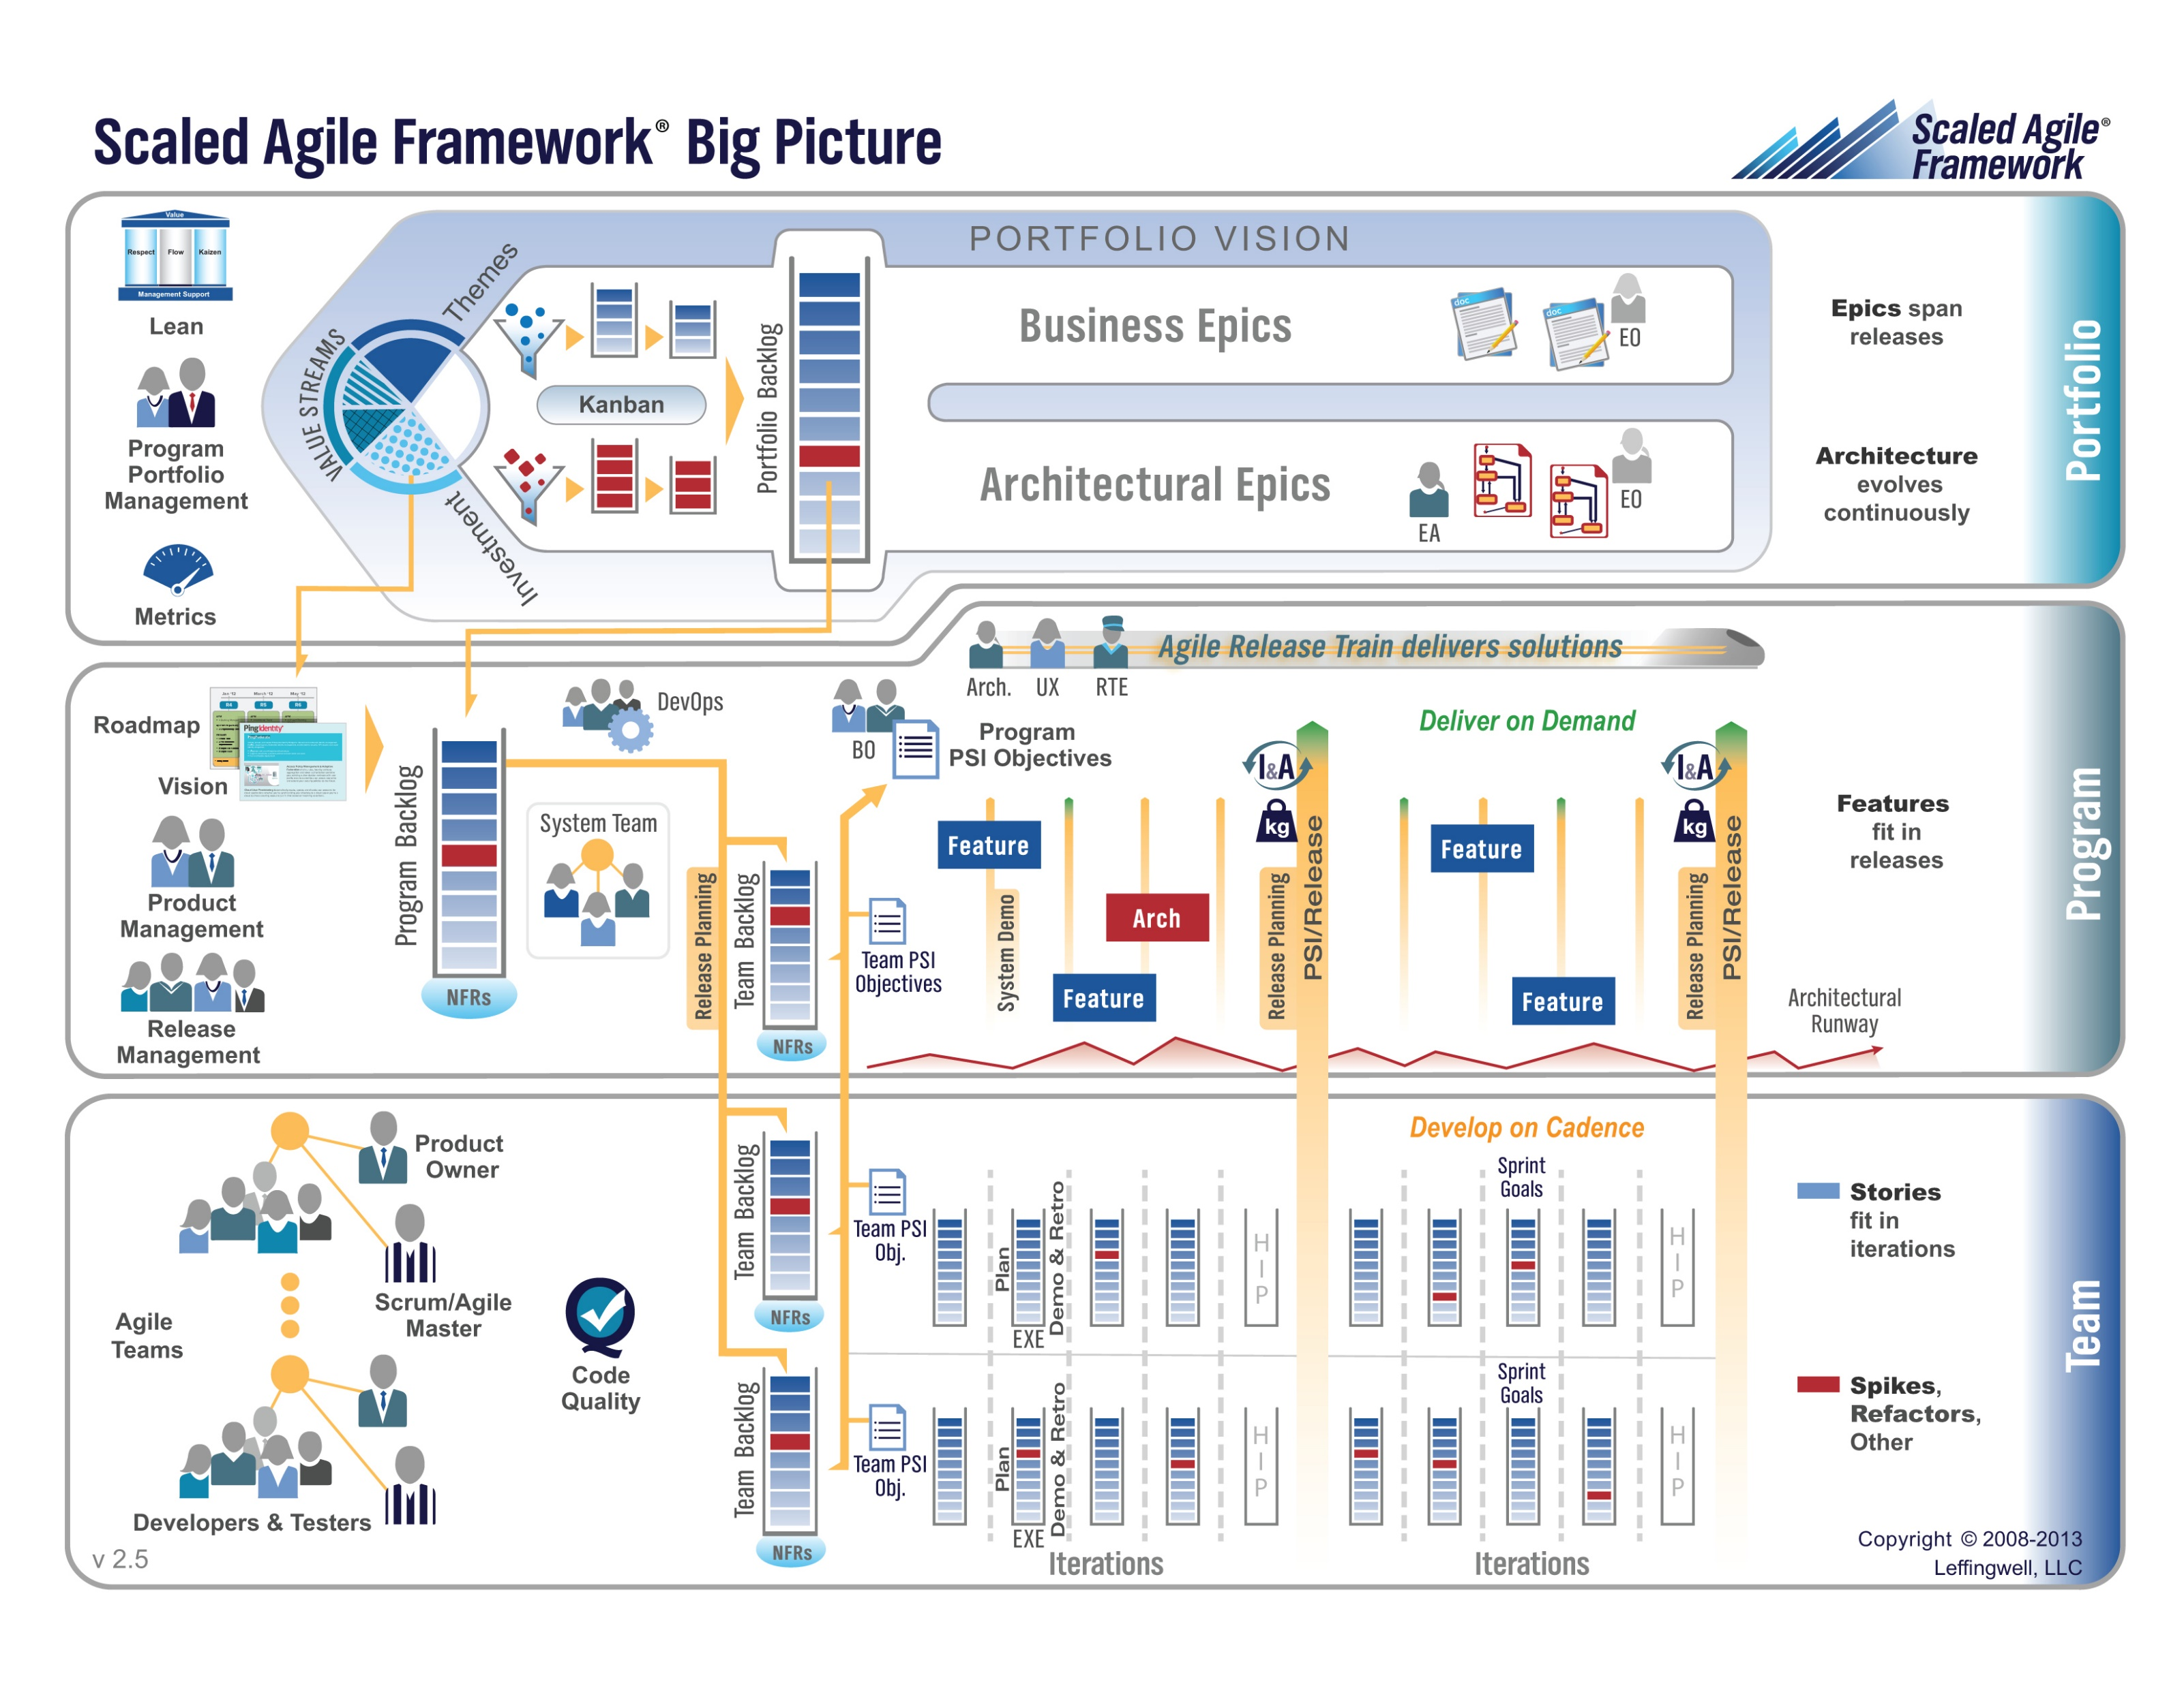

Slide 33
Requirements – Agile (Scrum)
When working in an Agile (Scrum) SDLC Requirements are generally:
Captured before each sprint
Documented using Stories (light weight)… always from a user perspective
In Scaled Agile Epics & Features are also used
Only detailed as needed
Estimated using Story Points (very light weight)
Immutable for current sprint
Change is encouraged for future sprints
Notes:
Final Topics:
SMART: Specific, Measurable, Achievable, Relevant, and Time-boxed
Be very careful attempting to measure productivity across teams
Story Points vs Use Case Points vs Function Points

Slide 34
Multi-Domain Integration & Complex Dependencies
Notes:
Critical Path… Light Weight long-term planning

Slide 35
Multi-Domain Examples
Most Agile system development is part of a larger initiative that includes multiple domains. Many of these larger initiatives are unable or unwilling to fully adopt Agile methodologies.
Examples include:
Implementing a new aircraft model
Building a new car factory
Updating a new car model or a new model of agricultural harvester
Executing portfolio management and annual budgeting within an organization
Migrating to a new purchased accounting system (buy vs build)
Agile initiatives need to be able to effectively integrate which often requires adopting some Plan & Document Project Management practices.

Slide 36
Complex Dependencies
Agile processes intentionally do not look for long term dependencies. There are times when intentionally managing and monitoring at least a subset of these dependencies is necessary.
Examples:
Implementing user preferences is dependent on securely creating a website in the Google cloud
Securely creating a web page in the Google cloud is dependent on custom authentication
Custom authentication is dependent on Microsoft Office user authentication
Microsoft Office authentication likely requires hosting a web service in Azure
Pure Agile may not allow us to understand that we need to start on item 4 four sprints before we expect to have item 1 implemented.

Slide 37
Prework For Next Class
Complete through activity 9 and actively working on activity 10 prior to next class
Be prepared for Scrum Team Review of FOX chapter 6 Saas Client Framework
Be prepared for Scrum Team Discussion 2

Slide 38
End of Session

Slide 39
Requirement, Requirements, Requirements, and More Requirements!!!
Notes:
Critical Path… Light Weight long-term planning

Slide 40
Review FOX Chapter 7 Requirements
Assign presenter
Team discusses topics while the presenter summarizes the topics below:
Behavior-Driven Design, Gemba, Requirements, Use Cases, and User Stories
Points, velocity, SMART, and MVP
Story Points, Use Case Points, Function Points, and measuring productivity across teams
User Experience / User Interface Design, Interface Sketches, and Storyboards
Requirements Gathering Waterfall (Requirements) vs. Iterative (Use Cases) vs. Agile (Stories)
Team sits back, relaxes, and acknowledges the bravery and dedication of the presenter

