Slide 1

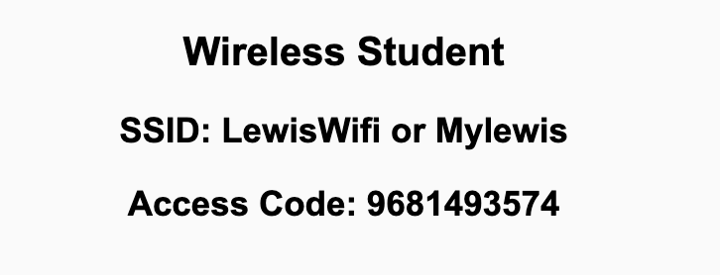
Preflight Check List
Sign into our Zoom meeting through our integrated Blackboard/Zoom link
Make sure that you can hear the conversation, see shared desktops, and view chat topics
Thank you if you choose to leave your camera on to help make our class more interactive
Be prepared to share your computer screen
Be prepared to utilize a headset with a microphone
In person participants also:
Make sure that your microphone and speakers are muted/off so that we don’t get an echo
Sit in a good spot near the classroom ceiling microphones if possible

Slide 2
Recordings
Discuss that recording are:
Opportunistic
Automatically available in Blackboard/Zoom
Sound Check… plus Video, and Desktop Sharing check
Start Recording

Slide 3
Agenda:
Prework & Announcements
Team Review of Computing Components
Lab
Discussion & Questions welcome at any time but please be present with no phones or email during our time together

Slide 4
Prework
Complete through activity 11
Be prepared to review “Computer Science Illuminated” Computing Components
Looking Ahead:
Wednesday: Quiz 3 and Lab
Friday: No class
Sunday: Everything is Due!

Slide 5
Computing Components
Assign presenter
Team discusses topics while the presenter summarizes the most important topics including the representation of:
Computing Components
Stored Program plus Von Neumann Architecture
Ram and Rom plus Secondary Storage
Embedded Systems
Parallel Architectures plus Classes of Parallel Hardware
Team sits back, relaxes, and acknowledges the bravery and dedication of the presenter

Slide 6
Prework For Next Class
Complete through activity 12
Be prepared for Quiz 3 and Lab
Looking Ahead:
Wednesday: Quiz 3 and Lab
Friday: No class
Sunday: Everything is Due!
You instructor will have limited availability Thursday through Sunday

Slide 7
Lab: Azure Web Applications with CI/CD
What is Continuous Integration / Continuous Delivery (CI/CD)?
Review Azure Website assignment
Create and Azure based web application while focusing on CI/CD:
Prerequisites include Git, GitHub, Azure, Web Browser, Finder, Terminal, and VS Code
Create a public GitHub repository with a License and README.md
Add basic web application to the GitHub repository (W3C Html tutorial)
Create an Azure website and link it to the GitHub repository
Optionally: Update local Git repository with “git pull --no-edit” to update GitHub action
Update website, push changes, and review site
Regularly update and test Azure website during development
Notes:
git config –global pull.rebase false

Slide 8
End of Session

