Slide 1

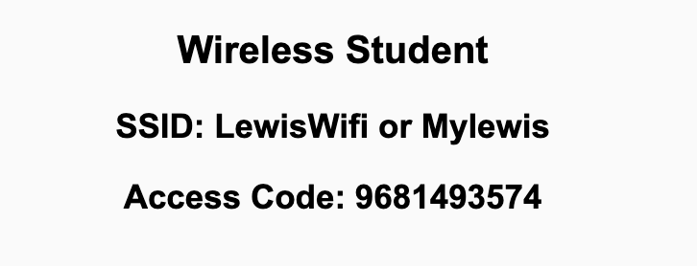
Preflight Check List
Sign into our Zoom meeting through our integrated Blackboard/Zoom link
Make sure that you can hear the conversation, see shared desktops, and view chat topics
Thank you if you choose to leave your camera on to help make our class more interactive
Be prepared to share your computer screen
Be prepared to utilize a headset with a microphone
In person participants also:
Make sure that your microphone and speakers are muted/off so that we don’t get an echo
Sit in a good spot near the classroom ceiling microphones if possible

Slide 2
Recordings
Discuss that recording are:
Opportunistic
Automatically available in Blackboard/Zoom
Sound Check… plus Video, and Desktop Sharing check
Start Recording

Slide 3
Agenda:
Prework and Announcements
Review “Programming The World Wide Web” JavaScript (chapter 5) and W3C JavaScript Tutorial
Lab with Map Mania Lite and Custom Domain Names
Discussion & Questions welcome at any time but please be present with no phones or email during our time together

Slide 4
Prework For Next Class
Complete through activity 11
Be prepared for reviewing “Programming The World Wide Web” JavaScript (chapter 5) and W3C JavaScript Tutorial
Looking Ahead:
Wednesday: Quiz 3 and Lab
Friday: No class
Sunday: Everything is Due!

Slide 5
Review of Sebesta chapter 4 Basic JavaScript
Assign presenter
Team discusses topics while the presenter summarizes the topics below:
JavaScript is a scripting language that can be embedded in HTML
Main uses for JavaScript are input validation, communication, page updates
JavaScript objects can contain multiple properties which may be added dynamically
JavaScript is dynamically typed and uses call-by-value to pass function parameters
Regular expressions are a sequence of special characters used for denoting a pattern
In JavaScript, we can search for patterns using methods of String or using the RegExp object
Team sits back, relaxes, and acknowledges the bravery and dedication of the presenter

Slide 6
Review of HTML and JavaScript (Sebesta chapter 5 )
Assign presenter
Team discusses topics while the presenter summarizes the topics below:
HTML, the Document Object Modal (DOM) tree structure, and getElementById
Events in a the web page, tag attribute, and addEventListener methods
Adding, removing, or modifying DOM elements
Navigator and Canvas
DOM, DOM2, and DOM3
Team sits back, relaxes, and acknowledges the bravery and dedication of the presenter

Slide 7
Prework For Next Class
Complete through activity 12 and working on activity 13
Be prepared for Quiz 3 and Lab
Looking Ahead:
Friday: No class
Sunday: Everything is Due!

Slide 8
End of Session

