Slide 1

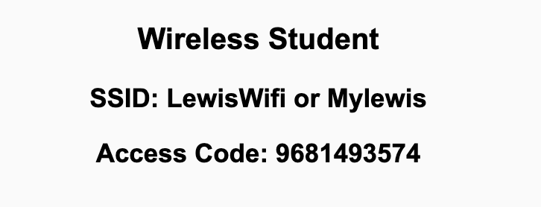
Preflight Check List
Sign into our Zoom meeting through our integrated Blackboard/Zoom link
Make sure that you can hear the conversation, see shared desktops, and view chat topics
Thank you if you choose to leave your camera on to help make our class more interactive
Be prepared to share your computer screen
Be prepared to utilize a headset with a microphone
In person participants also:
Make sure that your microphone and speakers are muted/off so that we don’t get an echo
Sit in a good spot near the classroom ceiling microphones if possible

Slide 2
Recordings
Discuss that recording are:
Opportunistic
Automatically available in Blackboard/Zoom
Sound Check… plus Video, and Desktop Sharing check
Start Recording

Slide 3
Agenda:
Prework and Announcements
Sprint 4 Planning
Prework for Next Class
Team Planning Review
Discussion & Questions welcome at any time but please be present with no phones or email during our time together

Slide 4
Prework & Announcements
No class Friday
Everything is due Sunday!
I have limited availability Thursday through Sunday
Be prepared for sprint 4 planning Monday

Slide 5
Sprint Planning

Slide 6
Sprint Planning
Sprint 4 Changes:
Similar to the previous sprints with Discussion, Quiz, Lab, and Reflection
No holidays will make it a little easier than the last sprint
Map Mania Version 2 will be challenging

Slide 7
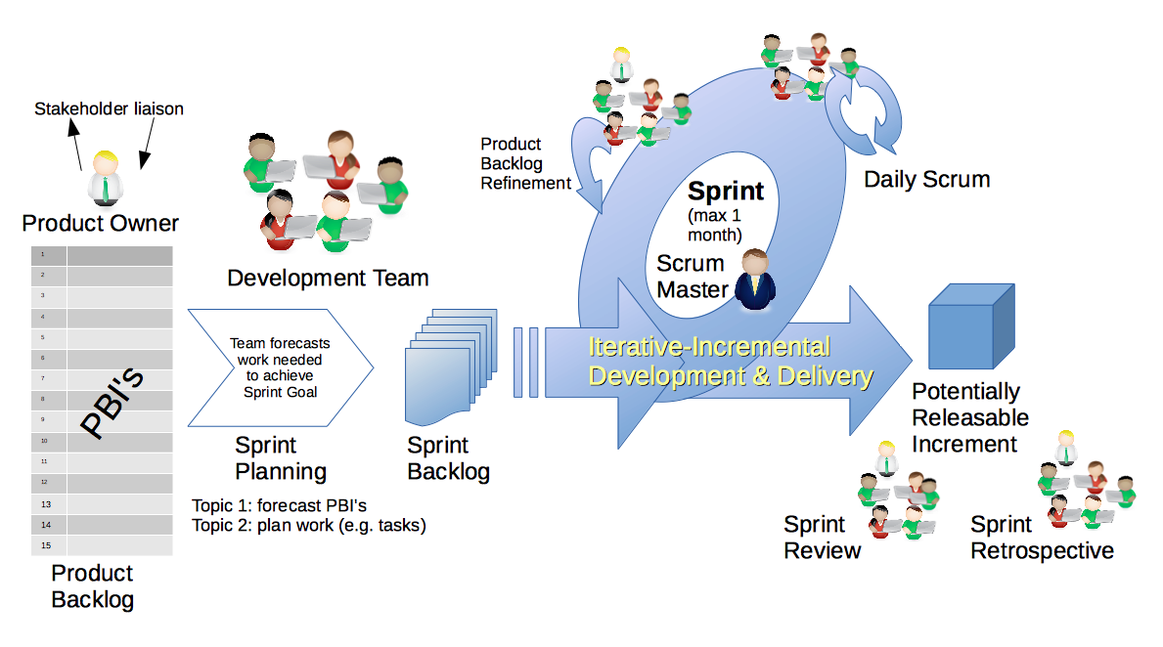
Scrum Process – Sprint Planning
By Dr ian mitchell - Own work, CC BY-SA 4.0, Link

Slide 8
Review Activities List
and Assignments

Slide 9
Prework For Next Class
Complete through activity 5
Those scheduled to demo on Wednesday please be a couple of minutes early to class

Slide 10
Review Wednesday
Demo Schedule

Slide 11
Scrum Team Planning Review
As a scrum team:
Review sprint activities & assignments in detail
Discuss and document questions/concerns
Scrum master share your team’s top 2 questions/concerns during report out

Slide 12
Agenda:
Prework & Announcements
Lab
Prework for Next Class
Quiz 3
Discussion & Questions welcome at any time but please be present with no phones or email during our time together

Slide 13
Prework & Announcements
Complete through activity 12 and working on activity 13
Be prepared for Quiz 3 and Lab
Looking Ahead:
Friday: No class
Sunday: Everything is Due!
I will have limited availability Thursday through Sunday

Slide 14
Lab
What do you need to be successful in sprint 3?
Notes:
git config –global pull.rebase false

Slide 15
Lab
Can we create a static website with:
HTTPs
WWW Domain name
Base Domain name
Notes:
git config –global pull.rebase false

Slide 16
Lab: Azure Web Applications with CI/CD
What is Continuous Integration / Continuous Delivery (CI/CD)?
Review Azure Website assignment
Create and Azure based web application while focusing on CI/CD:
Prerequisites include Git, GitHub, Azure, Web Browser, Finder, Terminal, and VS Code
Create a public GitHub repository with a License and README.md
Add basic web application to the GitHub repository (W3C Html tutorial)
Create an Azure website and link it to the GitHub repository
Optionally: Update local Git repository with “git pull --no-edit” to update GitHub action
Update website, push changes, and review site
Regularly update and test Azure website during development
Notes:
git config –global pull.rebase false

Slide 17
Prework For Next Class
No class Friday
Everything is due Sunday!
I have limited availability Thursday through Sunday
Be prepared for sprint 4 planning Monday

Slide 18
Quiz 3
A sincere attempt at quiz 3 is due
before you leave class today.

Slide 19
End of Session

