Slide 1

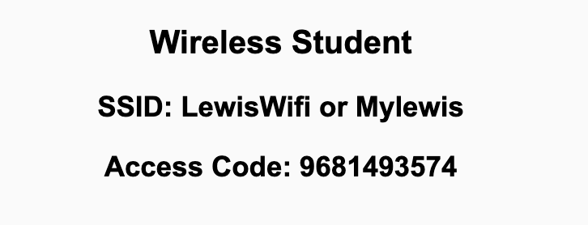
Preflight Check List
Sign into our Zoom meeting through our integrated Blackboard/Zoom link
Make sure that you can hear the conversation, see shared desktops, and view chat topics
Thank you if you choose to leave your camera on to help make our class more interactive
Be prepared to share your computer screen
Be prepared to utilize a headset with a microphone
In person participants also:
Make sure that your microphone and speakers are muted/off so that we don’t get an echo
Sit in a good spot near the classroom ceiling microphones if possible

Slide 2
Recordings
Discuss that recording are:
Opportunistic
Automatically available in Blackboard/Zoom
Sound Check… plus Video, and Desktop Sharing check
Start Recording

Slide 3
Agenda:
Prework & Announcements
Team Discussion 4
Review “Dynamic Documents with JavaScript” (Sebesta chapter 6)
Lab
Discussion & Questions welcome at any time but please be present with no phones or email during our time together

Slide 4
Prework For Next Class
Complete through activity 6
Be prepared for Scrum Team Discussion 4
Be prepared for Scrum Team Review of Sebesta chapter 6 on “Dynamic Documents with JavaScript”

Slide 5
Prework & Announcements
Complete through activity 7
Be prepared for Scrum Team Discussion 4

Slide 6
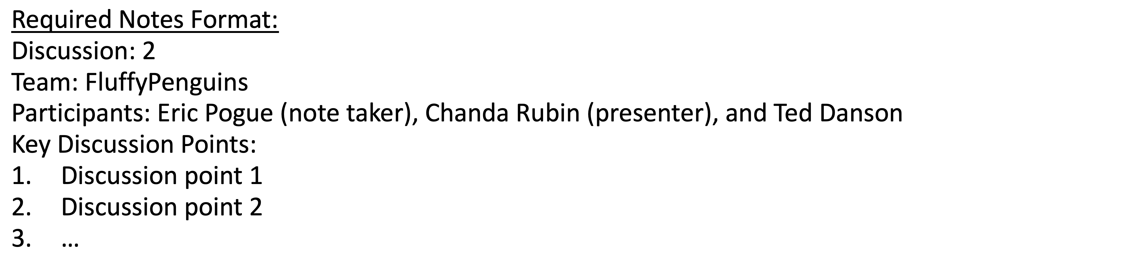
Discussion
Assign note taker and presenter roles
Review and discuss the discussion topic for this sprint for approximately 10 minutes
Note taker takes notes and presenter prepares a summary report out
Note taker share notes with all participating team members and each team member pastes and submits exact copy of the notes into their individual discussion board
Presenter Report Out

Slide 7
Review “Dynamic Documents with JavaScript” (Sebesta chapter 6)
Assign presenter
Team discusses topics while the presenter summarizes the topics below:
Dynamic HTML and Positioning Elements
Moving Elements and Element Visibility
Changing Color, Fonts, Dynamic Content, and Stacking Elements
Mouse Cursor, Mouse Click, Moving Elements
Dragging/Dropping
Identify the associated or best sample application for each subject
Team sits back, relaxes, and acknowledges the bravery and dedication of the presenter

Slide 8
Prework For Next Class
Complete through activity 9
Be prepared for Review of Sebesta chapter 7 on “XML and Web Services” plus JSON

Slide 9
Lab
Review Sebesta examples

Slide 10
End of Session

Slide 11
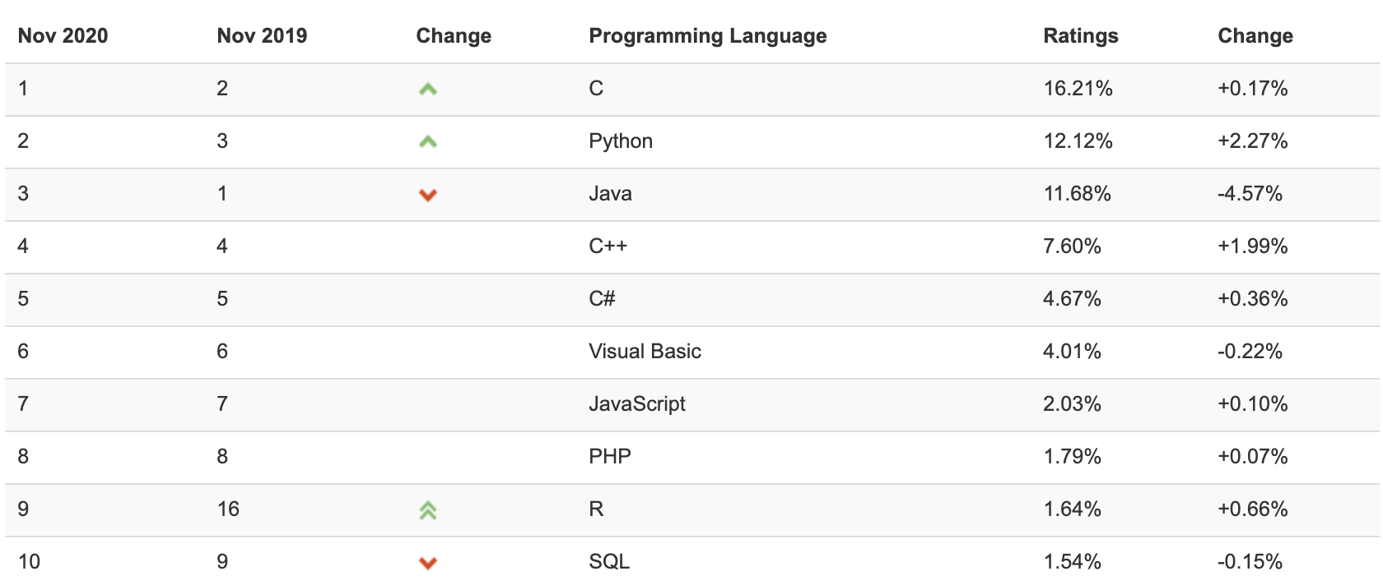
TIOBE Index for November 2020 November Headline: Python is unstoppable and surpasses Java

Slide 12
PHP Popularity

Slide 13
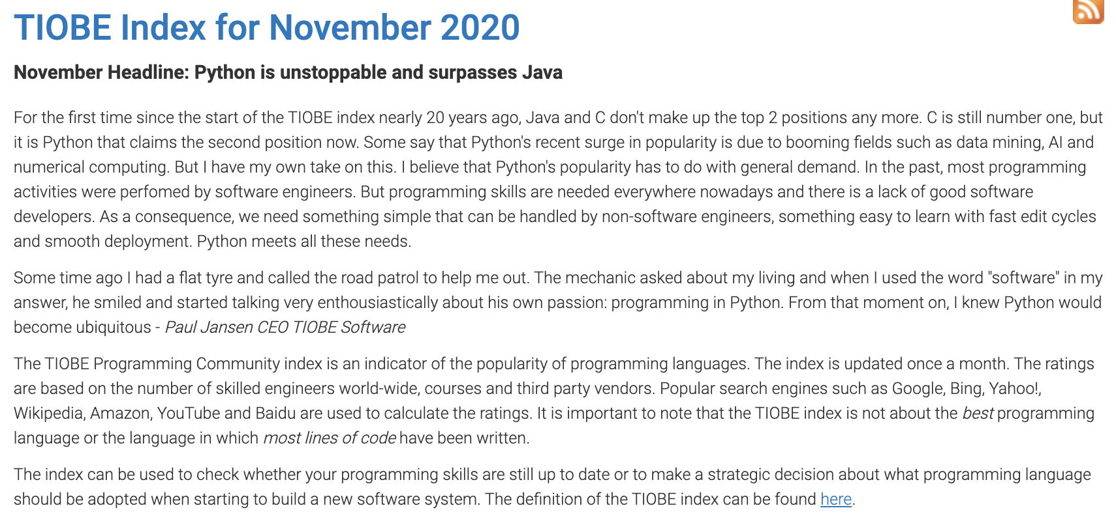

Slide 14
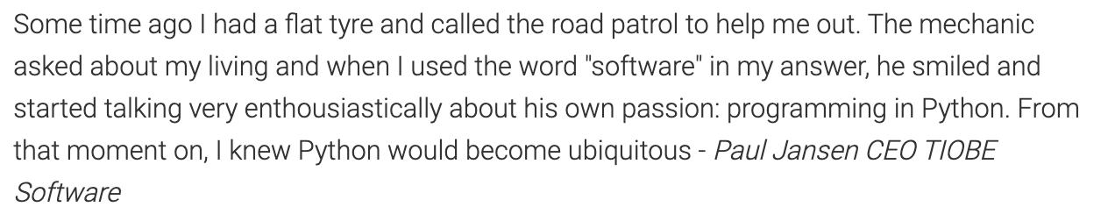

Slide 15
