Slide 1

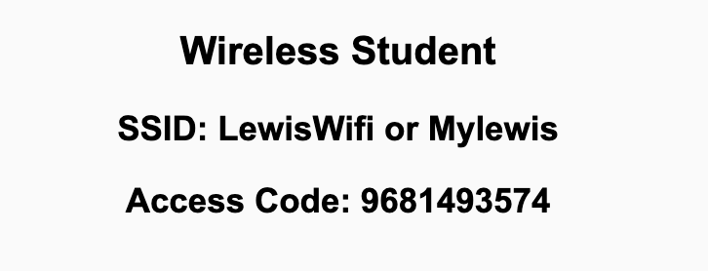
Preflight Check List
Sign into our Zoom meeting through our integrated Blackboard/Zoom link
Make sure that you can hear the conversation, see shared desktops, and view chat topics
Thank you if you choose to leave your camera on to help make our class more interactive
Be prepared to share your computer screen
Be prepared to utilize a headset with a microphone
In person participants also:
Make sure that your microphone and speakers are muted/off so that we don’t get an echo
Sit in a good spot near the classroom ceiling microphones if possible

Slide 2
Recordings
Discuss that recording are:
Opportunistic
Automatically available in Blackboard/Zoom
Sound Check… plus Video, and Desktop Sharing check
Start Recording

Slide 3
Agenda:
Prework & Announcements
Job Opening Review OR YouTube, Eric’s Trip to Google, The Social Dilemma, and Technology Business Models
“Engineering Software As a Service” Test-Driven Development
More Testing Topics
Discussion & Questions welcome at any time but please be present with no phones or email during our time together

Slide 4
Prework For Next Class
Complete through activity 9
Be prepared to review “Engineering Software As a Service” Test-Driven Development

Slide 5
Job Opening Review

Slide 6
YouTube, Eric’s Trip to Google, The Social Dilemma, and Technology Business Models

Slide 7
The Question
“Professor Pogue, Why don’t you put your videos on YouTube? It works great.”
- students from Lewis University
The Response:
It makes me uncomfortable that Google and YouTube (and Facebook and Amazon) are all focused on getting more of your attention and I am enabling that by putting my content on YouTube.

Slide 8
Story Time with
Eric’s Trip to Google

Slide 9
Quotes from “The Social Dilemma”
“We’re the product. Our attention is the product being sold to advertisers.” - Justin Rosenstein, former engineer Facebook and Google, co-founder of Asana
“It’s the gradual, slight, imperceptible change in your own behavior and perception that is the product.” - Jaron Lainer, founding father of Virtual Reality Computer Scientist

Slide 10
Quotes from “The Social Dilemma”
“We’ve created a world in which online connection has become primary. Especially for younger generations. And yet, in that world, anytime two people connect, the only way it’s financed is through a sneaky third person whose paying to manipulate those two people. So we’ve created an entire global generation of people who were raised within a context with the very meaning of communication, the very meaning of culture, is manipulation.” - Jaron Lainer, founding father of Virtual Reality Computer Scientist

Slide 11
Quotes from “The Social Dilemma”
“If something is a tool, it genuinely is just sitting there, waiting patiently. If something is not a tool it's demanding things from you. It's seducing you, it’s manipulating you, it wants things from you. We've moved away from a tools based technology environment, to an addiction and manipulation used technology environment. Social media isn't a tool waiting to be used. It has its own goals, and it has its own means of pursuing them by using your psychology against you.” - Tristan Harris, former design ethicist at Google and co-founder of Centre for Humane Technologies‍

Slide 12
Quotes from “The Social Dilemma”
“We’re training and conditioning a whole new generation of people that when we are uncomfortable or lonely or uncertain or afraid, we have a digital pacifier for ourselves. That is kind of atrophying our own ability to deal with that.” - Tristan Harris, former design ethicist at Google and co-founder of Centre for Humane Technologies

Slide 13
Eric’s Opinion and Editorial Comments
We are polarizing viewpoints by providing individualized feeds that reinforce already held views and opinions. This reinforcement and polarization is a byproduct of the desire to gain a few more seconds of attention (or another click).

Slide 14
The Original Question
“Professor Pogue, Why don’t you put your videos on YouTube? It works great.”
-- students from Lewis University
The Response:
It makes me uncomfortable that Google and YouTube (and Facebook and Amazon) are all focused on getting more of your attention and I am enabling that by putting my content on YouTube.

Slide 15
Update - October, 2021
"The result has been more division, more harm, more lies, more threats and more combat. In some cases, this dangerous online talk has led to actual violence that harms and even kills people,"
-- Former Facebook data scientist Frances Haugen
Also considerable conversation around the “addictive” nature of social media and impact to children and young adults.

Slide 16
Recommendation
Take a few minutes to to contemplate the Google, YouTube, Facebook, WhatsApp, and TicTok style business model. Also consider the Apple and Microsoft business model.
Be aware. Decide what’s right for you.

Slide 17
Test-driven Development (TDD)
Test-driven development (TDD) is a software development process that relies on the repetition of a very short development cycle: requirements are turned into very specific test cases, then the code is improved so that the tests pass. This is opposed to software development that allows code to be added that is not proven to meet requirements.
American software engineer Kent Beck, who is credited with having developed or "rediscovered"^{[1]} the technique, stated in 2003 that TDD encourages simple designs and inspires confidence.^{[2]}
Test-driven development is related to the test-first programming concepts of extreme programming, begun in 1999,^{[3]} but more recently has created more general interest in its own right.^{[4]}
Programmers also apply the concept to improving and debugging legacy code developed with older techniques.^{[5]}
From Wikipedia, the free encyclopedia
Notes:
What is the term that Jeremy used for doing it in the place?

Slide 18
Test-Driven Development and Software Testing
Assign presenter
Team discusses topics while the presenter summarizes the most important topics including the representation of:
Software testing and test-driven development
Cost of fixing defects and Testing differences based on SDLC
Who should be responsible for quality plus the merits of “testing in quality”
Types of Testing
Final Thoughts summary from lecture
Team sits back, relaxes, and acknowledges the bravery and dedication of the presenter

Slide 19
Prework For Next Class
Complete through activity 10
Be prepared for Quiz 4

Slide 20
Software Testing

Slide 21
Testing Terms
Unit Testing: developer testing their own code
Integration Testing: development team testing their full code
System Testing: multiple development teams testing a full system or systems
Acceptance Testing: business and/or customers testing the full system
Performance Testing: testing performance at the Unit, Integration, and/or System level
Manual Testing: a person using the application often running test scenarios
Automated Testing: a group of automated tests that run on the application in the Unit, Integration, System, or Performance testing areas
UI Automated Testing attempts to exercise the application be reproducing user events (key & mouse events)
API Automated Testing occurs at the function/method API level (JUnit for example)

Slide 22
Testing Terms (continued)
Verification: does the application perform as expected
Validation: does the application provide the business benefit that was expected
Behavioral Testing: verifying that the correct functions were called with the correct parameters
State Testing: focuses on the results of those calls

Slide 23
Software Testing “Truths”
You can’t afford to test in quality! Never underestimate the necessity of good design and implementation (testability, encapsulation, etc.)
Defects are exponentially more expensive to fix the longer the exist.
Unit - $200
Integration - $600
User Acceptance - $6,000
Production - $100,000+

Slide 24
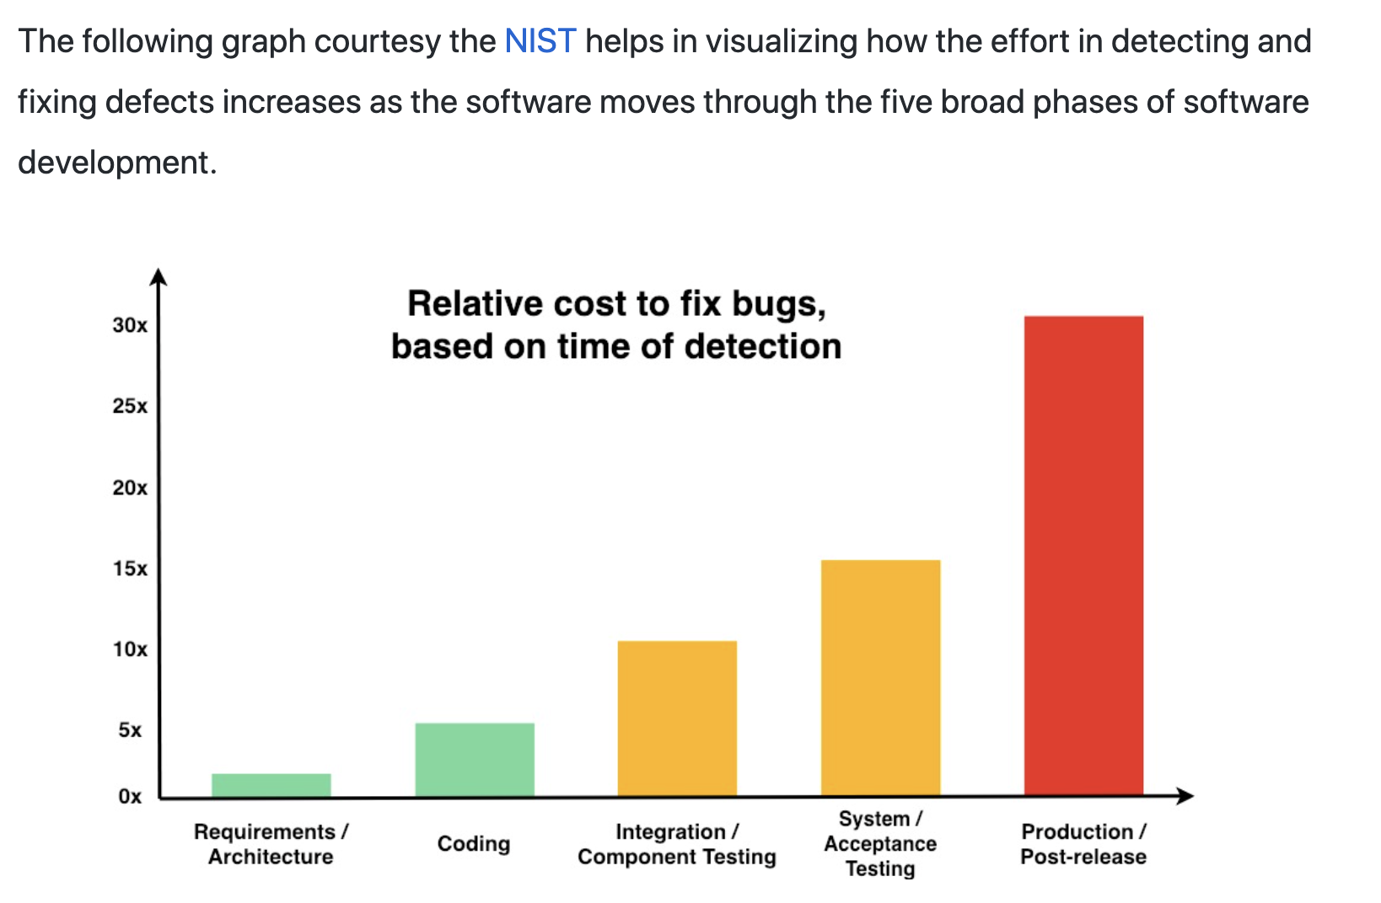
The Cost of Fixing a Defect Increases Exponentially

Slide 25
Software Testing “Truths” (continued)
Performance issues are often the most difficult and expensive defects to fix because:
they are often found only when running under heavy load and/or in production
latency issues are really hard to fix
Testability needs to be goal of of software development because the permutations of features, data, tools, environments, etc. can quickly become insurmountable
Testing requirements vary based on on software architecture

Slide 26
Software Testing “Truths” (continued)
Developers need to be responsible for product quality. Tester should be able to minimize that chance that a defect makes it to production.
Dave Cutler of Windows NT fame had a quote. I wish I could remember the exact words, but it went something like:
“I hate having testers because they give developers the false
hope that someone else can save them from their sins.”

Slide 27
Automated Testing
Unit testing can be done in two ways − manual testing and automated testing.
Automated testing has become a more important part of effective software testing. The pros of Automated Testing include:
Repeatable tests that are quick to run and can support Iterative and Agile development
Very effective in validating environments and doing “smoke tests” to make sure a new build meets a minimal set of requirements
Supports Performance Testing very effectively
Very inexpensive and quick to repeat testing and validate fixes
Various implications include UI, API, and Unit automation tests… each has a very different set of pros and cons
Notes:
False positives versus valid defects found.
Manual Testing and Automated Testing can be supportive of each other.

Slide 28
Automated Testing
Unit testing can be done in two ways − manual testing and automated testing.
Some of the benefits of Automated Testing have been oversold. Some of the challenges include:
Developers rarely can come up with scenarios in scripts that they would not already have tested in their normal unit testing… they often don’t know what they don’t know
UI focused Automated Testing (key & mouse events) are often challenging and create/maintain a great number of false-positives
API Level Automated Testing (i.e. REST) scripts are often more useful and easier to maintain
Environmental verification, API, and finally UI Automated testing is generally the best order to show value quickly with Automated Testing
Automated Testing investment is often not prioritized or tracked so it is difficult to know its effectiveness
Scripts can be expensive to develop and maintain
Notes:
False positives versus valid defects found.
Manual Testing and Automated Testing can be supportive of each other.

Slide 29
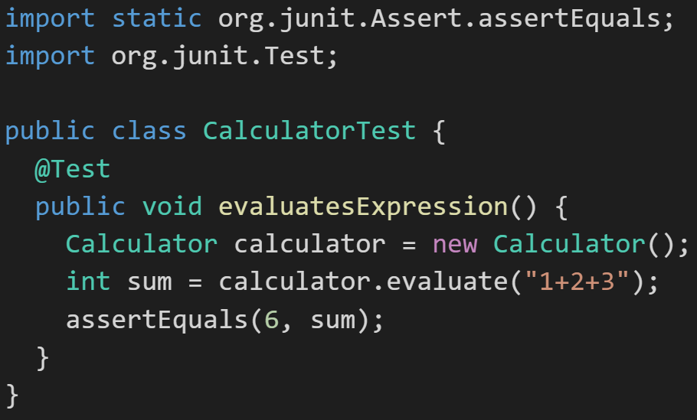
Automated Unit Testing Example: JUnit
Unit testing can be done in two ways − manual testing and automated testing.
JUnit [link] is a Automated Testing framework focused on developing and running Unit test for Java applications. JUnit:
Is a Java opensource extension
Provides annotations to identify test methods.
Provides assertions for testing expected results.
Provides test runners for running tests.
JUnit tests allow you to write codes faster, which increases quality.
JUnit is elegantly simple. It is less complex and takes less time.
JUnit tests can be run automatically and they check their own results and provide immediate feedback. There's no need to manually comb through a report of test results
Notes:
@Test
identifies the method as a test method (remember, method and function are synonyms)
@Test(expected = Exception.class)
fails if the method does not throw the named exception
@Test(timeout=100)
fails if the method takes longer than 100 milliseconds
@Before
public void method()
This method is executed before each test. It is used to prepare the test environment.
@After
public void method()
This method is executed after each test. It is used to clean up the test environment, including cleaning up expensive memory structures.
@BeforeClass
public static void method()
This method is executed once, before any test is done. It is used to do time-intensive tasks before any test is done.

Slide 30
End of Session

