Slide 1

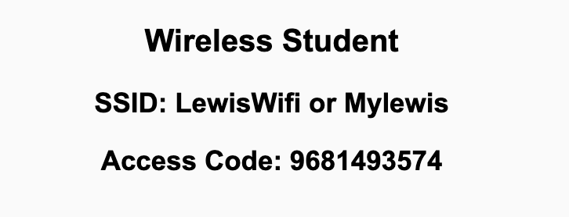
Preflight Check List
Sign into our Zoom meeting through our integrated Blackboard/Zoom link
Make sure that you can hear the conversation, see shared desktops, and view chat topics
Thank you if you choose to leave your camera on to help make our class more interactive
Be prepared to share your computer screen
Be prepared to utilize a headset with a microphone
In person participants also:
Make sure that your microphone and speakers are muted/off so that we don’t get an echo
Sit in a good spot near the classroom ceiling microphones if possible

Slide 2
Recordings
Discuss that recording are:
Opportunistic
Automatically available in Blackboard/Zoom
Sound Check… plus Video, and Desktop Sharing check
Start Recording

Slide 3
Agenda:
Prework & Announcements
Recall: Foreshadowing Final Projects and Sprints 5 through 8
Defining the Challenge
Team Polling
Questions Breakout Session
Lab… including final Lab question
Discussion & Questions welcome at any time but please be present with no phones or email during our time together

Slide 4
Prework & Announcements
Be prepared for Lab
Everything is due Sunday!
Request for time to work together on “Health Insurance Risk Calculator for the Web As A Team”

Slide 5
Recall: Foreshadowing Final Projects and Sprints 5 through 8
Review syllabus
Final Project will start in sprint 5 and continue through sprint 8
In sprint 5 your team will be setting up your Saas environment, defining your final project, and delivering user functionality
We will be utilizing scrum including sprint planning, story creation, sprint reviews (demos), and Done
We will be using our Saas architecture including web development, Azure, GitHub, Node.js, and MongoDB Atlas
In person attendance will become a higher priority during sprint reviews and sprint planning
We will continue to learn more agile techniques and add them to our process

Slide 6

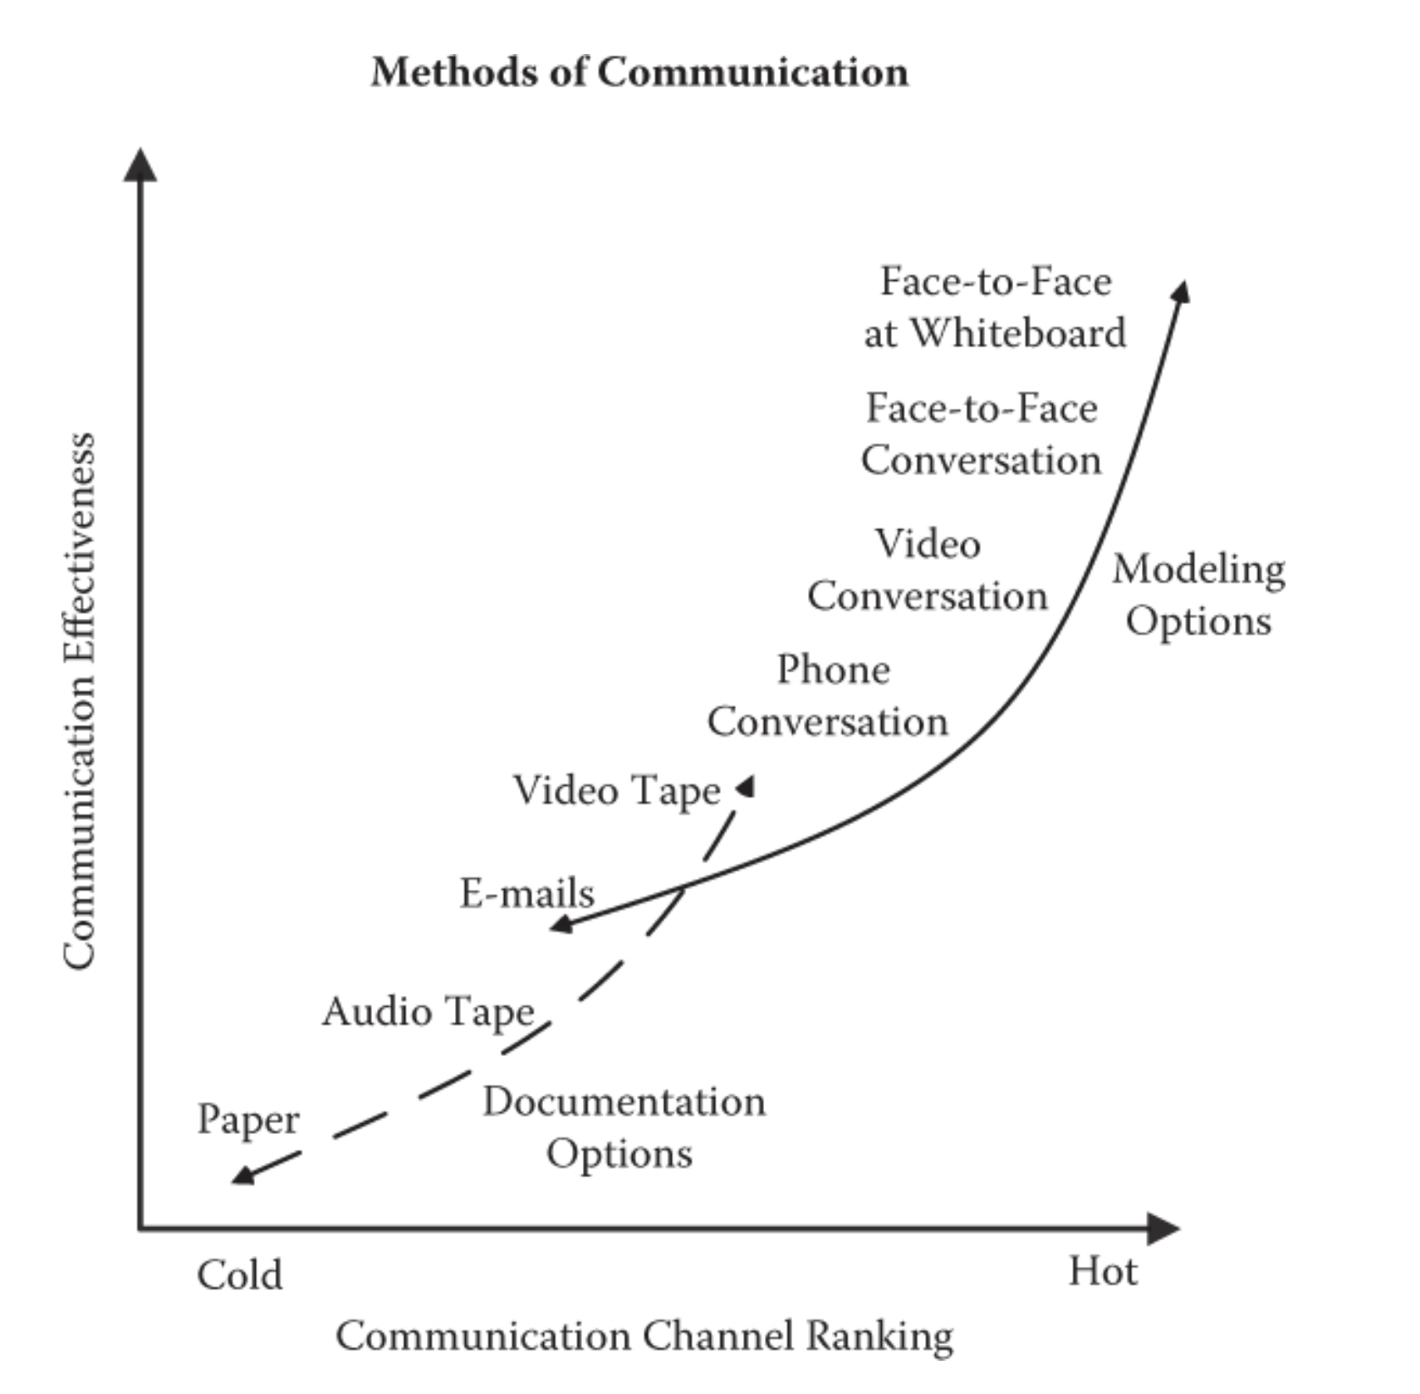
What is the challenge?

Slide 7
What is the challenge?
How can we be most effective with sprint planning and sprint reviews ?
How do we reward those that are participating effectively? And appropriately place the burden of ineffective participation (or non-participation)?

Slide 8
Scrum Team Poll
(optional, anonymous & private)

Slide 9
Breakout
Questions:
Do we need to make changes to teams? And/or would it be beneficial to mix up the teams for the second half of the semester?
What can we do to make sprint planning and sprint reviews most effective? (particularly when we need to have the team available and in person if possible)?
How would you feel about changing (or eliminating) the days we we have remote class?
How will you and your team come up and evolve a product idea?
Report-out

Slide 10
Prework For Next Class
Everything is due Sunday!
Be prepared for sprint 5 planning

Slide 11
Lab... Including final lab question

Slide 12
End of Session

