Slide 1

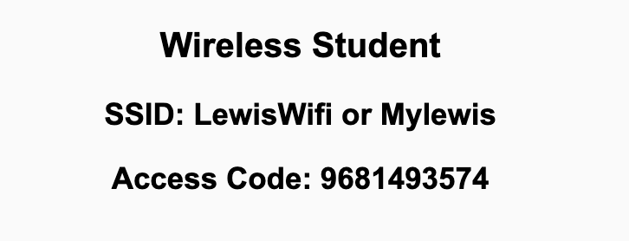
Preflight Check List
Sign into our Zoom meeting through our integrated Blackboard/Zoom link
Make sure that you can hear the conversation, see shared desktops, and view chat topics
Thank you if you choose to leave your camera on to help make our class more interactive
Be prepared to share your computer screen
Be prepared to utilize a headset with a microphone
In person participants also:
Make sure that your microphone and speakers are muted/off so that we don’t get an echo
Sit in a good spot near the classroom ceiling microphones if possible

Slide 2
Recordings
Discuss that recording are:
Opportunistic
Automatically available in Blackboard/Zoom
Sound Check… plus Video, and Desktop Sharing check
Start Recording

Slide 3
Agenda:
Prework & Announcements
Discussion 5 (abbreviated)
Monday Sprint Planning Goals
Backlog Grooming in preparation for Monday’s Sprint 5 Planning
Prework for Next Class
Special Guest Robert Pogue with Product Owner, Backlog Grooming, and Sprint Planning hints
Discussion & Questions welcome at any time but please be present with no phones or email during our time together

Slide 4
Prework
Complete through activity 9
Be prepared for Product Owner discussion with Robert Pogue
Be prepared for Discussion 5
Be prepared for Sprint 5 Backlog Grooming
Be prepared of discussion of Software Maintenance (FOX chapter 9) and Software Maintenance & Support… I may ask that you complete this on your own so that we have more time for other activities
Looking Farther Ahead:
Monday (Nov 1): Sprint Planning (in-person) …contact me if you cannot be there Monday
Wednesday (Nov 3): Metrics plus Quiz 5
Friday (Nov 5): Backlog Grooming in preparation for Sprint 6 Planning
Monday (Nov 8): Sprint 6 Planning …contact me if you cannot be there Monday or need to be remote

Slide 5
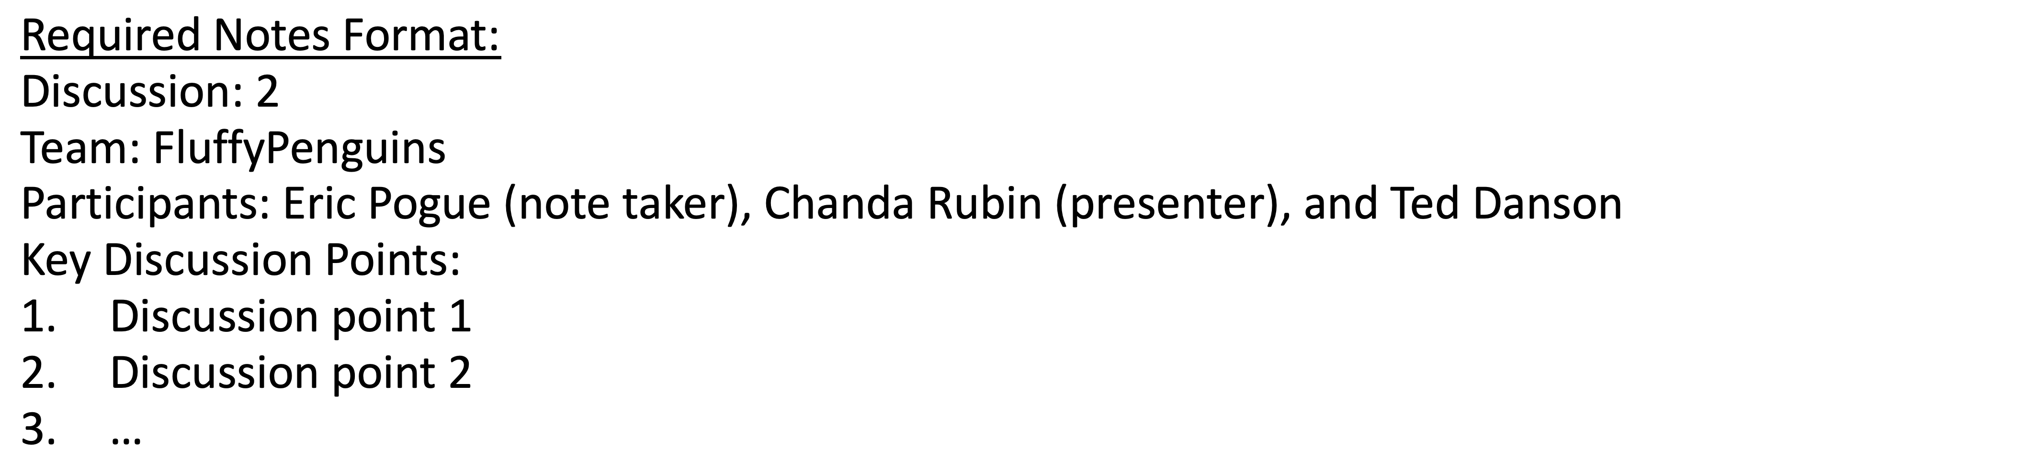
5 Discussion 5 (abbreviated)
Assign note taker and presenter roles
Review and discuss the discussion topic for this sprint for approximately 10 minutes
Note taker takes notes and presenter prepares a summary report out
Note taker share notes with all participating team members and each team member pastes and submits exact copy of the notes into their individual discussion board
Presenter Report Out

Slide 6
Preview Monday’s Sprint 5 Planning
Monday’s Sprint 5 Planning Goal:
By the end the class Monday each team member will have committed to multiple meaningful User Stories that are estimated at a total effort of approximately 5 Story Points
Note: It is each team member’s responsibility to request and commit to stories. It is NOT the Product Owner’s responsibility to assign or convince team members to accept stories.

Slide 7
Preview Monday’s Sprint 5 Planning
Monday’s Sprint 5 Planning Goal:
By the end the class Monday every team member will have committed to multiple meaningful User Stories that are estimated at a total effort of approximately 5 Story Points per person
Steps:
Define “Done” prior to Monday’s session… keep it simple but it must include demoing the story in production to the Product Owner
Groom Story Backlog to include sufficient stories (story points times the number of team members)
Team members REQUEST stories, stories are assigned, and team members COMMIT to delivering (see “Done” above) stories by end of sprint
The TEAM is responsible for defining Done and grooming the story backlog.
The Product Owner maintains and updates the story backlog.
Each team member is responsible for requesting and committing to stories. Stories must be deliverable within the sprint. For sprint 5, make it a priority to assign a story to a single team member.

Slide 8

Review User Story, Spike, and Backlog
User Story
Spike:
A user story that does not deliver functionality to the product user. This in not a generally accepted definition.
User Story Template
Backlog
Backlog Template?

Slide 9
Backlog Grooming
Backlog Grooming includes:
Creating and Deleting
Prioritizing
Estimating
Spitting or Consolidating

Slide 10
Likely Story and Spike Backlog Items
Story (Spike):
Set up shared GitHub repository
Set up Production and Test Azure websites
Set up development environment (1 per team member)
Story
As a college instructor I would like to see a landing page that fully describes the application functionality
As a _______ I would like to be able to access the continuously updated Project Proposal
What make sense for you product?

Slide 11
Prework For Monday
Sprint Planning
Your in-person presence in requested Monday. Please contact me if you cannot be there Monday or need to participate remotely.
Looking Farther Ahead:
Wednesday (Nov 3): Metrics plus Quiz 5
Friday (Nov 5): Backlog Grooming plus Lab
Monday (Nov 8): Sprint Planning …contact me if you cannot be there Monday or need to be remote

Slide 12
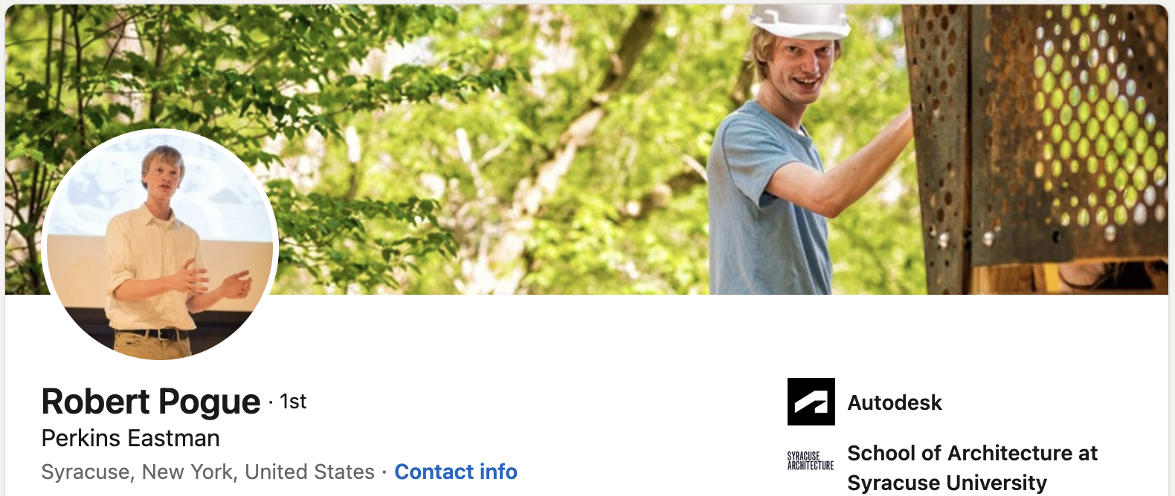
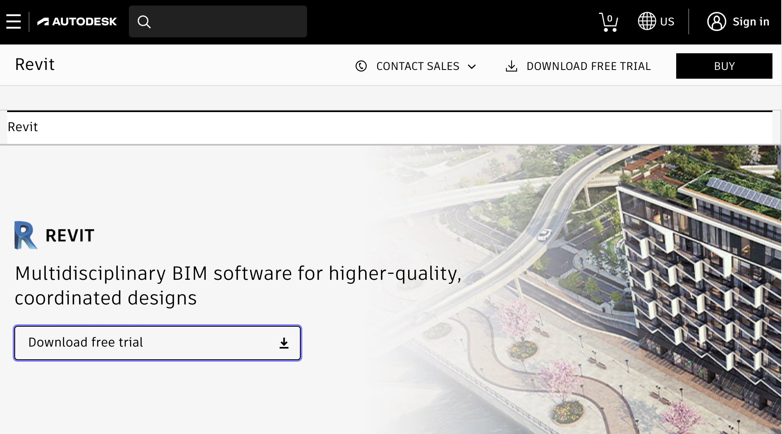
Special Guest Robert Pogue with Product Owner, Backlog Grooming, and Sprint Planning

Slide 13
More Backlog Grooming
Backlog Grooming includes:
Creating and Deleting
Prioritizing
Estimating
Spitting or Consolidating

Slide 14
End of Session

