Slide 1

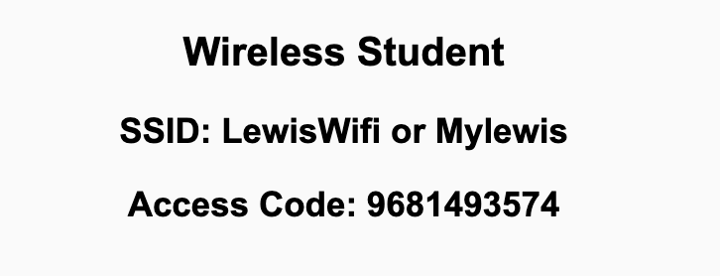
Preflight Check List
Sign into our Zoom meeting through our integrated Blackboard/Zoom link
Make sure that you can hear the conversation, see shared desktops, and view chat topics
Thank you if you choose to leave your camera on to help make our class more interactive
Be prepared to share your computer screen
Be prepared to utilize a headset with a microphone
In person participants also:
Make sure that your microphone and speakers are muted/off so that we don’t get an echo
Sit in a good spot near the classroom ceiling microphones if possible

Slide 2
Recordings
Discuss that recording are:
Opportunistic
Automatically available in Blackboard/Zoom
Sound Check… plus Video, and Desktop Sharing check
Start Recording

Slide 3
Agenda:
Prework & Announcements
Discussion 5
RPCs, Web Services, SOAP, REST, and CORS
Review Sebesta chapter 10 on Ajax
Prework for Next Class
Discussion & Questions welcome at any time but please be present with no phones or email during our time together

Slide 4
Prework
Complete through activity 6
Be prepared for Scrum Team Discussion 5
Be prepared for Sebesta chapter 10 and review on Ajax

Slide 5
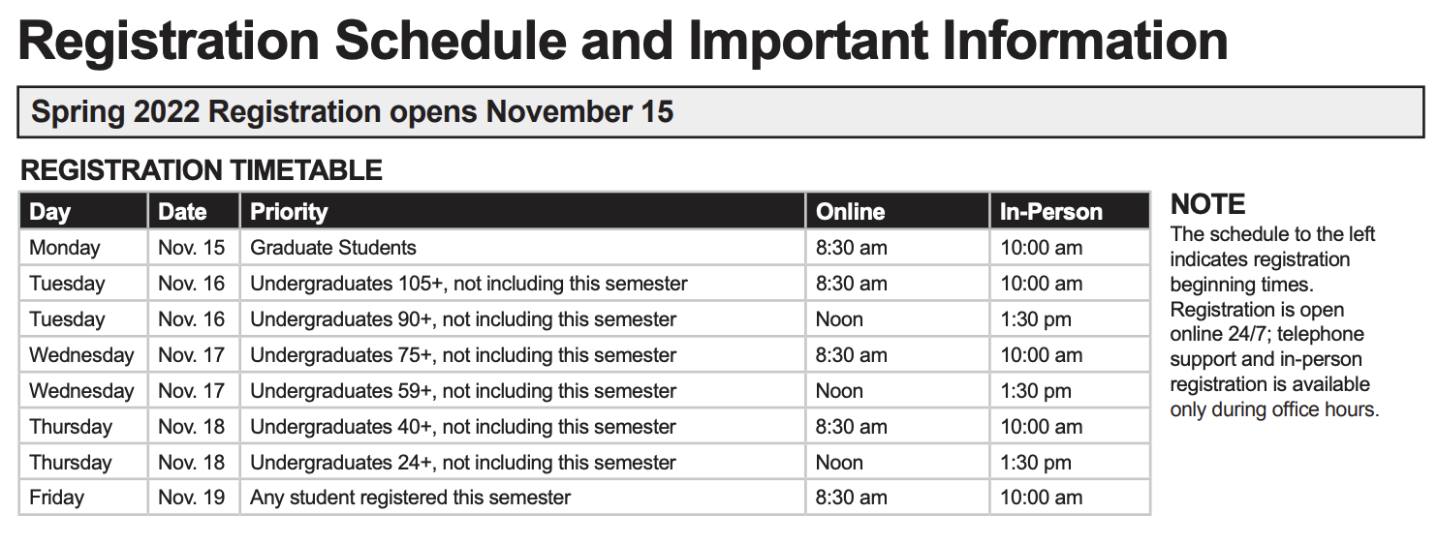
Announcements

Slide 6
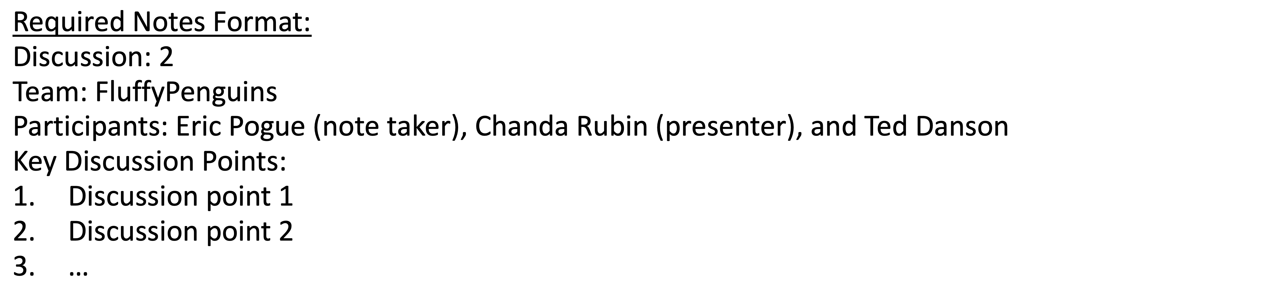
Discussion
Assign note taker and presenter roles
Review and discuss the discussion topic for this sprint for approximately 10 minutes
Note taker takes notes and presenter prepares a summary report out
Note taker share notes with all participating team members and each team member pastes and submits exact copy of the notes into their individual discussion board
Presenter Report Out

Slide 7
What’s a RPC?

Slide 8
The Internet, The Web, Web Services, and REST

Slide 9
Web Services, REST, SOAP, and CORs

Slide 10

Web Services
In a web service, the Web technology such as HTTP—originally designed for human-to-machine communication—is utilized for machine-to-machine communication, more specifically for transferring machine-readable file formats such as XML and JSON.
In practice, a web service commonly provides an object-oriented web-based interface to a database server, utilized for example by another web server, or by a mobile app, that provides a user interface to the end user.
Many organizations that provide data in formatted HTML pages will also provide that data on their server as XML or JSON, often through a web service to allow syndication

Slide 11
REST and Soap

Slide 12
REST
Representational State Transfer (REST) is an architectural style that defines a set of constraints and properties based on HTTP. Other kinds of web services, such as SOAP web services, expose their own arbitrary sets of operations.
"Web resources" were first defined on the World Wide Web as documents or files identified by their URLs. However, today they have a much more generic and abstract definition that encompasses every thing or entity that can be identified, named, addressed, or handled, in any way whatsoever, on the web. In a RESTful web service, requests made to a resource's URI will elicit a response that may be in HTML, XML, JSON, or some other format. The response may confirm that some alteration has been made to the stored resource, and the response may provide hypertext links to other related resources or collections of resources. When HTTP is used, as is most common, the operations available are GET, POST, PUT, DELETE, and other predefined CRUD HTTP methods.
By using a stateless protocol and standard operations, REST systems aim for fast performance, reliability, and the ability to grow, by re-using components that can be managed and updated without affecting the system as a whole, even while it is running.

Slide 13


CORS
Cross-Origin Resource Sharing (CORS): CORS is a mechanism that uses additional HTTP headers to tell a browser to let a web application running at one origin (domain) have permission to access selected resources from a server at a different origin. A web application makes a cross-origin HTTP request when it requests a resource that has a different origin (domain, protocol, and port) than its own origin.
An example of a cross-origin request: The frontend JavaScript code for a web application served from http://domain-a.com uses XMLHttpRequest to make a request for http://api.domain-b.com/data.json.
For security reasons, browsers restrict cross-origin HTTP requests initiated from within scripts. For example, XMLHttpRequest and the Fetch API follow the same-origin policy. This means that a web application using those APIs can only request HTTP resources from the same origin the application was loaded from, unless the response from the other origin includes the right CORS headers.
Notes:
https://developer.mozilla.org/en-US/docs/Web/HTTP/CORS
https://www.youtube.com/watch?v=o8puzjzpjqo

Slide 14
Prework For Next Class
Complete through activity 8
Be prepared for review of chapter 13 and review our Database Access through the Web

Slide 15
Scrum Team Sebesta Chapter 10 Ajax
Scrum Master accepts volunteers for (or assigns) Presenter
Team discusses and presenter summarizes the topics from Chapter 2 including:
Ajax makes Web application like modern application
Ajax Toolkits
Security
Team sits back, relaxes, and acknowledges the bravery and dedication of the presenter
Team returns to class Zoom session where presenter presents summary

Slide 16
End of Session

