Slide 1

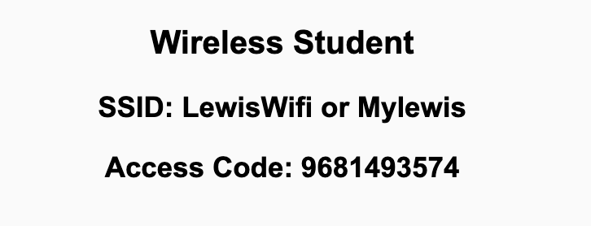
Preflight Check List
Sign into our Zoom meeting through our integrated Blackboard/Zoom link
Make sure that you can hear the conversation, see shared desktops, and view chat topics
Thank you if you choose to leave your camera on to help make our class more interactive
Be prepared to share your computer screen
Be prepared to utilize a headset with a microphone
In person participants also:
Make sure that your microphone and speakers are muted/off so that we don’t get an echo
Sit in a good spot near the classroom ceiling microphones if possible

Slide 2
Recordings
Discuss that recording are:
Opportunistic
Automatically available in Blackboard/Zoom
Sound Check… plus Video, and Desktop Sharing check
Start Recording

Slide 3
Agenda:
Prework & Announcements
INVEST to Write Good User Stories
Sprint Planning
Discussion & Questions welcome at any time but please be present with no phones or email during our time together

Slide 4
Prework For Monday
Sprint Planning
Your in-person presence in requested Monday. Please contact me if you cannot be there Monday or need to participate remotely.
Looking Farther Ahead:
Wednesday (Nov 3): Metrics, Maintenance, plus Quiz 5
Friday (Nov 5): Backlog Grooming plus Lab
Monday (Nov 8): Sprint Planning …contact me if you cannot be there Monday or need to be remote

Slide 5
INVEST to Write Good User Stories
Independent: Self contained, not dependent on other user stories
Negotiable: Leave space for discussion, discovery and invention
Valuable: Has immediate value to stakeholder.
Estimable: Constrained in size and scope, just enough information
Small: Ideally 1-2 days work with larger efforts being decomposed
Testable: Acceptance criteria makes clear when work is done

Slide 6
Sprint Planning Goal
By the end the class Monday every team member will have committed to multiple meaningful User Stories that are estimated at a total effort of approximately 5 Story Points per person
Steps:
Define “Done” prior to Monday’s session… keep it simple but it must include demoing the story in production to the Product Owner
Groom Story Backlog to include sufficient stories (story points times the number of team members)
Team members REQUEST stories, stories are assigned, and team members COMMIT to delivering (see “Done” above) stories by end of sprint
The TEAM is responsible for defining Done and grooming the story backlog.
The Product Owner maintains and updates the story backlog.
Each team member is responsible for requesting and committing to stories. Stories must be deliverable within the sprint. For sprint 5, make it a priority to assign a story to a single team member.

Slide 7
This is Your Scrum Process

Slide 8
Scrum Team Sprint 5 Planning

Slide 9
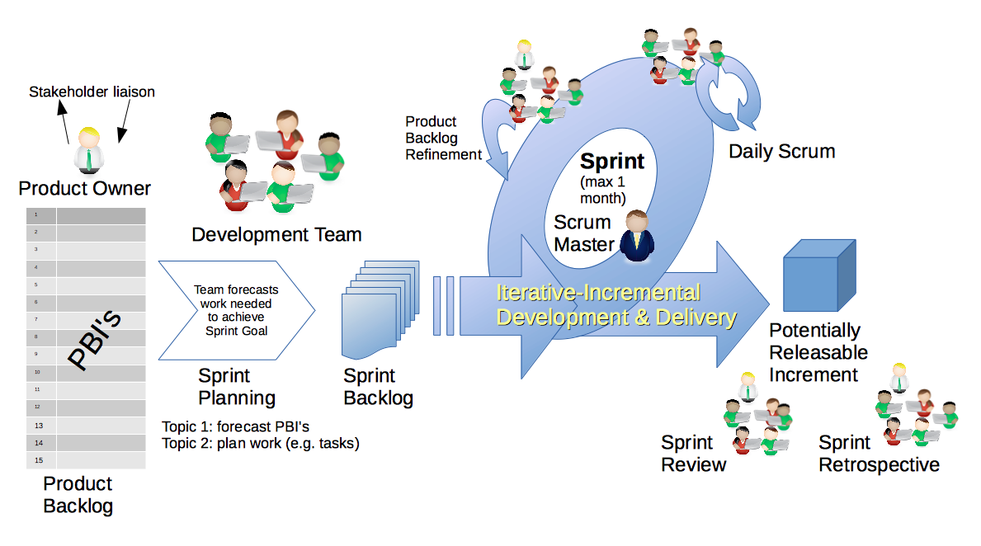
Scrum Process
By Dr ian mitchell - Own work, CC BY-SA 4.0, Link

Slide 10
Scrum Team Sprint 5 Planning
Steps:
Priorities & Roles Assignment (review)
Epic Backlog Grooming (review)
Story Backlog Grooming (review)
Sprint Planning
Commitment to Sprint Backlog
Celebrate!

Slide 11
Step 1: Priorities & Roles
Recall Agile Priorities (associated scrum role):
Customer (Product Owner)
Technology (Architect)
Process (Scrum Master)
Recall the Agile Glossary [link]
Recall that one person can play multiple roles.
Recall that it is different/difficult for us because we are playing the role of the customer as well as the delivery team.

Slide 12
Step 2: Epic Backlog Grooming (skip)
Recall User Stories, Epics and Backlogs
Recall the Agile Glossary [link]… review User Story format

Slide 13
Scrum Process – Where is Epic Backlog Grooming?
By Dr ian mitchell - Own work, CC BY-SA 4.0, Link
Notes:
Epics are not part of Scrum.

Slide 14
Recall Scaled Agile

Slide 15
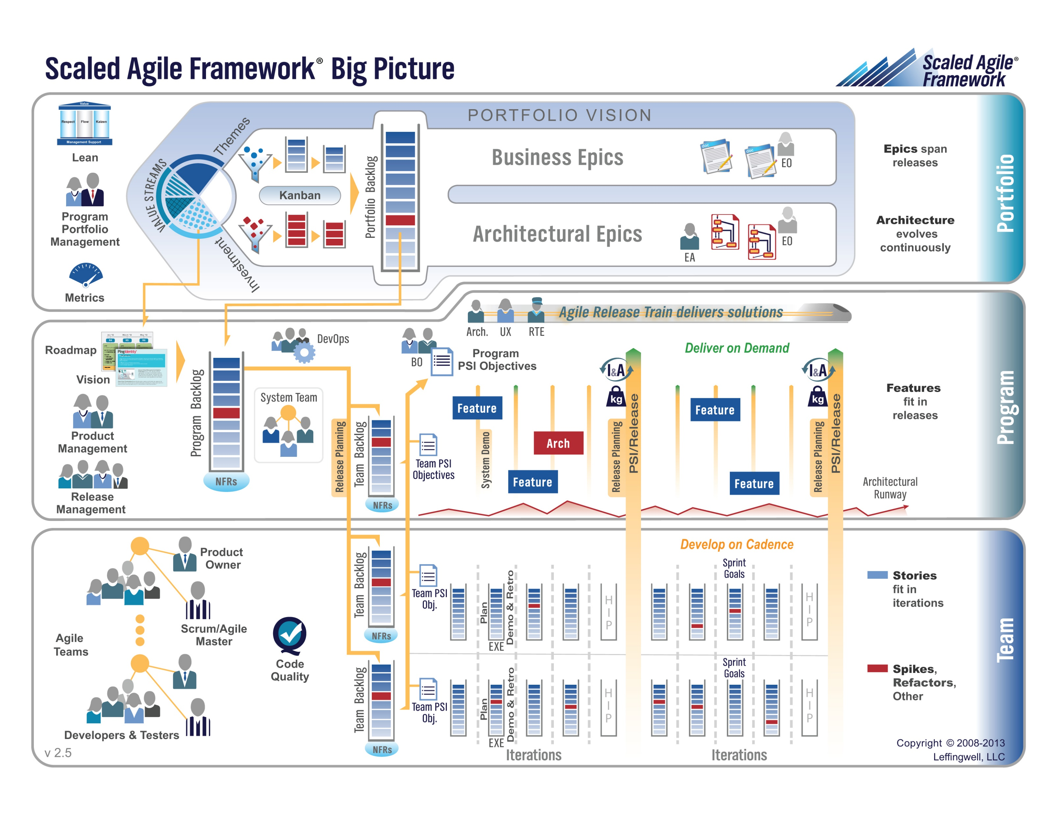

Slide 16
Step 2: Epic Backlog Grooming (skip)
Actions & Requirements:
Product Owner to lead the review and/or creation of Epics
There must be one list of Epics managed by the Product Owner
Each Epic must deliver customer functionality and value
Epics should be written in User Story format
Epics must be prioritized and forced ranked
Each product must have at least three Epics
Epic Backlog Grooming report questions (Scrum Master):
What is the number of Epics?
How many are force ranked?

Slide 17
Step 3: Story Backlog Grooming
By Dr ian mitchell - Own work, CC BY-SA 4.0, Link

Slide 18
Step 3: Review Done, User Stories, and Story Backlog
“Done” must be well defined and for us includes at a minimum:
Successfully deployed and integration tested in the production environment
Demoed to the Product Owner
Available to be demoed to the class
User Stories must:
Be written in User Story format from a customer / user perspective
Deliver user (customer) value
Be associated with Epic in Scaled Agile
Product Product Backlog is:
Managed by to Product Owner
The team’s master list of prioritized (force ranked) User Stories
The team’s master list of all important project work (spikes, continuous improvement, etc.)
Notes:
How will you handle dependancies?

Slide 19
Step 3: User Story Estimation and Assignment
Requirements:
Product Owner to lead the estimating of User Stories.
Each User Story must have an estimated effort in Story Points
For our purposes assume 1 Story Point is approximately equal to 1 hour of effort
Each User Story must be deliverable in a single sprint

Slide 20
Step 3: Story Backlog Grooming
Requirements & Actions:
Update Product Backlog by:
Relocating “Done” User Stories “Done” list
Relocating “Pending” User Stories to the “Pending” list
Reviewing remaining User Stories
Creating new User Stories
Prioritize and rank important stories (anything that might make it to the Sprint Backlog)
Provide Story Point estimates for important stories
Product Backlog report out questions (Product Owner):
How is “Done” defined for your team?
What is the total number of user stories?
What is the total number of story points?
How many stories and story points are force ranked?
Notes:
How will you handle dependancies?

Slide 21
Step 4: Sprint Planning
By Dr ian mitchell - Own work, CC BY-SA 4.0, Link

Slide 22
Step 4: Team Capacity Estimation, Story Assignment, and Cut Line
Activities:
Estimate Scrum Team Capacity current sprint by multiplying the number of team members times 8 hours each team member
Each User Story should be requested/assigned to 1 (preferably) or more team members
Review your Product Backlog and draw your “cut line” to create your Sprint Backlog
Consider leaving some unutilized capacity to account for potential missed commitments

Slide 23
Step 4: Sprint Planning
Requirements & Activities:
Scrum Master and Product Owner lead effort to create Sprint Backlog
Move highest ranked Product Backlog stories to Sprint backlog until capacity is utilized
Comment: Your tools and formats you utilize for managing stories and backlogs are your own, but you need to be comfortable in showing how you choosing to do it.

Slide 24
Step 5: Sprint Backlog Commitment
By Dr ian mitchell - Own work, CC BY-SA 4.0, Link

Slide 25
Step 5: Sprint Backlog Commitment
The team commits to completing (fulfilling “Done” for each committed story) the stories in the Sprint backlog.
It is acceptable to miss commitments in Agile and Scrum.
However, it is required that we:
Be non-ambiguous in our commitments
Commit and deliver as a team
Be transparent in our actions
Commit to continuous improvement
Product Backlog report out questions (Scrum Master):
What is your team’s capacity and how was it calculate
How many stories and story points did you team commit to delivering in sprint 2
What are your assumptions about “carry-over” (high-risk) sprint 1 stories

Slide 26
Step 6: Celebrate
Recognize your teammates that stepped up. Tell them “Well done!”
Celebrate report out questions (Scrum Master & Product Owner):
How do you feel about your sprint 2 planning?

Slide 27

Review User Story, Spike, and Backlog
User Story
Spike:
A user story that does not deliver functionality to the product user. This in not a generally accepted definition.
User Story Template
Backlog
Backlog Template?

Slide 28
Backlog Grooming
Backlog Grooming includes:
Creating and Deleting
Prioritizing
Estimating
Spitting or Consolidating

Slide 29
Likely Story and Spike Backlog Items
Story (Spike?):
Set up shared GitHub repository
Set up Production and Test Azure websites
Set up development environment (1 per team member)
Story
As a college instructor I would like to see a landing page that fully describes the application functionality
As a _______ I would like to be able to access the continuously updated Project Proposal
What make sense for you product?

Slide 30
More Backlog Grooming
Backlog Grooming includes:
Creating and Deleting
Prioritizing
Estimating
Spitting or Consolidating

Slide 31
Prework For Next Class
Sprint Planning
Your in-person presence in requested Monday. Please contact me if you cannot be there Monday or need to participate remotely.
Looking Farther Ahead:
Friday (Nov 5): Backlog Grooming plus Lab
Monday (Nov 8): Sprint Planning …contact me if you cannot be there Monday or need to be remote

Slide 32
End of Session

Slide 33
Scrum Team Sprint 2 Planning
…This is Your Scrum Process

Slide 34
Scrum Process
By Dr ian mitchell - Own work, CC BY-SA 4.0, Link

Slide 35
Recall Perspectives & Priorities
Perspectives:
Process
Technology
Customer (User)

Slide 36
Recall Perspectives & Priorities
Process:
Waterfall
Iterative
Agile
CMMI and ISO
Technology:
Architecture & Design,
Languages, Tools, and Platforms
Customer (User):
Epics, Features, Stories

Slide 37
Recall Perspectives & Priorities
Agile Priorities:
Customer
Technology
Process

Slide 38
Agile Manifesto
& Principles [link]

Slide 39
Scrum Team Sprint 2 Planning
Steps:
Priorities & Roles Assignment
Epic Backlog Grooming
Product Backlog Grooming
Sprint Planning
Commitment to Sprint Backlog
Celebrate!

Slide 40
Step 1: Priorities & Roles
Recall Agile Priorities (associated scrum role):
Customer (Product Owner)
Technology (Architect)
Process (Scrum Master)
Recall the Agile Glossary [link]
Recall that one person can play multiple roles.
Recall that it is different/difficult for us because we are playing the role of the customer as well as the delivery team.

Slide 41
Recall Assigning Roles for Sprints 1 through 3
Roles Requirements & Actions:
Everyone must play the Scrum Master role for at least one sprint during the class
There must be a Product Owner responsible for managing User Stories, Epics and Backlogs
What role (or individual) will be responsible for demoing each sprint starting next Tuesday
The architect role is not a formal part of Scrum and is therefore optional
Sprint 2 Roles report out questions (Scrum Master):
Who is the Scrum Master?
Who is the Product Owner?
Who will demo for you team Tuesday
Notes:
Who before what.

Slide 42
Step 2: Portfolio Backlog Grooming (Epics)
Recall User Stories, Epics and Backlogs
Recall the Agile Glossary [link]… review User Story format

Slide 43
Scrum Process – Where is Epic Backlog Grooming?
By Dr ian mitchell - Own work, CC BY-SA 4.0, Link
Notes:
Epics are not part of Scrum.

Slide 44
Recall Scaled Agile

Slide 46
Step 2: Portfolio Backlog Grooming (Epics)
Actions & Requirements:
Product Owner to lead the review and/or creation of Epics
There must be one list of Epics managed by the Product Owner
Each Epic must deliver customer functionality and value
Epics should be written in User Story format
Epics must be prioritized and forced ranked
Each product must have at least three Epics
Epic Backlog Grooming report questions (Scrum Master):
What is the number of Epics?
How many are force ranked?

Slide 47
Step 3: Product Backlog Grooming (User Stories)
By Dr ian mitchell - Own work, CC BY-SA 4.0, Link

Slide 48
Step 3: Recall User Stories, the Product Backlog, and Done
Recall that User Stories must:
Be written in User Story format
Deliver user (customer) value
Be associated with Epic in Scaled Agile
Recall that the Product Product Backlog is:
Managed by to Product Owner
The team’s master list of prioritized (force ranked) User Stories
Opinion: The team’s master list of all important project work (spikes, continuous improvement, etc.)
Recall that “Done” must be well defined and for us includes at a minimum:
Successfully deployed and integration tested in the production environment
Demoed to the Product Owner
Available to be demoed to the class
Notes:
How will you handle dependancies?

Slide 49
Step 3: Recall User Story Estimation
Requirements:
Product Owner to lead the estimating of User Stories.
Each User Story must have an estimated effort in Story Points
For our purposes assume 1 Story Point is approximately equal to 1 hour of effort
Each User Story must be deliverable in a single sprint

Slide 50
Step 3: Product Backlog Grooming (User Stories)
Requirements & Actions:
Update Product Backlog by:
Relocating “Done” User Stories “Done” list
Relocating “Pending” User Stories to the “Pending” list
Reviewing remaining User Stories
Creating new User Stories
Prioritize and rank important stories (anything that might make it to the Sprint Backlog)
Provide Story Point estimates for important stories
Product Backlog report out questions (Product Owner):
How is “Done” defined for your team?
What is the total number of user stories?
What is the total number of story points?
How many stories and story points are force ranked?
Notes:
How will you handle dependancies?

Slide 51
Step 3: Future Considerations
Requirements & Actions:
Consider required Spikes and treat them as a User Story that does not deliver user value
Consider User Story and Spike dependencies
Consider “at risk” commitments in current Sprint
Notes:
How will you handle dependancies?

Slide 52
Step 4: Sprint Planning
By Dr ian mitchell - Own work, CC BY-SA 4.0, Link

Slide 53
Step 4: Recall Team Capacity Estimation and Cut Line
Activities:
Estimate Scrum Team Capacity current sprint by multiplying the number of team members times 8 hours each team member
Review your Product Backlog and draw your “cut line” to create your Sprint Backlog
Consider leaving some unutilized capacity to account for potential missed commitments (carry-over stories)

Slide 54
Step 4: Sprint Planning
Requirements & Activities:
Scrum Master and Product Owner lead effort to create Sprint Backlog
Move highest ranked Product Backlog stories to Sprint backlog until capacity is utilized
Comment: Your tools and formats you utilize for managing stories and backlogs are your own, but you need to be comfortable in showing how you choosing to do it.

Slide 55
Step 5: Sprint Backlog Commitment
By Dr ian mitchell - Own work, CC BY-SA 4.0, Link

Slide 56
Step 5: Sprint Backlog Commitment
The team commits to completing (fulfilling “Done” for each committed story) the stories in the Sprint backlog.
It is acceptable to miss commitments in Agile and Scrum.
However, it is required that we:
Be non-ambiguous in our commitments
Commit and deliver as a team
Be transparent in our actions
Commit to continuous improvement
Product Backlog report out questions (Scrum Master):
What is your team’s capacity and how was it calculate
How many stories and story points did you team commit to delivering in sprint 2
What are your assumptions about “carry-over” (high-risk) sprint 1 stories

Slide 57
Step 6: Celebrate
Recognize your teammates that stepped up. Tell them “Well done!”
Celebrate report out questions (Scrum Master & Product Owner):
How do you feel about your sprint 2 planning?

