Slide 1

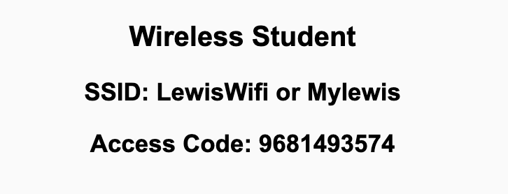
Preflight Check List
Sign into our Zoom meeting through our integrated Blackboard/Zoom link
Make sure that you can hear the conversation, see shared desktops, and view chat topics
Thank you if you choose to leave your camera on to help make our class more interactive
Be prepared to share your computer screen
Be prepared to utilize a headset with a microphone
In person participants also:
Make sure that your microphone and speakers are muted/off so that we don’t get an echo
Sit in a good spot near the classroom ceiling microphones if possible

Slide 2
Recordings
Discuss that recording are:
Opportunistic
Automatically available in Blackboard/Zoom
Sound Check… plus Video, and Desktop Sharing check
Start Recording

Slide 3
Agenda:
Prework & Announcements
Review Sebesta chapter 13 Database Access through the Web
Prework for Next Class
Lab
Discussion & Questions welcome at any time but please be present with no phones or email during our time together

Slide 4
Prework For Next Class
Complete through activity 8
Be prepared for review of chapter 13 and review our Database Access through the Web

Slide 5
Review Sebesta chapter 13 Database Access through the Web
Scrum Master accepts volunteers for (or assigns) Presenter
Team discusses and presenter summarizes the topics from Chapter 2 including:
Application Architecture, Web Development Stacks, and LAMP and alternatives
How to use relational databases for storing and accessing data
Querying using SQL and MySQL
Accessing MySQL from PHP
What about NoSQL?
Team sits back, relaxes, and acknowledges the bravery and dedication of the presenter
Team returns to class Zoom session where presenter presents summary

Slide 6
Prework For Next Class
Complete through activity 9
Be prepared Quiz 5

Slide 7
Lab
Mustang Lite

Slide 8
End of Session

